Slide 1
Submitted by the experts from
Informal document GRRF-78-31
78th GRRF, 16-19 September 2014
Agenda item 11(b)
Vehicle Safety -
(R)Evolution of Driving Assist Systems
Jochen Schäfer
Heiner Hunold

Slide 2
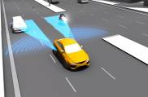
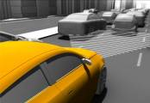
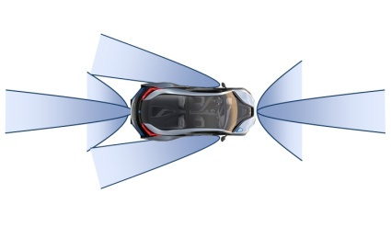
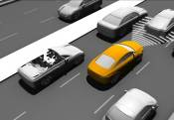
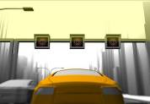
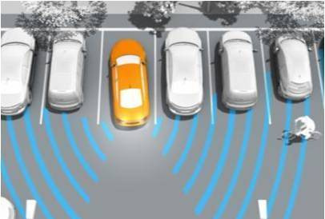
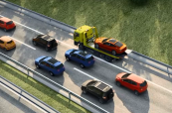
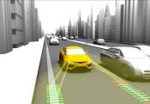
…
Which Driver Assist Systems are already available today?
Lane Change Assist
Blind Spot Detection
ACC
Side view
Parking
AEBS
Front view
Parking
Sign Recogn.
Automated Parking
Rear Cross Traffic Alert
Traffic Jam Assist
LDWS

Slide 3
…
Which Driver Assist Systems are already available today?
Adaptive Cruise Control (ACC)
Sensor Configuration
Control Systems
Traffic Jam Assist

Slide 4
…
Which Driver Assist Systems are already available today?
Advanced Emergency Braking System (AEBS)
Sensor Configuration
Control Systems
Traffic Jam Assist

Slide 5
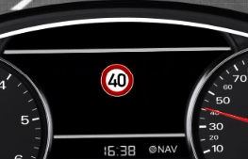
…
Which Driver Assist Systems are already available today?
Road Sign Recognition
Sensor Configuration
Control Systems
Optional: Speed Adaptation in ACC
Traffic Jam Assist

Slide 6
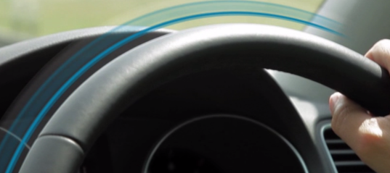
…
Which Driver Assist Systems are already available today?
Lane Departure Warning System (LDWS/LKAS)
Sensor Configuration
Control Systems
Traffic Jam Assist

Slide 7
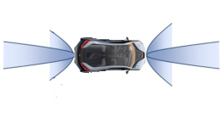
…
Which Driver Assist Systems are already available today?
Parking Systems
Sensor Configuration
Control Systems
Traffic Jam Assist

Slide 8
…
Which Driver Assist Systems are already available today?
Lane Change Assist (LCA)
Sensor Configuration
Control Systems
Traffic Jam Assist

Slide 9
…
Which Driver Assist Systems are already available today?
Traffic Jam Assist (TJA)
Sensor Configuration
Control Systems
Traffic Jam Assist

Slide 10
…

Slide 13
Levels of Automatisation

Slide 14
Permanent Monitoring by the Driver
Driver
Auto-
mation
Level 0
Level 1
Level 2
Level 3
Level 4
Level 5
Driver Only
Assisted
Partial
Auto-mation
Conditional
Auto-mation
High
Auto-mation
Full
Auto-mation
Driver
Driver
System
System
System is driving, with
more or less backup by the driver
or
System
Driver
System
Driver

Slide 15
… and which Levels have the Systems mentioned before?

Slide 17
For Questions, please contact:
Jochen Schäfer (jochen.schaefer@de.bosch.com)
Heiner Hunold (heiner.hunold@continental-corporation.com)
Pierre Laurent - CLEPA (p.laurent@clepa.be)

Slide 18
Links to videos which have been basis for the presentation
ACC:
http://www.youtube.com/watch?v=own_VaRZ9M8
AEBS:
http://www.youtube.com/watch?v=ehkDZS1hFnc
Traffic Sign:
http://www.youtube.com/watch?v=FM1a2zS2Eec
LDWS:
http://www.youtube.com/watch?v=GSzEi8dlFIc
http://www.youtube.com/watch?v=GdtVe1Pnayg
Parking:
http://www.youtube.com/watch?v=HWMzP9HYNCQ
Side Assist:
https://www.youtube.com/watch?v=DtmyjAN7KAY
Traffic Jam:
https://www.youtube.com/watch?v=Sc8wvpya15A
Highway Pilot:
https://www.youtube.com/watch?v=tbvTQuKpZNo
Valet Parking:
http://www.youtube.com/watch?v=vaAnVpBW6gw
http://www.youtube.com/watch?v=QPH8j2mrepM

