Slide 1
Particle emissions from Tyre and brake wear on-going literature review Summary and Open questions
Transmitted by the PMP Chair
Informal document GRPE-68-20
(68th GRPE, 7-10 January 2014, agenda item 7)
Sustainable Transport Unit
Institute for Energy and Transport
Joint Research Centre
8 January 2014

Slide 2
ON-GOING LITERATURE REVIEW
Approximately 100 peer-reviewed papers
10 papers presented in international conferences
Several intermediate and final research project reports
Technical publications from brake and tyre companies
Several licentiate and doctoral thesis

Slide 3
Literature study : Main issues
Many studies available but difficult to reconcile due to:
Many different sampling methodologies/locations and measurement techniques - Representativeness of real-world emissions?
Important differences between LD and HD vehicles
Influence of driving conditions – Definition of “normal driving conditions”?
Lack of a clear definition of non-exhaust emissions especially for tyre and road wear and resuspended material
Nevertheless, in general, there is consensus on the emission factors

Slide 4
NON EXHAUST EMISSIONS - IMPORTANCE
Exhaust and non-exhaust sources are estimated to contribute almost equally to total traffic-related PM₁₀ emissions (2010)
The relative contribution of non-exhaust sources is expected to increase the forthcoming years due to the tendency of decrease of exhaust emissions
Contributions of specific sources to non-exhaust traffic-related PM₁₀ emissions
Source | PM₁₀ (%)
Brake Wear | 16-55*
Tyre Wear | 5-30**
Resuspension | 28-59
* Significantly lower contributions have been reported in freeways (~ 3%)
** Many studies don’t distinguish from road wear

Slide 5
BRAKES
TYRE AND BRAKE WEAR – MASS SIZE DISTRIBUTIONS
TYRES
50% of generated BW particles (mass) become airborne. Among these 80% are PM_{10.} The rest may deposit on the road or nearby
Mass weighed mean diameters of 2-6 μm have been reported
0.1-10% by mass of generated TW particles is emitted as PM₁₀
TW mass distributions appear a clear mode at 50-80 μm, while PM₁₀ mass distribution is bimodal with peaks at 2-3 μm and 5-9 μm
Aerodynamic Particle Sizer
Aerodynamic Particle Sizer
[Example adopted from Iijima et al., 2007]
[Example adopted from Gustafsson et al., 2008]

Slide 6
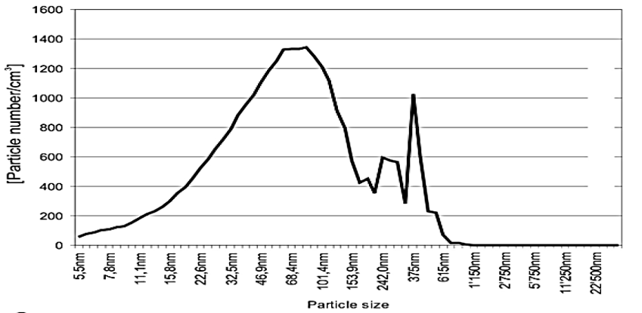
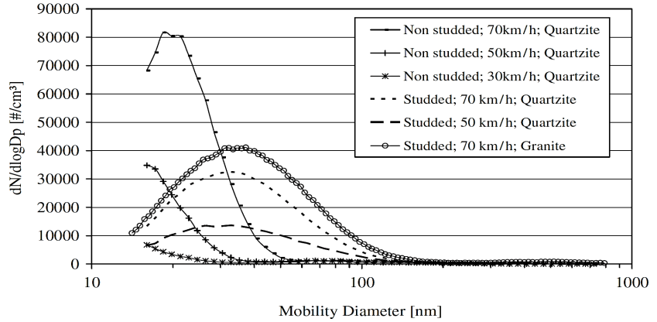
BRAKES
TYRE AND BRAKE WEAR – NUMBER SIZE DISTRIBUTIONS
TYRES
BW PN distributions appear to be bimodal with both peaks lying within the fine mode
Some studies report 1st peak at the UF size, while others find at ~ 350 nm
PN distributions are unimodal. Some studies report a peak at the UF size (~ 15-50 nm), while others mention that under “normal” driving conditions no UF particles are emitted
Transmission Electron Microscope
Scanning Mobility Particle Sizer
[Example adopted from Gasser et al., 2009]
[Example adopted from Dahl et al., 2006]

Slide 7
TYRE AND BRAKE WEAR - CHEMICAL CHARACTERIZATION
Most important chemical constituents of wear particles
 | PM_{2.5} | PM_{2.5-10} | Wear particles
Brake Wear | Transition metals (Cu, Fe), Sb (III, V), Sn, Ba, Zr, Al, S, OC>>EC | FeO, Fe₂O₃, Cu oxides, Sb (III), Sb (V), Sn, Ba, Zr, Al | Cu, Fe, Sb (III, V), Sn, Ba, Zr, Al, S, PAHs, n-alkanes, n-alkanoic acids, benzaldehydes
Tyre Wear | Zn, organic Zn, Cu, S, Si, Organic compounds, EC | Zn, organic Zn, Cu, Si, Mn | Zn, Cu, S, Si, PAHs, benzothiazoles, natural resins, n-alkanes, EC
NEED FOR: Identification of organic constituents in PM₁₀ brake and tyre wear particles and investigation of the chemical composition of modern lining materials

Slide 8
TYRE AND BRAKE WEAR – EMISSION FACTORS
EFs derived from road simulation studies
EFs derived from receptor modeling
 | PM_{2.5} (mg km⁻¹ veh⁻¹) | PM₁₀ (mg km⁻¹ veh⁻¹)
Brakes LDV | 2.1-5.5 | 2.0-8.0
Tyres* LDV | ⁻ | 3.5-9.0
 | PM_{2.5} (mg km⁻¹ veh⁻¹) | PM₁₀ (mg km⁻¹ veh⁻¹)
Brakes LDV | 0.0-5.0 | 1.0-8.8
Tyres* LDV | 0.3-5.0 | 6.0-13
* Friction tyres
* Friction tyres
Brake and tyre wear PM₁₀ EFs of HDVs are estimated to be approximately one order of magnitude higher compared to LDVs
Much higher PM₁₀ EFs have been reported in case of studded tyres

Slide 9
Health effects of non-exhaust particles
Non-exhaust traffic related PM emissions significantly contribute to ambient PM10 and PM2.5
Several studies carried out on animals or in-vitro cells with sometimes contradictory results (different techniques and methodologies used) – Difficulties in extrapolating the results to humans
Fate of non-exhaust particles: Residence time? Dispersion? Exposure?
Soil and water contamination? (Not considered in the JRC literature study and apparently not well investigated)

Slide 10
What abatement measures?
Minimizing particle generation by changing chemical composition/physical properties of brakes and tyres?
Are particle generation mechanisms and influencing factors sufficiently known?
Only in the case of particles from brake wear the source is linked exclusively to the vehicle
Traffic and/or driving behaviour control measures? (e.g. speed limits, Low Traffic Zones, congestion charges,…)
Road conditions/characteristics? (e.g. road material, road maintenance, wetting/cleaning,…)
Cost/effectiveness?

Slide 11
On-going research activities
Brake industry involved in research studies to better understand particle generation mechanisms and to evaluate the possibility of reducing particle generation (e.g. EU funded REBRAKE )
WBCSD (World Business Council for Sustainable Development) - Tire Industry Project (TIP)
Goal : Anticipate the potential long term environmental and health issues relating to tyre materials, Tyre & Road Wear Particles, end of life tyres and recycling management

