Slide 1
Informal document GRB-60-16
(60th GRB, 1-3 September 2014,
agenda item 2)
Transmitted by the expert from OICA
Assessment on the
Minimum Sound Level of the Horn
60th GRB Working Party on Noise
September 2014
INTERNATIONAL ORGANIZATION OF MOTOR VEHICLE MANUFACTURERS

Slide 2
Review of Regulatory Situation in Countries that do not apply ECE R28

Slide 3
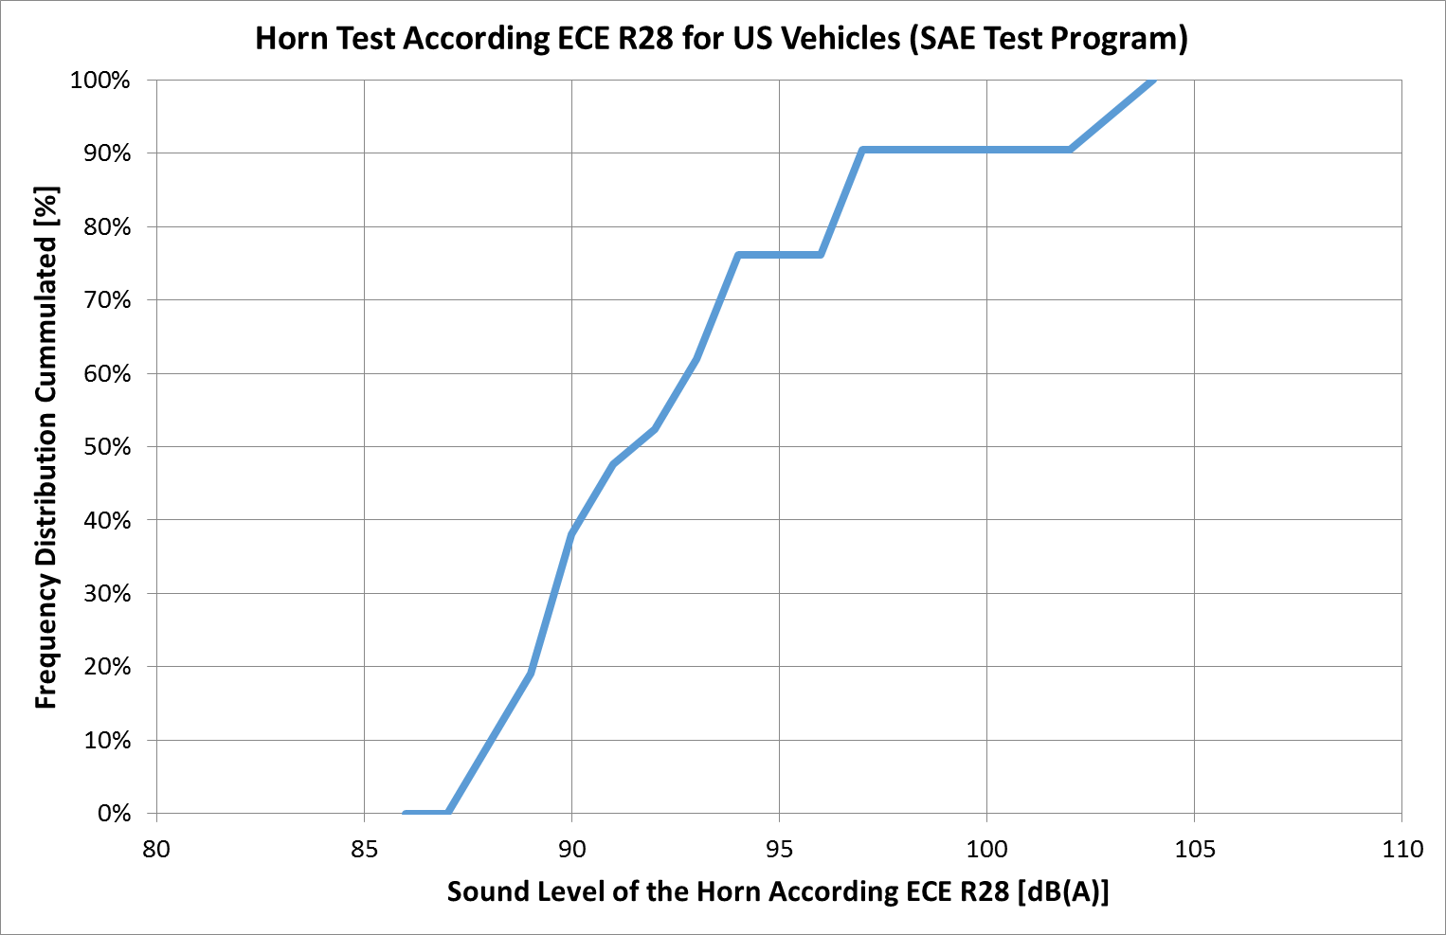
SAE Assessment on typical Horn Level of US Vehicles
ECE R28 Requirement
85
89
93
US Vehicles
97
101
105
109
113
115
More than 60% of the tested vehicles have sound values for the horn below 93 dB(A).

Slide 4
Recalculation of Korean Horn Requirement
Korea
Level: 90 dB(C)
Distance: 2.0 m
ECE R28
Level: 93 dB(A)
Distance: 7.0 m
Distance Correction:
The sound levels attenuates by -3 to -6dB per doubling of the distance. This means that measuring in 7 m distance the sound level is approximately -5.8 dB more quiet compared to a measurement in 2 m distance.
Filter Correction:
Applying an A-Filter instead a C- Filter will result in slightly higher sound level of approximately + 1.6 dB.
Result:
L_{Korea(ECE R28 conform)} = 90 dB -5.8 dB + 1.6 dB = 85.8 dB

Slide 5
Conclusions from the Review of other Regulations
There is no country that requires higher sound levels compared to ECE R28.
Most countries require only that a horn is installed.
Some countries require that the horn is audible in a certain distance „under normal conditions of traffic“, but no country provides a test method for this requirement.
An assessment of SAE for the US market indicates that the typical horn level of US vehicles is between 88dB and 95dB, with 60% of the vehicles under 93 dB horn level.
It is concluded that a minimum sound level of 87 dB(A) for the vehicles a specified in paragraph xxx of ECE R28 provides a sufficient level of safety.

