Slide 1
Rail Schemes and the PPP Model
November 2014

Slide 2
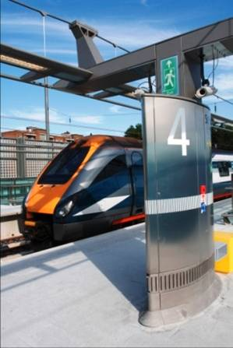
Rail Schemes and the PPP Model
Rail Schemes
PPP model
Successful Projects
Lessons Learned
Conclusions

Slide 3
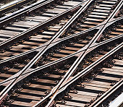
Rail Schemes
Transport by rail
  Encourages economic growth and development
  Is more energy efficient than transport by road or air
Establishing need
  Improving cross-border traffic
  Easing bottlenecks
  Increasing capacity
Support from
  EU – Connecting Europe Facility
  The World Bank

Slide 4

PPP Model
Definition
“typically medium to long term, between the public and private sectors whereby some of the services that fall under the responsibilities of the public sector are provided by the private sector, with clear agreement on shared objectives for delivery of public infrastructure and/ or public services”
World Bank - PPP in Infrastructure Resource Center

Slide 5
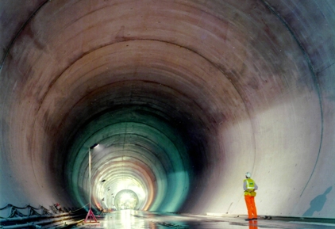
PPP Model
Structures
  Traditional – DBFM
  Construction Finance – DBF
  O&M concession
Scope
  High Speed lines
  Infrastructure enhancements
  Railway Station development
  Rolling Stock procurement

Slide 6

PPP Model
Risks
  Political risk
  Construction risk
  High capital cost
  Demand risk (passenger revenues)
  Availability of finance
Rewards
  Whole Life costing
  Spreading the cost

Slide 7

PPP Model
Issues
  Availability of suitable schemes
  Market appetite
Alternative funding
  Real estate development
  Car parks
Working Party on Transport Trends and Economics 27th Session
  PPPs are not always the best solution for financing transport infrastructure and very careful steps should be taken and considered before proceeding with such an investment tool

Slide 8
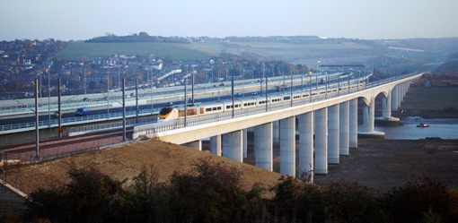
Successful Projects - UK
High Speed 1
  100km high speed line linking St. Pancras International to the Channel Tunnel
  Two phases - Section 1 completed in September 2003 and Section 2 completed in July 2007
  Capital cost US$10 billion
  Sale of 30 year concession to Borealis Infrastructure / Ontario Teachers’ Pension Plan consortium for US$3.3 billion in November 2010

Slide 9
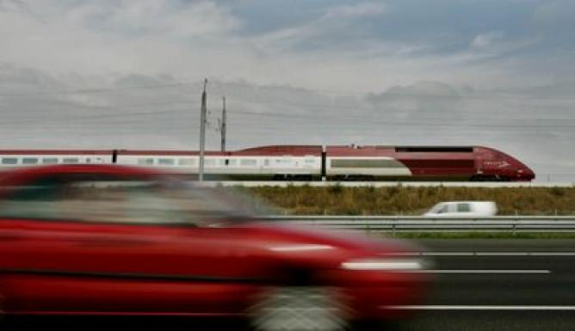
Successful Projects – The Netherlands
HSL Zuid
  HSL procured through a public private partnership
  125km high speed line linking Amsterdam to Belgian border
  Infraspeed awarded 30 year concession to maintain and operate HSL in 2002
  Construction completed in 2008
  Capital cost €5 billion

Slide 10
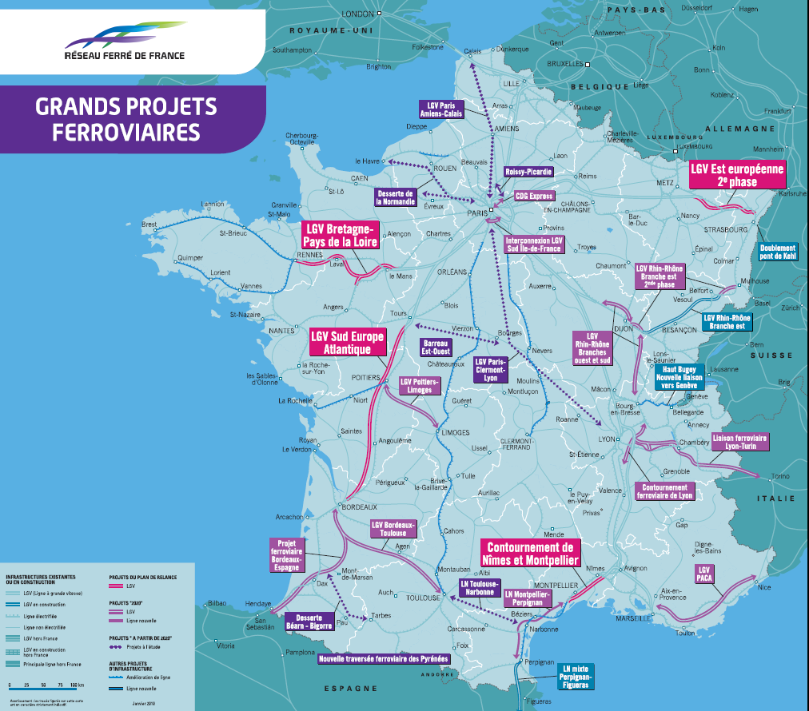
Successful Projects – France
HSL Brittany Pays-de-Loire - Le Mans/ Rennes
DBFM
180 km high speed line
€3.4 billion
HSL South Europe Atlantic - Tours/ Bordeaux
50 year concession
300 km high speed line
€8 billion
Montpellier Odysseum New Railway Station
DBFM
€100 million

Slide 11
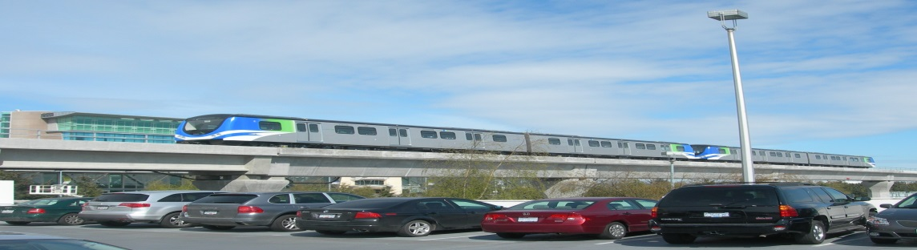
Successful Projects - Canada
Canada Line
  Rapid rail transit linking downtown Vancouver and Richmond to the airport
  Procured through P3 process
  SNC Lavalin awarded 35 year concession to build, operate and maintain RAV in 2005
  Construction completed in 2010
  Capital cost C$2 billion
  Payment mechanism 90% availability/ 10% volume

Slide 12
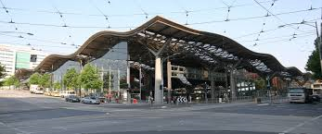
Successful Projects - Australia
Southern Cross Railway Station – Melbourne
  Public Private Partnership for redevelopment of railway station
  30 year concession on DBFM basis
  Capital cost A$ 1.5 billion

Slide 13

Lessons Learned
The importance of appropriate risk allocation
Flexibility of contracts
  Avoiding ‘hair triggers’
Government support
  Political ‘buy-in’
  Stakeholder management
Good governance
  Tender process
  Project management

Slide 14

Conclusions
What makes a successful project
SC2 project
  Proposal for UNECE Standard on best practice for the management of Public Private Partnership (PPP) programmes in the rail sector
  The aim of the project will be to provide standards for:-
    - A structural template for the development of rail schemes
    - A recommended common approach to risk allocation
    - Model forms of contract based on international best practice

Slide 15

Contact
Jonathan Beckitt
Infrastructure and Project Finance Group
CMS Cameron McKenna LLP
Mitre House 160 Aldersgate Street London EC1A 4DD
Tel: +44 20 7367 2113
jonathan.beckitt@cms-cmck.com

