Slide 1
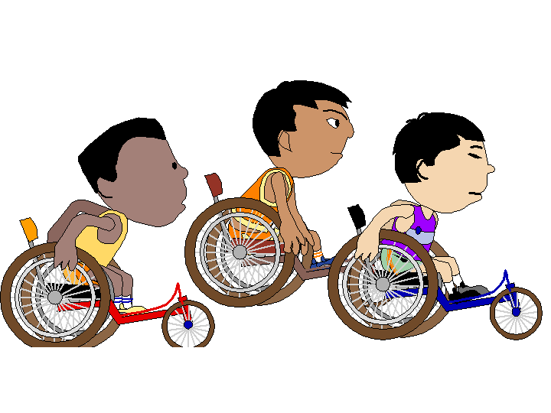
Accessible Rail Cars and Train Stations: Best Practice & Recommendations
Ann Frye
Ann Frye Ltd

Slide 2
Key Messages
Confidence is the most important factor;
To be confident travellers need:
  Reliable information (for pre-journey planning and throughout the journey);
  Available well trained staff;
  Accessible and user friendly stations;
  Accessible and user friendly trains;
  A coherent and strategic approach to accessiblility.

Slide 3
Information
Disabled and older travellers need information that is:
  In a format that they can understand and use;
  And that gives them all the details they need about possible barriers to mobility (where is the best place to change to avoid steps etc).

Slide 4
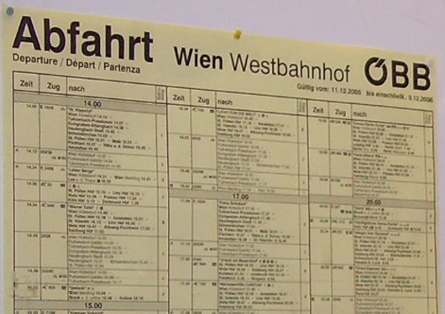
Not like this.....

Slide 5
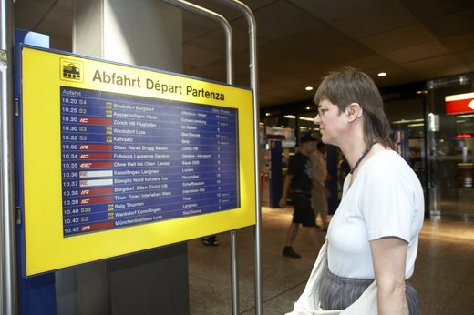
But like this......
© bav.admin.ch

Slide 6
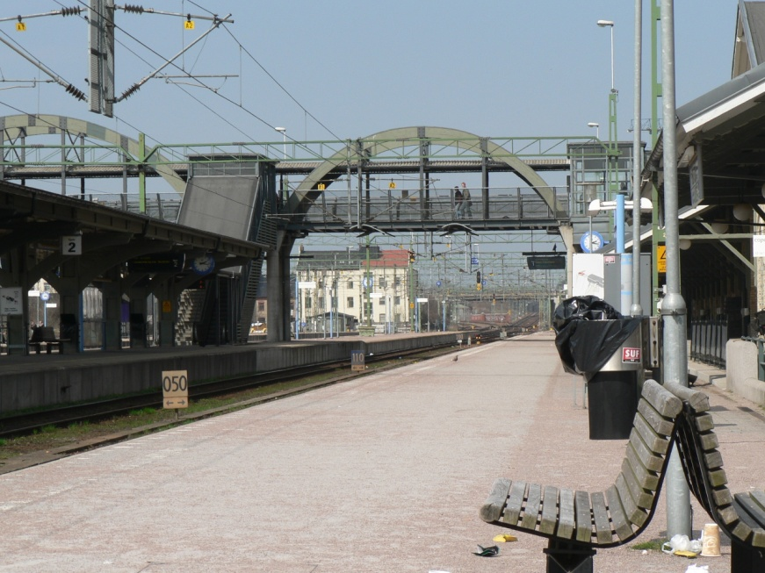
Information: ResPlus - Sweden
A web based information and reservation system run by Samtrafiken i Sverige AB ;
Includes all intercity and local trains and other transport connections between any two points;
The web-based tool also contains full information on station access with detailed maps (including service and facility information);
Sketch plans show how the station and its surroundings are situated, while photographs illustrate the interior and exterior of the buildings;
See www.resplus.se

Slide 7
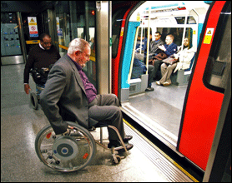
Information: Direct Enquiries - London
Website giving access information about all London Underground stations;
Developed in partnership with disability organisations;
Includes detailed access information to all 274 London Underground (Tube) stations to help disabled people plan a journey using stations that have access facilities that meet their needs;
See www.directenquiries.com/
Photograph courtesy of Transport for London

Slide 8
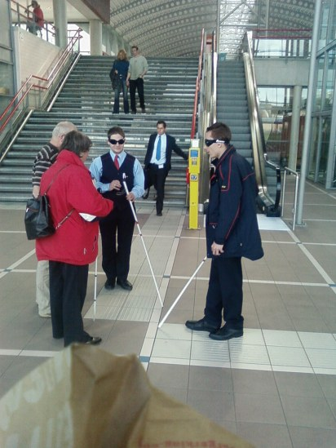
Staff Training
Well trained staff are essential to the confidence of disabled travellers;
Here staff of NS – Nederlandse Spoorwegen experience the station environment wearing blindfolds;
Good training applies from senior management through all customer facing staff.
Copyright @ Wordpress.com

Slide 9
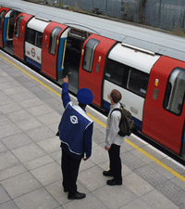
Staff availability
Absence of staff is one of the biggest causes of anxiety among older and disabled travellers;
Staff need to be a visible presence both on stations and on trains;
Their training should equip them both to understand and deal with customer needs.

Slide 10
Accessible and User Friendly Stations ...

Slide 11
Universal Design
Universal Design is an important concept for good station design.
The principles of universal design are :
  Simple and intuitive;
  Equitable;
  Flexible;
  Low physical effort;
  Appropriate size & space.
And it isn’t just about the “hardware”, good management and organisation are vital too.

Slide 12
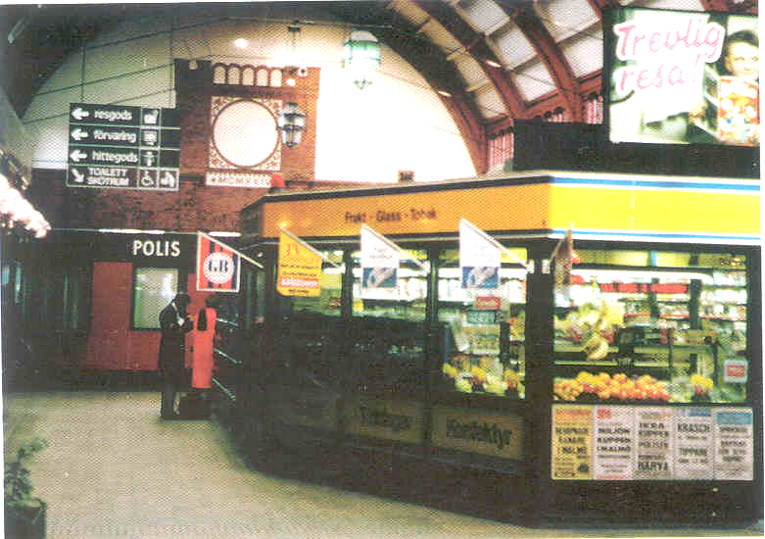
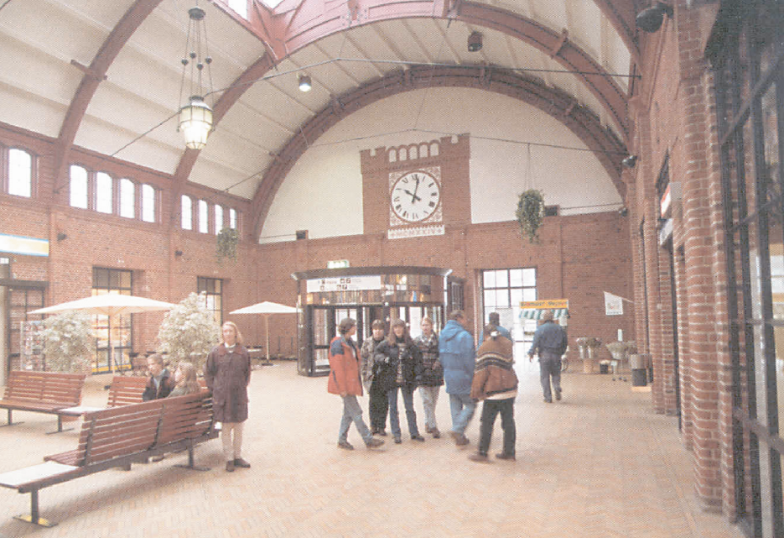
Reducing stress through good design
After
Before

Slide 13
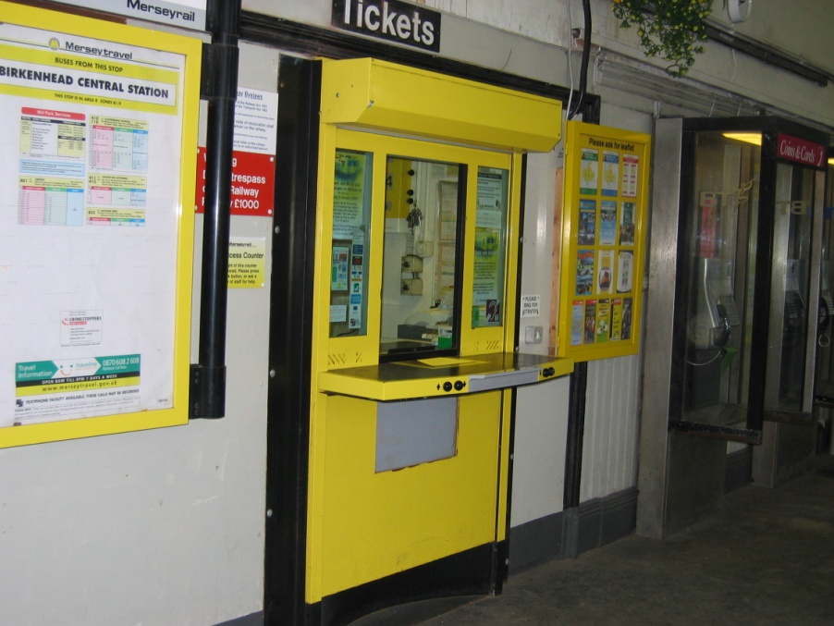
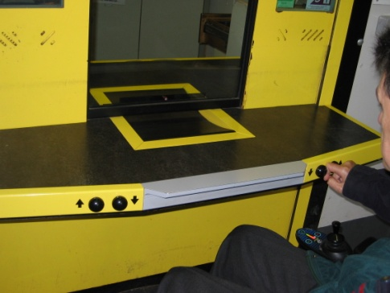
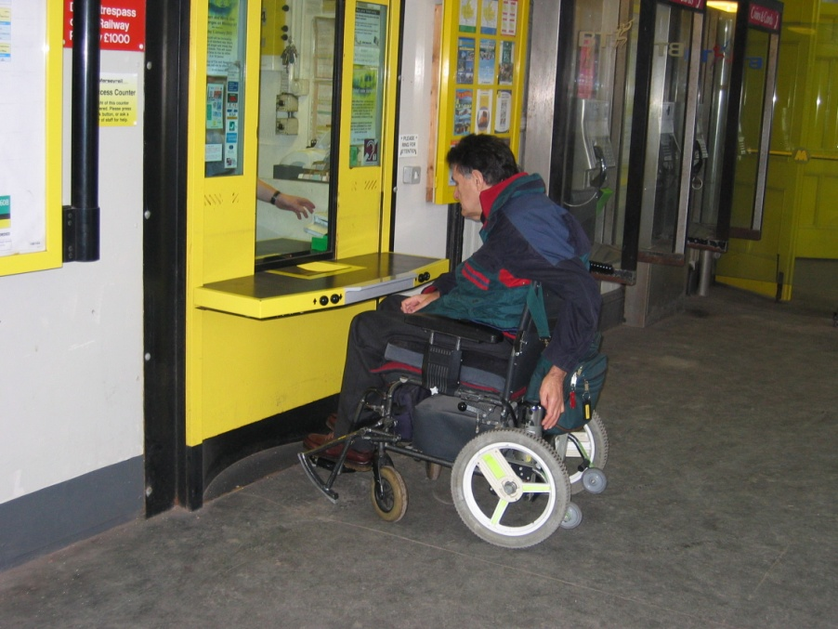
Meeting everyone’s needs
Controlled
By the user
Adjustable
height
ticket
counter

Slide 14
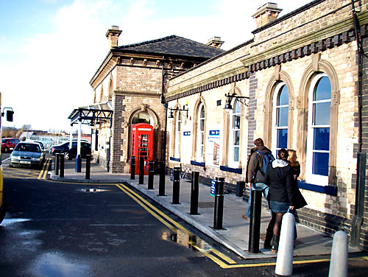
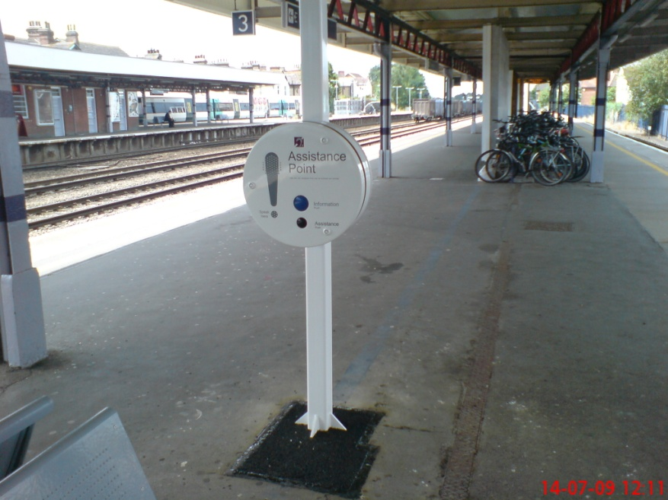
Access improvements at existing stations
Often simple, low cost changes can improve accessibility..
And confidence...

Slide 15
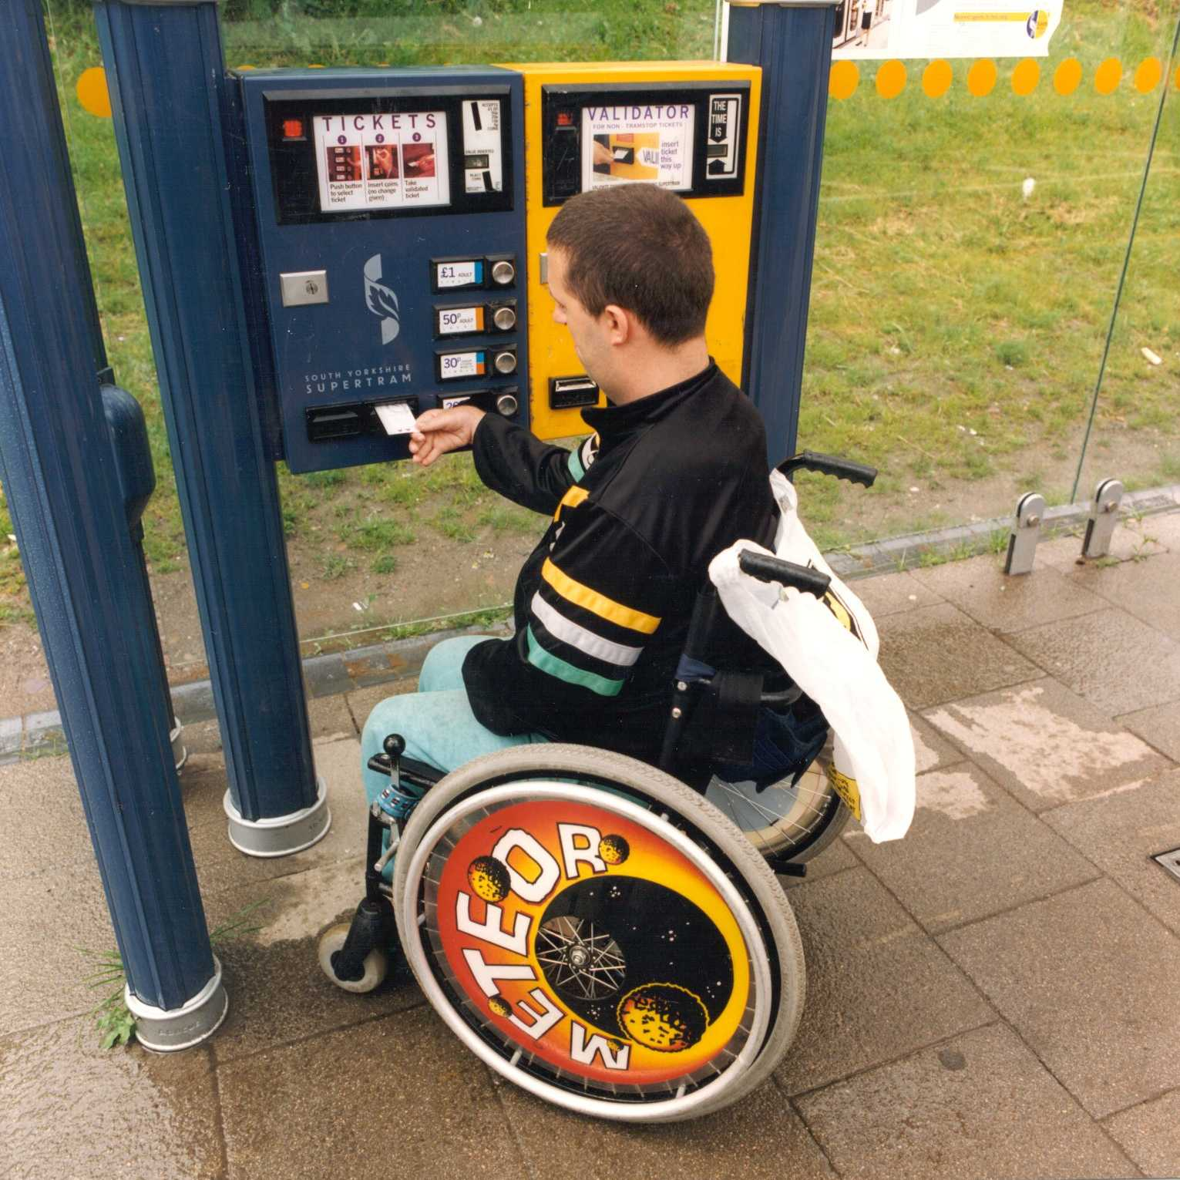
Ticket machines that a wheelchair user can reach

Slide 16
Ticket machines that people can understand...
Complex ticketing arrangements and poor signage add to stress:
Barcelona Metro has turned conventional design on its head:
  Ticket machine designed by blind people;
  Designed for passengers not engineers!
  Intuitive to use;
  Everyone gets tickets faster;
  Fewer staff employed to help.

Slide 17
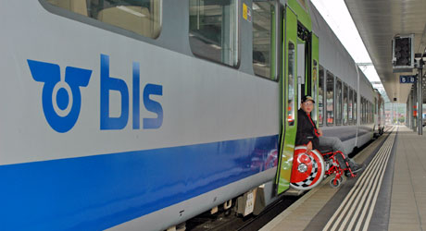
Platform /Train interface
Level boarding is the ideal, but is often impossible;
Raised sections of platform provide one solution.

Slide 18
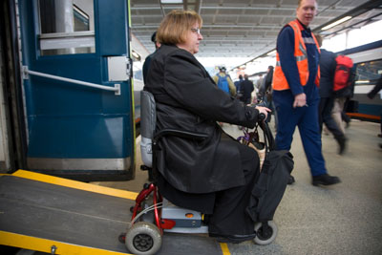
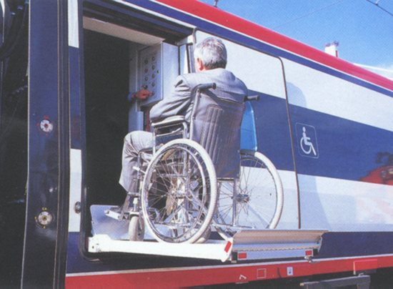
Platform /Train interface
Boarding aids may be the only solution;
Ramps are less intimidating for a wheelchair user;
High lifts can be frightening;
Well trained staff must always be available

Slide 19
Accessible and User Friendly trains

Slide 20
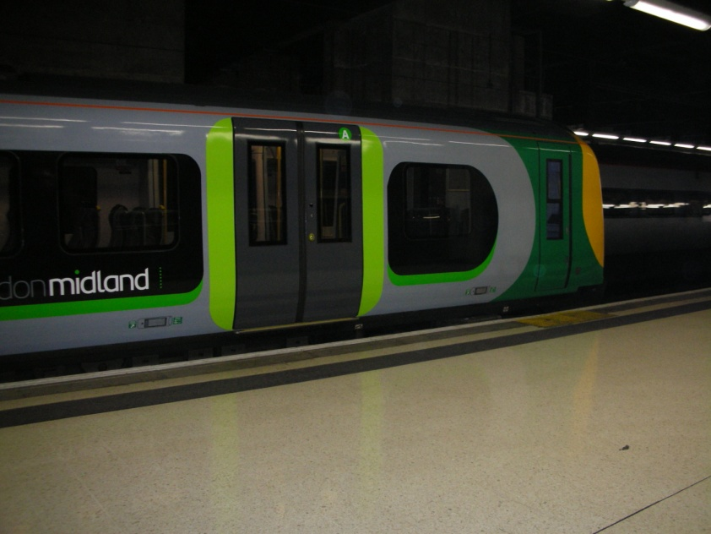
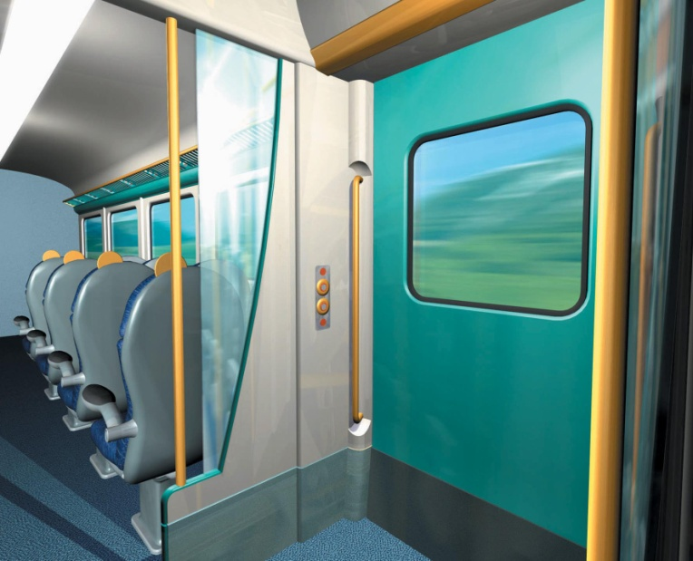
Help for people with low vision
Colour contrast helps people with low vision;
To locate the doors outside the train and
To find their way around inside.

Slide 21
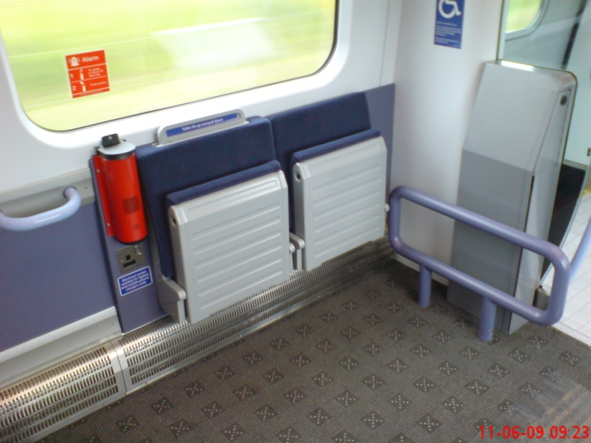
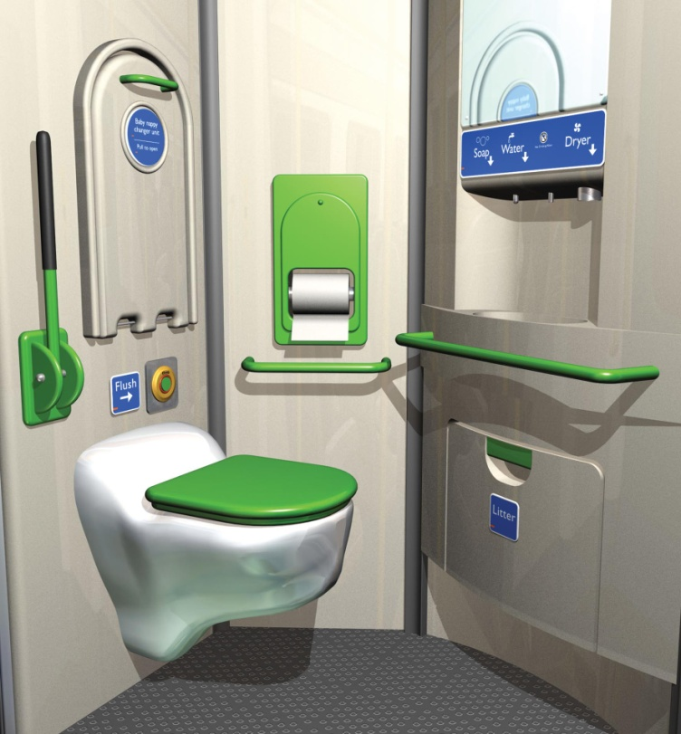
Space for wheelchair users
Spaces for wheelchair users that allow enough room to manoeuvre;
Toilet facilities that wheelchair users can manage without difficulty.

Slide 22

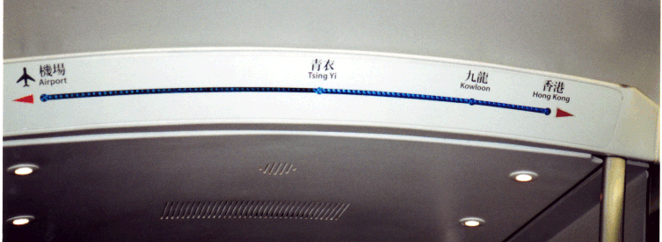
Information for people with vision or hearing loss....
Audible and visual “next stop” information helps all passengers;

Slide 23
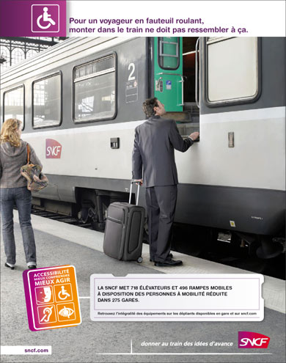
A strategic approach
Access improvements need to be made as part of a coherent plan and policy commitment;
Ad hoc changes will not enable people to travel with confidence;
This is the SNCF strategy launched in 2008.

Slide 24
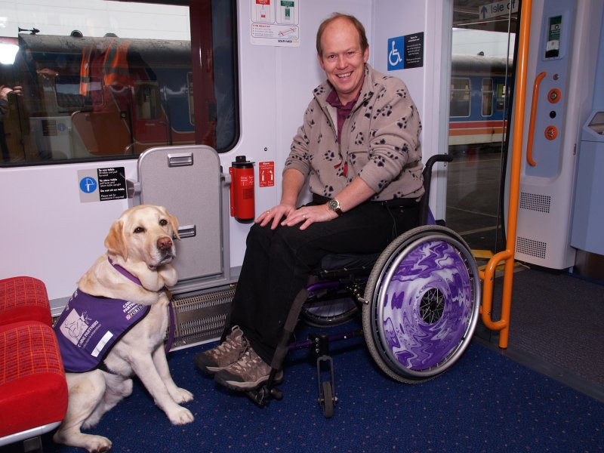
Building Confidence
Some train operators - like South West Trains in the UK - are offering “try the train” days to enable disabled people to find out what is available and how to travel by train.

Slide 25
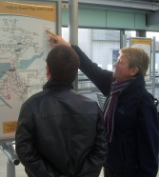
Building Confidence
Some transport companies provide a companion to travel with a disabled person until they have the confidence to make the journey alone...

Slide 26
Summary
Best practice is about :
  A clear strategy and policy that leads to consistent facilities and services;
  A positive commitment to staff training across all levels of the operation;
  Engagement with disabled people on a regular basis to understand their needs ;
  A commitment to follow international law and best practice guidance on both station and train design and operation;
  An understanding of the principles of universal design as a key approach to better access for all.

Slide 27
Accessible Rail Cars and Train Stations: Best Practice & Recommendations
Ann Frye
Ann Frye Ltd

