Slide 1
OICA and CLEPA joint contribution to GRE-90-23 and GRE-90-35

Slide 2
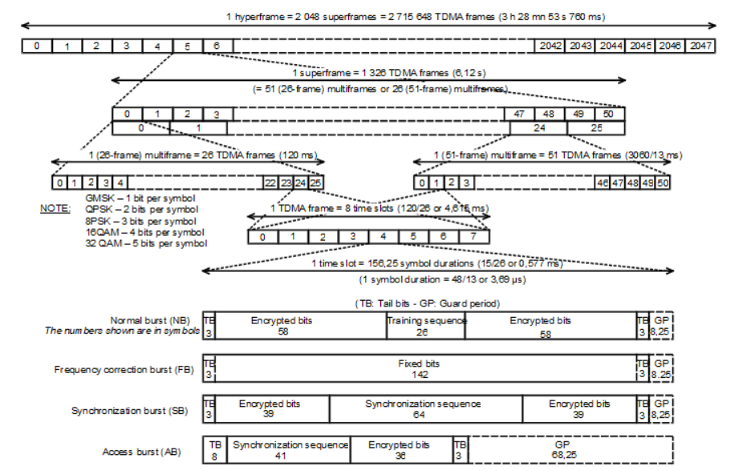
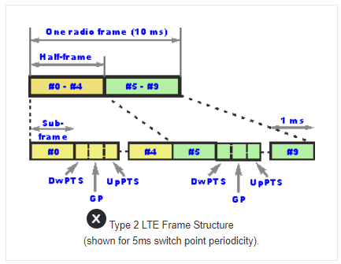
Rationale for introducing a new pulse modulations
2G (GSM) Frame Structure
4G (LTE) Frame Structure Type 2 (TDD)
Frame length: 10ms (consisting of 10 sub-frames)
Sub-frame length: 1ms
Frame length: 4.16ms = 217Hz
Slot length: 577µs
This corresponds to PM (1000 Hz, 10% duty cycle)!
Conclusion: An eligible modulation to emulate LTE is PM3 (1000Hz, 10% duty cycle). In order to consider multiple LTE transceivers transmitting simultaneously, the duty cycle was updated to 50%. The PM with 1000Hz and 50% modulation is also required in MIL-STD-461G.
This corresponds to PM (217Hz, 577µs)!
Conclusion:
PM1 (217Hz, 577µs) is suitable to emulate 2G.

Slide 3
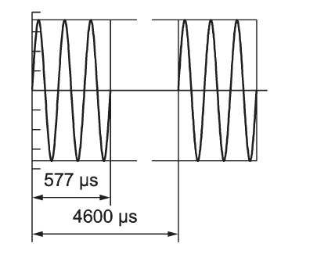
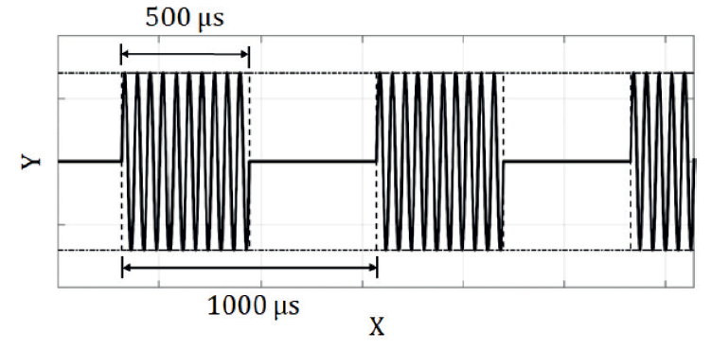
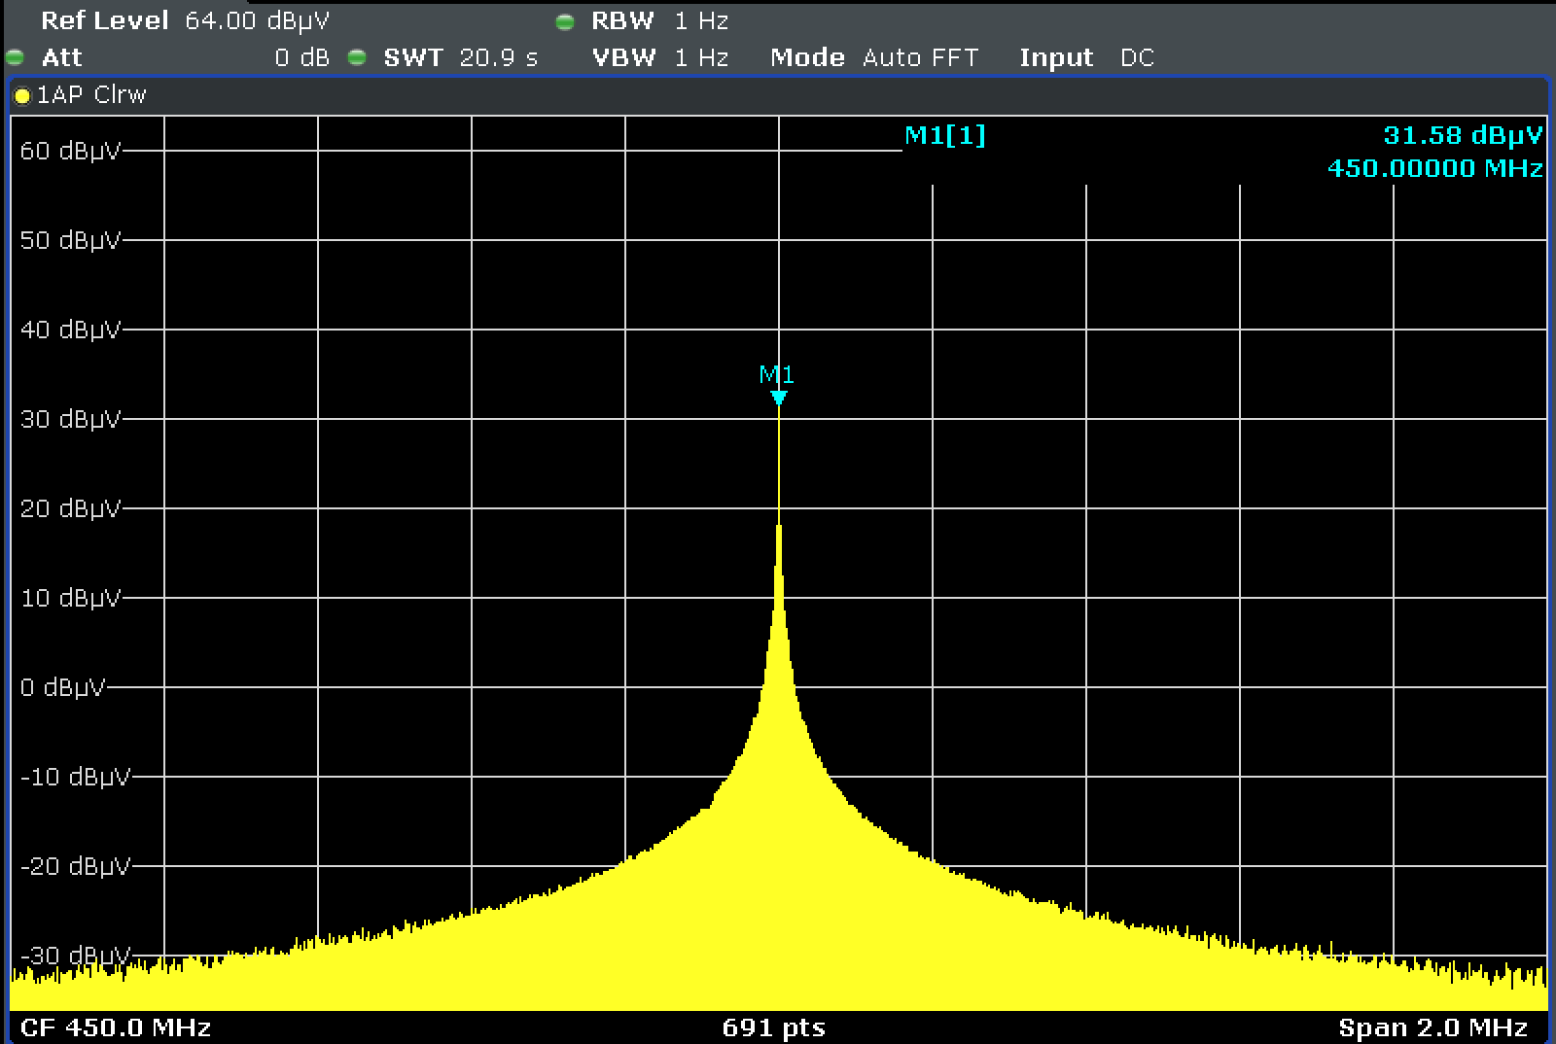
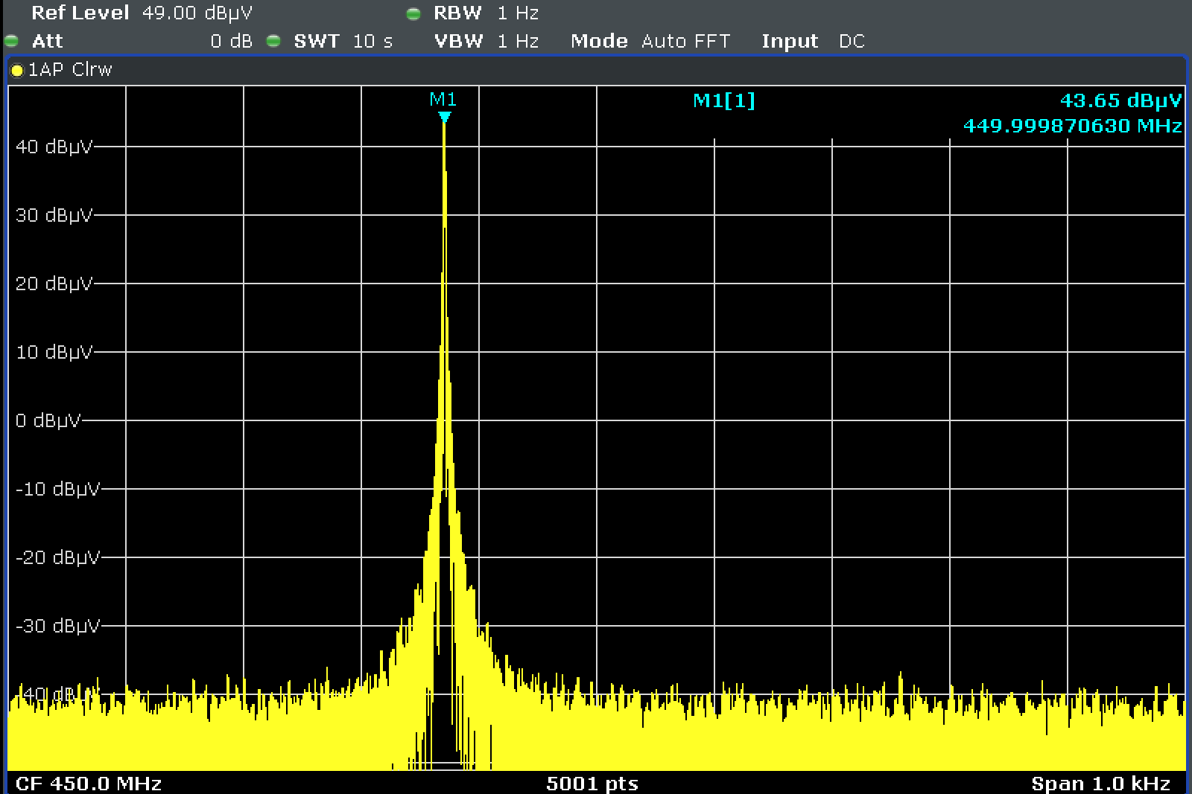
Envelope Spectrum of PM1 and PM3 in comparison
Signal generator connected to spectrum analyzer, Carrier Frequency: 450 MHz, Level: 50 dBµV; RBW: 1 Hz
PM1: 217 Hz, 12,5 % duty cycle
PM3: 1 kHz, 50% duty cycle
PM3 covers PM1: higher modulation frequency (pulse rate) and higher duty cycle is considered to be more harmful.

Slide 4
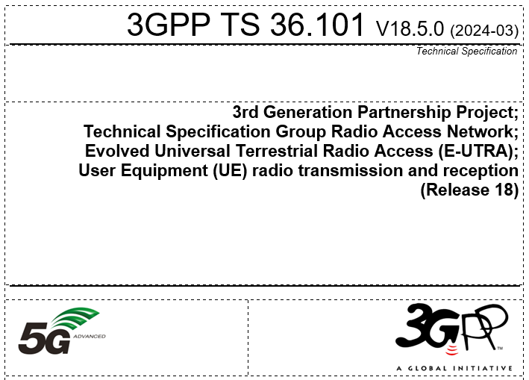
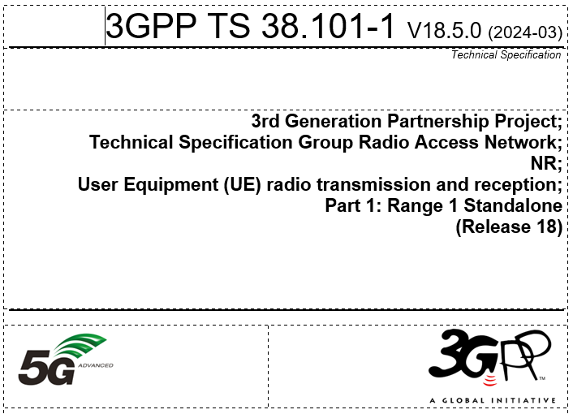
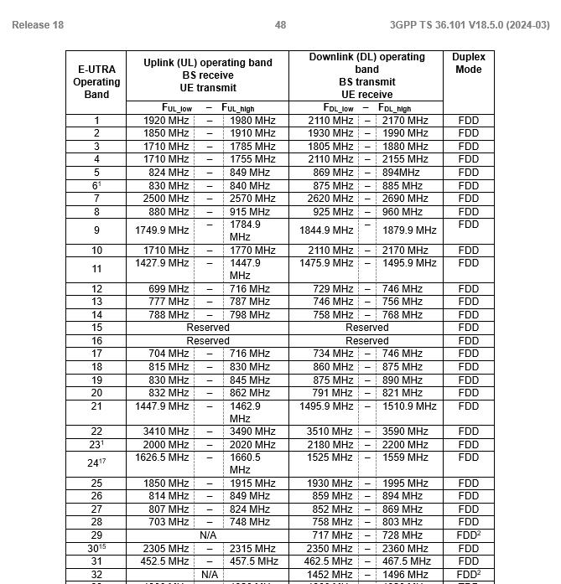
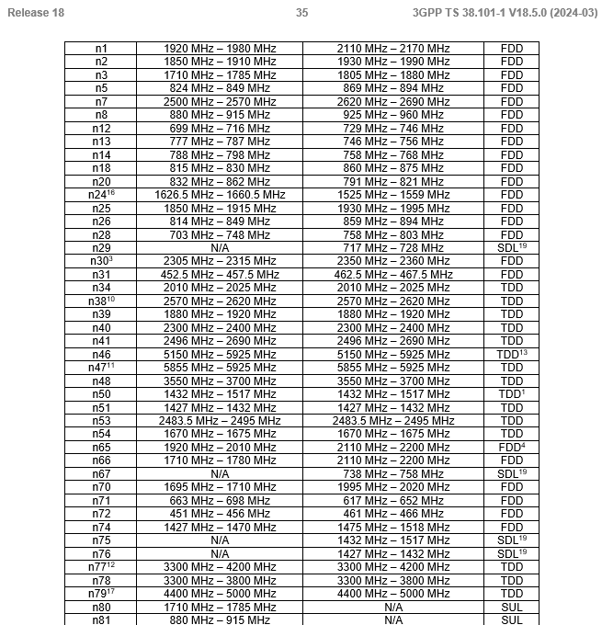
Frequency ranges for state-of-the art cellular applications
Excerpt of 4G (LTE) frequency bands
Excerpt of 5G NR FR1 frequency bands
Source: Specification # 36.101 (3gpp.org)
Source: Specification # 38.101-1 (3gpp.org)

Slide 5
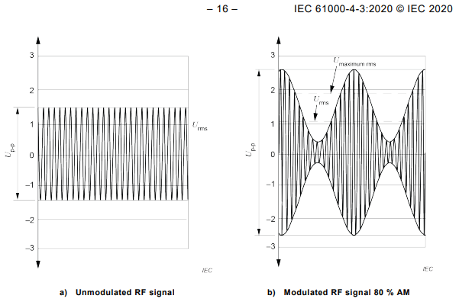
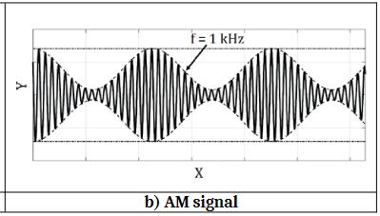
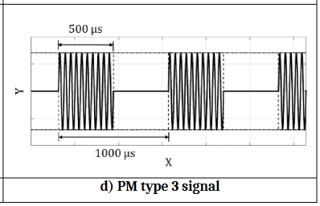
AM Modulation: Upward vs. downward modulation
AM upward modulation per IEC 61000-4-3:2020
AM downward modulation per ISO 11451-1:2015 & ISO 11452-1:2015
PM3 per ISO 11451-1 DIS (N3346) and 11452-1 DIS (N3342)
Peak conservation in ISO 11451-1 and 11452-1 ensures that the maximum amplitude level of AM does not exceed the maximum CW level
while PM corresponds to a pulsed (i.e. on-off) CW signal.
In contrast to AM, PM additionally emulates switching characteristics of a digital modulated signal.

Slide 6
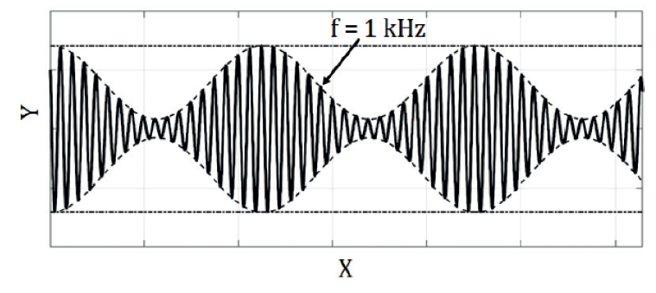
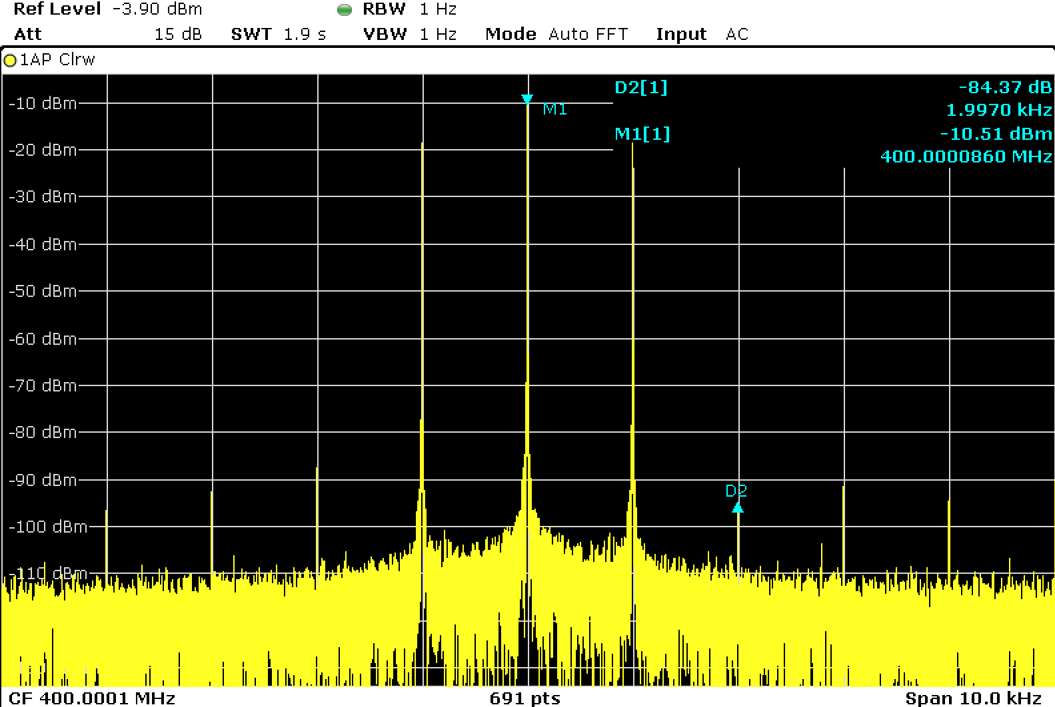
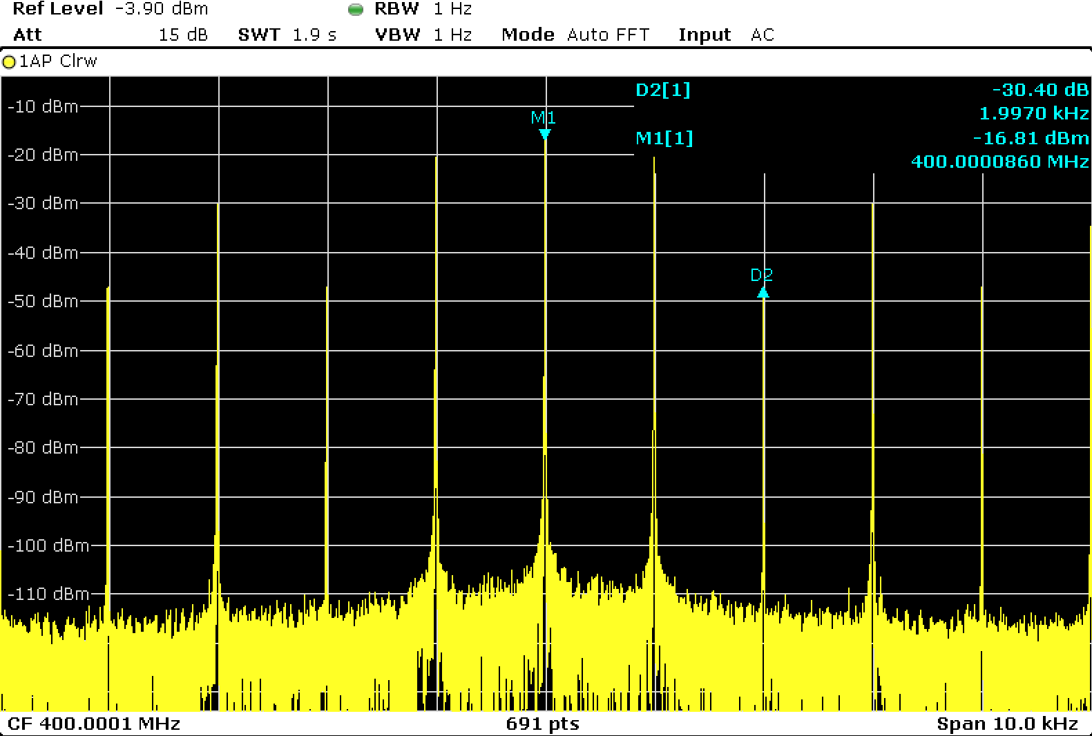
Spectrum of AM and PM3 in comparison
Signal generator connected to spectrum analyzer, Carrier Frequency: 400 MHz, Level: -10 dBm; RBW: 1 Hz
AM: 1 kHz, 80% depth
PM3: 1 kHz, 50% duty cycle
Equal modulation frequency for AM and PM3: distance between two spectral lines is 1 kHz for both modulations.

Slide 7
Summary of AM use
Communication applications:
PM3 was introduced at 380 MHz to cover TETRA, 4G, 5G, WIFI
Maritime¹⁾ applications:
1,6 – 27,5 MHz (J3E: single sideband without carrier)
Railway²⁾ applications:
Old train station control systems might still use AM
Train radio: FM or TETRA
Aviation³⁾ applications:
Frequency range for civil applications: 108 - 137 MHz (Aircraft communications radio)
Frequency range for military applications: 225 - 400 MHz (Aircraft communications radio)
Amateur Radio⁴⁾ :
Focus on frequency bands with PRIMARY status: 1,8 – 450 MHz (and 24 – 250 GHz)
No practical use reported in the 70 cm (420 – 450 MHz) band: highest frequency << 450 MHz
Infotainment applications⁵⁾:
Radio broadcasting: LF: 0,1485 – 0,2835 MHz / MF: 0,5265 – 1,607 MHz / HF: 3,9 – 26,1 MHz
Analog television: 47 – 838 MHz; Reference document does not provide detailed information on modulation; Analog television outdated – digital television services apply other modulations (typically OFDM, carriers with QAM);
Spectrum comparison of AM and PM3 shows similarities between both modulations
1) Information provided by Bundesamt für Seeschifffahrt und Hydrographie (The BSH is a higher federal authority within the portfolio of the Federal Ministry for Digital and Transport.)
2) Source: German component manufacturer for trains
3) Sources: Complete List Of Airband Frequencies.. | Skyscanworld.com, The basics of air band radios (buytwowayradios.com), Common Military (United States) Scanner Frequencies and Radio Frequency Reference (radioreference.com)
4) Source: International Amateur Radio Union (IARU), ITU - Amateur and Amateur-satellite Service Spectrum
5) Source: Radio Services Database CISPR/TR 31 V4 => reference document: Recommendation ITU-R BT.417-5

Slide 8
Recap: OICA and CLEPA proposal
As given in GRE-90-23 and GRE-90-35:
The test signal modulation shall be:
AM (amplitude modulation), with 1 kHz modulation and 80 per cent modulation depth in the 20 to 800 400 MHz frequency range; and
PM2 (pulse modulation type 2), Ton 3 µs, period 3,333 µs in the 2,700 to 3,100 MHz frequency range; and
PM3 (pulse modulation type 3), Ton 500 µs, period 1,000 µs in the 800 380 to 2,700 MHz and the 3,100 to 6,000 MHz frequency ranges.
Summary: Extend the use of PM3 to start from 380 MHz instead of 800. Limit use of AM to 400 MHz
As given in ISO/2nd DIS 11451-1 (N3346) and ISO/2nd DIS 11452-1 (N3342):

