Slide 1
Submitted by the expert from China
Informal document GRE-90-30
90th GRE, 29 Apri-3 May 2024
agenda item 6.(a)
Questions regarding the interpretation of UN R48-08

Slide 2
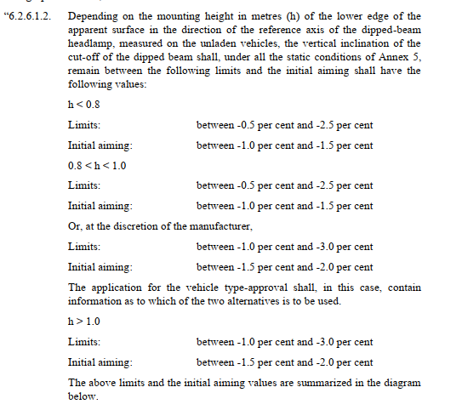
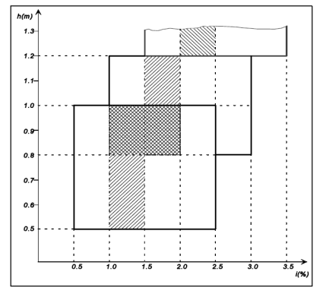
ECE R48-08
There is no requirement for
h=0.8 and h=1.0.
It is recommended to add:
0.8≤ h≤1.0

Slide 3
ECE R48-08
ECE R148-00
ECE R48 mentions that if the side facing parking lamps reciprocally incorporated in the side direction-indicator lamps or in the side‑marker lamps are amber, what color are the side facing parking lamps without reciprocally incorporated lamps?
Without any preconditions, the side facing parking lamps are amber.
ECE R148-01
What color are the side facing parking lamps ?
The chromaticity description of (c) the parking light on the opposite side has been deleted from the 01 series.

