Slide 1
ASEP / RD-ASEP Study Interim Report to 78th GRBP September 2023
Informal Document GRBP-78-34
78th GRBP, 30 Aug – 01 Sept 2023
Agenda Item 3
Submitted by OICA

Slide 2
Study on ASEP and RD-ASEP Monitoring
Study Outline
UTAC was tasked by ACEA to perform a study on ASEP and RD-ASEP.
The study consists of two work packages:
Work Package 1 Did the implementation of ASEP as it currently stands lead to any design changes?
Work Package 2 Collect data from the RD-ASEP monitoring and provide a basic analysis as input to the IWG on RD-ASEP;
Joint study of CPs and Automotive Industry
France, Germany, Japan, The Netherlands, OICA (ACEA)

Slide 3
Study on ASEP and RD-ASEP Monitoring
Work Package 1 Description
Main Question:
Did the introduction of ASEP - initiated since July’2016 under UN R51.03 - lead to changes in vehicle design?
Therefore,
A literature study shall be performed to get information about the awareness of the public on ASEP.
A questionnaire has been made for OEMs.
A questionnaire for mainly GRBP CPs ➔ We need the support from CPs to learn their perspective on ASEP.
A test program on vehicles will carried out in Autumn 2023

Slide 4
Study on ASEP and RD-ASEP Monitoring
QUESTIONS to OEMs
QUESTIONS to CPs / Authorities
In which region is your manufacturing company located?
Which vehicle segments do you specifically target?
What has been the average annual production volume of passenger vehicles (M1) over the last 5 years?
What has been the average annual production volume of commercial vehicles (N1) over the last 5 years?
Which specific vehicle categories (UN-ECE system) do you produce?
In relation to the vehicle category (PMR) you specified, how significant is the impact of ASEP on your vehicle design?
Which type of propulsion system is utilized in your vehicles?
Which specific vehicle classes do you manufacture?
In the case of your vehicles impacted by ASEP, which specific components underwent changes in their design targets?
How do you prove compliance with ASEP towards the TAA?
When you carry out ASEP tests, which test method do you use?
Which ASEP tests method is more favorable for your specific cars?
How do you deal with the Annex 7 mandatory Reference Sound Assessment (RSA)?
Do you follow - although not mandatory - the guidance of GRB68-03 (GRBP Document for Reference only) ?
How do you rate ASEP? Is it considered an important tool for single vehicle noise abatement?
You are a representative for a Contracting Party from which region?
As in your function as representative for a Contracting Party, you are from …
Do you (or your country, or your administration) accept SoC only, or do you request additional information?
Do you (or your country, or your administration) request application of GRB 68-03 (document for reference on ASEP interpretation) for approval in your country?
For EU vehicle registration, are you aware that under single vehicle approval according article 44 Regulation (EU) 858/2018, still the older vehicle regulation UN R51.02 is applicable (which means that ASEP is no mandated )
For EU members only, how many vehicles using the single vehicle approvals are registered per year in your country?
Do you carry out vehicle sound emission tests according UN R51 for market surveillance?
If YES, do you check ASEP as well?
If YES, do you check extended ASEP according to paragraph 6.2.3 as well?
Have you (or your country which you represent) received explicit complains from citizens about noisy motor vehicles (not motorcycles) as single noise events?
If YES, how have the complains developed during the last 5 years (tendency: increase, stable, decrease)
Do you think or do you have evidence that ASEP has helped to make noisy single vehicles more quiet?
How do you rate ASEP? Is it an important tool for single vehicle noise abatement?

Slide 5
Study on ASEP and RD-ASEP Monitoring
WP 1 Test program:
Tests according to UN R51.03 and RD-ASEP based on the test program outlined by the IWG RD-ASEP in 2017/2018.
8 vehicles targeted.
If possible, twin pairs of vehicles shall be tested, one of it approved under UN R51.02 and then its successor under UN R51.03 (preferably stage 2).
Single vehicles might be tested as well, if they are interesting.
Vehicles selection is based on press reports and outcome of questionnaires.

Slide 6
Study on ASEP and RD-ASEP Monitoring
Work Package 1 timing:
Literature study ➔ DONE
Preparation of Questionnaires ➔ DONE
Questionnaire Analysis by End September’2023
Test program to be finished until End’2023
Presentation of results for WP1 is planned for GRBP 79

Slide 7
Study on ASEP and RD-ASEP Monitoring
Work Package 2
Monitoring data on RD-ASEP shall be collected. Data are expected in the mandatory RD-ASEP monitoring sheet.
UTAC to make a data-exchange platform ➔ see next slide
Creation of a database for the RD-ASEP monitoring data
Review the Questionnaire coming with the RD-ASEP monitoring sheet
Provide a pre-analysis mainly statistical nature on
Number of datasets delivered
% of ICE, HEV, EVs, …
Problems detected (wrong completion, problems with algorithm, …)
Provide thoughts and ideas by UTAC, where RD-ASEP might need improvement

Slide 8
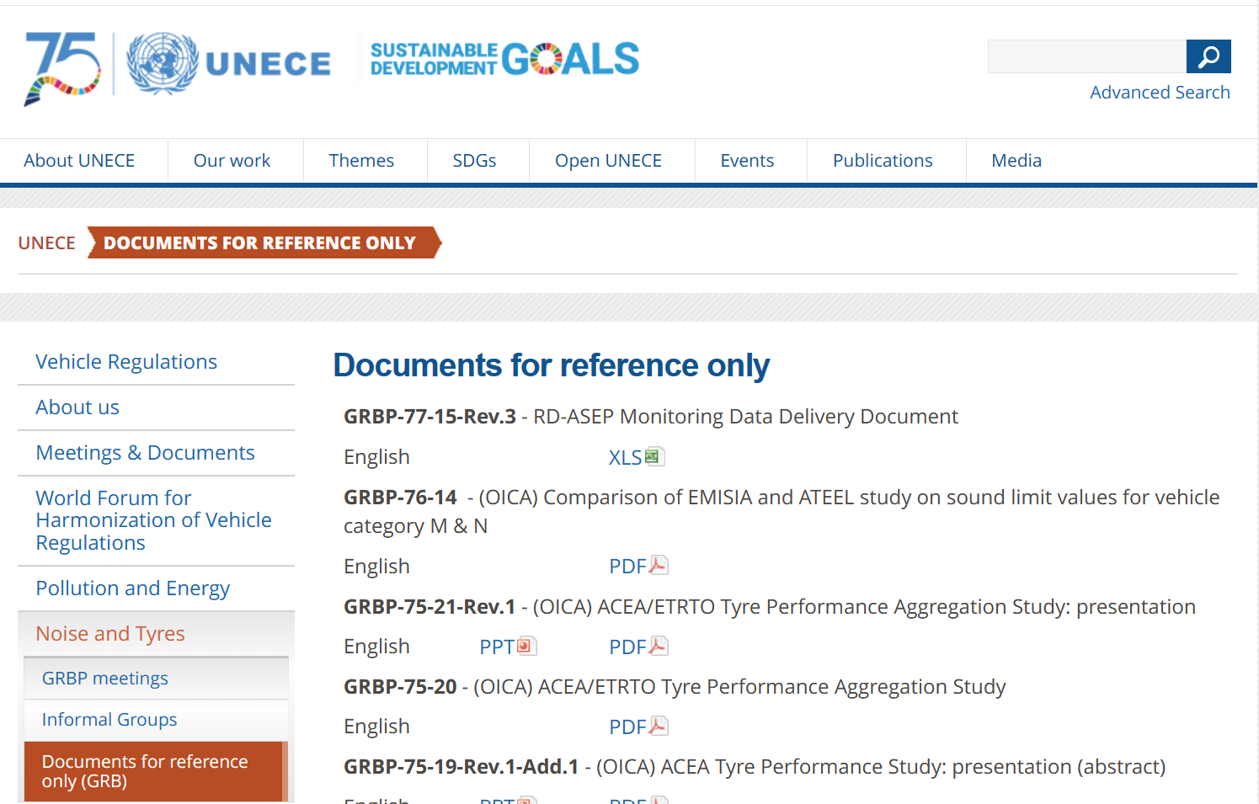
Study on ASEP and RD-ASEP Monitoring
Here you find the RD-ASEP Monitoring Data Delivery Document

Slide 9
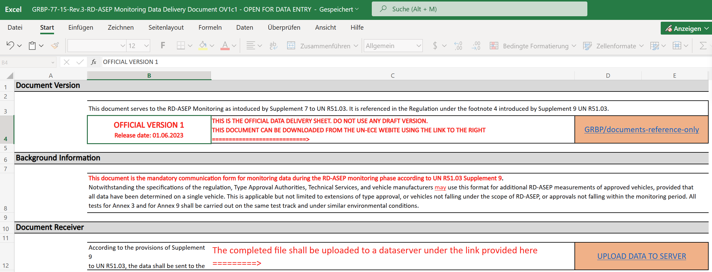
Study on ASEP and RD-ASEP Monitoring
The RD-ASEP Monitoring Data Delivery Document contains the link for data submission
Here is the link to the UTAC server,
where you can upload completed monitoring documents

Slide 10
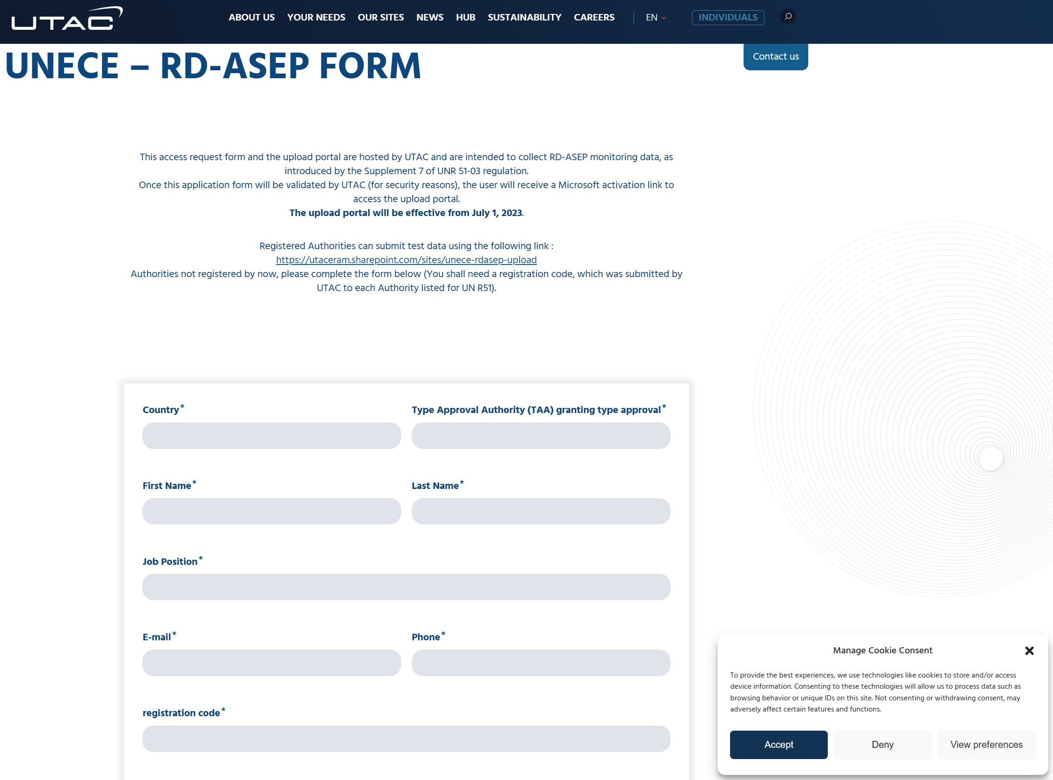
Study on ASEP and RD-ASEP Monitoring
UTAC Website for data submission
Link: https://www.utac.com/unece-rdasep-form/
➔ Type Approval Authorities to submit data
➔ Therefore, each TAA will need registration code from UTAC for data submission.

Slide 11
Study on ASEP and RD-ASEP Monitoring
Work Package 2 timing
Data exchange platform by July’2023 ➔ DONE
Creation of database for Analysis of monitoring data ➔ IN PROGRESS
Data collection ➔ IN PROGRESS
Data analysis ➔ WILL BE STARTED ONCE REASONABLE DATA AMOUNT HAS BEEN COLLECTED
Interim reports are planned for GRBP 79 and 80,
Final report is planned for GRBP 81

