Slide 1
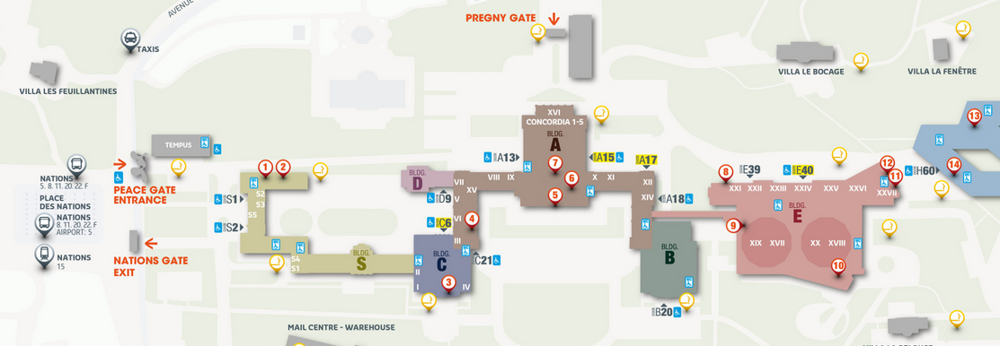
Working Party on Pollution and Energy (GRPE) General information
Note by the secretariat
Informal document GRPE-89-04
89th GRPE, 30 May - 2 June 2023
Agenda item 1
This 89th session
Pregny gate re-opened on 22 May, badges to be collected at Pregny again more info: https://www.ungeneva.org/en/practical-information/delegates
2 Nominations of officers (Chair(s) / Vice-chair(s)) received
Election of officers to take place by acclamation
Badge collection
Entrances
A11
GRPE room

Slide 2
Working Party on Pollution and Energy (GRPE) General information
Note by the secretariat
Informal document GRPE-89-04
89th GRPE, 30 May - 2 June 2023
Agenda item 1
This 89th session
The session is organized as an in-person session. The Special Regime for COVID-19 (list of decisions approved via silence procedure) is lifted since May 2023.

Slide 3
Working Party on Pollution and Energy (GRPE) General information
Note by the secretariat
Informal document GRPE-89-04
89th GRPE, 30 May - 2 June 2023
Agenda item 1
Next sessions
The next (90th) session will be held on 9 - 12 Jan 2024, tbc
For IWG meetings in conjunction with GRPE, please inform secretariat
Proper session to tentatively start on Wednesday 10 Jan morning
The deadline for the submission of official working documents is 17 October 2023
Scheduled as in-person session (unless a sponsor is identified and approval is granted by EXCOM)
Tentative timetable, subject to change
9 Jan : 14:30-17:30
10 - 11 Jan : 9:30-12.30/14:30- 17:30
12 Jan : 9:30-12.30
91st session scheduled from 11-14 June 2024

