Slide 1
WEFE nexus in Central Asia
Gulzada Azhetova
Water & Environment Specialist
November 15, 2022
Notes:
1

Slide 2
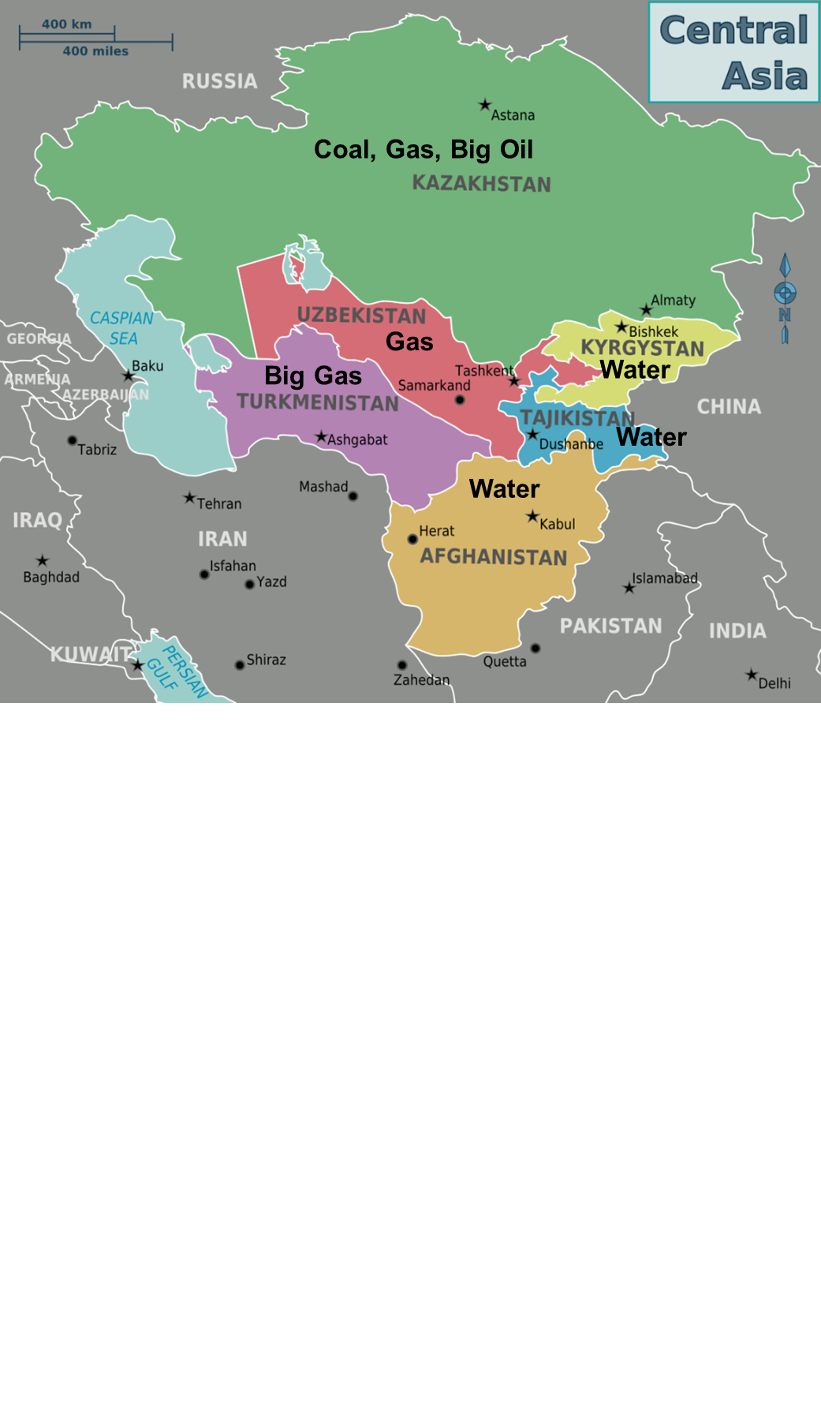
INSERT GRAPHIC TO ADD MAP
MAP IS 6.17” TALL
Notes:
2

Slide 3
Regional Connectivity
Regional Development Cooperation Strategy 2020-2025:
“Enhanced Regional Cooperation on Shared Energy and Water Resources”
Notes:
USAID RDCS 2020-2025 is focused on regional connectivity of Central Asian states which says “Enhanced Regional Cooperation on Shared Energy and Water Resources”. “USAID will help converting issues of water and energy to be compelling reasons for cooperation rather than conflict resulting in more effective and equitable management of these two critical trans-boundary resources”.
3

Slide 4
REGIONAL WATER AND VULNERABLE ENVIRONMENT ACTIVITY
October 2020 - September 2025
$21.5 million
Syr Darya and Amu Darya
All five Central Asian countries
Economic incentives to cooperate (“cost of inaction”)
Notes:
4

Slide 5
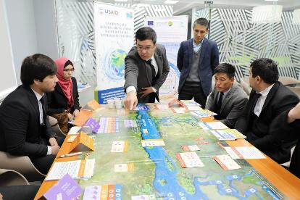
Key technical interventions:
Increase regional networking on education, capacity building, research
Connecting small basin organizations to higher levels
Promote adoption of WEAP/LEAP modeling for better decision making
Improve bilateral.regional cooperation
Notes:
5

Slide 6
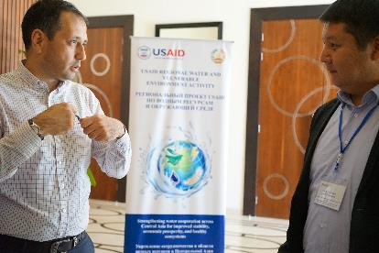
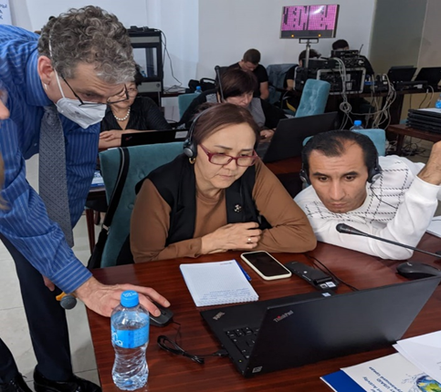
Expected results:
WEFE nexus is included into CA universities’ curricula
Small Basin Councils became sustainable
Bilateral/Regional cooperation on transboundary water management is strengthened
Decision makers use long term modeling scenarios for climate-smart and sustainable water management.
Notes:
6

Slide 7
Opportunities for cooperation
Promoting WEAP and LEAP modeling in Central Asia
http://www.riverbp.net/community_of_practice/
https://www.facebook.com/CentralAsiaForWaterAndEnvironment

Slide 8
Thank you!
Gulzada Azhetova
Water and Environment Specialist
gazhetova@usaid.gov
Economic Development Office
USAID/CA Almaty
+7 771 552 3250
Notes:
8

