Slide 1
FIA Protection Profile for Automated and Connected Vehicles
Gerd Preuss, FIA Representative UNECE 7th GRVA session UNECE Geneva 21 – 25 September 2020
Informal document GRVA-07-41
7th GRVA, 21-25 September 2020
Agenda item 5(a)

Slide 2
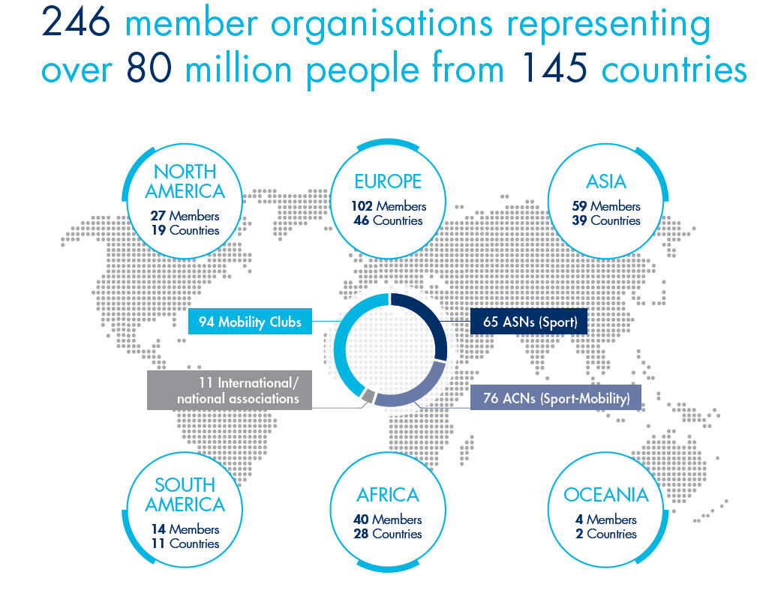
THE FIA: a worldwide presence
Founded in 1904, with headquarters in Paris, the Fédération Internationale de l'Automobile (FIA) is
a non-profit making association.
It brings together 246 national motoring and sporting organisations from 145 countries on five continents.
Its member clubs represent 80 millions of motorists

Slide 3
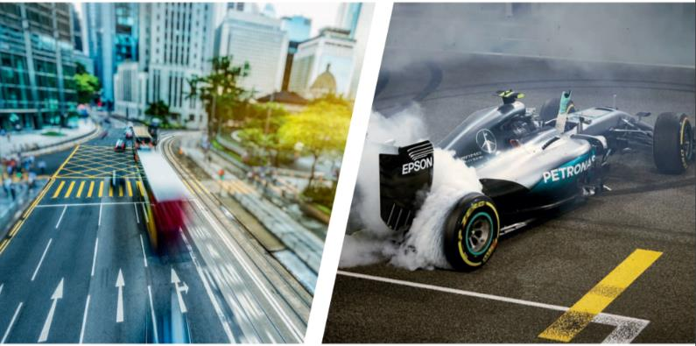
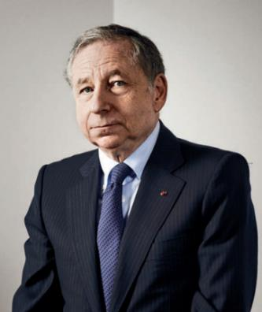
THE FIA: two pillars
SPORT
MOBILITY
Mission: ensures that fair, capably regulated and above all safe events are conducted in all corners of the globe.
Mission: ensure that safe, affordable and clean systems of transport are available to all.

Slide 4
FIA Protection Profile for Automated and Connected Vehicles
FIA proposes to use a common protection profile for the IT security of vehicles
1. FIA developed in cooperation with TÜViT a Protection Profile
Based on consumer views on regulations for automated and connected vehicles, the FIA developed a protection profile for automated and connected vehicles. The document is available as informal document WP.29-181-10.
2. In the Report of its 181th session WP 29 noted: “….WP.29 agreed that this ((WP.29-181-10)) report would be referred to the Working Party on Automated/autonomous and Connected Vehicles (GRVA) as well as other relevant groups.”

Slide 5
FIA Protection Profile for Automated and Connected Vehicles
FIA proposes to use a common protection profile for the IT security of vehicles
1. Why a common protection profile
All vehicles operate in the same environment and in the same traffic situations. The protection profile describes the IT security, risks and threats for the assets in the different traffic situations.
As all vehicles must fulfill the same protection profile, the consumer can be sure to drive vehicles with high IT security, independent from the brand and model
2. A Protection Profile is technology neutral
The protection profile (PP) is used by type approval authorities to check the level of IT security. The PP does not determine the use of a predefined technology. The vehicle manufacturer must fulfil the “Target of Evalulation (TOE)”.
It is up to the individual vehicle manufacturer to build vehicles that meet this TOE

Slide 6
FIA Protection Profile for Automated and Connected Vehicles
FIA proposes to use a common protection profile for the IT security of vehicles
3. Scope of the Protection Profiles
The PP is vaild for components that transfer data and functions from/to the vehicle for Onboard Telematic Platform components These are e.g.
Human Machine Interface
Telecommunication Interface / Docker Station
Automotive Gateway, externally administrated (A-GW Admin) including firewall and authorisation concept
The PP shall not be developed for the whole vehicle or systems, it shall be only applicable for high security key components!

Slide 7
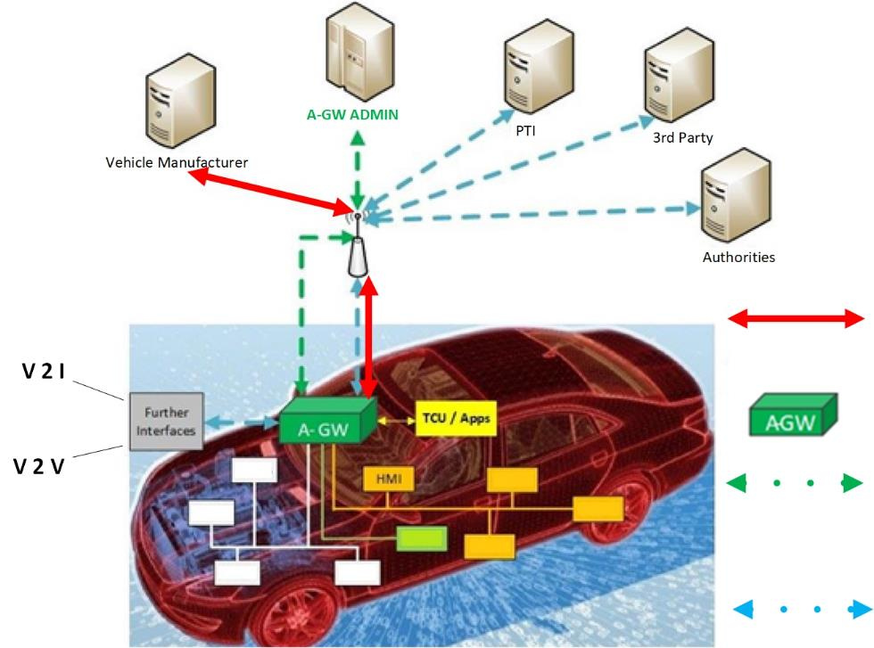
FIA Protection Profile for Automated and Connected Vehicles
A harmonized communication channel can ensure highest IT security over the lifetime,
e.g. an Automotive Gateway (A-GW)
The A-GW covers all use cases of an automated and connected vehicle, such as V2V and V2I as well as remote diagnostics
Software Updates OTA by VM
Harmonised Automotive Gateway, externally administrated (A-GW Admin) including firewall and authorisation concept
Authorisation, Authentication, Certification
Bi-directional transfer of vehicle data and functions, NO software changes

Slide 8
FIA Protection Profile for Automated and Connected Vehicles
FIA proposes to use a common protection profile for the IT security of vehicles
3. Test procedures and Performance Criteria are missing in ECE/TRANS/WP.29/2020/79
“Each Contracting Party applying this Regulation shall notify….other Approval Authorities of the Contracting Parties…about the method and criteria taken …. This information is intended to be shared for the purposes of collection and analysis of the best practices “ ((Taken from ECE/TRANS/WP.29/2020/97, 5.3.2))
The FIA protection profile, would work from Day 1 as a common security target on a high level. The FIA approach is also compatible to ISO 21434.
4. Highest Security and Access to Data for Authorised Stakeholders
FIA commissioned a study on the secure On-Board Telematics Platform conducted by TÜViT as well as the Protection Profile of the Automotive Gateway as one of the key security relevant components in the OTP.

Slide 9
FIA Protection Profile for Automated and Connected Vehicles
What are the advantages for Contracting Parties of a Common Protection Profile
Worldwide harmonised type approval requirements
The protection profile can be used to check the IT security of vehicles, independent from the vehicle manufacturer. It provides clear requirements for type approval authorities
2. The Protection Profile is usable for type approval (1958), but in theory also for self certification (1998)
The protection profile provides to the vehicle manufacturer a detailed description to build secure vehicles. The Target of Evalution can be based on different technologies
3. Lifetime
By using the FIA / TÜViT concept of the Automotive Gateway the simple and secure change of hardware components (HMI, TCU, A-GW) is possible over the lifetime of the vehicle.

Slide 10
FIA Protection Profile for Automated and Connected Vehicles
The Methodology of Common Criteria is already used or in the development of different vehicle regulations
The FIA Protection Profile is based on the PP for C-ITS, which is going to be mandated by EU law in existing EU law. CC Precedencets, e.g. are for Road Works Warning Unit, Cryptographic Service Provider, V2X Hardware Security Module, V2X Transceiver
Digital Tachograph (EU)
Tachograph Card (EU)
Onboard Weighing Unit (Reg (EU) 2019/1213)
Alcohol Interlock (NL)

Slide 11
FIA Protection Profile for Automated and Connected Vehicles
FIA proposes GRVA to start the development of testing and performance criteria for automated and connected vehicles
The FIA protection profile is a contribution to this task

Slide 12
Thank you for your attention

