Slide 1
Informal document GRVA-07-12
7th GRVA session, 21-25 September 2020
Agenda item 7
AEBS-14 /GRVA-07
Justification for 2 Step Approach for AEBS Car to Bicycle

Slide 2
Introduction
The IWG on UN-R 152 (AEBS M1/N1) aims to establish performance requirements for AEBS in a scenario with a bicycle that is crossing the road at 15km/h.
The performance of the AEBS in a scenario with a crossing bicycle depends on the system‘s field of view, which will determine whether the bicycle can be detected in time in order to initiate an Emergency Braking.
Recent EURO NCAP results (AEBS-10-04) show that ca. 70% of all vehicles equipped with a Car2Bicycle AEB today are unable to avoid a collision with a crossing bicycle at vehicle speeds below 30km/h.
In order not to punish these front-runners, who introduced AEBS Car2Bicycle to their vehicles when it wasn‘t even regulated yet, by now requiring extensive re-design to meet these new performance requirements below 30km/h, CLEPA/OICA propose a 2-Step Approach for Car2Bicycle provisions.

Slide 3
AEBS Car to Bicycle scenario
What is the challenge avoiding a collision when travelling below 30km/h?
*
Field of view needed to avoid a collision at 30km/h:
When travelling at 20km/h, a bicycle travelling at 15km/h will be outside the field of view almost up to the collision.
Performance of ca. 70% of AEB Car2Bicycle systems tested in EURO NCAP in 2018/19. (see slide 5)
v=20km/h
Field of view needed to avoid a collision at 20km/h:
Field of view needed to avoid a collision at 20km/h.
Performance of ca. 30% of AEB Car2Bicycle systems tested in EURO NCAP in 2018/19. (see slide 5)
v=20km/h
*Illustration of principle geometric relations, in reality an even larger field of view is required for robust performance (e.g. due to computing time, object classification)

Slide 4
AEBS Car to Bicycle scenario
Why should this be regulated in a 2-Step Approach?
What is the difference between the 1-Step and the 2-Step Approach?
Collision avoidance required for vehicle speed of km/h;
Collision mitigation required for a vehicle speed of km/h
XX
YY
1-Step
approach
=
2-Step
approach
1-Step
approach
2-Step approach
until 09/2028 after 09/2028
20
20
20
20
25
25
25
25
30
30
30
30
30
35
35
35
35
35
40
40
40
40
40
Car2Bicycle first
approved
after 07/2024
45
45
Car2Bicycle approved
before 07/2024
45
45
45
50
50
50
50
50
55
55
55
55
55
60
60
60
60
60
The 1-Step and 2-Step approach will establish the same level of safety of new type approvals after 07/2024.
The 1-Step approach would punish manufacturers who offered Car2Bicycle capabilities early, by forcing them to re-design their systems based on new performance thresholds that were unknown at the time of system development.

Slide 5
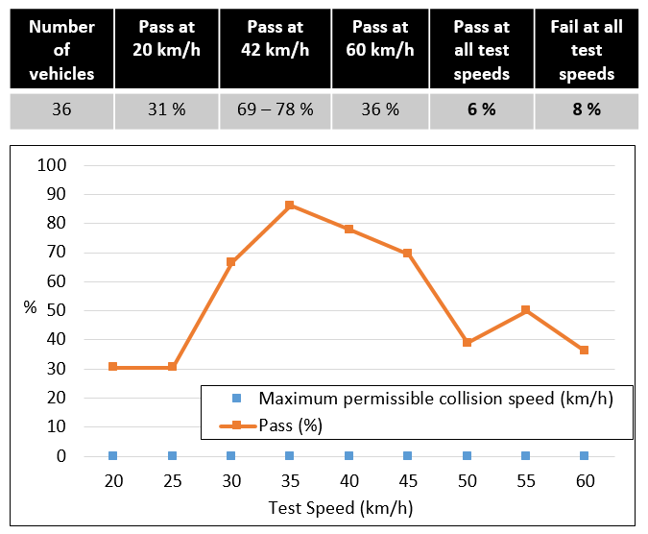
AEBS Car to Bicycle scenario
Why should this be regulated in a 2-Step Approach?
EURO NCAP C2B test results (AEBS-10-04)
Why is this 2-Step Approach necessary and reasonable?
The issue comes with the required collision avoidance at low vehicle speeds.
Whether the AEBS will be able to avoid a collision when travelling at a speed lower or close to that of the target depends the field of view of its sensors.
If the bicycle travels outside of the field of view of the AEB sensors, the system cannot react to it.
In today‘s EURO NCAP results, only ca. 30% of vehicles tested in the Car2Bicycle scenario are capable of avoiding a collision below 30km/h – and this doesn‘t take into account the number of vehicles not even fitted with Car2Bicycle yet.
The field of view cannot be changed through software, it requires new sensors fitted to these vehicles, which usually requires a re-design of the vehicle architecture (e.g. in the form of hardware, communication, software).
These changes require extensive validation testing of all features based on the new sensor input or related to the change in vehicle architecture.
20
25
30
30
35
35
40
40
45
45
50
50
55
55
60
60
Only 30% of vehicles with AEBS C2B tested achieve avoidance at 20km/h, compared to almost 70% at 30km/h.

Slide 6
Summary
The proposed 2-Step Approach will establish the same high performance requirements for vehicles whose AEBS Car2Bicycle is type approved after 07/2024.
While the 1-Step Approach would unnecessarily bind ressources and finance for re-design for existing systems, and thereby prevent future safety innovations with additional benefits to road safety,
The 2-Step Approach will ensure that vehicles that were early on alreadyequipped with AEBS Car2Bicycle will not have to be redesigned towards the end of their lifecycle.

Slide 7
Backup

Slide 8
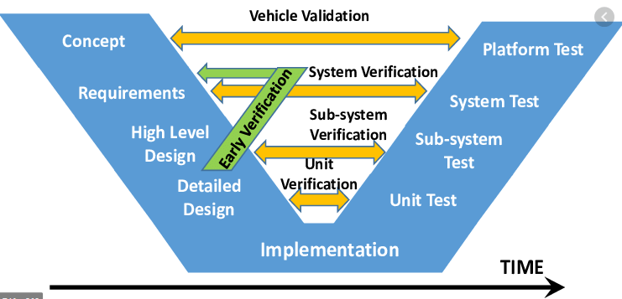
AEBS Car to Bicycle scenario
What would be the required effort to adapt a vehicle to meet the 1-Step Performance requirements between 20 and 30km/h?
What is the likely cause for not achieving collision avoidance between 20-30km/h?
A too narrow field of view of the AEBS sensors fitted to the vehicle.
How can this be solved?
(A) Fit additional sensors to the vehicle, to achieve a wider field of view (e.g. corner radar sensors)
(B) Fit a different sensor to the existing sensor set of the AEBS (e.g. a camera with a wider opening angle)
What changes in the vehicle, if you fit new or different sensors to the vehicle?
These new sensors need to be incorporated into the vehicle architecture, especially the communication system
The vehicle architecture is something that is fixed for a vehicle platform very early during the development cycle, because any changes to it have a potential impact to all ECUs on that communication bus.
This effort to adapt existing vehicle architectures was even acknowledged by the IWG CS/OTA, that decided to not apply new provisions with an impact on vehicle architecture to already existing vehicles.
What is needed for the development of the AEBS functionality?
New sensor input basically means a new development of the entire AEBS functionality
If sensor fusion is applied, this new input needs to be balanced in order to achieve robustness
The performance of the sensor and the overall AEB functionality needs to be validated.
What is needed for the overall vehicle?
Validation of all other systems related to that new input
Example of other systems that depend on camera input and would have to be re-validated if a new camera was fitted to the vehicle:
Lane Departure Warning/Protection Systems
Lane Keeping Assist (UN-R79 ACSF B1)
Lane Change Assist (UN-R79 ACSF C)
AEBS Car2Car, Car2Pedestrian
Risk Mitigation Function
ACC

Slide 9
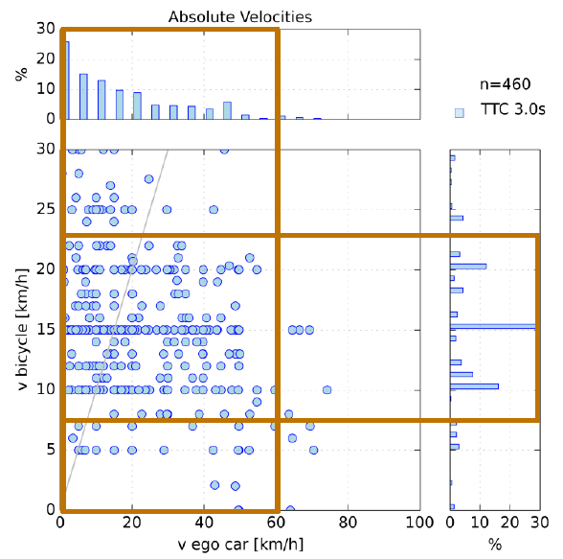
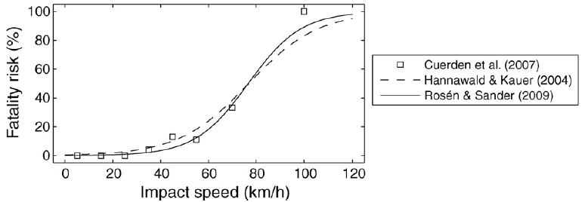
AEBS Car to Bicycle scenario
Impact of the 2 step Approach on road safety
What would be the impact on road safety if a 2-step approach were to be introduced?
Based on GIDAS data more than half of the accidents between a car and a crossing bicycle occur when the bicycle is travelling between 10-15km/h
However, only approx. 15% of these accidents are within the speed range of the car between 20-30km/h
Therefore by adding the speed range between 20-30km/h to the performance requirements on Car2Bicycle AEBS approx. 8% of additional accidents scenarios would be addressed.
These 8% of accidents would be addressed, by vehicles already today fitted with Car2Bicycle AEBS, two years earlier with the 1-Step approach than with the 2-step approach.
Studies by Korea, summarized in AEBS-11-06, also indicated a much greater relevance of impacts with high relative speeds.
Additionally, various studies on fatalities in Car2Pedestrian accident scenarios suggest that the relation between the fatality risk and impact speeds is not linear: lower fatalities at low speeds.
Therefore the tremendous effort to adapt existing vehicles already fitted with AEBS Car2Bicylce complying with the requirements of the 2-step Approach to meet the required performance of the 1-step approach is not proportional compared to the relatively small, temporary benefit on road safety.
Data: German In-Depth Accident Study (GIDAS), 2005-2018. Bicycle crossing nearside (C1)
Studies on Car2Pedestrian accident scenarios show that the fatality risk increases disproportionately with higher impact speeds
(Rosén, Erik, and Ulrich Sander. "Pedestrian fatality risk as a function of car impact speed." Accident Analysis & Prevention 41.3 (2009): 536-542.)

Slide 10
AEBS Car to Bicycle scenario
Geometry of the required opening angle
d₁=v_{Bicycle}*t_{collision}
Bicycle
What’s the geometrical connection between vehicle speed and bicycle speed?
tan α $=$ $\frac{15 km/h}{30 km/h}$ $=$ 0,5 => α ≈ 27°required* opening angle for performance at 30km/h
tan α $=$ $\frac{15 km/h}{20 km/h}$ $=$ 0,75 => α ≈ 37°required* opening angle for performance at 20km/h
d₂=v_{Car}*t_{collision}
$$tan α=\frac{d_{1}}{d_{2}}=\frac{v_{Bicycle}×tcollision}{v_{Vehicle}×tcollision}=\frac{v_{Bicycle}}{v_{Vehicle}}$$
$$α$$
Vehicle
*This is the minimum theoretical value. At anything less the AEBS will physically not be capable of avoiding a collision.
In order to achieve robust behavior an additional 5-10° are needed.

