Slide 1
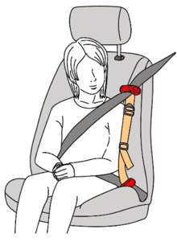
Informal Document GRSP-68-27
68th GRSP, 7-11 December 2020
agenda item 12
SMART KID BELT
Clarification to SKB dynamic test performance

Slide 2
GRSP 7- 11 December 2020
Informal Document GRSP-68-xx
During last year there have been plenty different unsubstantiated allegations towards Smart Kid Belt (SKB):
    Submarining / GRSP-50-09e & GRSP-50-25e
    Vertical Component / GRSP 6520e
    Risk in abdominal part in case of P6 dummy
    Non-compliance with regards to supplement 11
None of the above has been proven

Slide 3
GRSP 7- 11 December 2020
Informal Document GRSP-68-xx
Since all test conducted on P3 and P6 dummies proved SKB excellent performance now we have new issue - P10 dummy.
Type-approval tests for SKB according to UN R44 requirements were conducted by Polish technical service – PIMOT in 2017. Since 2017 the technical service conducted more than 160 tests using P3, P6 and P10 dummies. All with satisfactory results.

Slide 4
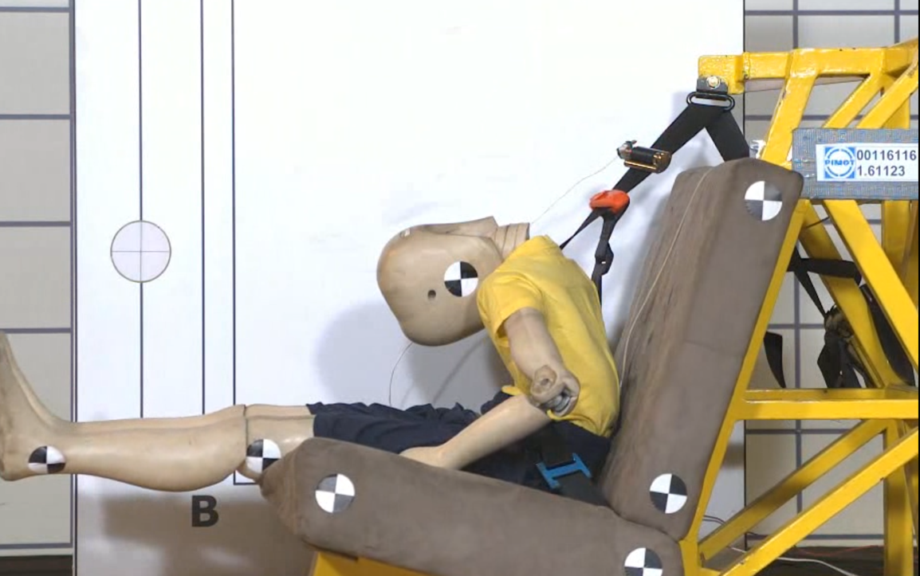
GRSP 7- 11 December 2020
Informal Document GRSP-68-xx
RDW observations in their test has no reflection in SKB’s qualification test conducted by Polish technical service PIMOT.
The lap belt position at the maximum horizontal head excursion
no abdominal penetration

Slide 5
GRSP 7- 11 December 2020
Informal Document GRSP-68-xx
WHY AGAIN 160 CONDUCTED DYNAMIC TESTS RESULTS IN PIMOT ARE BEING UNDERMINED ?
WHY ONLY ONE DUTCH TEST SHALL BE TREATED AS MORE RELIABLE AND SERIOUS THAN OTHERS ?

Slide 6
GRSP 7- 11 December 2020
Informal Document GRSP-68-xx
From December last year we see the need of complex discussion in that subject, but unfortunately that discussion is aimed only at SKB, not other CRS.
As we’ve heard the arguments concerning the limitation of the current test procedure and the used P-dummies in R44 (from the Dutch delegation) and test results obtained in accordance with R44 (from the EC), we think that the discussion should also cover the existing requirements of R44.
Verification tests conducted by European Commission are concluded in official reports, which haven’t been discussed with other EU Member States yet. The subject will be discussed during next Forum meeting.

Slide 7
GRSP 7- 11 December 2020
Informal Document GRSP-68-xx
Even independent research conducted with accordance to new enhanced regulation R129 clearly proved excellent performance of this new innovative CRS

Slide 8
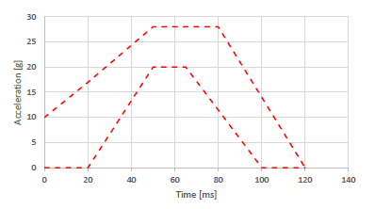
GRSP 7- 11 December 2020
Informal Document GRSP-68-xx
The sensors were registered by the following parameters:
- the test trolley acceleration,
- dummy’s head acceleration, where the maximum value may not exceed 80g for the Q6 head cumulative 3 ms value,
- dummy’s chest acceleration, where the maximum value may not exceed 55g for the Q6 chest cumulative 3 ms value,
- the forces and bending moment in the upper part of the cervical spine,
- deflection of the dummy torso,
- pressure in the left and right abdominal sections of the dummy.
Figure 1 Description of the acceleration cure of the test trolley

Slide 9
GRSP 7- 11 December 2020
Informal Document GRSP-68-xx
For all tested devices the data was shown inline charts. For additional visualization, all characteristic values had been compared into bar charts.
Figure 2 Chest Resultant Acceleration for all CRS tested
Figure 3 Chest Resultant Acceleration for all CRS tested regarding the maximum limit

Slide 10
GRSP 7- 11 December 2020
Informal Document GRSP-68-xx
Figure 4 Head Resultant Acceleration for all tested devices
Figure 5 Head Resultant Acceleration for all tested devices regarding the maximum limit

Slide 11
GRSP 7- 11 December 2020
Informal Document GRSP-68-xx
Figure 6 Upper neck force for all tested devices

Slide 12
GRSP 7- 11 December 2020
Informal Document GRSP-68-xx
Figure 8 Right abdominal pressure for all tested devices regarding the maximum limit
Figure 9 Left abdominal pressure for all tested devices regarding the maximum limit

Slide 13
GRSP 7- 11 December 2020
Informal Document GRSP-68-xx
Based on our evaluation of the test results, it can be seen that the safety criteria pointed in Regulation No. 129 have been met for almost all tested restraint devices (except for abdominal pressure in one of the tested solutions).
However, the analysis of recorded data and individual values of physical quantities perfectly show significant differences between each solution.
Based on the results from IDIADA, it can be concluded that the Smart Kid Belt can be considered as a safe forward-facing CRS. The system performed very well when tested in terms of all safety parameters and we could not observe any risk factor indicated by some GRSP participants.

Slide 14
GRSP 7- 11 December 2020
Informal Document GRSP-68-xx
Type Approval tests of Smart Kid Belt carried out in Pimot Vehicle Safety Laboratory with accordance to UN ECE Regulation No.44 did not show the lap belt passing fully beyond the pelvic structure and penetrating the abdomen before reaching maximum horizontal head excursion (figure 10).
Figure 10 The lap belt position at the maximum horizontal head excursion

Slide 15
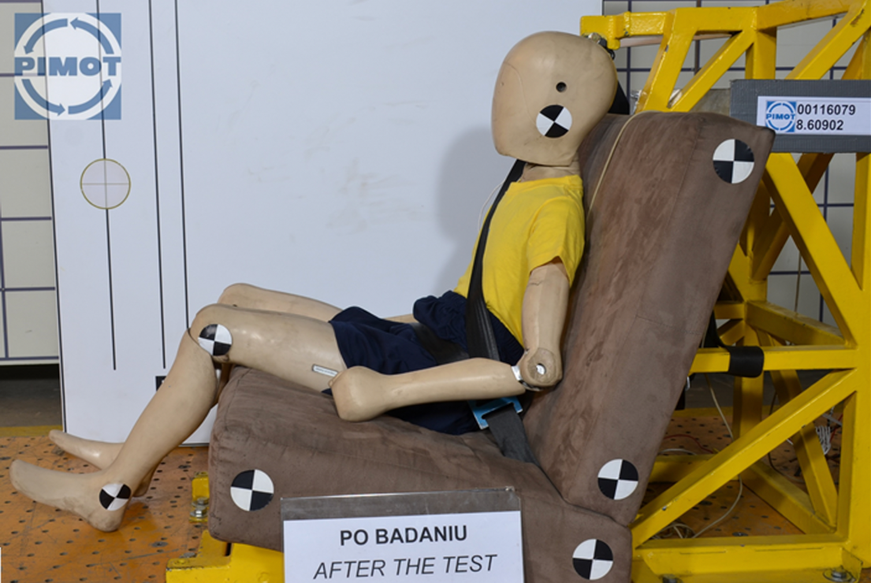
GRSP 7- 11 December 2020
Informal Document GRSP-68-xx
Photo after the test (Fig 11) clearly shows that lap belt did not pass fully beyond the pelvic structure and did not penetrate into abdomen before reaching maximum horizontal head excursion.
Figure 11 The lap belt position after the test

Slide 16
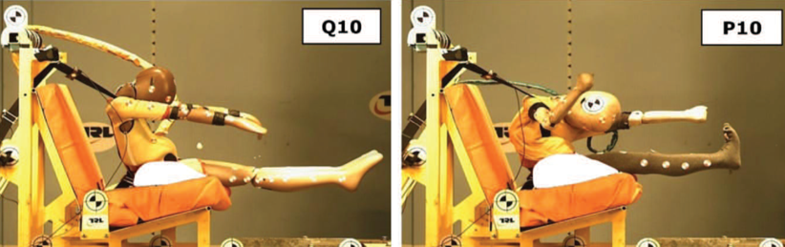
GRSP 7- 11 December 2020
Informal Document GRSP-68-xx
With reference to CRS 46 document findings, we can see clear difference in P10 dummy behavior vs. new Q10
The belt remains on the shoulder of Q10, which is restrained by the adult belt, resulting in a more symmetrical arm and leg movement. Whereas the P10 does not interact well with the 3-point belt, the belt slips off the shoulder and down the upper arm. This results in the upper torso of the P10 twisting as the belt restraints the dummy.
Figure 10 shows the typical kinematics of the Q10 and P10 at the point of the maximum head excursion. The Q10 kinematics is more representative of a real child.
The Q10 torso remains more upright, whereas the P10 dummy bends towards its leg; very much the same pattern of movement seen in the booster seat testing.
As the Q10 torso remains more upright during the impact, the child restraint is compressed further down into the test bench cushion, compared to the P10 on the same booster cushion.
Figure 12 Example positions of maximum head excursion during impact for the Q10 and P10 dummy

Slide 17
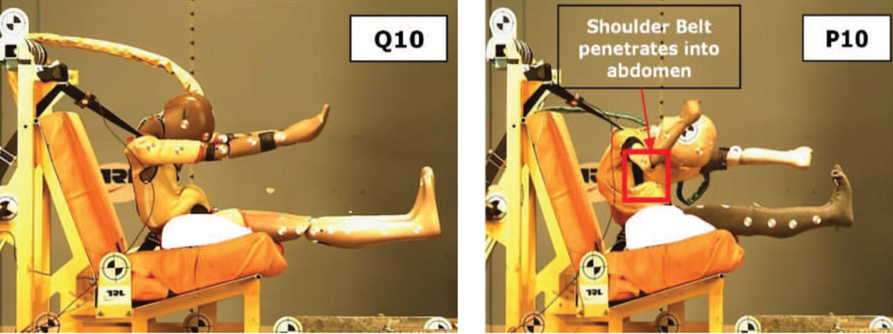
GRSP 7- 11 December 2020
Informal Document GRSP-68-xx
Another perfect example of P10 abnormal behavior vs. Q10 dummy.
The shoulder belt also penetrates the top of the abdomen insert of the P10 (Figure 13). In contrast, the Q10 abdomen bulges, and in some cases the shoulder belt may slip under the ribs at the top of the abdomen; this can cause the abdomen to insert to be displaced. The shoulder belt becoming trapped in the dummy occurred more often and to a greater extent in the tests with the P10. However, it is thought that this belt trapping in either dummy would not occur in a real child.
Figure 13 Images depicting seat belt interaction with the Q10 and P10 dummy

Slide 18
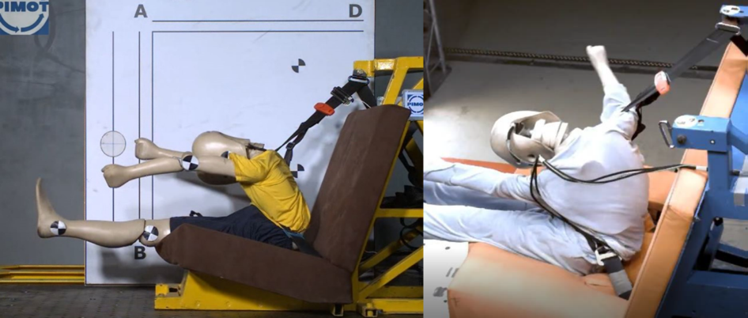
GRSP 7- 11 December 2020
Informal Document GRSP-68-xx
In the test included in document 20201110 EC SmartKidBelt_HL, for unknown reasons, the position of the dummy differs from that of the Pimot - the dummy is positioned asymmetrically at the moment of delay, which may have been the reason for the inappropriate fastening of the Smart Kid Belt device. Moreover, as mentioned earlier, the use of the P10 dummy is unreliable in comparison to Q10 due to structural differences.
Figure 14 On the left side, the dummy behaves symmetrically at the moment of delay, on the right side, asymmetrically

Slide 19
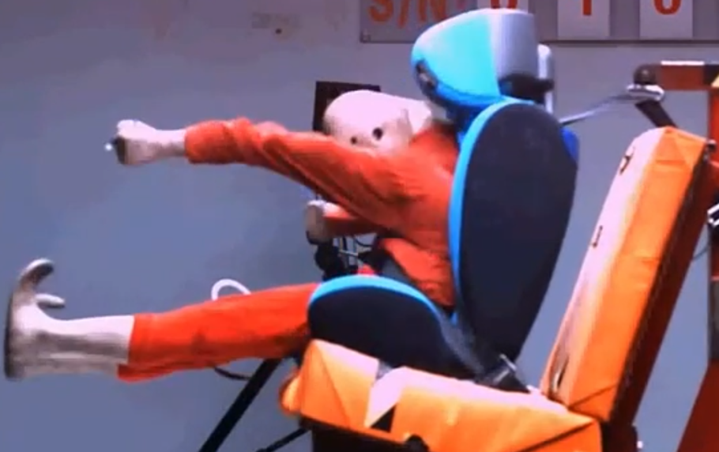
GRSP 7- 11 December 2020
Informal Document GRSP-68-xx
Example of standard CRS performance with 10yo dummy
Figure 16 Lap belt position before the point of maximum head excursion

Slide 20
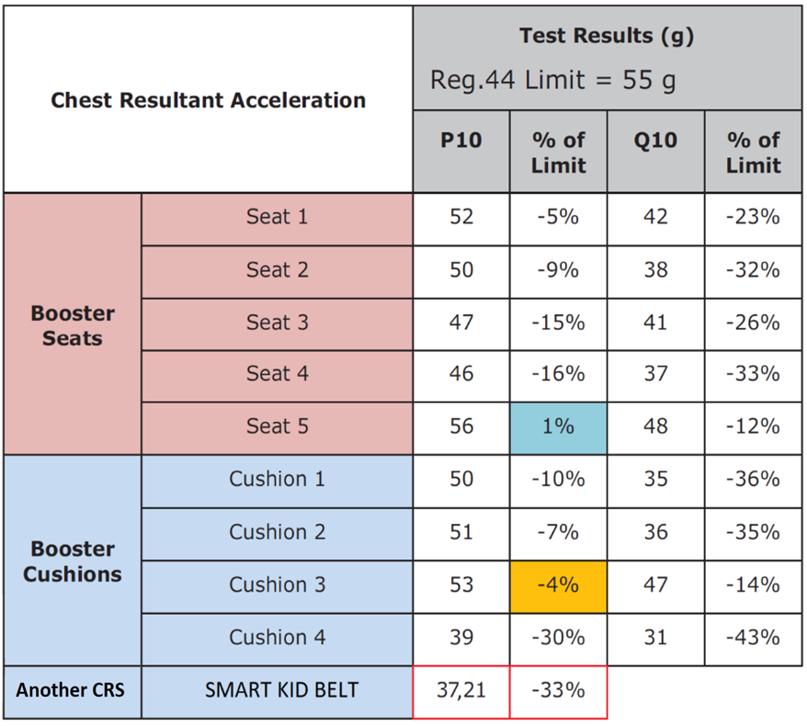
GRSP 7- 11 December 2020
Informal Document GRSP-68-xx
CONCLUSIONS:
According to the EEVC Report – Advanced Child Dummies and Injury Criteria for Frontal Impact, there is a big difference in results between P10 and Q10 dummy.
Comparison of the Q10 with the P10 in UN R44 testing showed that the kinematics of both dummies are significantly different. Due to the thorax and shoulder design of the Q10, the interaction with the adult belt is different from the P10 dummy, which tends to slide out of the belt. This results in a difference in measured loading between the two dummies.

Slide 21
GRSP 7- 11 December 2020
Informal Document GRSP-68-xx
THANK YOU

