Slide 1
Braxx Smart Kid Belt
Informal document GRSP-68-24
7 - 11 December 2020
Agenda item 9
Non-compliance with ECE R44.04

Slide 2
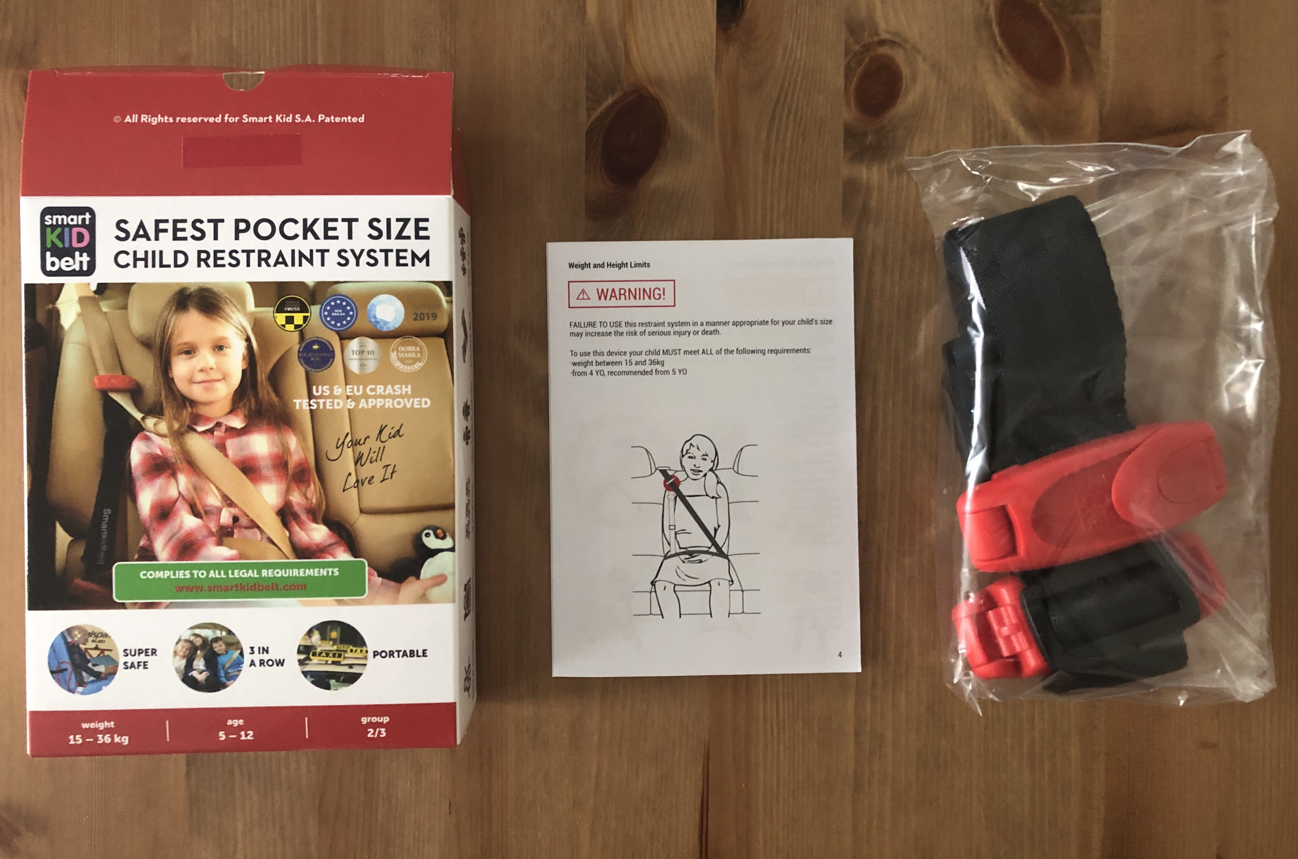
Background
Several countries have raised concerns in GRSP since Poland issued an approval in 2017 according to ECE R44.04 for the “Braxx Smart Kid Belt” as universal child restraint system Group II and III.
It concerns a guide strap, which is connecting the adult shoulder belt to the lap belt
During GRSP-67, held in July 2020, the Netherlands presented GRSP-67-05e, with an overview of the requirements under ECE R44.04 that this device does not meet (http://www.unece.org/fileadmin/DAM/trans/doc/2020/wp29grsp/GRSP-67-05e.pdf)
GRSP-68-xx

Slide 3
Background
NL issues with testing performed:
Hybrid II 6yo dummy was used instead of P6 dummy. Completely different dummy which will give different results than P6. Lack of abdominal clay will make the assessment of possible injuries impossible.
Test with P10 dummy performed with the testfloor in raised position. This position is only meant to be used for CRS using a support leg
PL responded by document GRSP-67-32e (http://www.unece.org/fileadmin/DAM/trans/doc/2020/wp29grsp/GRSP-67-32e.pdf)
GRSP-68-xx

Slide 4
Additional Testing
NL is not satisfied with the explanations given in this document and during the meeting
NL decided to conduct additional testing using P6 and P10 dummy
Testing is carried out by TASS in Helmond, assigned E1/E4 Technical Service for Child Restraint Systems.
Test report number TASS: 20ExpH07754001-39206-2 dated 20 October 2020
GRSP-68-xx

Slide 5
Additional Testing
4 tests carried out:
H07754001001: P6 dummy with SKB
H07754001002: P6 dummy only
H07754001003: P10 dummy with SKB
H07754001004: P10 dummy only
GRSP-68-xx

Slide 6
Conclusions
Test H07754001003 (P10 dummy) failed section 7.1.4.3.; TASS stated the following: “High speed movies show the lap belt passing fully beyond the pelvic structure and penetrating the abdomen prior to reaching maximum horizontal head excursion. The lap belt passing the pelvic structure is considered to be a failure according par. 6.2.2.2.”
The slipping of the belt towards the abdominal area starts at the buckle side and is caused by the lack of positive guidance. (For comparison: properly designed booster seats, hold the lap belt in place and thus prevent abdominal penetration)
All 4 tests (dummies with and without SKB) meet the dynamic performance criteria; this shows the limitation of the test procedure and the used P-dummies rather than the quality of the product.
Meeting (part of) the dynamic test conditions, does not overrule having to meet other static requirements.
GRSP-68-xx

Slide 7
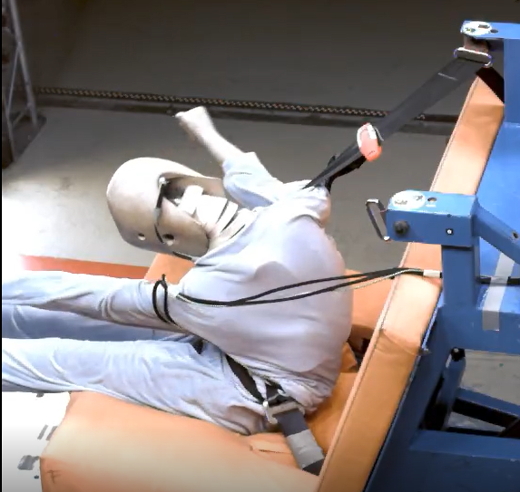
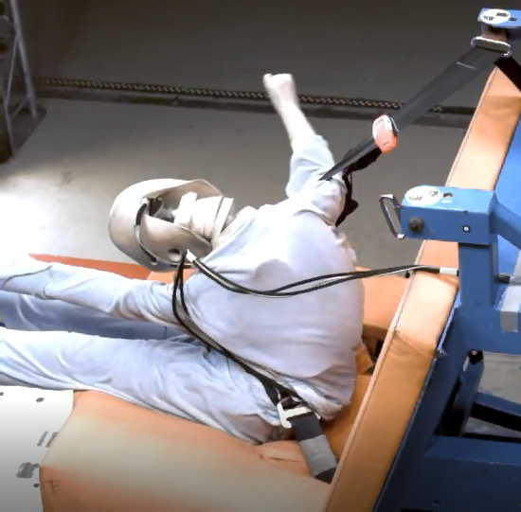
Conclusions
P10 with SKB after 95 ms (just before belt slipping)
P10 with SKB after 105 ms (right after belt slipping)
Additional testing has confirmed the major concerns raised in document GRSP-67-05e and highlights the sensitivity of this product that may result in abdominal injuries.
Conclusions drawn in document GRSP-67-05e are herewith further underlined.
GRSP-68-xx

Slide 8
Conclusions GRSP-67-05e
This device is out of scope of ECE R44 and therefore approval should not have been granted
This device does not meet a number of requirements, both technical and with regard to instructions for users and therefore approval should not have been granted
The manufacturer suggests that this device offers a level of protection similar to a child restraint and indicates it can be used for each and every type of vehicle (universal). The car design determines the level of protection for a great deal and might result in submarining and injuries in the abdominal area, since the device sold as a child restraint does not offer any protection or guidance in this area. At best, this device offers better protection than the adult belt itself, but lacks the additional protection of a child restraint system.
Since approval of this device was issued erroneously, it shall be withdrawn and Market Surveillance Authorities shall be informed.
GRSP-68-xx

Slide 9
Way forward
EU Commission started investigation on the Smart Kid Belt.
First results were presented in EU Forum meeting d.d. 10 November 2020
Results are in line with NL results
Hopefully the issue can be resolved within EU Forum. NL will await the outcome of the discussion within the EU
If no satisfactory conclusion is reached, NL will continue to follow Schedule 6 of 1958 Agreement and ask the GRSP chair to start the arbitration process
GRSP-68-xx

Slide 10
Thank you for your attention
GRSP-68-xx

