Slide 1
EXPLANATORY PRESENTATION TO CLEPA NECK LOAD LIMITS PROPOSAL
Informal document GRSP-68-10
68th GRSP, 07-11 Dec. 2020
Agenda item 12
Submitted by the experts from CLEPA
68th session of GRSP, 07 - 11th December 2020

Slide 2
BACKGROUND
ECE/TRANS/WP.29/GRSP/2019/19 proposed chest vertical acceleration limits for Q0, Q1 and Q1.5 dummies
Justification was potential for increased neck loading in rear-facing CRS with a supine seating position
R129 requires tensile neck force and flexion moment to be measured for monitoring only
GRSP deferred discussion to allow analysis of neck loads collected during R129 type-approvals
Data provided by UK(VCA), Spain and CLEPA

Slide 3
ANALYSIS METHOD
Overview
UK, Spain and CLEPA samples combined: 49 CRS = 471 tests
Data separated for each dummy by impact direction and CRS orientation
Worst-case condition identified for each dummy
Statistical analyses carried out (95th percentile; Mean+2SD)
Limits proposed based on statistical analyses and outliers

Slide 4
ANALYSIS METHOD
Caveats
SAE J211 sign convention may not have been used in all tests in VCA sample (especially flexion moment)
Timing of peak value is unknown and may have been generated in rebound (especially flexion moment)
UK, Spain and CLEPA samples may not be representative of the wider CRS market
Any limits are pragmatic and their relationship to real-world injury risk is unknown

Slide 5
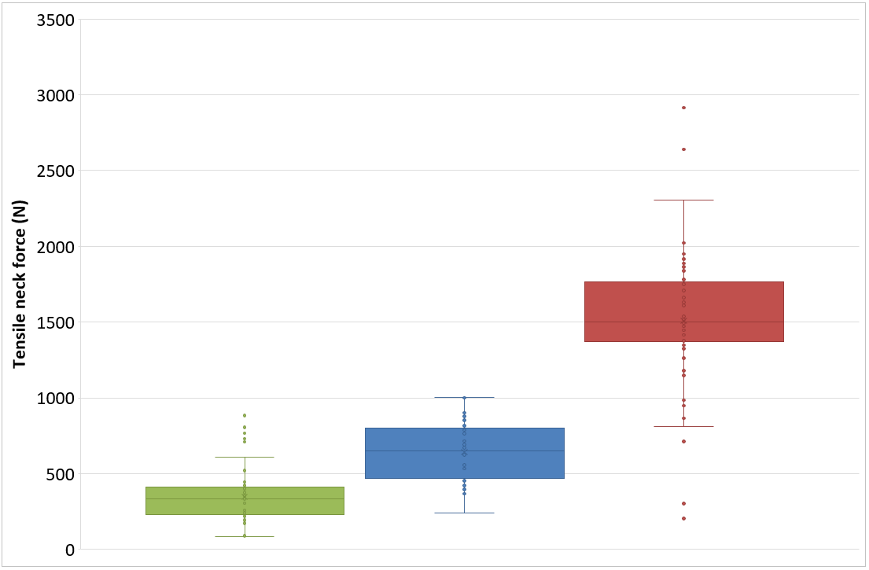
PROPOSAL
Tensile neck force
 | Q0
 | Q1
 | Q1.5
Dummy | 95th %ile | Mean + (2*SD) | Limit proposal
Q0 | 720 | 670 | [700] N
Q1 | 905 | 1018 | [950] N
Q1.5 | 2,122 | 2,443 | [2,300] N
With upper outliers removed*:
Q1.5 | 1,931 | 2,261 | [2,000] N
2,000 N
950 N
700 N
* CLEPA-Japan discussion – 26.11.20
n = 71
n = 40
n = 54

Slide 6
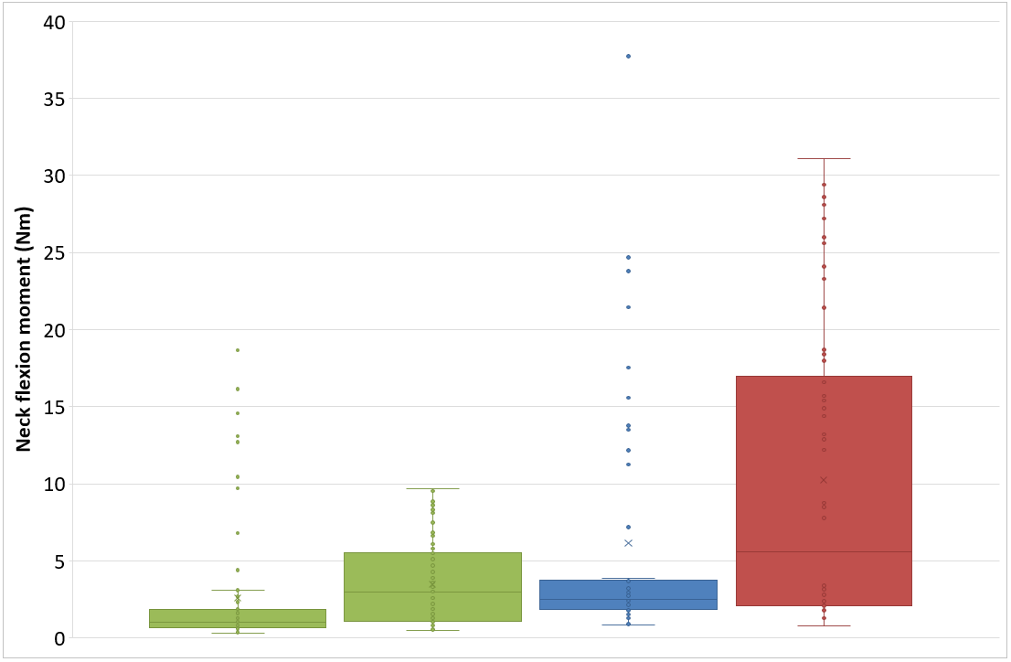
PROPOSAL
Neck flexion moment
 | Q0
 | Q1
 | Q1.5
Dummy | 95th %ile | Mean + (2*SD) | Limit proposal
Q0* | 13.0 | 10.8 | [10] Nm
 | 8.7 | 8.8
Q1 | 23.7 | 23.3 | [20] Nm
Q1.5 | 28.3 | 29.5 | [30] Nm
30 Nm
20 Nm
10 Nm
* Worst-case is unclear for Q0 dummy
n = 86
n =71
n = 62
n = 54

Slide 7
MOVING FORWARD
The analysis and limits presented here are work-in-progress based on samples from UK, Spain and CLEPA only (49 CRS)
Can other Contracting Parties provide their anonymised monitoring data to support our analysis and confirm the proposed limits?
CLEPA proposes to defer a decision until May 2021 with the understanding that further monitoring data will be provided

Slide 8
MANY THANKS FOR YOUR ATTENTION Acknowledgements: Vehicle Certification Agency (VCA) & UK Department for Transport Ministry of Industry, Commerce and Tourism, Spain & IDIADA CLEPA Secretariat
Informal document GRSP-68-XX
68th GRSP, 07-11 Dec 2020
Agenda item 12

