Slide 1

Submitted by the expert from Republic of Korea
Informal document GRSP-68-06
(68th GRSP, 7-11 Dec. 2020, agenda item 15)
KNCAP results of Micro-Mobility
(L7 Category vehicles)

Slide 2
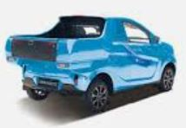
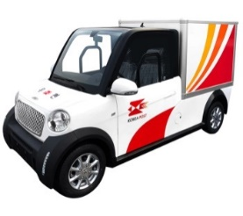
Statistics of Micro-Mobility in Korea
Statistics of Micro-Mobility in Korea
Registration : 6,678 vehicles (As of 28.Oct. 2020)
From Spain, China, Domestic (7 Manufacturers, all electronic vehicles)
Dimensions and Vehicle Type under the Korean Safety Requirements
Dimensions :
- Length : 3.6m or less
- Width : 1.5m or less
- Height : 2.0m or less
EU
- L : 3.7m or less
- W: 1.5m or less
- H : 2.5m or less
India
- L : 3.0m or less
- W: 1.5m or less
- H : 2.5m or less
Vehicle Type : passenger vehicle(600kg or less), vehicle for the carriage of goods(750kg or less)
<Passenger vehicles>
<Freight vehicles>
2p

Slide 3
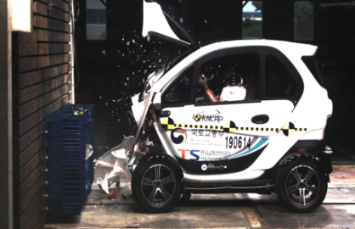
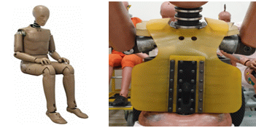
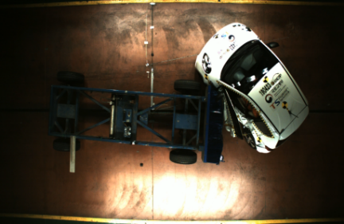
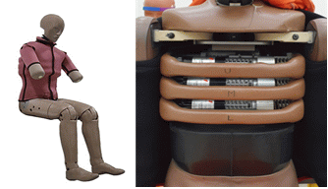
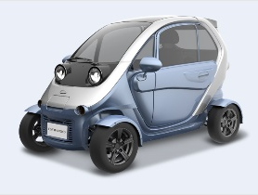
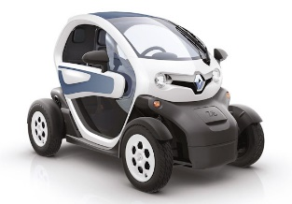
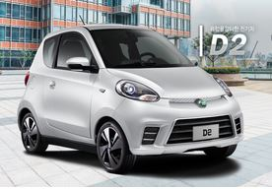
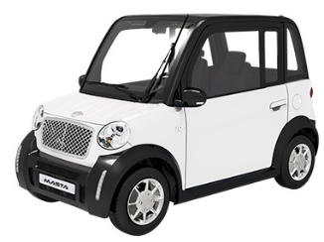
KNCAP for Micro-Mobility(2019)
KNCAP Test for Micro-Mobility (Euro NCAP Test protocols)
Test : Frontal and Side impact Test (50km/h), 50%ile Hybrid III & ESII
<Frontal impact Test (50km/h), 50%ile Hybrid III >
< Side impact Test (50km/h), ESII >
Test vehicle : 4 models
Vehicle Type | Domestic (1 models) | Foreign(3 models)
Passenger vehicle
<Case 1>
<Case 2>
<Case 3>
<Case 4>
3p

Slide 4
KNCAP for Micro-Mobility(2019)
Overall rating Calculation (Euro NCAP Test protocols)
Overall weighted score : 100×(3× Frontal integer + Side integer)/64 = % overall score
Rating bands (%)
★★★★★ | 75-100
★★★★ | 60-74.9
★★★ | 45-59.9
★★ | 35-44.9
★ | 25-34.9
- | 0-24.9
Body Regions assessed in Frontal Impact
Body Regions assessed in Side Impact
Head : 4 point
Neck : 4 point
Chest : 4 Point
Knee & Femur : 4 point
Head : 4 point
Chest : 4 Point
Abdomen : 4 point
Pelvis : 4 point
4p

Slide 5
KNCAP for Micro-Mobility(2019)
KNCAP Overall rating Results
Vehicle Type |  | Overall Rating | Star Rating | Frontal | Side
Domestic | Case 1 | 27 | ★ | 5 | 2
Foreign | Case 2 | 39 | ★★ | 7 | 4
 | Case 3 | 36 | ★★ | 5 | 8
 | Case 4 | 11 | - | 0 | 7
Comparison with other types in KNCAP
Passenger Vehicle Type | Overall Rating | Star Rating | Frontal ( )/16 | Side ( )/16
Small-Size | 95.9 | ★★★★★ | 15.5 | 14.9
Middle-size | 94.1 | ★★★★★ | 15.3 | 14.3
Micro-Mobility(L7 category) | 28.3 | ★★ | 4.3 | 5.3
Average Overall Rating(%)
Average Rating of each impact test
Frontal Impact
Side Impact
Micro-Mobility
Small-size
Middle-size
Micro-
Mobility
Small&
Middle -size
Micro-
Mobility
Small&
Middle -size
5p

Slide 6
KNCAP for Micro-Mobility(2019)
Frontal Impact Test Results
6p

Slide 7
KNCAP for Micro-Mobility(2019)
Side Impact Test Results
7p

Slide 8
KNCAP for Micro-Mobility(2019)
Comparison with Euro-NCAP
Motorcycle to Vehicle impact test
Overall Rating for Crash Safety
- Test velocity : 50km/h side impact to B-pillar
- Dummy : 50%ile wearing helmet
- Measuring HIC(head, neck, Chest deflect.)
 | Test results | FMVSS 208 | UN R137
Head(HIC) | 1,105 | 1,000 | 1,000
Neck(Nij) | 0.53 | 1.00 | -
Chest(Deflection) | 24.2 | 62.0 | 42.0
Combined Probability of Injury | 36% | - | -
Comparison of CPI*
* Combined Probability of Injury
 |  | Micro-Mobility CPI(Star rating) | Motorcycle CPI
Domestic | Case 1 | 44% (★) | 36%
Foreign | Case 2 | 26% (★★)
 | Case 3 | 24% (★★)
 | Case 4 | 66%(-)
8p

Slide 9
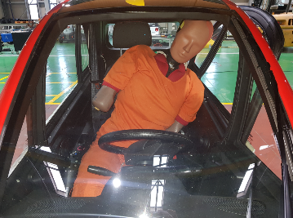
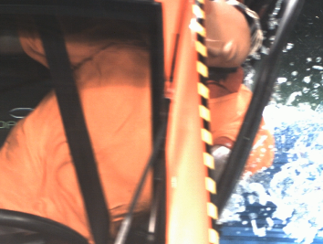
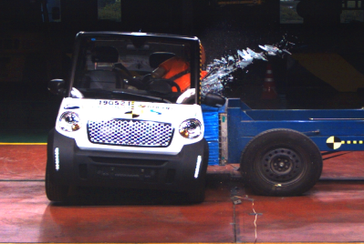

KNCAP for Micr- Mobility(2019)
Test Results on Electrical Safety of High voltage system
After impact test*, Check the safety insulation & prevention against electrical shock
* Frontal : 48.3km/h, Side : 50km/h
Vehicle Type |  | Frontal | Side
Domestic | Case 1 | Pass | Pass
Foreign | Case 2 | Pass | Pass
 | Case 3 | Pass | Pass
 | Case 4 | Pass | Pass
Test pictures
-Side Impact
< Case 1, 4 : Release Belt, Separate Head & Torso >
< Case 3 Door open >
9p

Slide 10
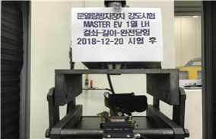
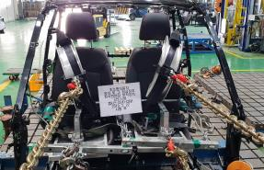
Other Tests for Micro-Mobility
Other Tests : All Pass
Door latch & hinge : similar to UN R11, apply about 80% of load
Applied Load | Striker & Latch (direction) | Hinge (direction)
UN R11 | 1,130 kg (Vertical) 905 kg (Width) | 1,130 kg (Longitudinal) 905 kg (Width)
Korean Requirements | 910 kg (Vertical) 730 kg (Width) | 910 kg (Longitudinal) 905 kg (Width)
Seatbelt Anchorage
< Door Hinge Test>
2 points-seatbelt : 1,820kg (0.2s or more)
3 points-seatbelt : 1,100kg (0.2s or more at pelvic & torso)
Applied Load | 2 points-seatbelt | 3 points-seatbelt
UN R14 (Seatbelt anchorage) | 2,270 kg (pelvic) | 1,360 kg (pelvic & torso)
Korean Requirement | 1,820 kg (pelvic) | 1,100 kg (pelvic & torso)
< Seatbelt Anchorage Test>
Seat Anchorage
Applied load : 20 times of seat weight
Electrical Safety of high voltage system
After collision test*, Check the safety insulation & prevention against electrical shock
* Frontal : 48.3km/h, Rear : 48.3km/h, Lateral : 50km/h
10p

Slide 11
Conclusions
Frontal & Side impact tests were performed using Euro-NCAP Heavy-Quadricycles Assessment Protocol in 2019
Overall Rating was 1~2 stars(Ave. 28.3%),
Compare with small & medium passenger vehicles(95%), 30% of those of vehicles.
CPI of 2 models of all test vehicles was low than that of motorcycle
It would be difficult to make new impact test requirements for Micro-Mobility to ensure crash safety as equivalent level with small passenger vehicles at this moment, More consideration would be needed
It was confirmed Micro-Mobility can comply with other requirements in KMVSS such as Door latch, Seat & seatbelt anchorage and electrical safety after impact
GRSP would consider to make some requirements for major components of Micro-Mobility as a first step
11p

Slide 12
Thank you for your attention
12p

