Slide 1



Moving Off Information Signal (MOIS) Regulation
Overview of Regulation Proposed by VRU-Proxi IWG
GRSG-118
Informal document GRSG-118-36
(118th GRSG, 15-17 July2020,
Agenda item 5)
16th July 2020

Slide 2
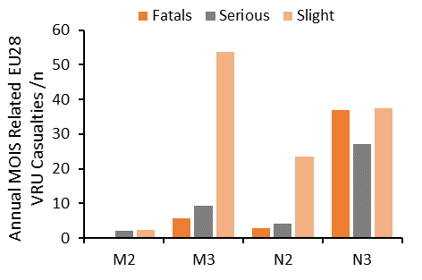
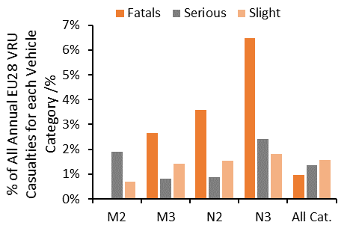
Collision Scenarios to be Addressed
Characteristics of Moving Off from Rest Collisions
A substantial number of VRUs are involved in collisions with heavy vehicles moving off from rest (~£98M /year)
More severe consequences for heavier (M2/M3/N2/N3) vehicles, compared to light vehicles
Key VRUs involved include pedestrians and cyclists
Key collision scenarios characteristics include:
  Crossing VRU: VRU (ped/cyclist) crossing in front of stationary heavy vehicle which subsequently moves off from rest
  Longitudinal cyclist: Cyclist located in carriageway in front of stationary heavy vehicle with heavy vehicle either moving off before or at same time as (but faster than) cyclist
  Blind spots: VRUs “located in vehicle blind spot” at critical point in time in 30% of MOIS related collisions
  Driver looked but didn’t see: Driver “failed to look properly” at critical point in time in 49% of MOIS related collisions

Slide 3
Collision Scenarios to be Addressed
Characteristics of Moving Off from Rest Collisions
A substantial number of VRUs are involved in collisions with heavy vehicles moving off from rest (~£98M /year)
More severe consequences for heavier (M2/M3/N2/N3) vehicles, compared to light vehicles
Key VRUs involved include pedestrians and cyclists
Key collision scenarios characteristics include:
  Crossing VRU: VRU (ped/cyclist) crossing in front of stationary heavy vehicle which subsequently moves off from rest
  Longitudinal cyclist: Cyclist located in carriageway in front of stationary heavy vehicle with heavy vehicle either moving off before or at same time as (but faster than) cyclist
  Blind spots: VRUs “located in vehicle blind spot” at critical point in time in 30% of MOIS related collisions
  Driver looked but didn’t see: Driver “failed to look properly” at critical point in time in 49% of MOIS related collisions

Slide 4
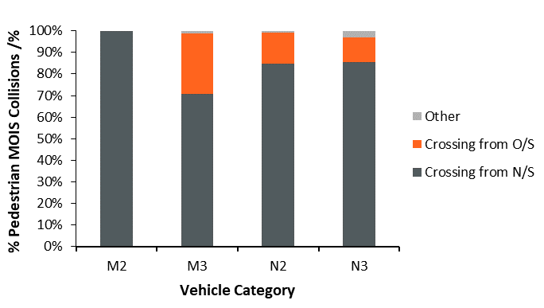
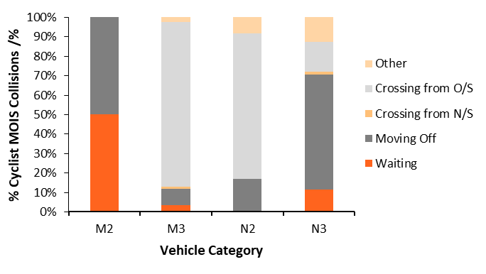
Collision Scenarios to be Addressed
Characteristics of Moving Off from Rest Collisions
A substantial number of VRUs are involved in collisions with heavy vehicles moving off from rest (~£98M /year)
More severe consequences for heavier (M2/M3/N2/N3) vehicles, compared to light vehicles
Key VRUs involved include pedestrians and cyclists
Key collision scenarios characteristics include:
  Crossing VRU: VRU (ped/cyclist) crossing in front of stationary heavy vehicle which subsequently moves off from rest
  Longitudinal cyclist: Cyclist located in carriageway in front of stationary heavy vehicle with heavy vehicle either moving off before or at same time as (but faster than) cyclist
  Blind spots: VRUs “located in vehicle blind spot” at critical point in time in 30% of MOIS related collisions
  Driver looked but didn’t see: Driver “failed to look properly” at critical point in time in 49% of MOIS related collisions

Slide 5
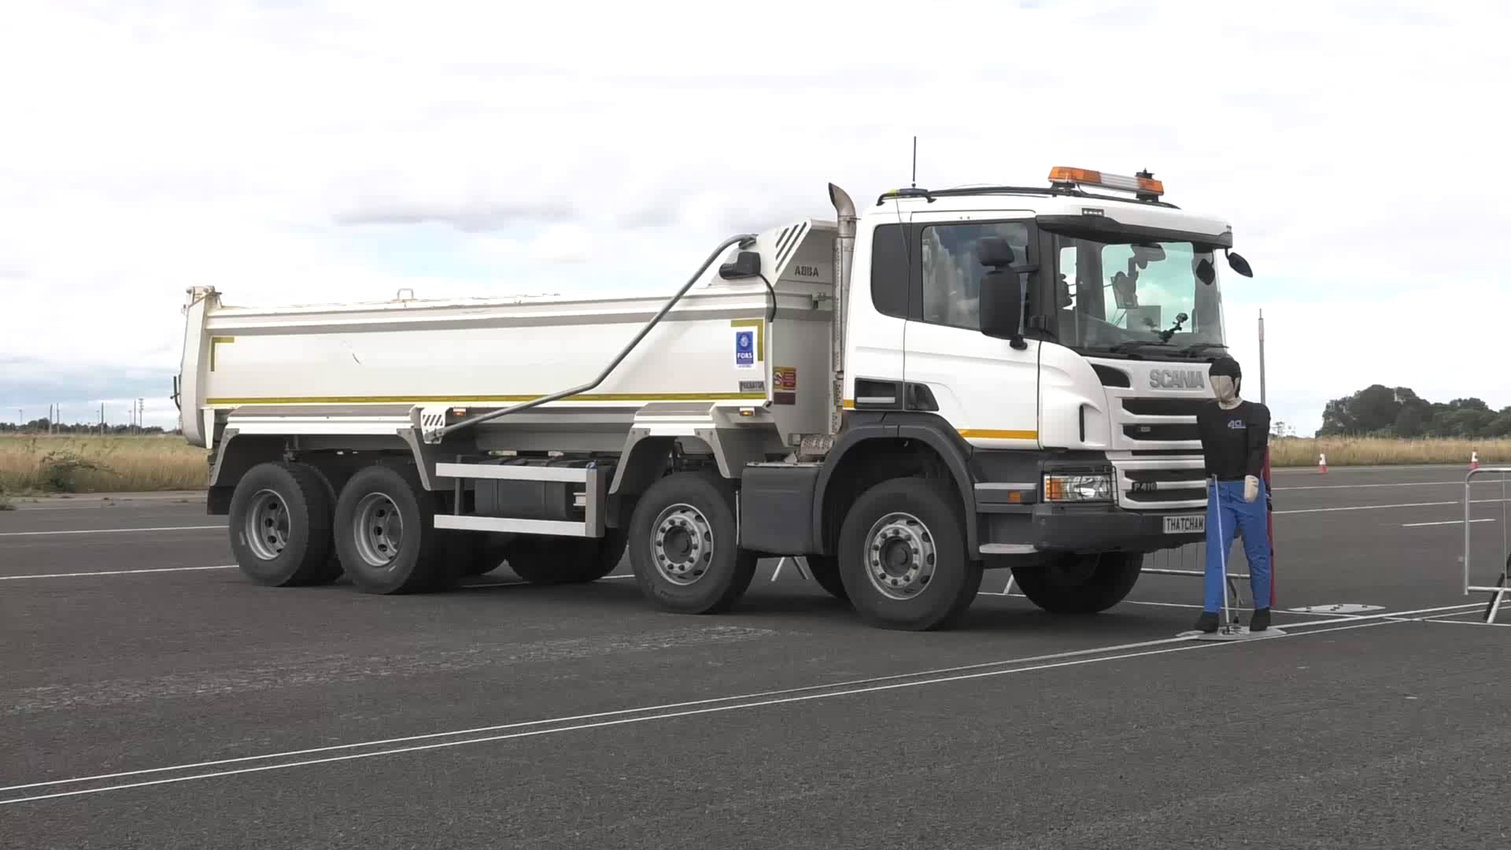
Key MOIS Regulation Requirements
The regulatory solution for the safety problem
Regulation drafted based on VRU-Proxi IWG consensus
Scope of regulation:
  Vehicle categories: M2, M3, N2, N3
  VRUs: Adult/child pedestrians, adult/child cyclists
System functionality:
  Detection of presence of VRUs in close proximity to vehicle front
  Provision of signal to alert driver of VRU presence
    Information signal (medium-urgency, low-intrusion)
    Collision warning signal (high-urgency, high-intrusion)
Applicable vehicle manoeuvres:
  Stationary while preparing to move off from rest
  Moving off from rest in a straight line
  Moving ahead slowly in a straight line
  Operational at vehicle speeds of ≤10 km/h
Truck – GVW ≥7.5t

Slide 6
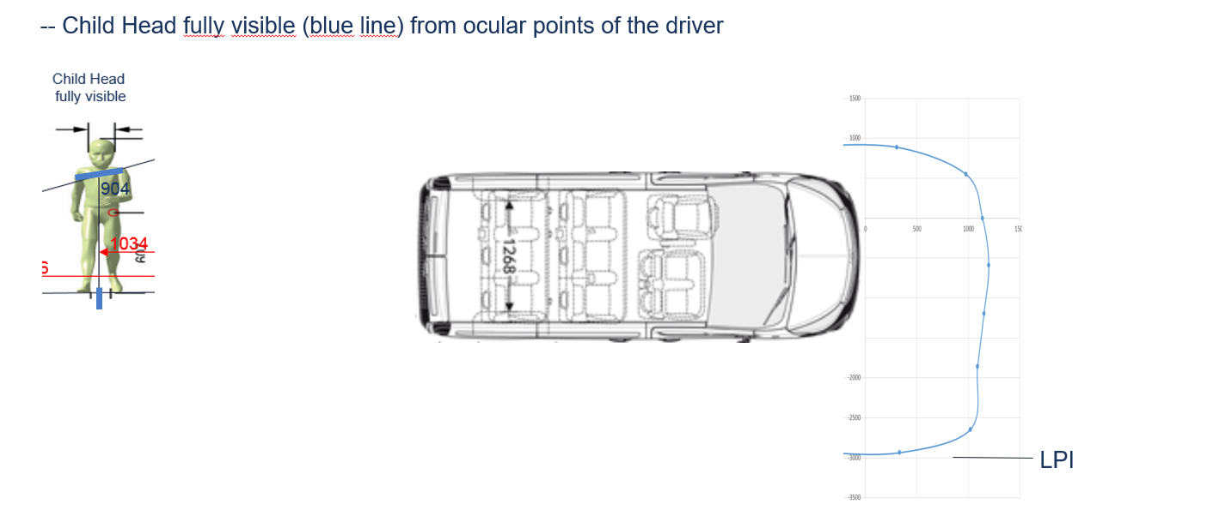
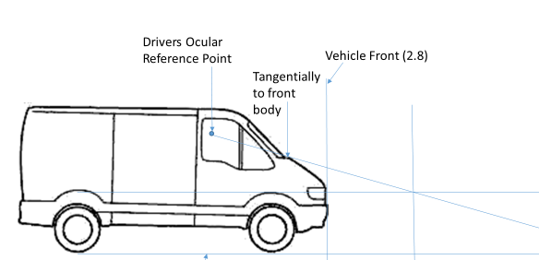
Key MOIS Regulation Requirements
The regulatory solution for the safety problem
VRU manoeuvres:
  Pedestrians:
    Crossing perpendicular from nearside and offside, vehicle stationary
  Cyclists:
    Crossing perpendicular from nearside and offside, vehicle stationary
    In carriageway, while stationary
    In carriageway, while moving off in same direction as vehicle
  Speeds:
    Pedestrian/cyclist crossing: 3-5 km/h
    Cyclist in carriageway: 0-10 km/h
Vehicle blind spot:
  Detection of VRU required within forward blind spot of vehicle
  Maximum forward extent of blind spot used to determine detection zone size
Max. forward separation plane
Blind spot boundary
0.9 m

Slide 7
Key MOIS Regulation Requirements
The regulatory solution for the safety problem
Detection zone:
  Trade off between true positives (detection of VRUs at risk) and false positives (detection of VRUs not at risk)
    Larger detection zones increase the likelihood of false positives
    More false positives => lower driver acceptance => less safe system
    Requirement to document efforts for reducing false positives
  Maximum forward separation plane
    Based on most forward point of the blind spot boundary
    Maximum of 3.7 m, minimum of 1.0 m, from vehicle front
  Minimum forward separation plane
    Distance of 0.8 m from vehicle front
  Nearside/offside separation planes
    Dependent on vehicle manoeuvre
    Potential moving off manoeuvre: 0.5 m outboard from vehicle width
    Low speed manoeuvre: in line with vehicle width (vehicle trajectory)
Right Hand Traffic Subject Vehicle
Min. forward separation plane
Offside separation plane
Offside vehicle plane
0.5 m
Max. forward separation plane
Vehicle width
Nearside separation plane
0.5 m
Vehicle front
Nearside vehicle plane
0.8 m
1.0 m – 3.7 m

Slide 8
Key MOIS Regulation Requirements
The regulatory solution for the safety problem
MOIS deactivation:
  Automatic deactivation: if malfunction, contamination or low ambient light (≤15 lux)
  Manual deactivation: through a sequence of intentional actions
Human-Machine Interface (HMI):
  Information signal
    Medium-urgency, low-intrusion signal
    Advance alert for presence of VRUs in close-proximity to front
    Optical signal only
  Collision warning signal
    High-urgency, high-intrusion signal
    Manufacturer defined strategy to alert driver of imminent collision
    At least two signal modes provided from optical, acoustic and haptic (optical signal shall be different from information signal)
  Failure warning signal
    Signal to alert driver of automatic deactivation
    Optical signal only – shall be different from information signal

Slide 9
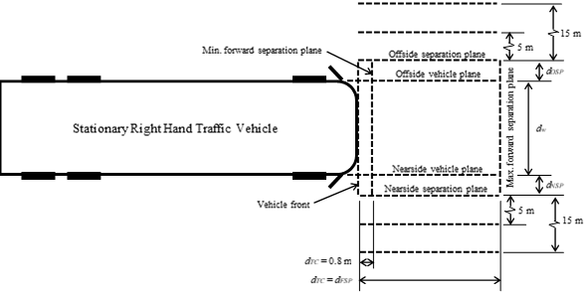
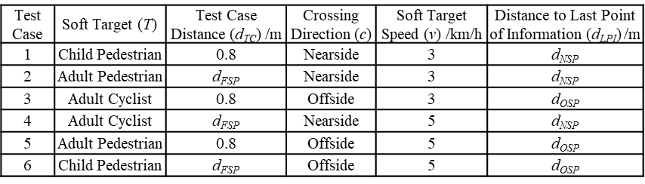
Test Specifications
Type Approval testing
Static Crossing Tests:
  Subject vehicle stationary, gear engaged, test planes marked out
  Pedestrian/cyclist test targets (based on ISO 19206) move at range of test speeds perpendicular to vehicle at range of distances from front of vehicle within detection zone
  Information signal shall be provided before test target reference point passes nearside/offside separation planes and until at least test target reference point passes the opposite separation plane
  Performed for two tests from Table 1 Appendix 1 and one additional test not in Table

Slide 10
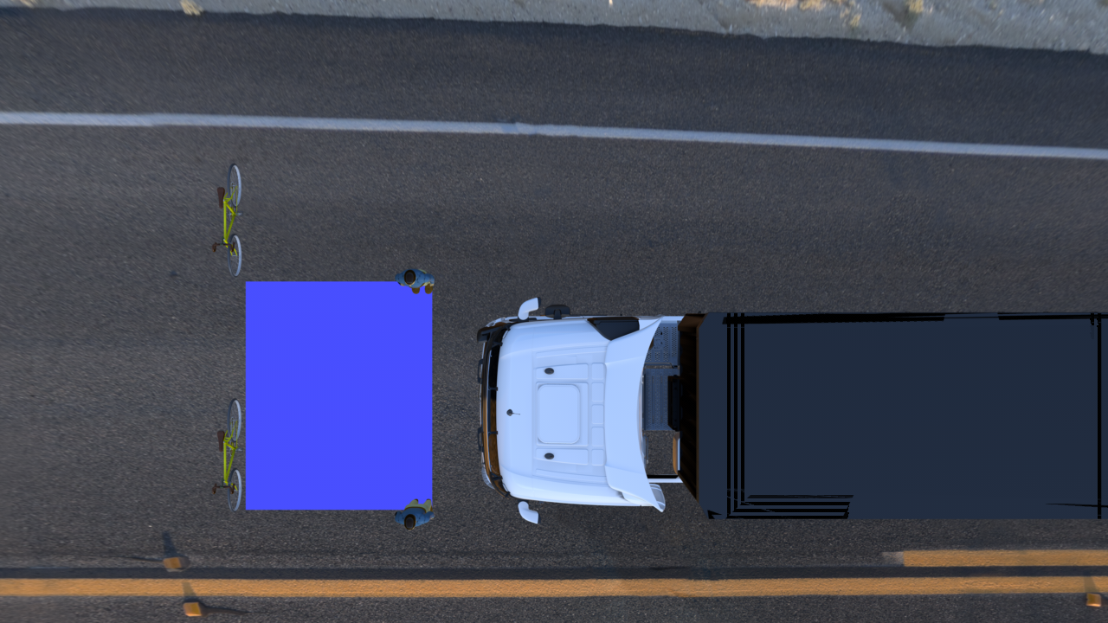
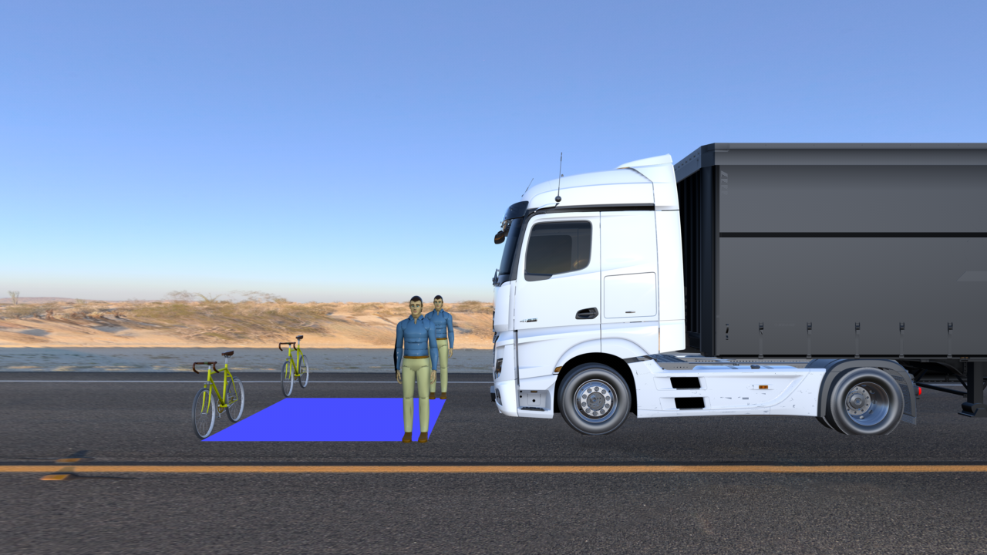
Test Specifications
Type Approval testing
Static Crossing Tests:

Slide 11
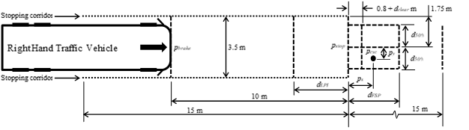
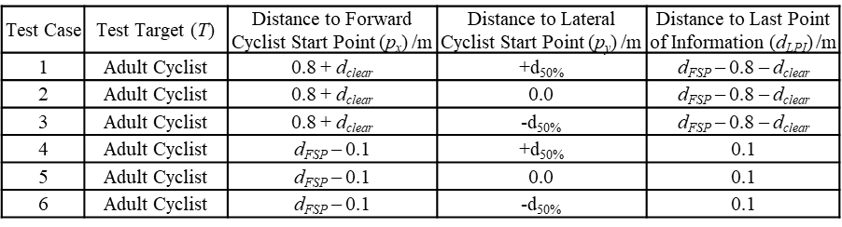
Test Specifications
Type Approval testing
Longitudinal Tests:
  Subject vehicle travelling at 10 km/h and braking to a stop, before area where test planes marked out
  Cyclist test targets stationary at a range of positions in front of vehicle within detection zone
  Cyclist moves off from rest either with or without subject vehicle also moving off from rest
  Information signal shall be provided before subject vehicle reaches a distance from the test target reference point equivalent to the maximum forward separation distance and shall be maintained for at least as long as the cyclist is located within the detection zone
  Performed for two tests from Table 2 Appendix 1 and one additional test not in Table

Slide 12
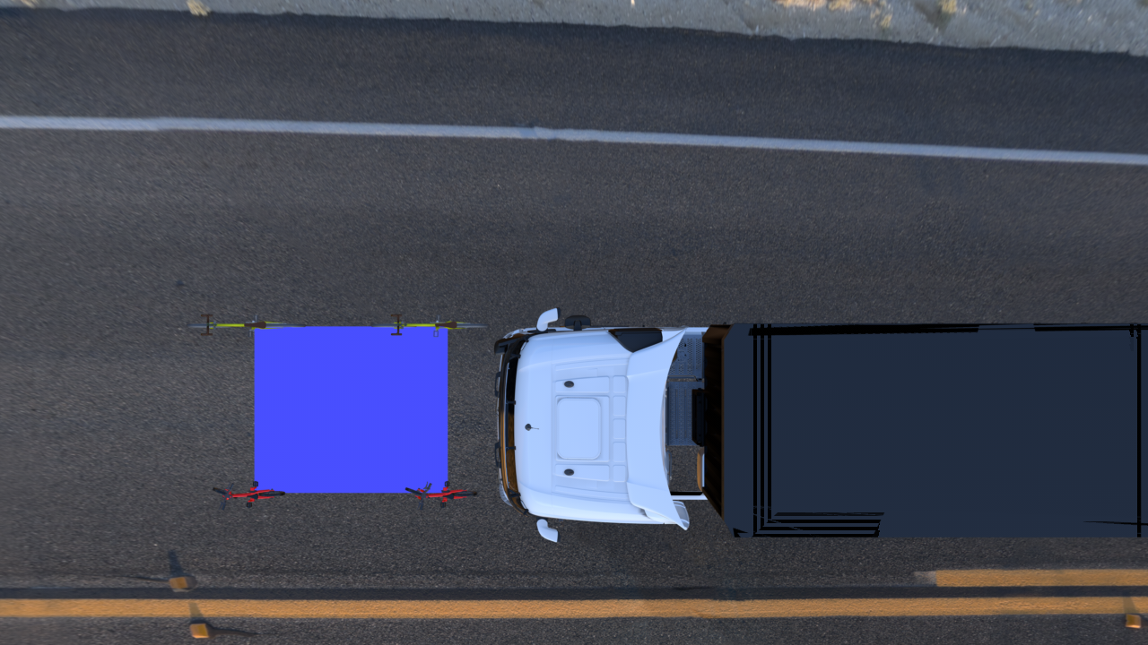
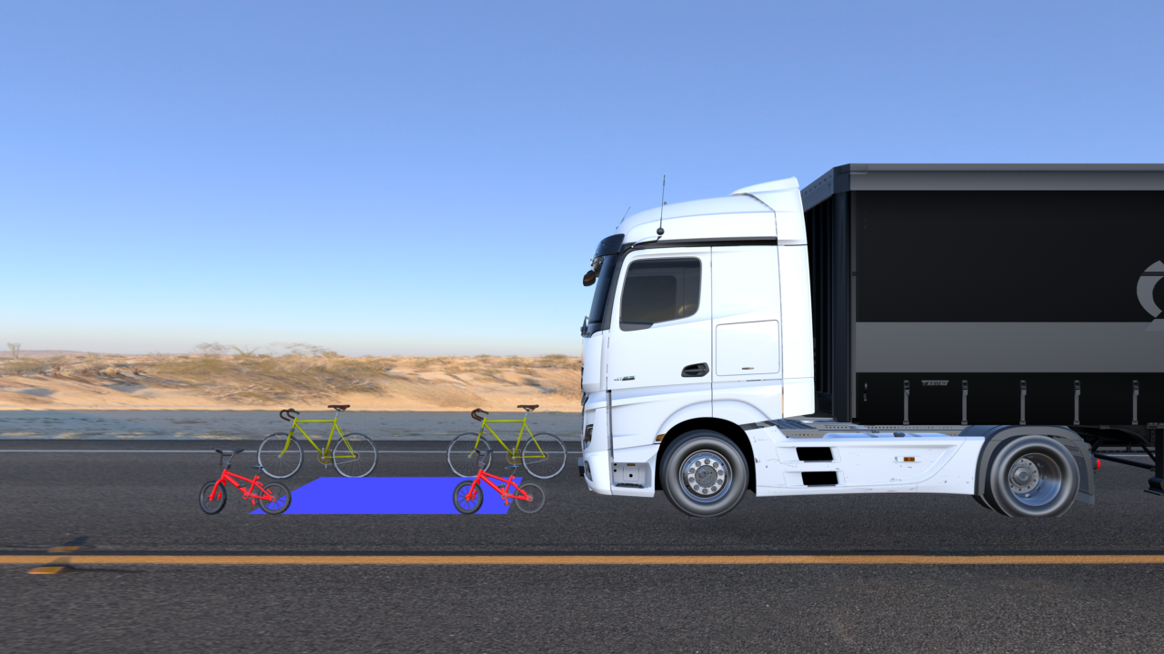
Test Specifications
Type Approval testing
Longitudinal Tests:

Slide 13


Questions?
Dr Phil Martin
Head of Biomechanics
pmartin@trl.co.uk
+44 [0]1344 770 326
TRL | Crowthorne House | Nine Mile Ride | Wokingham
Berkshire | RG40 3GA | United Kingdom

