Slide 1

UNECE GRPE Informal Group on Environmental and Propulsion Performance Requirements of L-cat Vehicles (EPPR L-cat)
State of Play
Informal document GRPE-80-27
80th GRPE, 14-17 January 2020
Agenda item 8(b)
Adolfo Perujo (IWG chairman)

Slide 2
EPPR meetings in 2019/2020
Face-to-face meetings
08-09 Jan 2019: EPPR 26th (GRPE Geneva summary; GTR2 & OBD2)
19-22 Feb 2019: EPPR 27th (JRC Ispra; GTR2 & OBD2)
26-29 Mar 2019: EPPR 28th (Geneva; GTR2 & OBD2)
21-22 May 2019: EPPR 29th (Geneva; GTR2 & OBD2)
15-18 Oct. 2019: EPPR 31st (CARB; OBD2 & Durability)
14-15 Jan. 2020: EPPR 33rd (Geneva; OBD2 & Durability)
12-13 Feb. 2020: EPPR 34th (NL; OBD2 & Durability)
Web conferences
20 Sept. 2019: EPPR 30th (OBD2 & Durability)
04 Dec. 2019: EPPR 32nd (OBD2 & Durability)

Slide 3
Amendment 4 to UN GTR 2
The IWG issued a working document containing the Amendment 4 to UN GTR No. 2(*) for consideration at the 79th session of GRPE (May 2019) (ECE/TRANS/WP.29/GRPE/2019/12)
http://www.unece.org/fileadmin/DAM/trans/doc/2019/wp29grpe/ECE-TRANS-WP29-GRPE-2019-12e.pdf
GRPE-79-21 (EPPR) amendments to GRPE/2019/12 Endorsed by GRPE
GRPE-79-21-Rev.1 (Sec.) amendments to GRPE-79-21
  Inclusion of the "Statement of technical rationale and justification"
  Several minor editorial points
EPPR-30-01 (EPPR Sec.), revision of GRPE-79-21-Rev.1
  Amendments: necessary to remove the last residual references to three- and four-wheelers, which were finally not included in the Scope.
    (*) on the measurement procedure for two-wheeled motor cycles equipped with a positive or compression ignition engine with regard to the emissions of gaseous pollutants, CO₂ emissions and fuel consumption.

Slide 4
Amendment 4 to UN GTR 2
WP29-2019-121, on the agenda of Nov 2019 WP29
  Based on EPPR-30-01
WP29-2019-122, Amend 4 GTR2 Technical Report
The GTR Technical Report and Regulation were adopted at Nov 2019 WP29.

Slide 5
Amendment of UN GTR 18 to include OBD 2
Purpose:
  To develop functional aspects of On-Board Diagnostic (OBD) systems.
Mode of Operation:
  “Corresponding Group” within the IWG EPPR L-Cat (agreed by all parties) to concentrate in the development of OBD 2 has been ended as the Phase 1(§) was finished within schedule
Vice-chair
  The IWG has decided to appoint Mr. Suzuki-san as vice-chair of the EPPR IWG.
  Mr. Suzuki-san will provide support to the chair in the running of the IWG
  (§)Speed up to complete phase 1 of the process was necessary because of a CP required the development of OBD 2 for regional legislation.

Slide 6
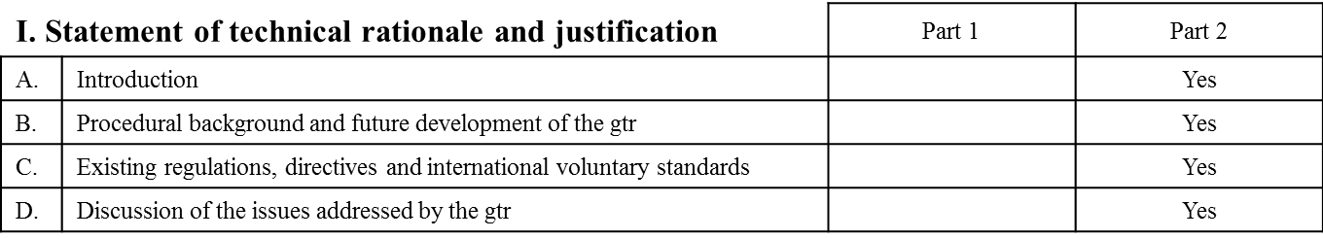
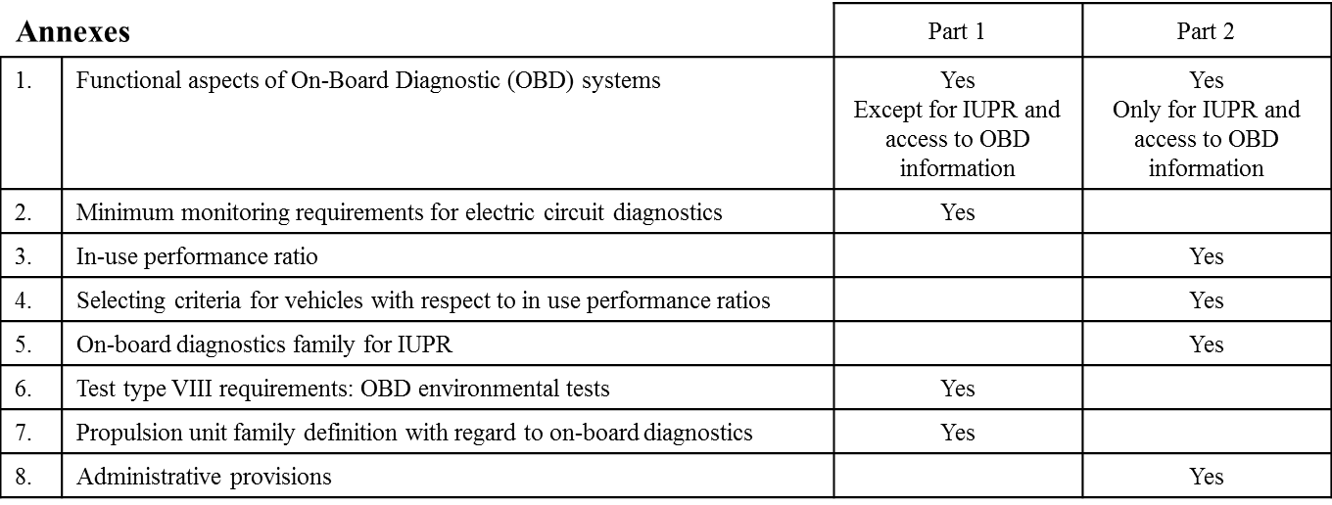
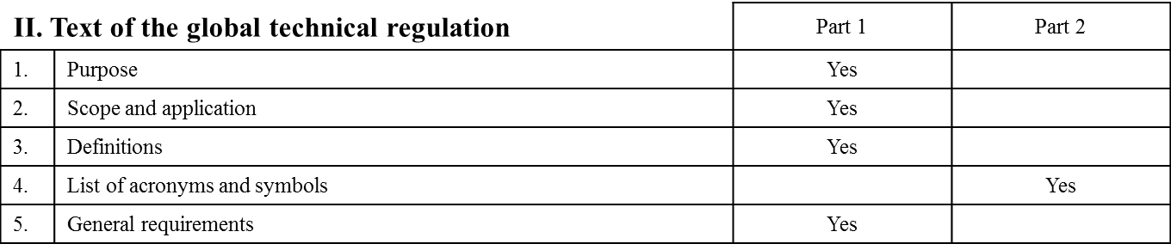
Amendment of UN GTR 18 to include OBD 2
Content:
  The work of the OBD 2 (amendment to GTR 18) is also based on the European EURO5 regulation

Slide 7
Amendment of UN GTR 18 to include OBD 2
Progress:
  Informal document GRPE-79-23: This is the consolidated document addressing the phase 1 of the work of the IWG and in particular of the work of the Correspondent Group as defined by the IWG in is formation (EPPR-24and its term of reference
  Informal document GRPE-80-XX: This is the Informal Document including the full amendment to GTR 18 and the basis of the Working Document planned to be submitted to GRPE in March 2020.
  IWG intends to submit a Working Document for endorsement by the GRPE in its next session (81st session – June 2020)
  Amendment to GTR No.18 is expected to be adopted by WP29 in Nov 2020.

Slide 8
Durability of pollution-control devices
The initial working document is based on:
  Reg. (EU) 168/2013 amended by Reg. (EU) 2019/129 and Reg. (EU) 134/2014 amended by Reg. (EU) 2018/295
Base document: EPPR-8-11, proposal GTR test type V, submitted by EC at EPPR 8th session in 2014.
The work started in the 30th session of the EPPR (Sept. 2019)
The work is on-going

Slide 9
IWG EPPR L-cat work outlook
The IWG intends to request the extension of its mandate for the period 2021-2026
  Request to GRPE 81st session
  Request to WP291 Nov.2020
Next areas of activities:
  Propulsion Unit Performance
    Possibly in parallel to the development of the Durability GTR once the OBD amendment work is completed
  GTRs to be transposed into UN Regulations (?)
  https://wiki.unece.org/pages/viewpage.action?pageId=63308245

Slide 10

Any questions?
You can find me at adolfo.perujo@ec.europa.eu

