Slide 1
Transmitted by the expert from France
Informal document GRB-72-22
(72nd GRBP, 7-9 September 2020,
agenda item 5 (a))

Slide 2
Radial Definition proposal
GRBP - 72th session – September 2020
Informal document linked to working document 2020/21

Slide 3
Background
Titre de partie
Sous-titre de partie
A tyre manufacturer applied to get an EC type-approval in respect of a type of tyre that incorporates a new architecture.
This new architecture has the functionalities of a Radial tyre (mechanical decoupling of the summit and the bead), but strictly speaking, does not meet the regulatory definition of a radial structure, insofar as the condition " are laid substantially at 90° " is not everywhere respected, especially under the summit of the tyre.
As this structural architecture opens new radial tyres performances possibilities, the followings actions have been done:
Based on R30 and R117 tests results, France granted provisional approvals to this tyre type for use in France only.
France has been authorized by EC to grand an EC type approval.
As Radial definition revision is necessary, France propose a working document to upgrade the Radial definition of the UN_ECE regulations.

Slide 4
Background (detailed timing)
Titre de partie
Sous-titre de partie
On 23 October 2019 France applied for authorization to grant an EC type-approval in respect of a type of tyre that incorporates a new structural architecture.
From 16 July 2019 to 12 September 2019 the Technical Service UTAC (France) and the Manufacturer’s approved test laboratory carried out tests in accordance with UNECE Regulations Nos 30 and 117 of the tyre type, for which the exemption is sought. France has provided the Commission and the other Member States with all the information referred to in points (a), (b) and (c) of Article 20 of Directive 2007/46/EC.
France granted provisional approvals to this tyre type, as follows: a) on 11 December 2019, in accordance with the performance requirements set out in UNECE Regulation No 30 and b) on 12 December 2019, in accordance with the performance requirements set out in UNECE Regulation No 117.
The applicable requirements for C1 tyres are laid down in UNECE Regulations Nos 30 and 117, which are listed in Annex IV to Regulation (EC) No 661/2009 of the European Parliament and of the Council as being compulsory for the purposes of EC type approval. UNECE Regulations Nos 30 and 117 and Regulation (EC) No 661/2009 are also listed in Part I of and Appendix 1, Tables 1 and 2, to Annex IV and Appendices 1 to 6 to Annex XI to Directive 2007/46/EC.
UNECE Regulation No 30 provides for the definition of radial tyre, which does not include the possibility of laying the tyre ply cords at an angle slightly different from substantially 90° to the center line of the tread.
France has demonstrated that, in comparison with the requirements from which the exemption is sought, the tyre type concerned by this Decision fulfils safety and environmental requirements, meaning wet grip and rolling sound emission within the prescribed type-approval limits, improved rolling resistance, reduced mass and comparable contact patch, cornering stiffness and vertical stiffness to the ones of the standard tyre.

Slide 5
Objectives of the Radial definition revision
Enlarge and enrich the current definition of a radial structure while ensuring the radial tyres key features (mechanical decoupling between the tread and the bead).
Allow new potentially innovative features that do not strictly meet the current definition of a Radial tyre structure but could provide significant improvement in safety and/or environmental performances.
Existing approved radial tyres still comply with the proposed amended radial definition (no additional requirements).

Slide 6
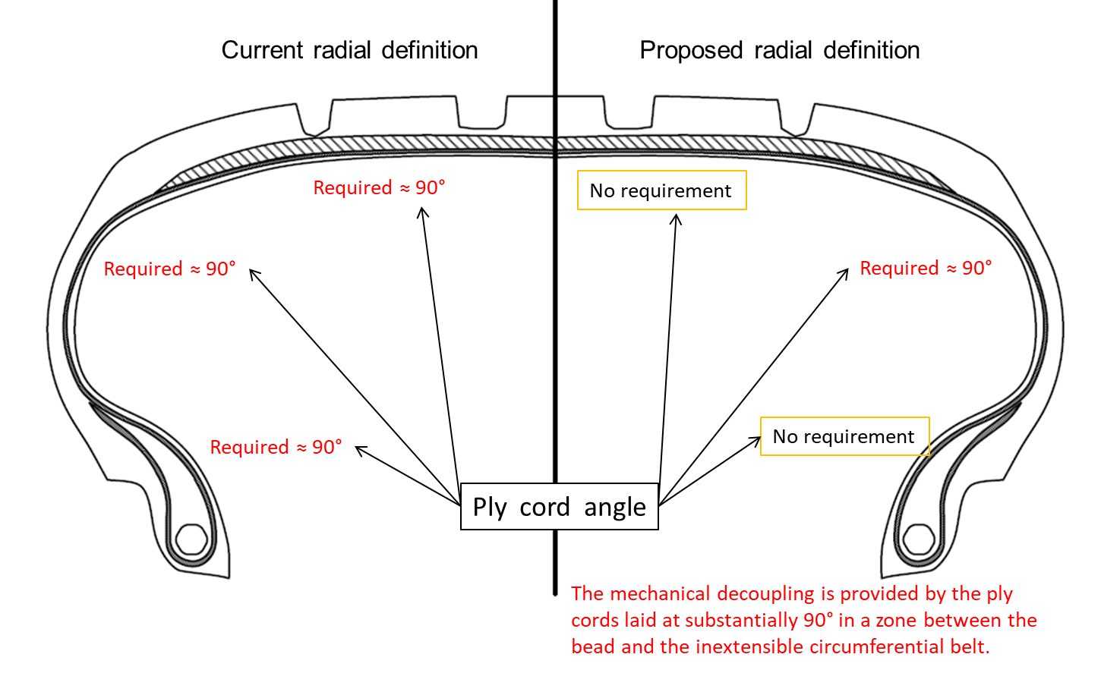
Summary of the proposal

Slide 7
Summary of the proposal

Slide 8
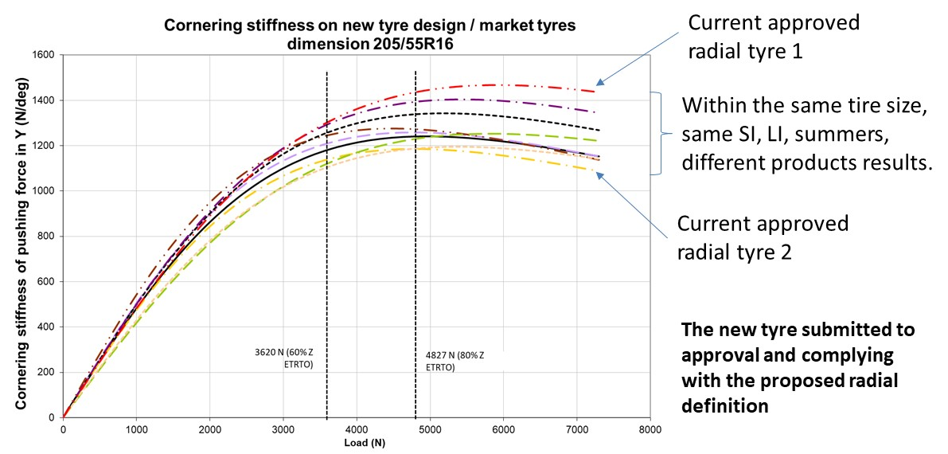
Summary of the proposal : Cornering stiffness

Slide 9
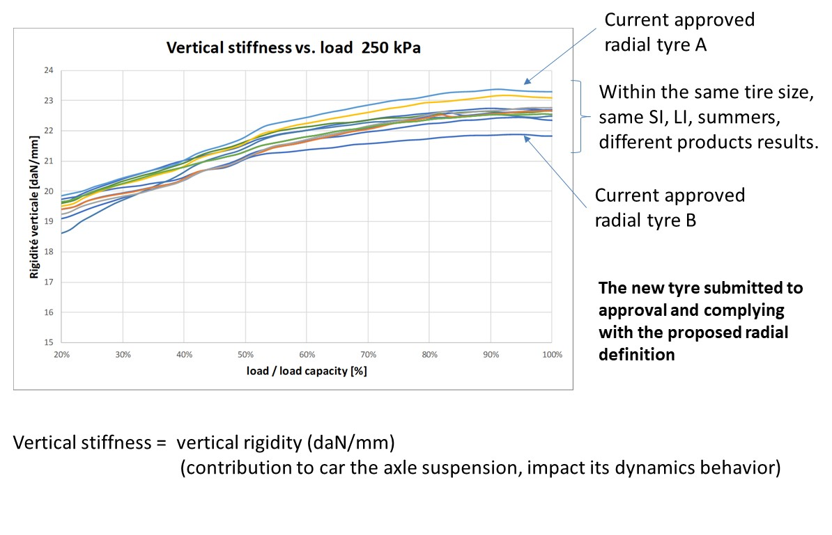
Summary of the proposal : Vertical stiffness

Slide 10
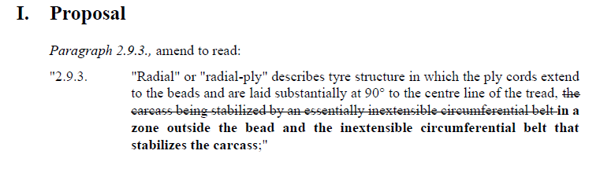
Radial definition proposal from France (doc. GRBP-2020-21)

Slide 11
Proposal justifications
Enlarges and enriches the current definition, whilst keeping the essential feature of a radial structure (mechanical decoupling between tread and bead)
Allows potentially innovative features
Existing approved radial tyres still comply with the proposed amended radial definition (no additional requirements).
No change on the type definition in UN Regulation N° 30. Like today, each tyre manufacturer must manage its regulatory types and therefore the mixability on the same axle/vehicle, in agreement with the Type Approval Authority.
None of the IP rights owned by the tyre manufacturer is deemed to be essential to have access to the amended definition. Furthermore, the amended definition would enable any other tyre manufacturers to sell tyres that would not comply with the current definition of a radial tyre.

