Slide 1



GSR TPMS Testing – validation of proposed amendments to R141
13-20 July 2020
Study on behalf of the European Commission
Transmitted by the experts of the Task Force Tyre Pressure Monitoring System & Tyre Installation (TPMSTI)
Informal document GRBP-72-20
(72nd GRBP, 7-9 September 2020,
agenda item 5 (g))

Slide 2
Open questions for defining the test procedure
Diffusion test - can all vehicle tyres be deflated in a reasonable time period ? What is a reasonable time period, to minimise pressure changes due to temperature changes ?
How long does it take for tyre temperatures to stabilise during the learning phases ? Is this influenced by driving speed ?
What is the effect of vehicle loading on warming up time ?
Can the proposed test procedures be carried out repeatably, reliably, practically ?
Any other lessons ?

Slide 3
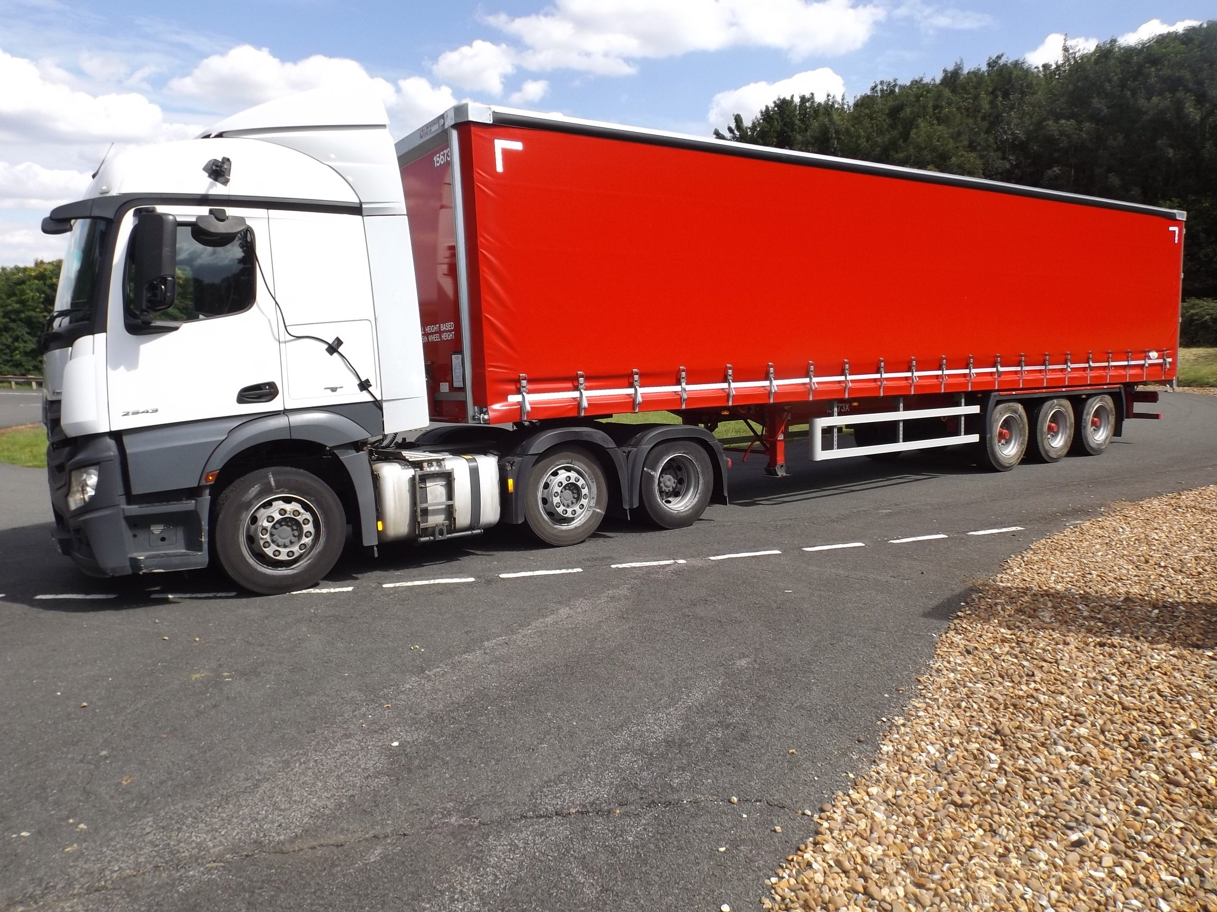
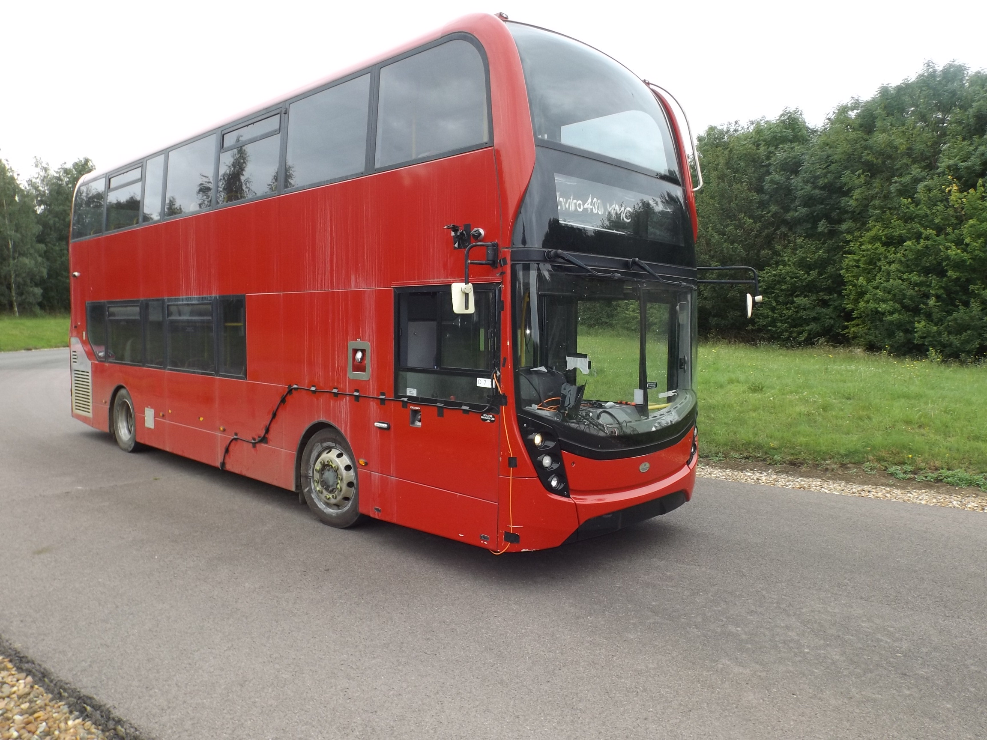
Test location and vehicles
Tractor unit 3 axle – steer + drive twin + lift
315/70 R22.5 tyres – 5 brands
Trailer 3 axle
One brand 385/65 R22.5 tyres
Bus 4x2 axle configuration
One brand 275/70 R22.5 tyres

Slide 4
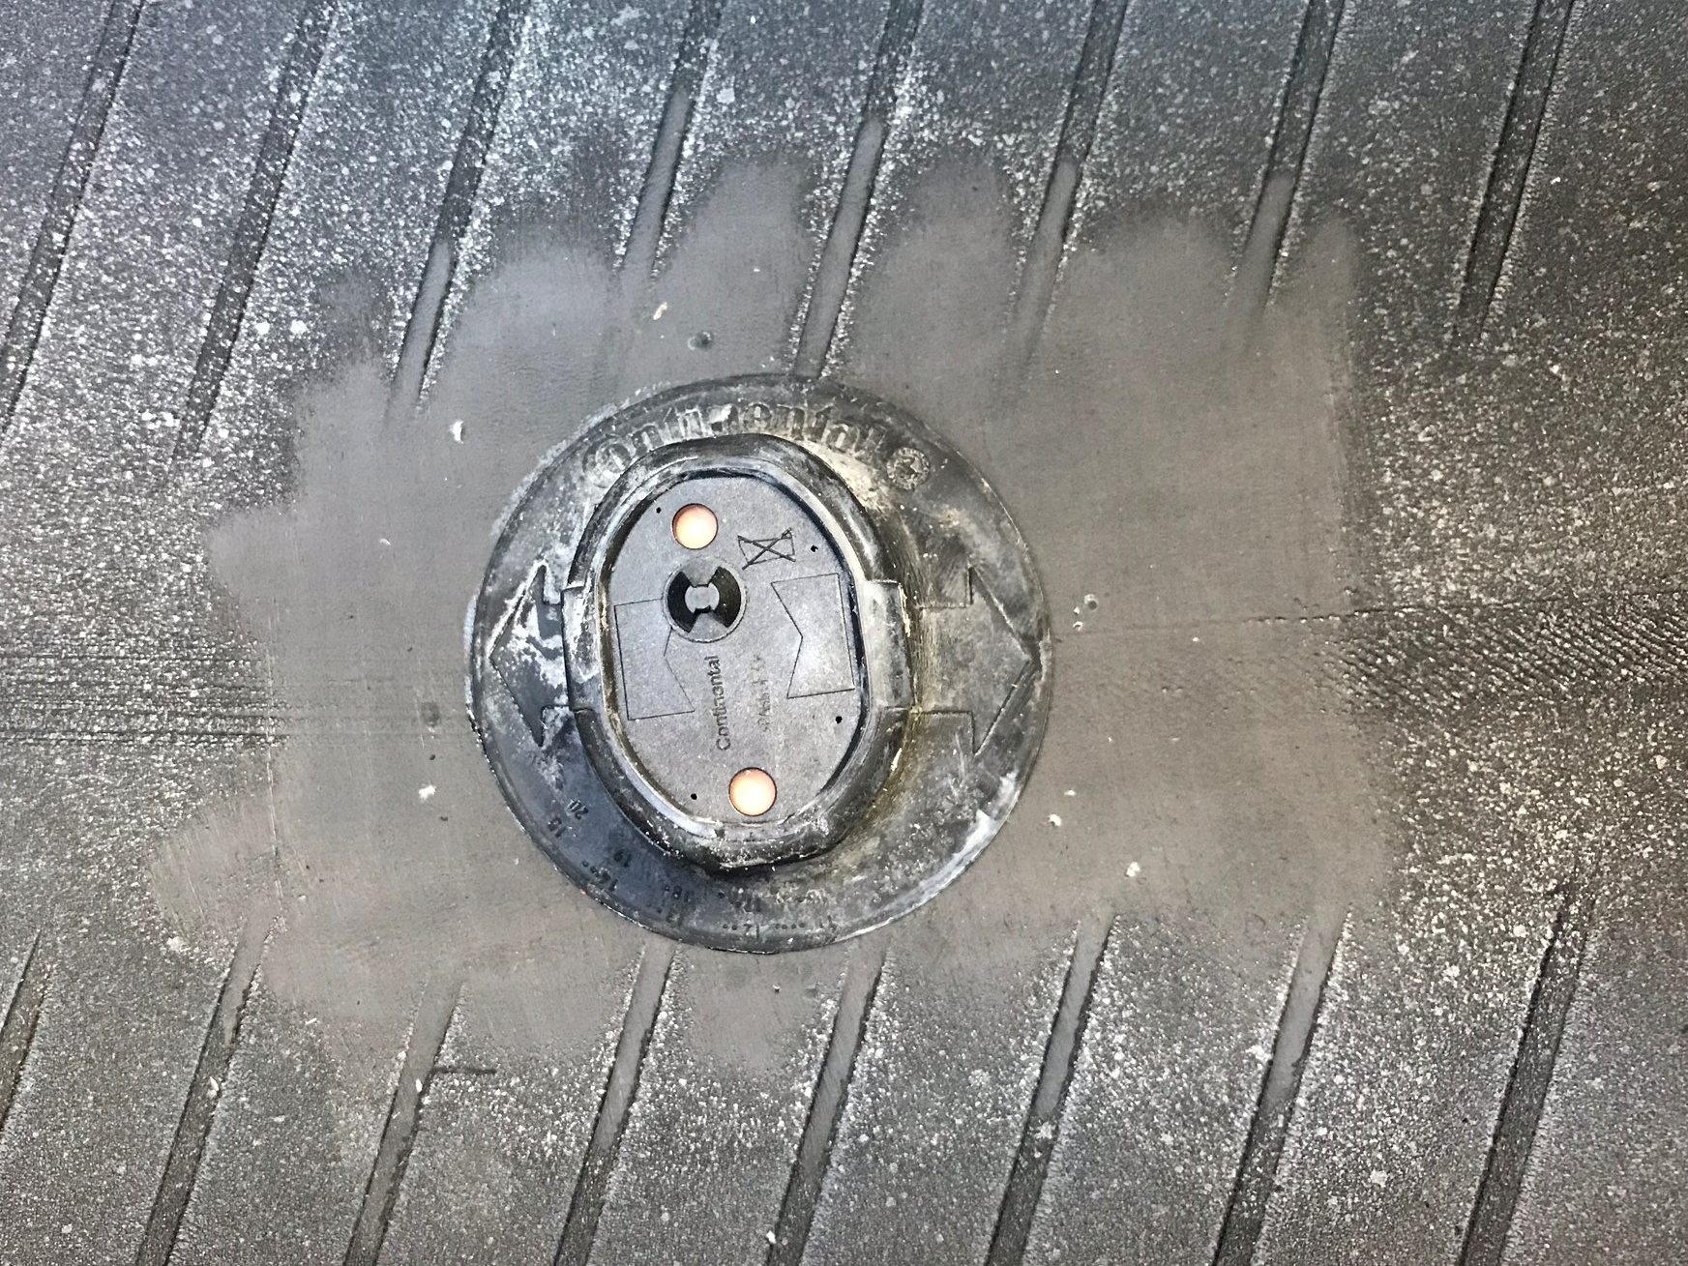
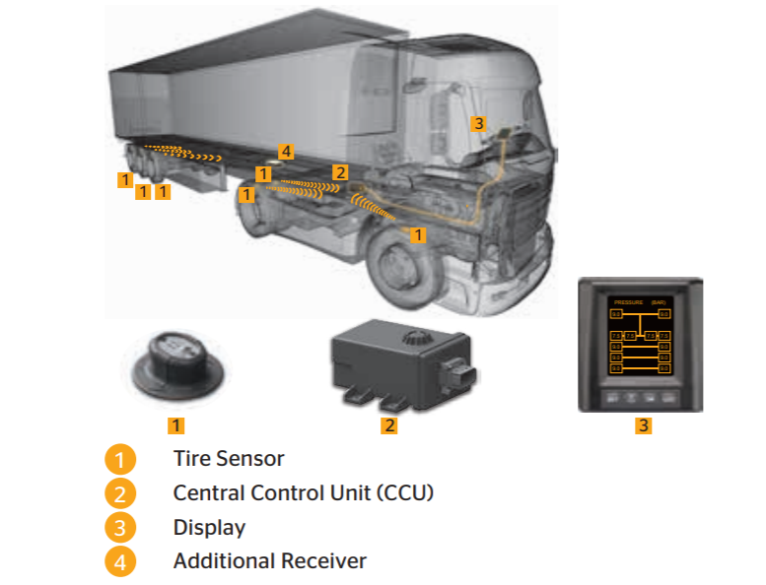
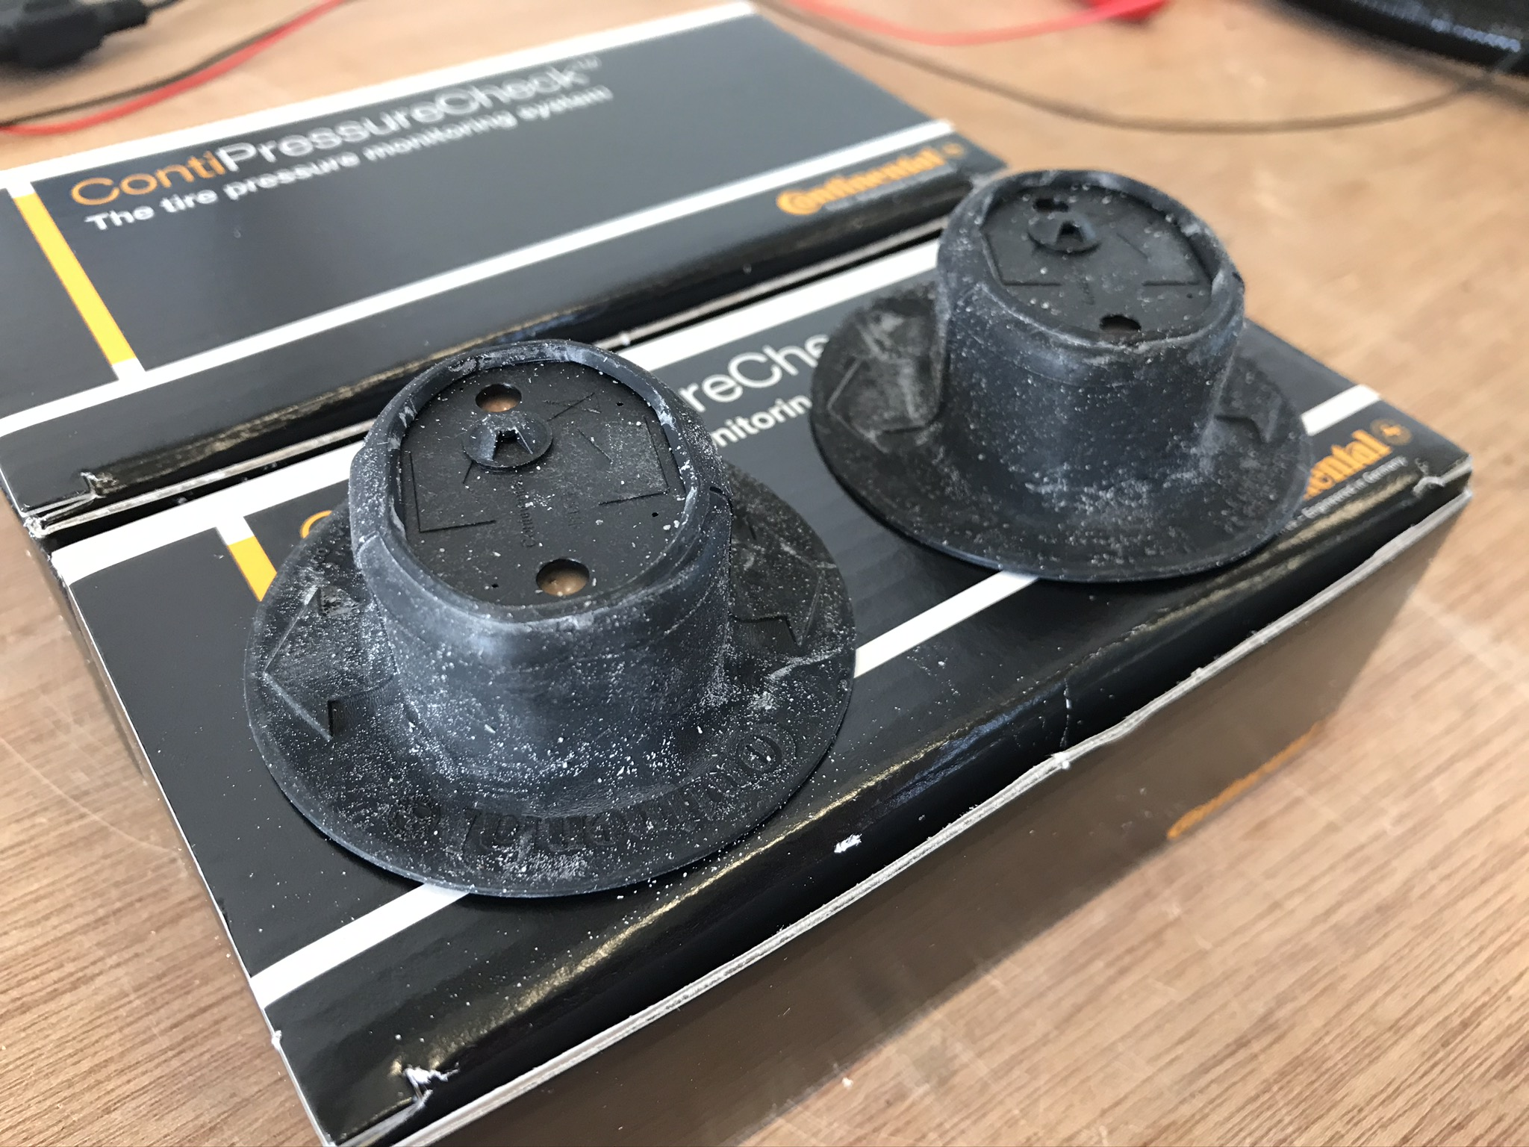
TPMS used
Includes temperature measurement

Slide 5
Test programme

Slide 6
Open questions for defining the test procedure
Question 1
Diffusion test - can all vehicle tyres be deflated in a reasonable time period ? What is a reasonable time period, to minimise pressure changes due to temperature changes ?

Slide 7
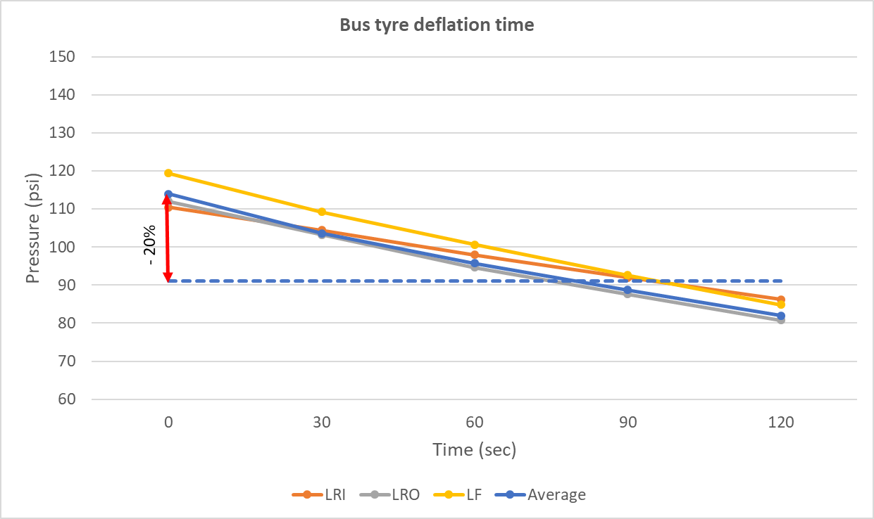
Tyre deflation – how long does it take ?
Initial test with bus:
To reduce by 20% ≈ 80 seconds
Deflation times for -20% were measured in the diffusion tests:
Bus:
6 tyres / 2 people = 10:53 mins
Truck:
8 tyres / 2 people = 13:48 mins
3.5 mins / tyre / person
Additional people were needed for timing and recording
(For reference: 1 psi = 69 mBar)

Slide 8
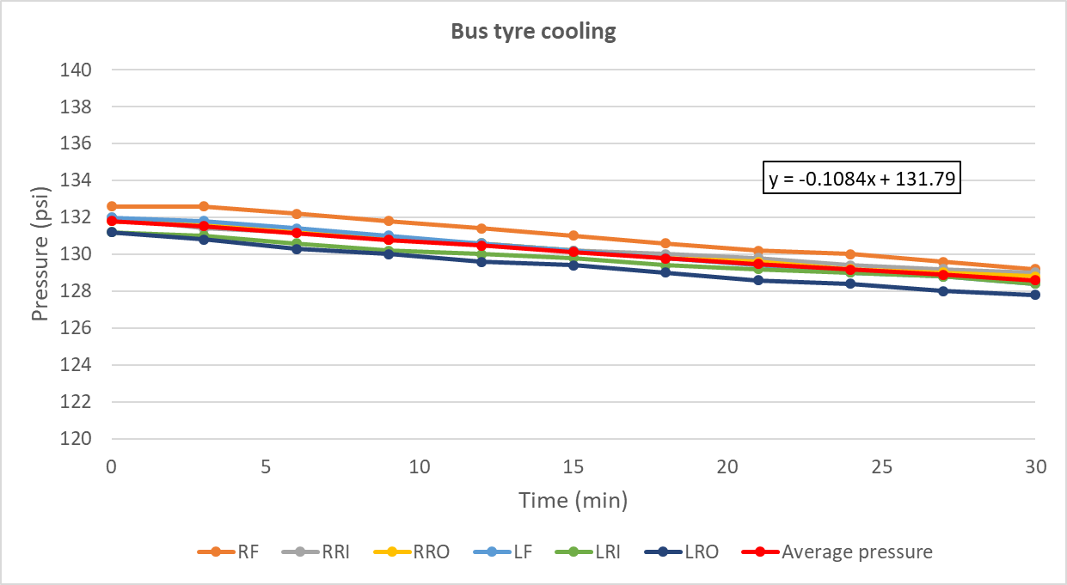
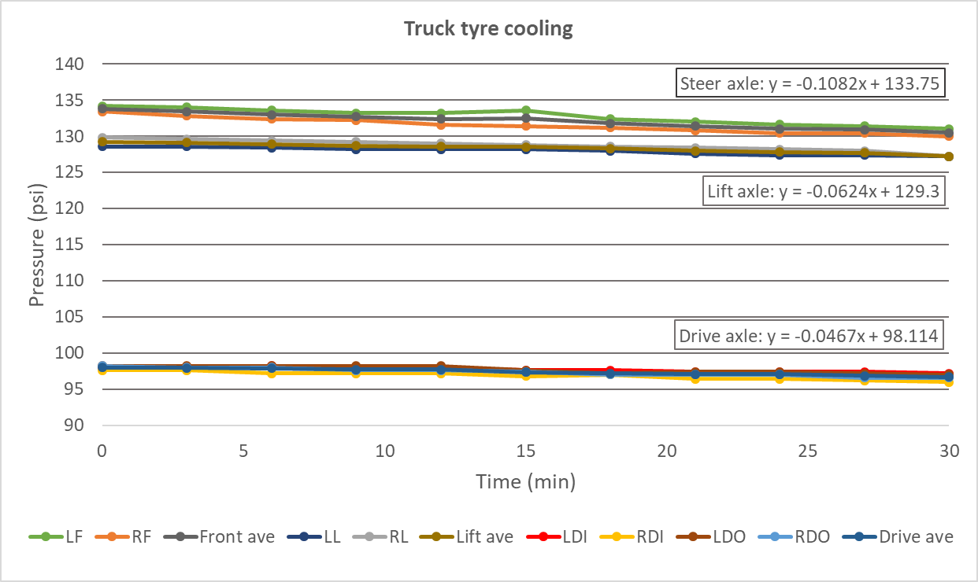
Tyre deflation – temperature / pressure effects with time
Bus:
Reduction of 3 psi
average in 30 mins
= 0.11 psi / min
Bus and truck cooling
Truck:
Reductions of 1.1 – 2.9 psi
= 0.05 – 0.11 psi / min
= 0.6 – 1.1 % in 15 min

Slide 9
Regulatory proposal (Submitted to the experts of TPMSTI)
2.5.2
Procedure for the diffusion test to verify the requirements of paragraph 5.3. to this Regulation.
Deflate all tyres within five minutes of measuring the warm pressure as described in paragraph 2.4.3. above for vehicles of category M1 and N1 and 15 minutes for vehicles of category N2, N3, M2, M3, O3 and O4, until the deflated tyres are at Pwarm - 20 per cent, plus a further deflation of 7 kPa, namely Ptest. Following a stabilisation period of between two and five minutes, the pressure Ptest shall be rechecked and adjusted if necessary.

Slide 10
Open questions for defining the test procedure
Question 2
How long does it take for tyre temperatures to stabilise during the learning phases ? Is this influenced by driving speed ?

Slide 11
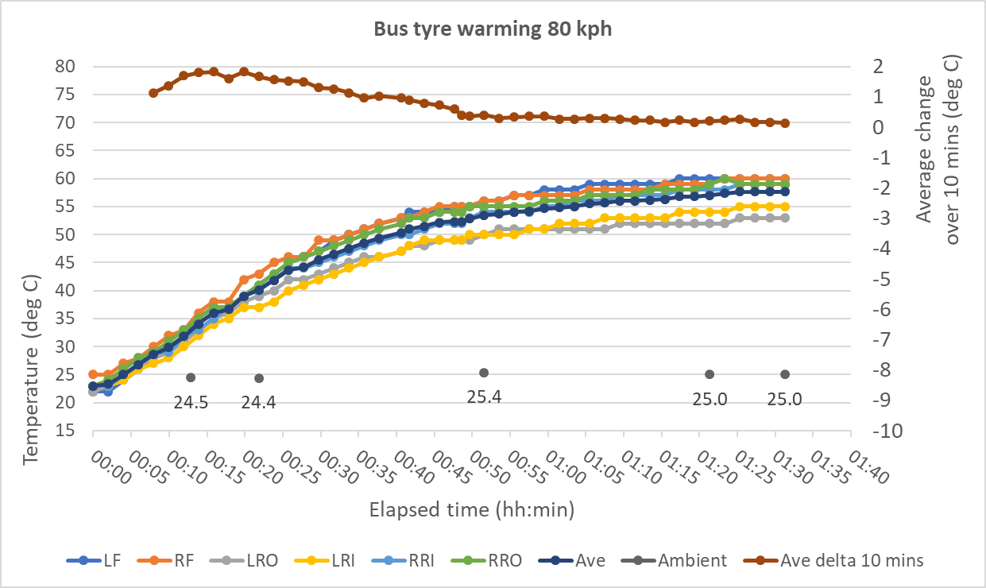
Tyre warming
Bus puncture test
Temperatures stabilise after
∼ 1.25 hour

Slide 12
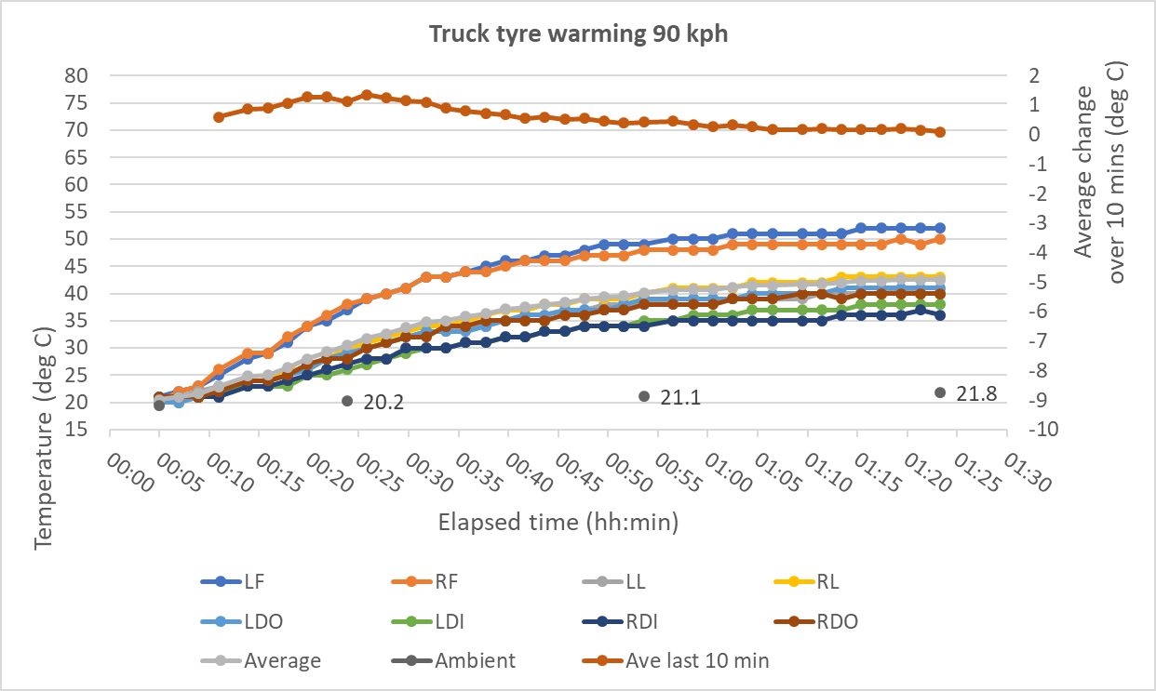
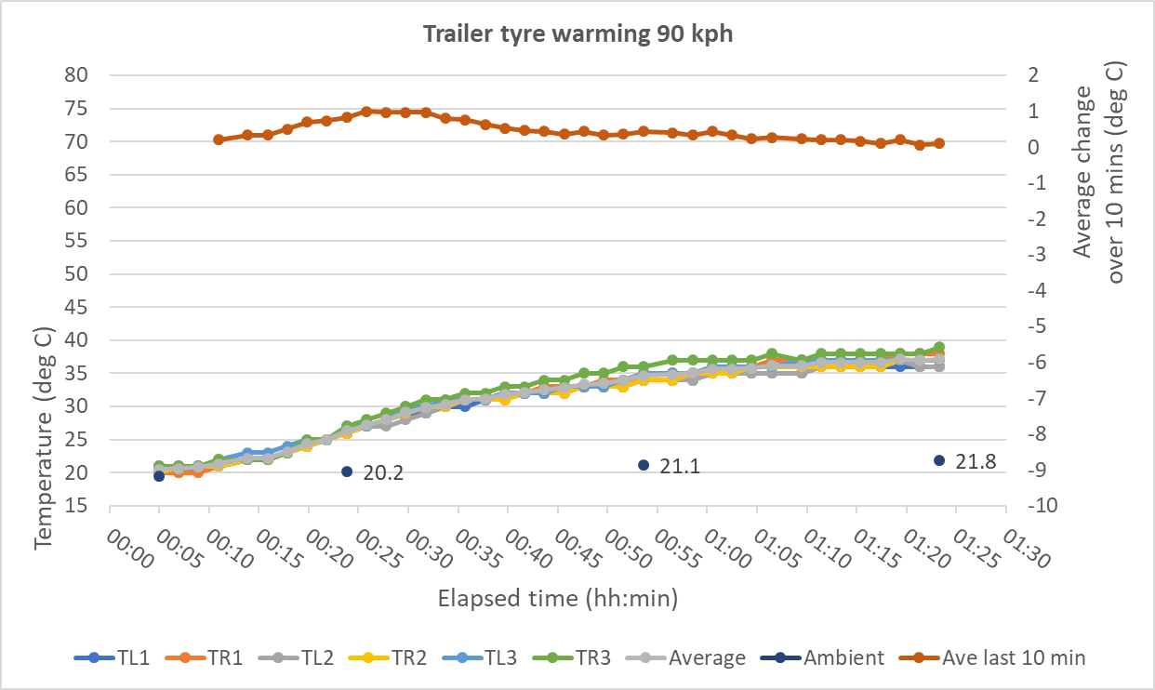
Tyre warming
Truck and trailer diffusion test
Temperatures stabilise after ∼ 1 hour

Slide 13
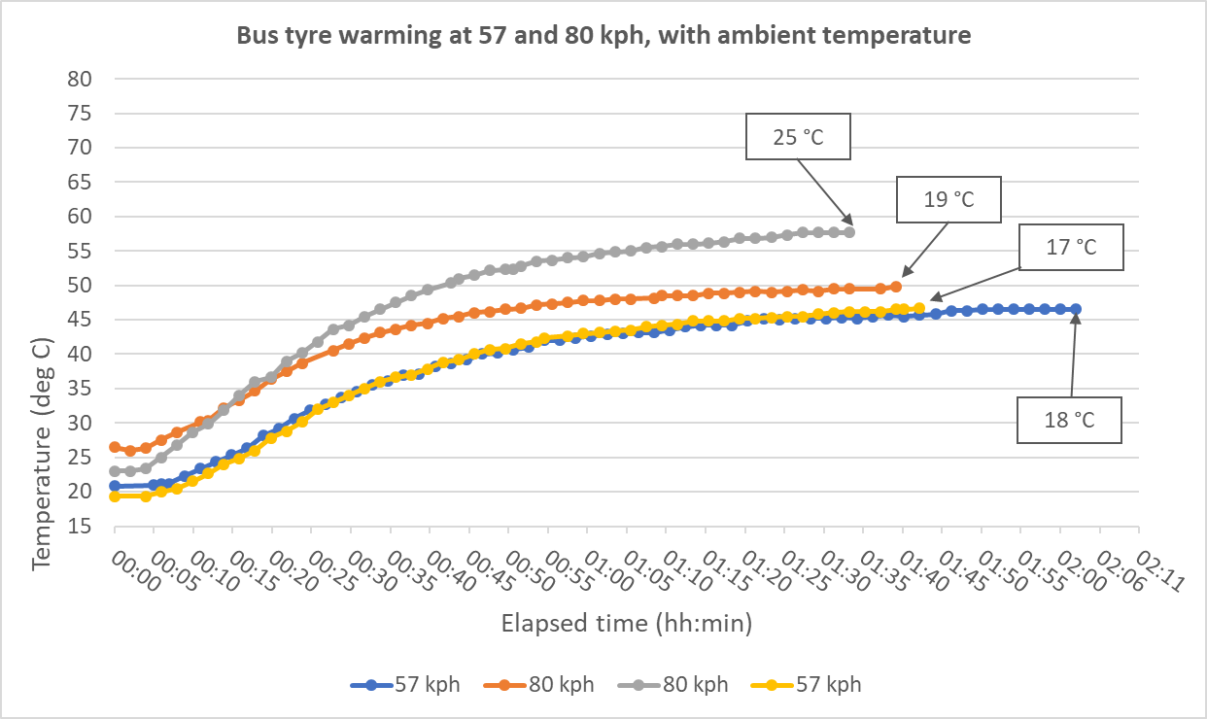
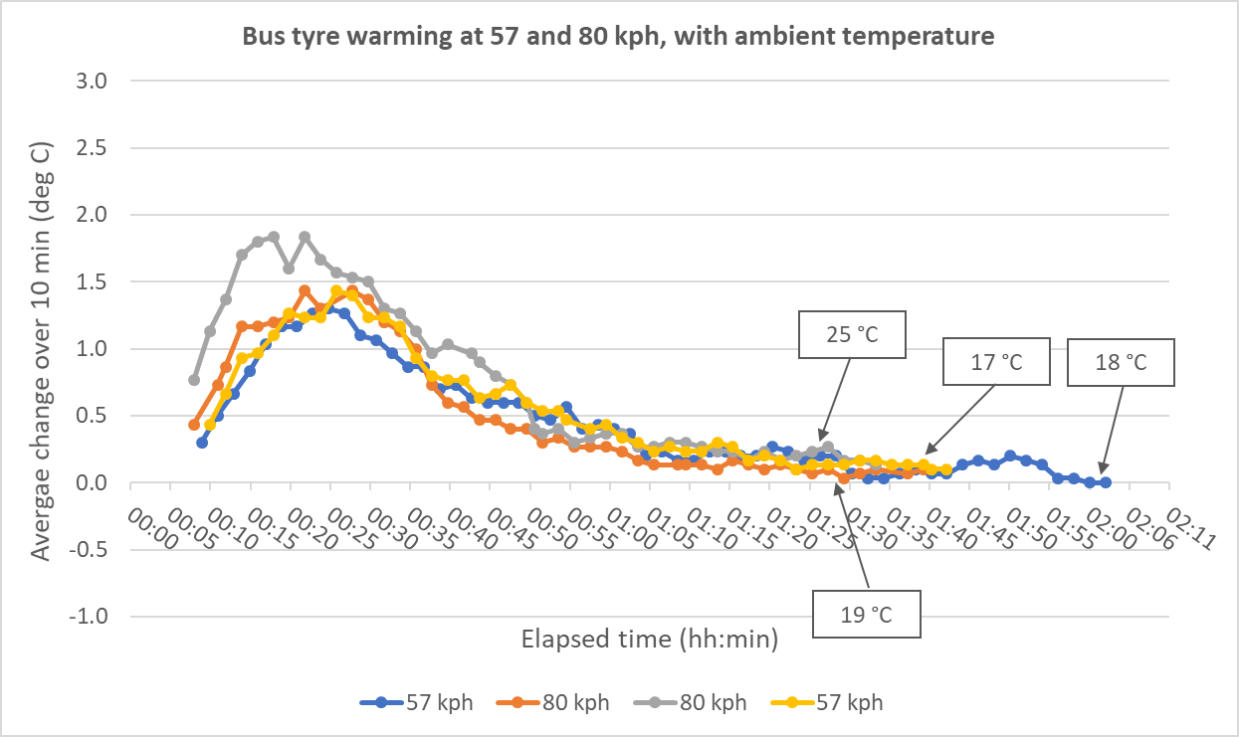
Tyre warming
Bus tests compared:
Temperatures stabilise after
∼ 1.25 – 1.5 hour
Speed effect is insignificant
Ambient temperature adds to the tyre temperature

Slide 14
Regulatory proposal (Submitted to the experts of TPMSTI)
2.4.1.
For vehicles of category N2, N3, M2, M3, O3 and O4, drive the vehicle for a minimum of 180 minutes at a speed of fifty-seven km/h ±10 km/h.
180 minutes to allow for variations in vehicle type and ambient conditions.
57km/h as mid-point of speed range

Slide 15
Open questions for defining the test procedure
Question 3
What is the effect of vehicle loading on warming up time ?

Slide 16
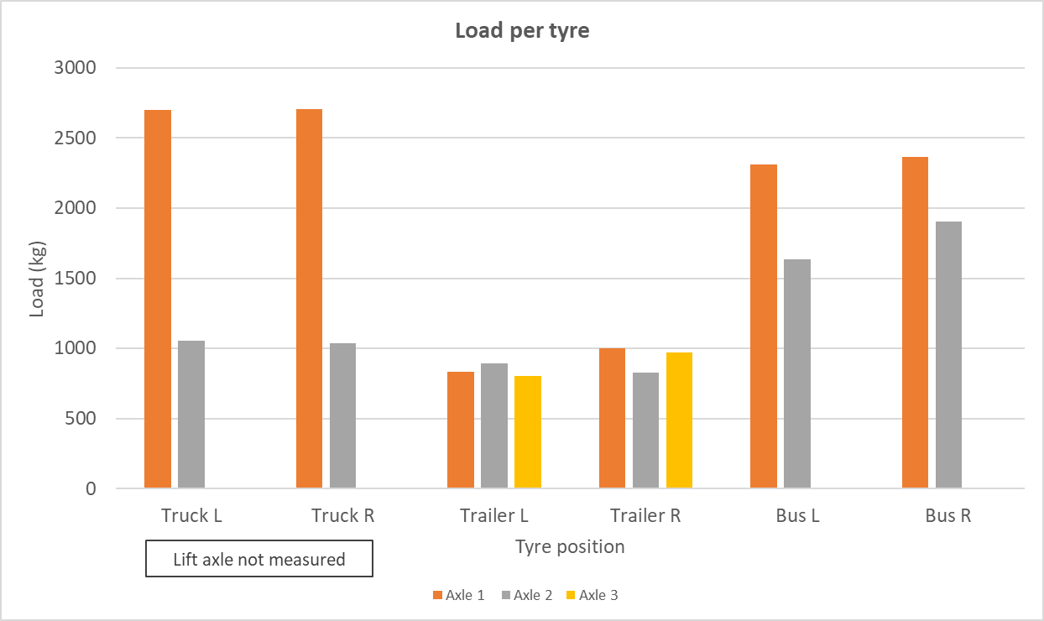
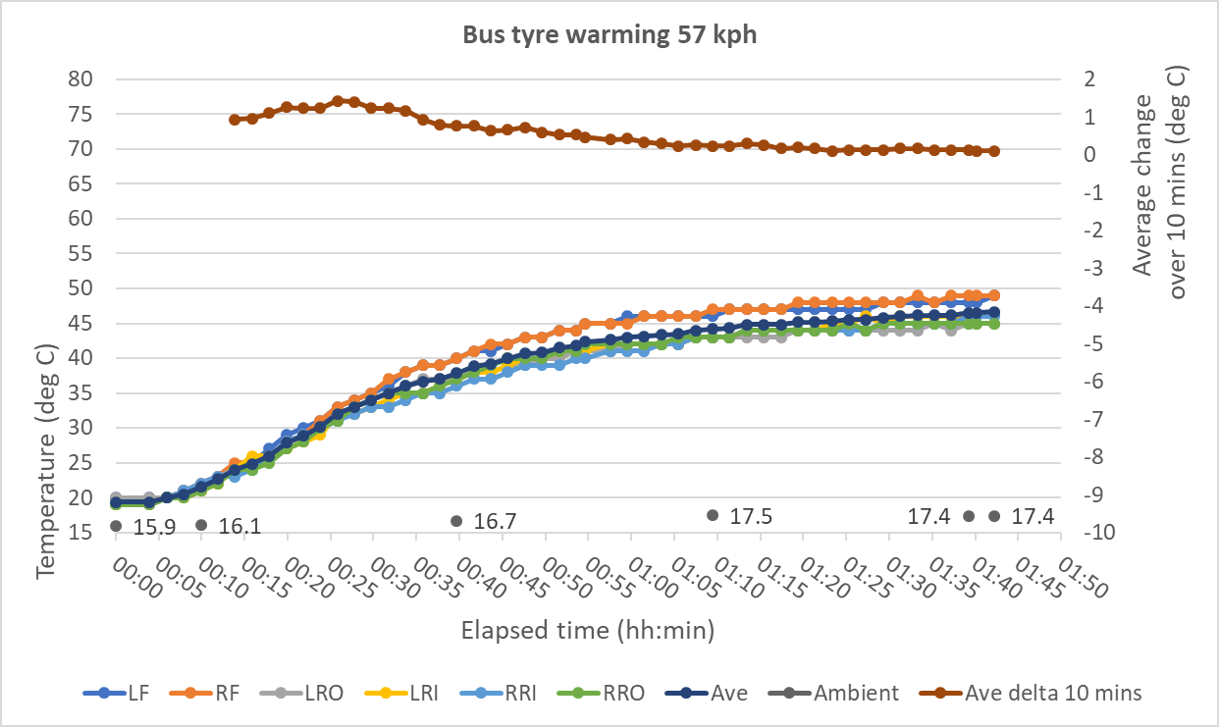
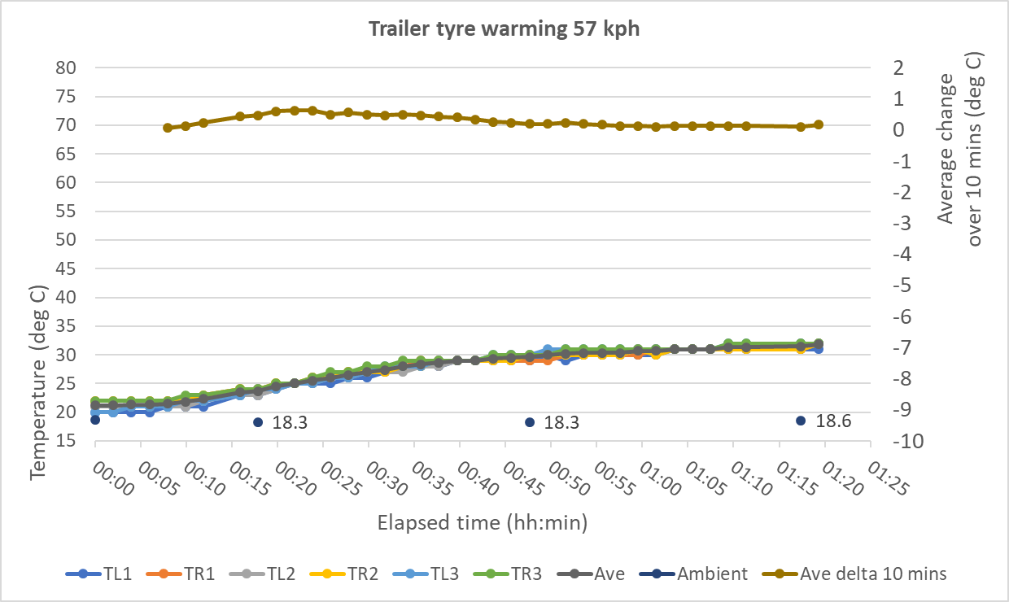
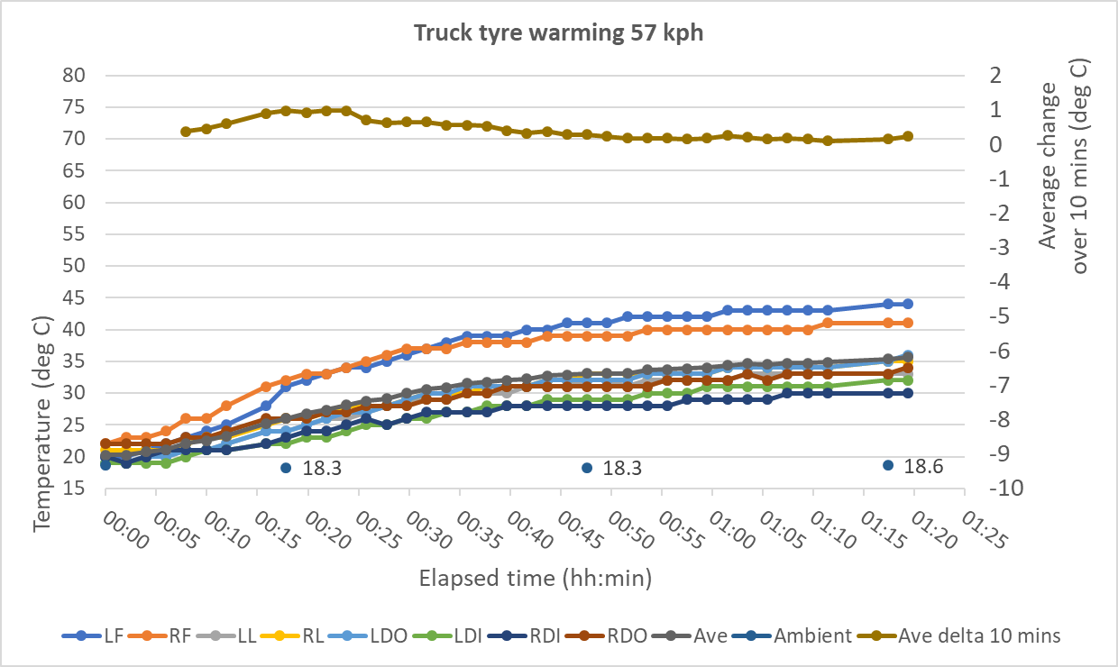
Tyre load
Little effect on warmup time
Temperature reached is higher

Slide 17
Regulatory proposal (Submitted to the experts of TPMSTI)
1.5.1. Test weight
The vehicle may be tested at any condition of load, the distribution of the mass among the axles being that stated by the vehicle manufacturer without exceeding any of the maximum permissible mass for each axle.
No changes to existing R141 text required

Slide 18
Open questions for defining the test procedure
Question 4
Can the proposed test procedures be carried out repeatably, reliably, practically?
The test procedures (puncture, diffusion, malfunction) were followed successfully and repeatably on multiple vehicle types using speed ranges agreed by stakeholders.
Simple equipment and a small number of personnel were required.

Slide 19
Open questions for defining the test procedure
Question 5
Any other learning
Pressure gauges should be used with a high deflation flow rate, or with an additional system for releasing pressure (e.g. an additional valve)
Soak time should be increased – 1 hour is not enough

Slide 20
Regulatory proposal (Submitted to the experts of TPMSTI)
Paragraph 2.1.
Before inflating the vehicle's tyres, leave the vehicle stationary outside at ambient temperature with the engine off shaded from direct sunlight and not exposed to wind or other heating or chilling influences for at least one hour for vehicles of category M1 and N1 and 4 hours for vehicles of category M2, M3, N2, N3, O3 and O4.

