Slide 1
Submitted by the Chair of the Informal Working Group (IWG) on TYRE GTR
Informal document WP.29-180-20
180th WP.29 10-12 March 2020
Agenda item 14.2.4.
Amendment # 2 to UN GTR No. 16 on Tyres

Slide 2
What is submitted to WP.29/AC.3
ECE/TRANS/WP.29/2020/41: Proposal for Amendment No. 2 to UN GTR No. 16 (Tyres)
ECE/TRANS/WP.29/2020/42: Proposal for the Technical Report for Amendment No. 2 to UN GTR No. 16 (Tyres)

Slide 3
Subject of Amendment No. 2 to UN GTR No. 16 as authorized by AC.3
Reference: Authorization ECE/TRANS/WP.29/AC.3/48
Amendment of the GTR text:
Amendment to the GTR 16 scope
Addition of new definitions (Section 2)
Harmonization of the Load Range concept in relationship to Inflation Pressure (Section 2)
Alignment of the provisions with the most recent developments in UN Regulations Nos. 30 and 54 (Sections 3.3 and 3.5, Annexes 3 and 6)
Harmonization of FMVSS 139 requirements relative to UN Regulation No 54 “PSI” index (Sections 3.7 and 3.8)
Addition of new harmonized provisions for physical dimensions of LT/C tyres (new Section 3.5.2; old Sections 3.20 & 3.21 deleted)
Addition of new harmonized provisions for high speed test for LT/C tyres (new Section 3.6.2.2, old Section 3.16 modified with endurance test only renumbered 3.9, old Section 3.19 deleted)

Slide 4
Part I: Statement on Technical Rationale and Justification - Updated
New Executive Summary
New paragraphs 2bis, 3bis, 22bis (substituting 23bis), 28ter (old 28ter moved to 28quinquis), 28quater, 28sexies to update the content of the existing Part I
New paragraphs 49 to 93 – Justification of the content of Amendment No. 2

Slide 5
Part II:
New Harmonized Provisions a. Physical Dimensions
Addition of new harmonized provisions for physical dimensions of LT/C tyres
(new Section 3.5.2 old Sections 3.20 & 3.21 deleted)
Subdivision in 3 categories:
Physical dimension for metric sizes (excluding all sizes listed in Annex 6) Most stringent requirements from FMVSS 139/R54 retained
Physical dimension for high flotation sizes (excluding all sizes listed in Annex 6)
Requirements of UN Regulation No. 54 adopted by WP.29/AC.1 at the June 2018 session (ECE/TRANS/WP.29/2018/55)
Physical dimension for sizes listed in Annex 6 (Legacy)

Slide 6
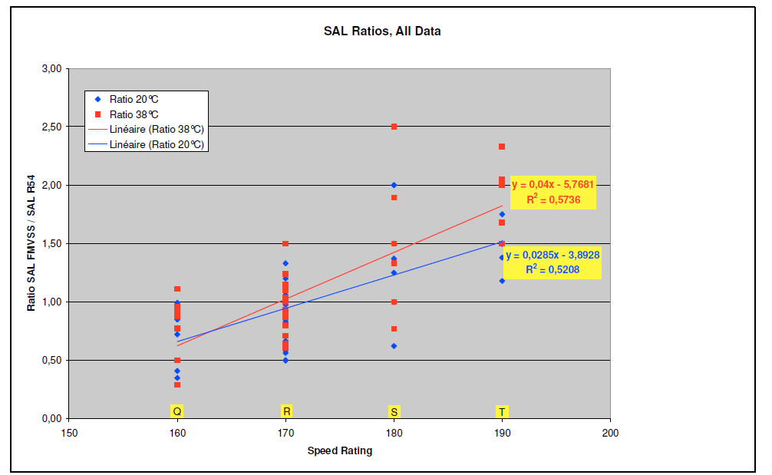
New Harmonized Provisions b. High Speed Test
Assessment of FMVSS139 High Speed test vs R54 Load/Speed test made by tyre industry:
IWG TYRE GTR conclusion:
Tyres with Speed Symbol S, T and H: Existing UN Reg 54 HS test
Final test speeds are based on the speed symbol of the tyre
25°C ambient temperature
Tyres with Speed Symbol Q and R: test to 160 resp 170 km/h at 35°C ambient temperature*
Modified UN Reg 54 test
Test severity is equivalent to existing FMVSS 139 requirement
Test efficiency (duration – impacting test lab capacity) is significantly improved
All tyres with SS < Q: test to 160 km/h (99 mph) at 35°C ambient temperature: existing FMVSS test
*UN Reg 54 with higher temperature is more severe because it uses 35°C instead of 25°C ambient temperature
FMVSS 139 more severe
?
R54 more severe
Since available results did not allow to decide between R54 and FMVSS139 High Speed tests for ‘Q’ and ‘R’ Speed Symbols, one of the reasons of the extension of the IWG mandate by 2 years was requested and confirmed in order to give tyre industry the possibility to confirm the initial results on the High Speed harmonised test method.

Slide 7
New Harmonized concepts:
a. Reference Test Inflation Pressure
Proposal by the industry: Create a strong link between the test inflation and the tyre load rating
Proposal to para 2.61: “Reference Test Inflation Pressure” applicable for LT/C tyres means the minimum cold inflation pressure for the maximum load rating of the tyre in single application
b. Measuring Rim
IWG removed the concept of 'measuring rim' in the sense of rims on which a test is to be performed from GTR and replaced it by 'test rim' in line with the ISO definition.
Thus the GTR was made self consistent with regards to the rims to use for testing
c. Replacement of load range by a table referring to a Reference Test Inflation Pressure to define the test conditions coming from FMVSS 139
This proposal brings clarity and coherence without changing the technical provisions intent
Reference Test Inflation Pressure Range (kPa) | Load range for Nominal section width
 | ≤ 295mm | > 295mm
170 – 199 | Not Applicable | B
200 – 299 | B | C
300 – 399 | C | D
400 – 499 | D | E
500 – 599 | E | Not Applicable

Slide 8
New Harmonized concepts:
d. Harmonized marking covering the maximum load rating and corresponding inflation pressure aligned to the reference test inflation pressure
In line with the definition of the Reference Test inflation Pressure, the inflation pressure marked for single application (and dual application if applicable) shall be equal or higher than the Reference Test Inflation Pressure.
e. Clarification of the concept of maximum load rating and load capacity of a tyre
Reference Test Inflation Pressure was introduced to clearly define inflation pressure in relation to the maximum load rating:
2.34. "Load index" means a numerical code which indicates the maximum load rating. The list of these indices and their corresponding reference loads is given in Annex 2;
2.40. "Maximum load rating" means the reference mass corresponding to the load index used to define the load capacity of the tyre;
2.61. "Reference Test Inflation Pressure" applicable for LT/C tyres means the minimum cold inflation pressure for the maximum load rating of the tyre in single application;
f. Introduction of harmonized provisions of the Tread Wear Indicator for LT/C tyres
Tread wear indicator provisions have been introduced for LT/C tyres, in line with the FMVSS 139 requirements

Slide 9
New Harmonized concepts:
g. Introduction of test equipment tolerances specification guidelines
Annex 11 of UN GTR No. 16 was added to provide Contracting Parties with guidance on harmonised tolerances for various values in the technical prescriptions of UN GTR No. 16.
Amendments reflecting Chinese and Indian proposals
A number of proposals made by China and India aimed at harmonization of the provisions of its domestic legislation with those of UN GTR No. 16 were considered and proper amendments in the GTR text were introduced as follows:
Table added showing the relation between Load Range and Ply Rating
Number of tread wear indicators
Strength test: specific requirements for rim diameter codes 13 and below
China requirements for High-Speed test were considered together with the new provisions for the harmonized High Speed test
New Annex 11 was introduced as guidelines for the tolerances for test equipment
Assessment of the required and optional tyre markings
A new paragraph 1.2.(e) was introduced because some Class C3 tyres with Load Index between 122 and 131 that contain “LT” or “C”

Slide 10
Future works
IWG TYRE GTR identified topics for future TYRE GTR developments:
Provisions for Extended Mobility Tyres
Elimination of the Overall diameter measurement for Radial tyres after high speed test
Provisions for North American All-Season tyres
Updated Bead Unseating test
Updated Strength test
LT/C Endurance test to be harmonized
Wet Grip for Worn tyres
New provisions for winter performance
The activities can start when Contracting Parties to 1998 Agreement confirm their interest in further development of UN GTR No 16 with regards to the topics as above and their priorities.

Slide 11
Thank you for your attention!

