Slide 1
COVID-19 Crisis Meeting Studiengesellschaft für den Kombinierten Verkehr (SGKV) e.V. Research Association for Intermodal Transport
The German Promotion Centre for Intermodal Transport

Slide 2
Über die SGKV / About the SGKV
Gründung des gemeinnützigen Vereins im Jahr 1928 vor dem Hintergrund des Eintretens des Lkw in den Langstreckenverkehr zwecks Erforschung rationeller, multimodaler Transportkonzepte.
Rund 80 Mitglieder in Deutschland, Schweiz, Österreich und anderen Ländern
Ziel und Zweck des Vereins:
Forschung, Optimierung, Lehre und Beratung rund um den Kombinierten Verkehr
Verbreitung wissenschaftlicher Ergebnisse zur Verbesserung und Förderung der praktischen, alltäglichen Anwendung des intermodalen Verkehrs in Deutschland und Europa
Zusammenbringen aller Akteure der Transportkette, der Politik und Wissenschaft an einem Ort
Association was founded in 1928 to explore intelligent co-operations and multimodal concepts between the then upcoming trucks and rail services
About 80 members in Germany, Austria, Switzerland and other countries
Association’s objectives:
Research, optimization, teaching and consulting around the combined transport
Dissemination of scientific results to improve and foster the practical, everyday application of intermodal transport in Germany and Europe
bringing together all actors in the transport chain, politics and science in one place

Slide 3
Selected Members

Slide 4
SGKV - COVID-19 Crisis Meeting Background / general information
Platform for informal exchange with other terminal operators
Learning from each other how to deal with the corona crisis internally (best practice) and how to ensure (emergency) operation
In order to keep voting short and effective, a start was made within the membership with rather larger terminal operators and CT operators (including HUPAC, Contargo, duisport, Kombiverkehr)
The SGKV serves as moderator and forwards the results to other CT terminals, policymakers / authorities, ministries and, on request, to the press
Formulation of recommendations for action to politicians and authorities in order to maintain emergency operations (e.g. relaxing regulations)

Slide 5
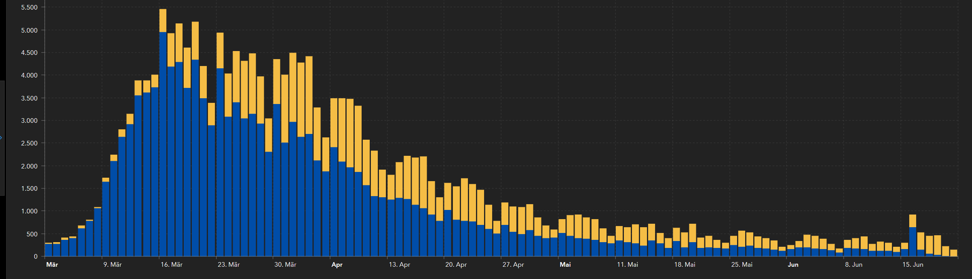
SGKV - COVID-19 Crisis Meeting Realisation
= Crisis Meeting
Source: RKI
Idea
translation publication of an English version
1. Crisis Meeting
Intensive and successful exchange with
the German Ministry of Transport
meetings are suspended
due to the relaxing situation
Creation and e-mailing (to all DACH-Terminals) of the
a) Guideline for CT-Terminals in dealing with COVID-19
b) Recommendations to Politics and Authorities
also free download on www.sgkv.de
Due to the relaxing situation
Decision to meet every 3 weeks

Slide 6
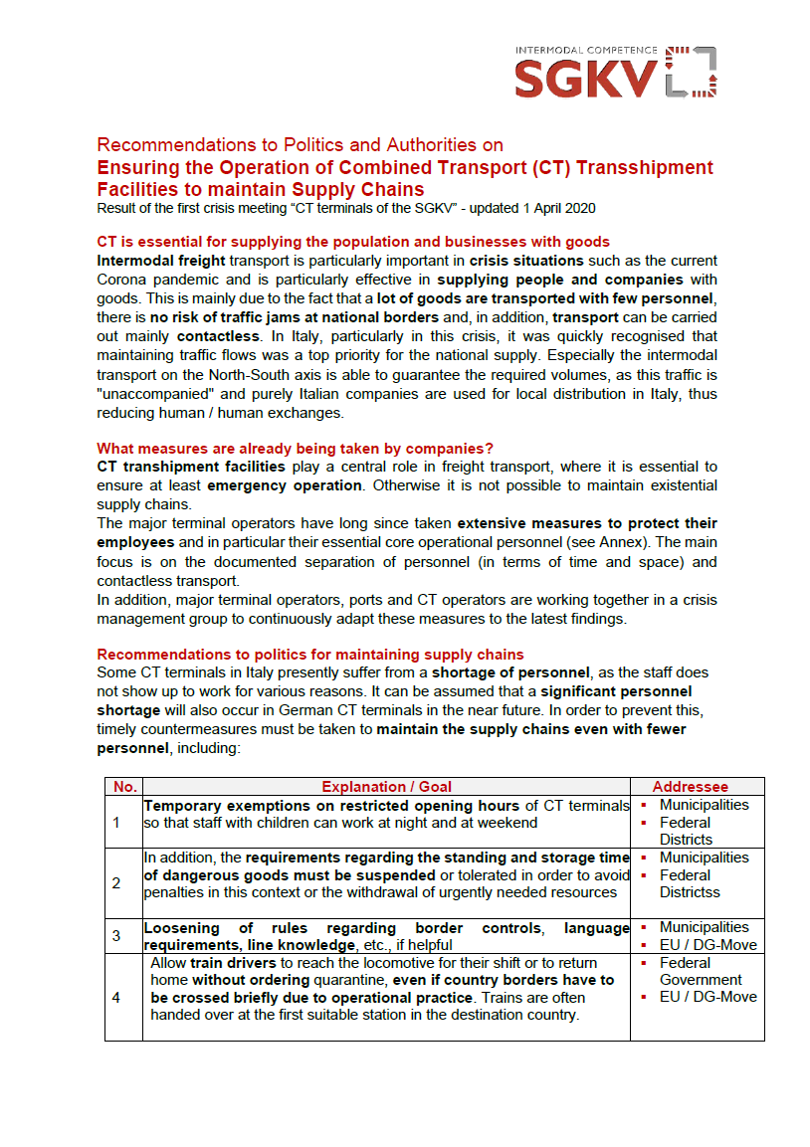
SGKV - COVID-19 Crisis Meeting Results
1) Recommendations to Politics and Authorities
currently 14 recommendations
it has proved to be advantageous to appoint the addressee / decision-makers directly
the most important requirements have been met (including shipping document as PDF-Mail and the ensuring for a 24/7 navigability of major waterways and railways)
There was a good exchange with the authorities. Many demands have been adopted and published: https://www.bmvi.de/SharedDocs/EN/Articles/K/Corona/faq-freight-and-logistics-during-corona.html

Slide 7
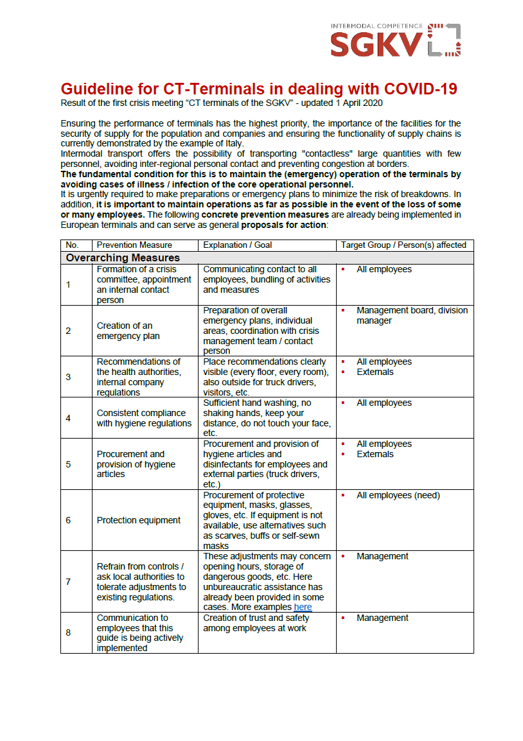
SGKV - COVID-19 Crisis Meeting Results
2) Guideline COVID-19 for CT-Terminals
currently 29 recommended measures
many terminals have implemented these measures and thus significantly minimized the risk of infection
no German terminal had to interrupt operations
one month after the first version of the SGKV terminal-guidelines, the Federal Government published (in parts) less stringent guidelines on occupational safety

Slide 8
SGKV - COVID-19 Crisis Meeting Lessons Learned
in need, the actors have worked together on the management level quickly, efficiently and openly to counter the threat
the quick development of the guidelines for CT terminals has achieved the desired effect, so that there have been very few corona cases in the terminals
the preparation of the recommendations for politicians and authorities was successful, as the combine transport sector spoke with one language. This has also made it easier for politicians and the authorities.

Slide 9
SGKV - COVID-19 Crisis Meeting Outlook
there is no comprehensive pandemic plan for freight and combined transport (for coming pandemics)
the Combined Transport has proven to be very crisis resistant (e.g. no congestion at the borders. very low staffing levels in relation to the volume transported). This is another reason to strengthen CT, besides ecological and economic aspects.
CT should be further optimised through consistent digitalisation and automation (including paperless transport). The crisis has shown that this is possible.
Important transport corridors (e.g. TEN-T) should be open 24/7 even in times of crisis. In some cases, important rail routes and locks were closed. Clear priorities should be set here.

Slide 10
SGKV e.V. Westhafenstr. 1, 13353 Berlin, Germany T +49 30 206 13 76 0 F +49 30 206 13 76 17
www.sgkv.de
www.intermodal-map.com
www.intermodal-info.de

Slide 11
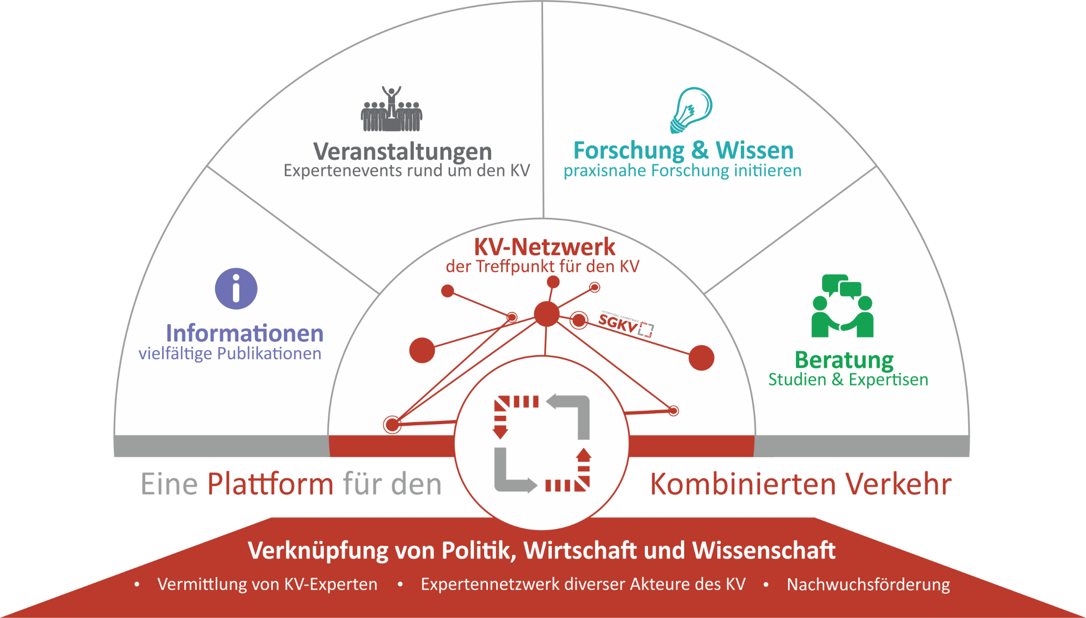
Portfolio

