Slide 1
INF.60
Economic Commission for Europe
Inland Transport Committee
Working Party on the Transport of Dangerous Goods 15 September 2020
Joint Meeting of the RID Committee of Experts and the Working Party on the Transport of Dangerous Goods
Bern, 10–11 September and Geneva, 14–18 September 2020

Slide 2
Decision by ITC
19. Furthermore, the Committee welcomed ongoing alignment activities by its Working Parties, in response to its invitation to its subsidiary bodies to take follow-up actions to align their work with the ITC strategy (ECE/TRANS/288, paras. 15 (a) and (c)) and decided to request the secretariat, in close cooperation with the Working Parties and in consultation with the Bureau to prepare a report on alignment activities of WPs and possible future activity for the consideration of the Committee at its eighty-third session.

Slide 3
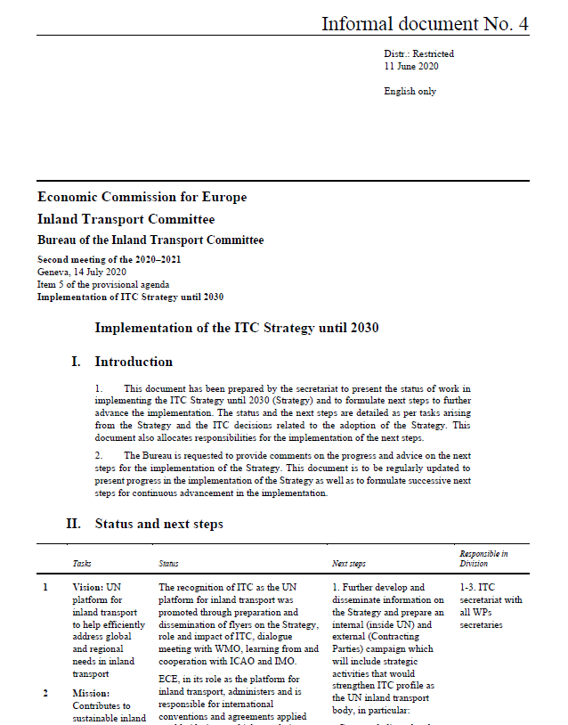
Implementation of the ITC decision
Status and next step
Related to the tasks of the strategy and decisions related to the adoption of the strategy

Slide 4
Decision by the ITC Bureau
The Bureau requested the secretariat to forward Informal Document No. 4 to all Working Parties or their Chairs and invite them to submit their suggestions or comments to the secretariat by Friday 16 October with a view for the Bureau to review the document and the alignment and implementing plans at its November session and consider the next steps towards its submission to the ITC for its consideration.

Slide 5
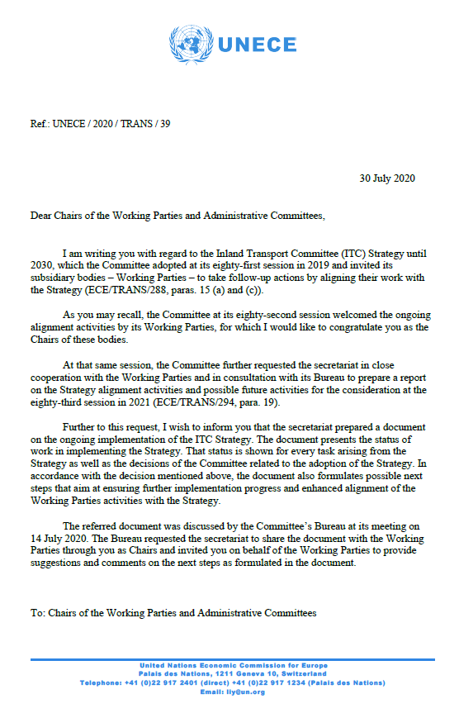
Follow-up on the ITC Bureau decision
Request – to review the document on next steps and provide comments and suggestions

Slide 6
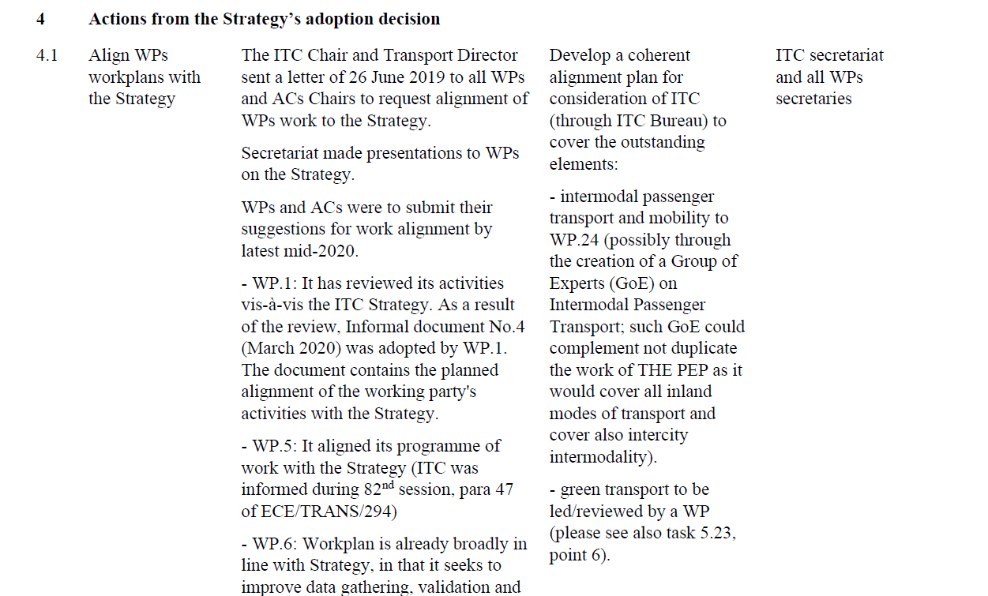
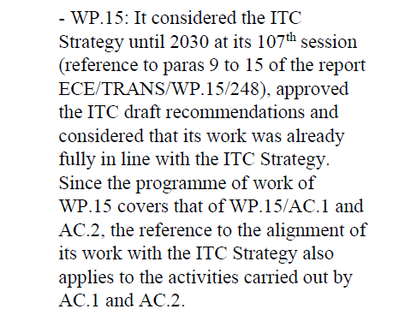
Implementation of the ITC decision

Slide 7
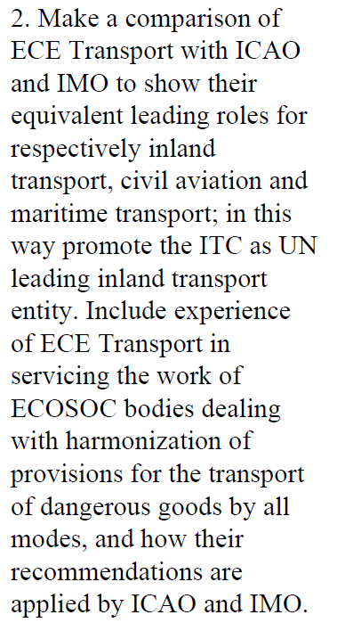
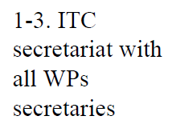
Implementation of the ITC decision

Slide 8
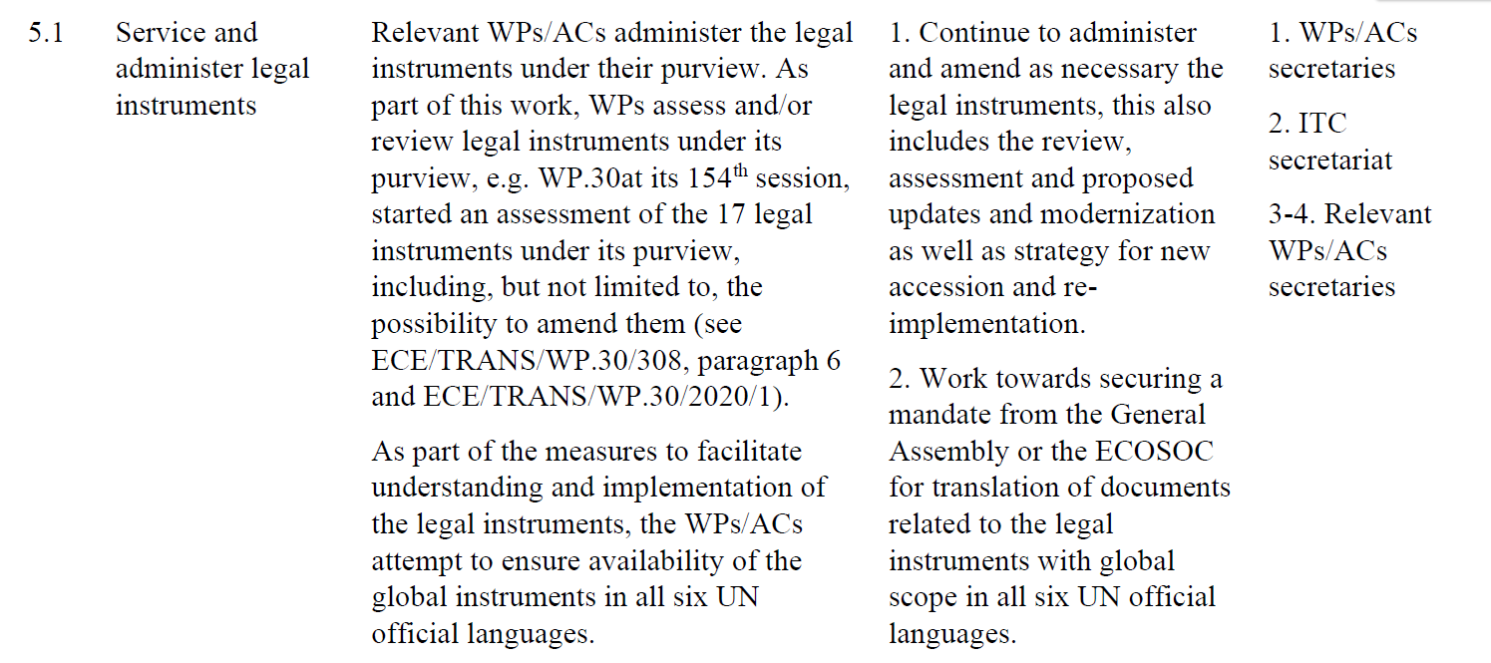
Implementation of the ITC decision

Slide 9
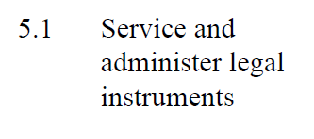
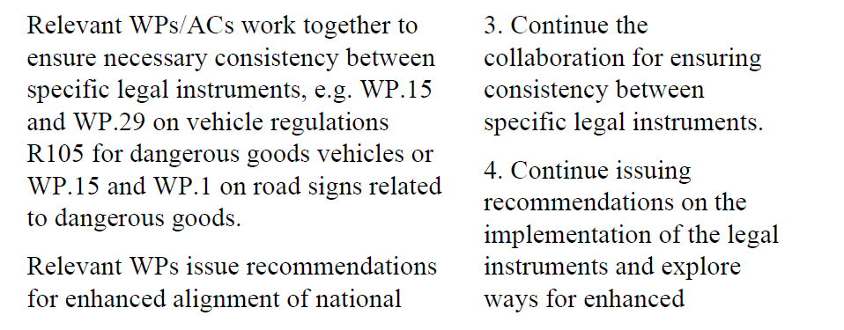
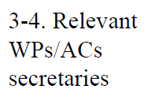
Implementation of the ITC decision

Slide 10
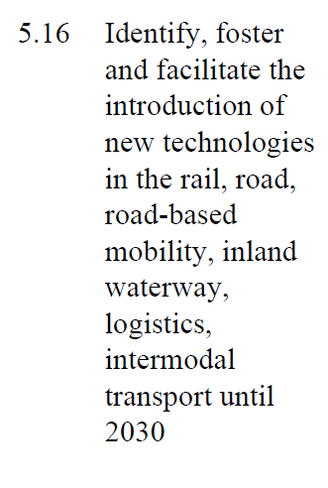
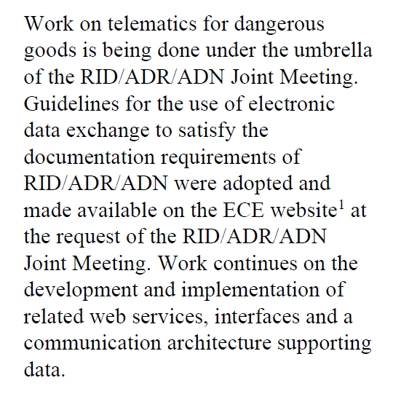
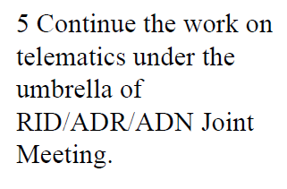
Implementation of the ITC decision

Slide 11
Implementation of the ITC decision
Your comments and views are welcome

