Slide 1
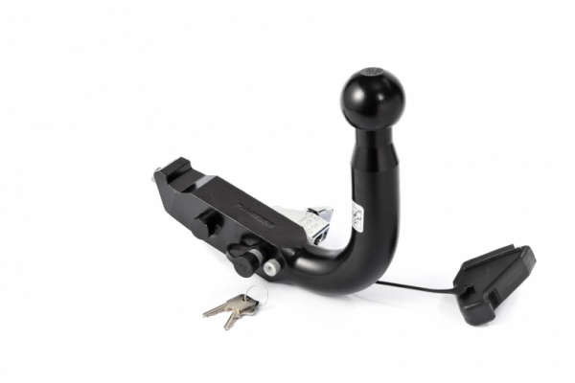
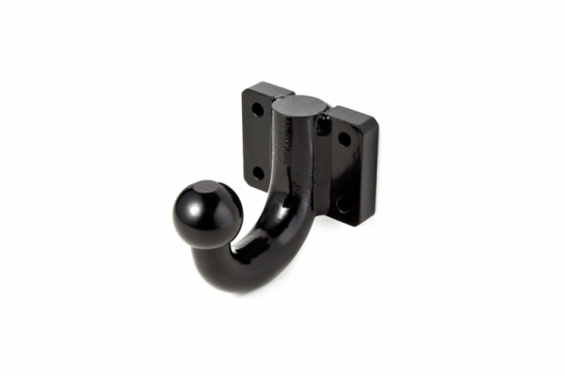
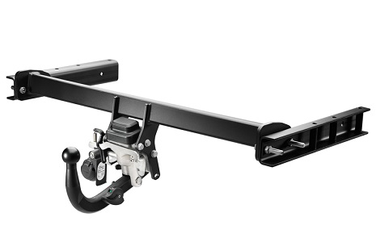
Informal document GRSG-116-33
(based on ECE/TRANS/WP.29/GRVA/2018/11)
(116th GRSG, 1-5 April 2019
agenda item 8)
Submitted by the expert from Poland
UN Regulation No. 55:
Examples of mechanical coupling devices
of class A

Slide 2
Mechanical coupling devices and components
Class | Short description
A | Coupling ball and towing brackets
B | Coupling heads
C | Clevis type drawbar coupling
D | Drawbar eyes
E | Non-standard drawbar
F | Non-standard drawbar beam
G | Fifth wheel couplings
H | Fifth wheel couplings pins
J | Non-standard mounting plates
K | Standard hook type couplings
L | Standard toroidal drawbar eyes
S | Devices and components not to conform to any other classes
T | Non-standard, non-automatic dedicated drawbar type coupling
Submitted by the experts from Poland

Slide 3
Mechanical coupling devices and components
Class A - Coupling balls and towing brackets employing a 50 mm diameter spherical device and brackets on the towing vehicle for connecting to the trailer by means of a coupling head.
Submitted by the experts from Poland

Slide 4
Tests of mechanical coupling device class A
Submitted by the experts from Poland

Slide 5
Example of mechanical coupling device class A
Submitted by the experts from Poland

Slide 6
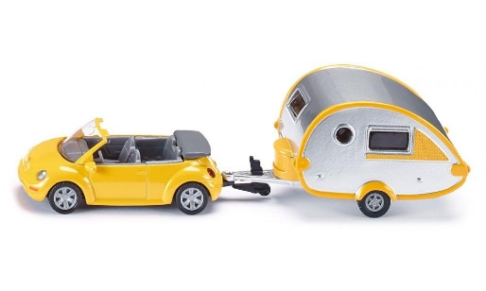
Examples of mechanical coupling device class A
COMMUNICATION FORM – Annex 1
9.3 | For class A mechanical coupling devices or components, including towing brackets:
 | Vehicle manufacturer's maximum permissible vehicle mass: | 1530 | kg
 | Distribution of maximum permissible vehicle mass between the axles:
 | front axle / rear axle | according to vehicle documentation
 | Vehicle manufacturer's maximum permissible towable trailer mass: | 1200 | kg
 | Vehicle manufacturer's maximum permissible static mass on coupling ball: | 75 | kg
 | Maximum mass of the vehicle, with bodywork, in running order, including coolant, oils, fuel, tools and spare wheel (if supplied) but not including driver: | 1200 | kg
 | Loading condition under which the tow ball height of a mechanical coupling device fitted to category M1 vehicles is to be measured - see paragraph 2 of annex 7, appendix 1: | 300 | kg
Submitted by the experts from Poland

Slide 7
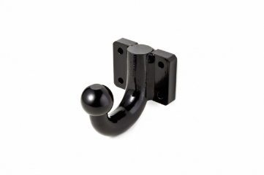
Example of mechanical coupling device class A
Coupling ball
Class A
Submitted by the experts from Poland

Slide 8
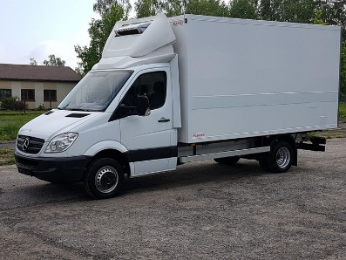

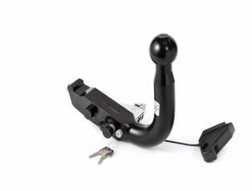
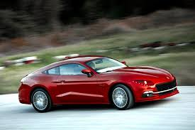
Examples of mechanical coupling device class A
COMMUNICATION FORM – Annex 1
9.3 | For class A mechanical coupling devices or components, including towing brackets, if Applicable:
 | Vehicle manufacturer's maximum permissible vehicle mass: | not applicable
 | Distribution of maximum permissible vehicle mass between the axles:
 | front axle / rear axle | not applicable
 | Vehicle manufacturer's maximum permissible towable trailer mass:
 | Vehicle manufacturer's maximum permissible static mass on coupling ball: | not applicable
 | Maximum mass of the vehicle, with bodywork, in running order, including coolant, oils, fuel, tools and spare wheel (if supplied) but not including driver: | not applicable
 | Loading condition under which the tow ball height of a mechanical coupling device fitted to category M1 vehicles is to be measured - see paragraph 2 of annex 7, appendix 1: | not applicable
Submitted by the experts from Poland

Slide 9
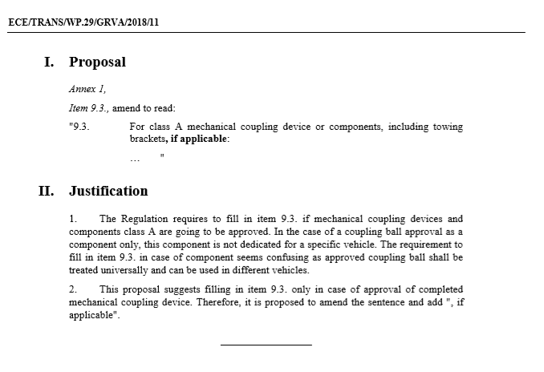
Submitted by the experts from Poland

Slide 10
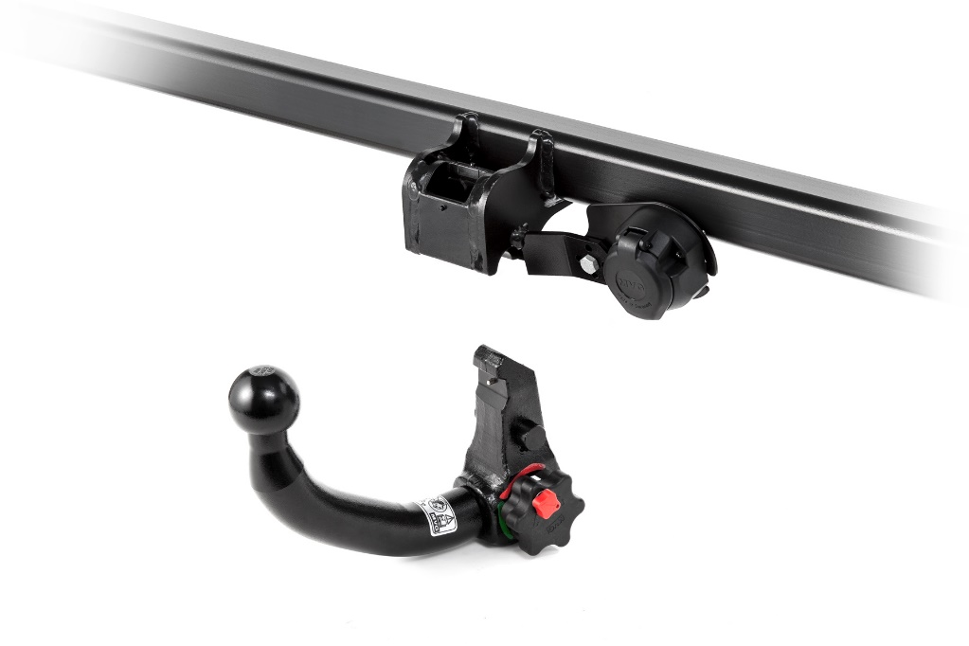
Thank you for your attention
Submitted by the experts from Poland

