Slide 1
IMMA comments on GRE-82-22
Informal document GRE-82-37
(82nd GRE, 22-25 October 2019,
agenda item 7 (b))
Transmitted by the expert from IMMA
82nd GRE session (22-25 October 2019)

Slide 2
Comments on GRE-82-22
IMMA: The transitional provisions aim to allow lead time to address unique technical difficulties for motorcycles when implementing DRL auto-switch (sensor placement in instrument cluster rather windscreen as for cars). Additionally, noting significant differences between motorcycle configurations, which may require model-specific calibration and testing.
IMMA: Manufacturers have been voluntarily installing DRL on a number of models for many years.
The 03 series of amendments introduces a new requirement to automatically switch between DRL and dipped-beam headlamp based on specified ambient lighting conditions.
Motorcycles fitted with DRL will need to be redesigned and calibrated to meet the new R53.03 requirements.
IMMA would like to request clarification on the above statement:
In IMMA understanding, 03 series of amendments is limited to the introduction of the new DRL auto-switch, which require a transitional period to 1 September 2023.
Any other amendments included in WP.29/2019/80 correspond to Supplement 3 to the 02 series to avoid legal uncertainty.

Slide 3
History
77/GRE (April 2017)
GRE/2016/35 (Japan): Introducing DRL Auto-Switch, with a proposed period of 48 months Transitional Provisions.
GRE-77-17 (Italy): About the technical difficulties of introducing DRL Auto-switch on motorcycles.
Decision to establish DRL-L special interest group, which started exchanging subsequently, involving EC, UK, NL, JP, IND, IMMA among others.
79/GRE (April 2018)
GRE/2018/19 (DRL-L): Result of the DRL-L special interest group to regulate DRL for motorcycles.
48 months of Transitional Provisions.
80/GRE (October 2018)
GRE/2018/50 (DRL-L): Updated version of GRE/2018/19.
A transitional period for DRL auto-switch was set until 1 September 2023.
Agreed at 80/GRE.
81/GRE (April 2019)
GRE/2019/12 (IMMA):
Proposal to correct §5.11.2 (AHO) to its original requirement.
GRE/2018/50 as amended by GRE/2019/12 adopted by GRE with unchanged TPs.

Slide 4
Transitional Provisions
Current situation:
R48.05 (cars):
48 months Transitional Provisions.
(66 months M1/N1 & 84 months for other categories, when applying alternative conditions, e.g. tell tale, …)
R53.03 (motorcycles):
Expected adoption at November WP.29 → Entry into force June 2020
September 2023: Expiry date of Transitional Provisions
= 40 months,
Shorter Transitional Provisions as for cars, even if technically more challenging
GRE-82-22 proposal (October 2019):
GRE-82-22 proposes to reduce the Transitional Provisions to September 2021.
If GRE agreed by means of a formal amendment (April 2020 83/GRE), the document would be submitted to November 2020 WP.29, with Entry into force June 2021.
This is very close to the proposed end of Transitional Provisions of September 2021.
= almost no lead time available

Slide 5
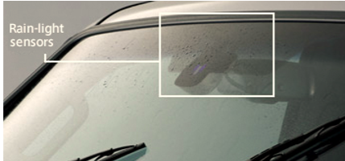
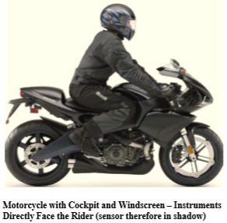
Technical difficulties
For cars/trucks, light sensors are mounted inside the cabin, typically near the rear-view mirror, behind the windscreen cleaned by wipers.
The sensor is forward facing and angled to give an unobstructed line-of-sight view to the sky to measure ambient lighting conditions.
Differently from cars, for motorcycles the most appropriate location is integration into the instrument cluster.
Complications:
Lack of a wiper mechanism to keep the sensor clean.
Not all motorcycles have a windshield to protect against contamination.
The sensor can be obscured by the rider and fairing.
Each model requiring dedicated integration and calibration.
GRE-77-17: on motorcycles technical difficulties

Slide 6
Conclusion
Shortening the currently foreseen Transitional Provisions is not appropriate as it would not provide the necessary time to solve these technical challenges.
In the proposal for adoption by WP.29 in November 2019 (WP.29/2019/80), the Transitional Provisions foreseen for implementation of DRL Auto-switch on motorcycles are shorter than the ones that were allowed for cars, even if motorcycles have a lot more technical challenges associated with implementing DRL Auto-switch.
IMMA requests to keep the Transitional Provisions, as agreed at 80/GRE and 81/GRE.

Slide 7
Thank you

