Slide 1
Informal document GRE-81-20
(81st GRE, 15-18 April 2019,
agenda item 4)
Transmitted by IWG SLR
UNIQUE IDENTIFIER
Impact and usage of the UI in Regulations No. [148]/[149]/[150]
Definition of the different phrases used
Approval marking
Approval number
Symbol
Additional symbol
Introduction of different possibilities when using the Unique Identifier
The comparison between the different options
Example: Usage of the current UI understanding in other Regulations i.e. Tyres

Slide 2
UNIQUE IDENTIFIER
Impact and usage of the UI in Regulations No. [148]/[149]/[150]
Necessary markings on a single function device according to par. 3.3.2. and 3.3.4. of Regulation No. [148]
Approval marking
(Par. 3.3.4.1.)
Trade name or mark
(Par. 3.3.4.2.)
Par. 3.3.2.
The approval marking shall consist of:
The circle surrounding the letter „E“ + number of authority
The Regulation number (148) followed by „R“, the series of amendments (00), a dash „-“ and the approval number (1111)
Symbols identifying the signalling function (R1)
Additional symbols
horizontal arrows for limited mounting positions
„R“ or „L“
„D“ or „Y“ for single lamp combinations
Vertical arrows for limited visibility
R1
EUROPEAN COMPANY
E4
ECME
MANUFACTURING EVERYTHING
[148]R00-1111
2DE-2345-02PA
Light source category (Par. 3.3.4.3.)
Rated Voltage or range (Par. 3.3.4.4.)
P21/5W
11-14V
On any fixed part visible after installation (par. 3.3.4.1.1.)
Anywhere on the device
(par. 3.3.4.7.)
Question 1: Who is the addressee of each part of these markings?
Question 2: Which of these information parts is needed when?

Slide 3
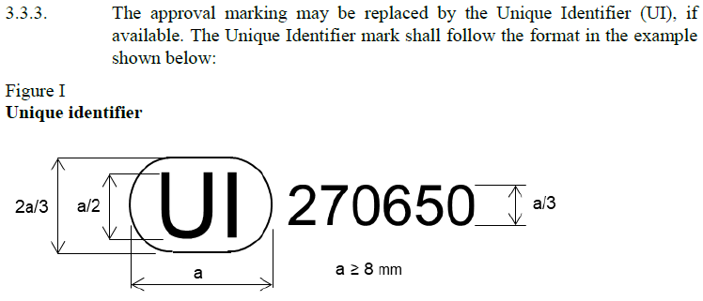
UNIQUE IDENTIFIER
Impact and usage of the UI in Regulations No. [148]/[149]/[150]
Current understanding and text for the usage of the Unique Identifier
Par. 3.3.2.
The approval marking shall consist of:
The circle surrounding the letter „E“ + number of authority
The Regulation number (148) followed by „R“, the series of amendments (00), a dash „-“ and the approval number (1111)
Symbols identifying the signalling function (R1)
Additional symbols
horizontal arrows for limited mounting positions
„R“ or „L“
„D“ or „Y“ for single lamp combinations
Vertical arrows for limited visibility
DETA Information (Level: public?)
R1
Regulation No.: [148]
Series of Amendments: 00
Authority: Netherlands
Function(s) included: Rear position (R1)
Approval number: 1111
Extension number: n.a.
Mounting height: below 750 mm
Mounting side: Right side only
Type „D“: No
Type „Y“: No
UI
270650
E4
+
[148]R00-1111
On the device
In the database (internet)
Question: Is there something like a „public“ level to the DETA?

Slide 4
UNIQUE IDENTIFIER
Impact and usage of the UI in Regulations No. [148]/[149]/[150]
DETA-33-08e, Par. 12, Draft Guidelines for application of the Unique Identifier (UI)
Utilizing the secure internet database and using the UI as marking is on a voluntary basis, unless a UN Regulation stipulates otherwise.
A UN Regulation may prohibit the use of the UI as marking for the items covered by that UN Regulation. A UN Regulation may also specify that additional symbols and information to be marked on the product can be regarded as part of the approval marking and may be replaced by the UI marking accordingly.
DETA Information (Level: public)
Regulation No.: [LSD]
Series of Amendments: 00
Authority: Netherlands
Function(s) included: Rear position(R1)
Approval number: 1111
Extension number: n.a.
Mounting height: below 750
Mounting side: Right side only
Type „D“: No
Type „Y“: No
Manufacturer logo/tm:
Manufacturer name: ECME
Product number: 2BA-2232-02F
Light Source(s): P21/5W
Voltage/Voltage range: 11-14V
S1
E4
UI
+
1234567
[LSD]R00-1111
On the device
EUROPEAN COMPANY
ECME
MANUFACTURING EVERYTHING
In the database (internet)
Question: Is this an option for lighting and light-signalling?

Slide 5
UNIQUE IDENTIFIER
Impact and usage of the UI in Regulations No. [148]/[149]/[150]
On the device,
original marking
Possible alternatives
Using UI, on the device
Using UI, in the database
UI
DETA Information (Level: public?)
270650
+
Regulation No.: [148]
Series of Amendments: 00
Authority: Netherlands
Function(s) included: Rear position (R1)
Approval number: 1111
Extension number: n.a.
Type „D“: No
Type „Y“: No
A
Replacing only a part of the approval marking
EUROPEAN COMPANY
P21/5W
11-14V
ECME
MANUFACTURING EVERYTHING
2DE-2345-02PA
DETA Information (Level: public?)
R1
UI
Regulation No.: [148]
Series of Amendments: 00
Authority: Netherlands
Function(s) included: Rear position (R1)
Approval number: 1111
Extension number: n.a.
Mounting height: below 750 mm
Mounting side: Right side only
Type „D“: No
Type „Y“: No
B
270650
+
E4
[148]R00-1111
Replacing the complete approval marking
11-14V
EUROPEAN COMPANY
P21/5W
ECME
MANUFACTURING EVERYTHING
2DE-2345-02PA
EUROPEAN COMPANY
P21/5W
11-14V
DETA Information (Level: public?)
ECME
MANUFACTURING EVERYTHING
2DE-2345-02PA
Regulation No.: [148]
Series of Amendments: 00
Authority: Netherlands
Function(s) included: Rear position(R1)
Approval number: 1111
Extension number: n.a.
Mounting height: below 750
Mounting side: Right side only
Type „D“: No
Type „Y“: No
Manufacturer logo/tm:
Manufacturer name: ECME
Product number: 2BA-2232-02F
Light Source(s): P21/5W
Voltage/Voltage range: 11-14V
C
UI
270650
+
Replacing the complete approval and the additional markings
EUROPEAN COMPANY
ECME
MANUFACTURING EVERYTHING
or even other solutions

Slide 6
UNIQUE IDENTIFIER
Impact and usage of the UI in Regulations No. [148]/[149]/[150]
Headlamp marking on the device (this is approval marking only!)
Rear combination lamp marking on the device (this is approval marking only!) (for device part 1 and part 2)
Remember: R[148] and R48
3.3.5.4. Lamps reciprocally incorporated with other lamps, of which the lens may also be used for other types of devices. The provisions laid down in paragraph 3.3.5. are applicable.
5.22. With the exception of retro-reflectors, a lamp even bearing an approval mark is deemed not to be present when it cannot be made to operate by the sole installation of a light source and/or a fuse.
Question: Will there be a difference when dealing with more complicated devices (more functions)?

Slide 7
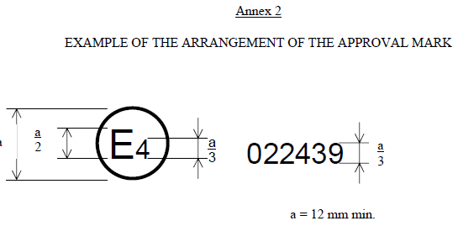
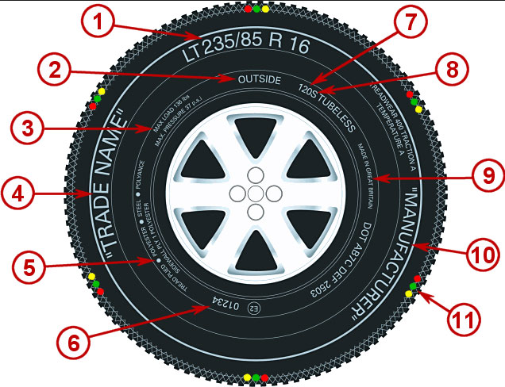
UNIQUE IDENTIFIER
Impact and usage of the UI in Regulations No. [148]/[149]/[150]
+
A lot of mandatory additional markings!!
Additional info:
A tyre needs a TA for Regulation No. 30 (the tyre itself) and secondly the TA for Regulation No. 117 (rolling noise).
R30 is bound to a tyre size,
R117 is not bound to a tyre size.
If a tyre is retreaded, it needs a TA acc. To R108 and this TA is bound to the procedure of the factory instead of the tyre.
Only this part of the whole marking could be replaced by the UI if we talk about approval marking

