Slide 1
Exchange of information with the WP.29 secretariat
Informal document WP.29-177-21
177th WP.29, 12-15 March 2019
Agenda item 4.1
Note by the secretariat
Type Approval Authorities
Technical Services
and
(new) L-IWVTA

Slide 2
1958 Agreement
Schedule 2 – Part 1, para. 3
Procedure for notification:
Contracting Parties shall notify the UNECE secretariat of the name, the address including electronic address and the category of activities of each designated technical service
In response to these provisions, the secretariat developped the web based application
This application was used to prepare the document
ECE/TRANS/WP.29/343/Rev.27 (and Add. 1 & 2)

Slide 3
UN Regulation No. 0
According to Para. 13.5:
A Contracting Party may accept a L-IWVTA
For that purpose, it shall notify to the secretariat [...] the UN Regulations and their versions for which it will accept type approvals
For such notification, the format provided in Annex 4, Part A, Section II shall be used.

Slide 4
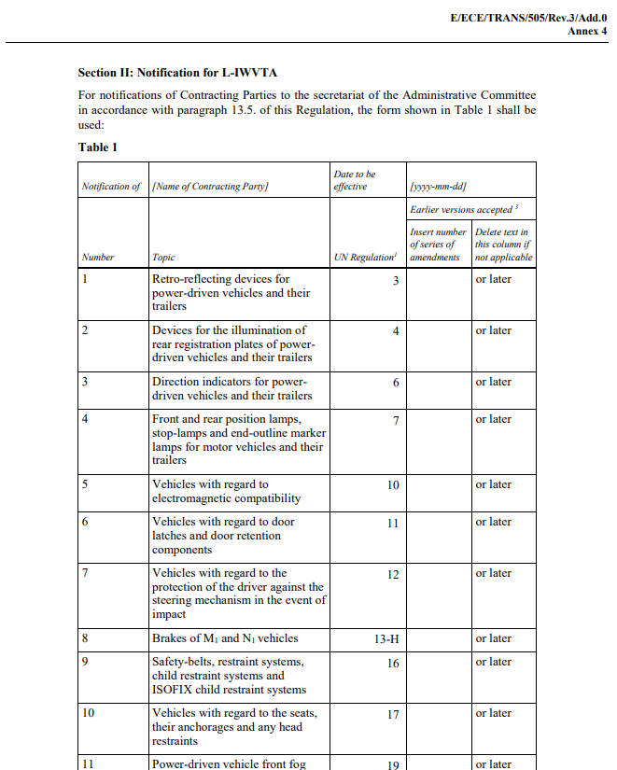
UN Regulation No. 0 Annex 4 Part A Section II
The secretariat announced the development of an extension of the web based application relevant for the exchange of information for the purpose of ECE/TRANS/WP.29/343 and its amendments:
Goal
Provide immediately the information submitted by the Contracting parties
(The paper version was produced once a year and up to three times a year informally)

Slide 5
UN Regulation No. 0 Annex 4 Part A Section II
The secretariat announced the development of an extension of the web based application relevant for the exchange of information for the purpose of ECE/TRANS/WP.29/343 and its amendments:
Goal
Provide immediatly the information submitted by the Contracting parties
(The paper version was produced once a year and up to three times a year informally)
The content of Table 1 shall be shared electronically

Slide 6
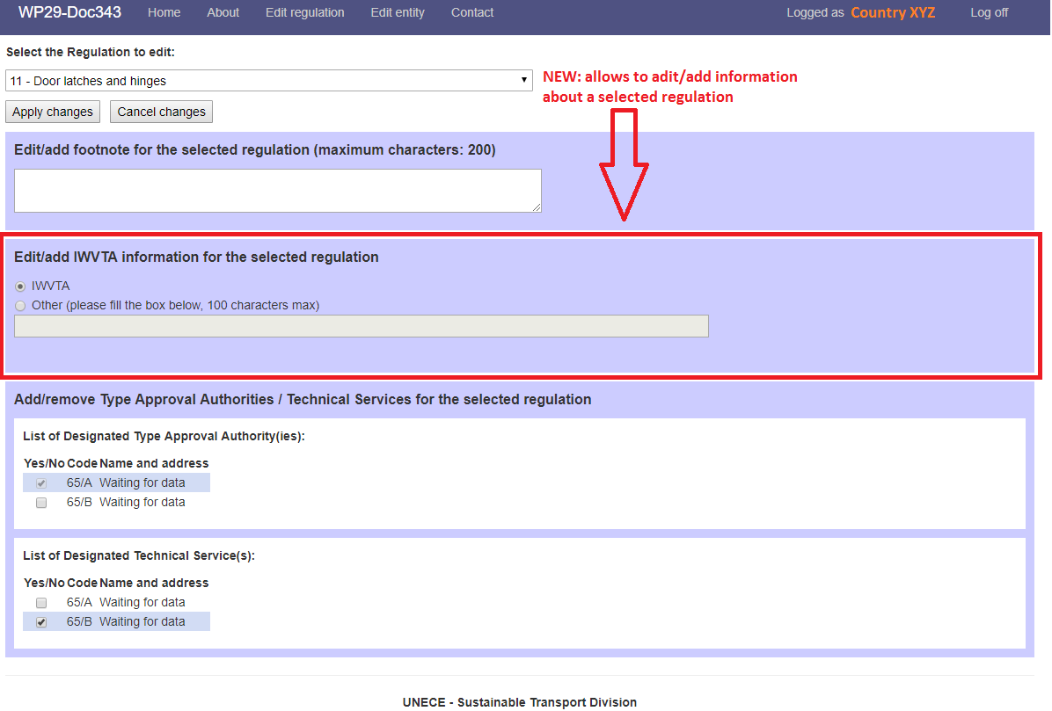
Version developed and currently tested:
This slide shows the change made to the web application to allow each SPOCs of Contracting Parties to notify for relevant UN Regulations (Here: UN R.11) the information requested in para. 13.5 (and Annex 4, Part A, Section II of UN R. 0.)
xx series
xx series or later

Slide 7
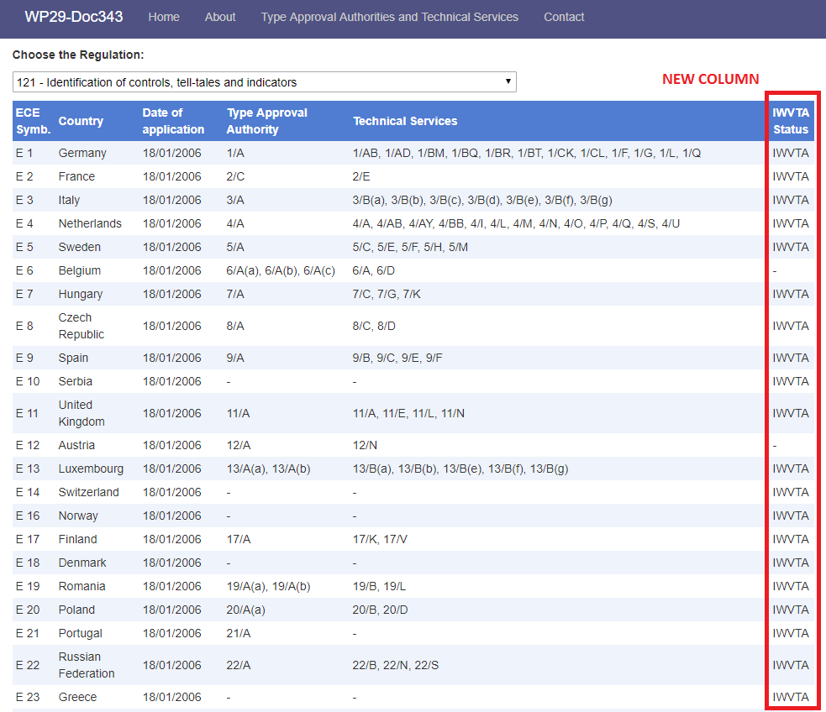
The information will be displayed for each UN Regulation as it was originally proposed by the IWG on IWVTA for the paper version of the ECE/TRANS/WP.29/343/Rev.x

