Slide 1





INTERTRAN
Project of the Asia-Pacific Regional Assembly of the International Union of Railways
Liudmila Renne
Deputy Head of the Foreign Projects and
International Cooperation Department
JSC Russian Railways

Slide 2

RZD IN COMPARISON WITH OTHER WORLD RAILWAY COMPANIES
3
3

Slide 3

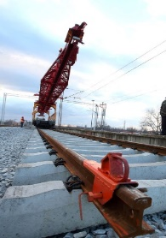

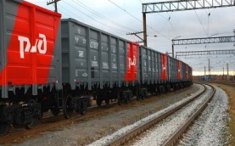
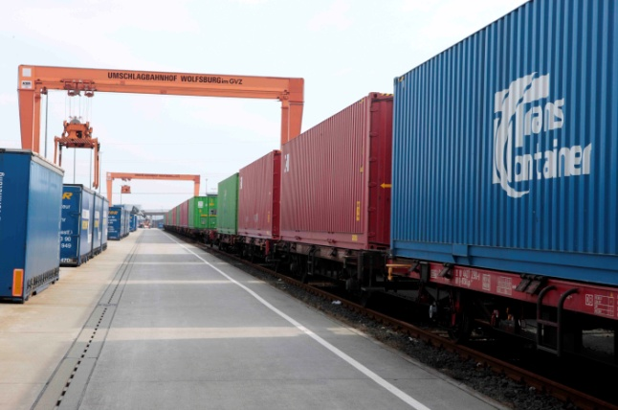
RZD IN FIGURES
About us
180
85 600
1.1
YEARS OF HISTORY
AND EXPERIENCE
KM LENGTH
OF THE NETWORK
BLN., PASSENGER TURNOVER EVERY YEAR
40
10 000
1.2
BLN. Т, CARGO TURNOVER EVERY YEAR
PRESENCE IN COUNTRIES
TRAINS DAILY
12
16
REPRESENTATIONS ABROAD IN ASIA AND EUROPE
REGIONAL BRANCHES
HIGH QUALITY
INNOVATIVE SOLUTIONS
NEW TECHNOLOGIES
COMFORT AND EFFICIENCY

Slide 4
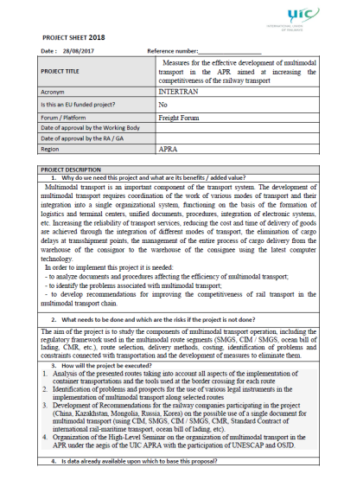
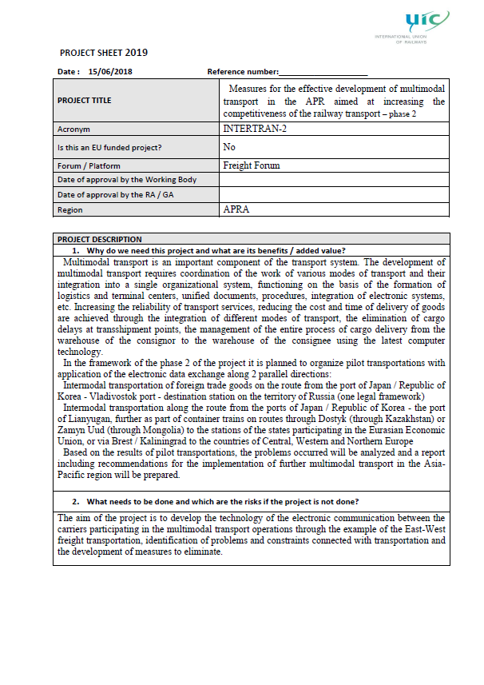
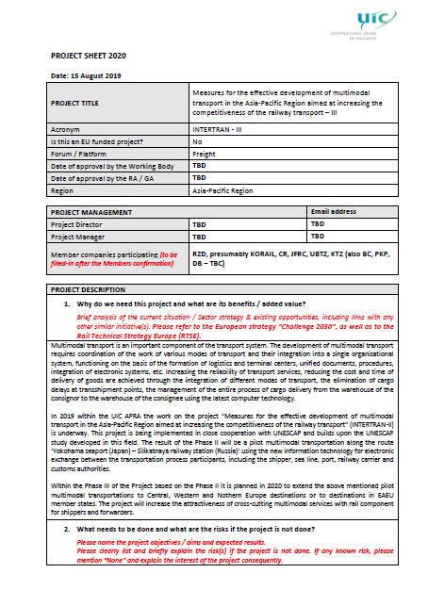
EFFICIENCY OF INTERTRAN PROJECT IMPLEMENTATION
  PRACTICAL MEASURES TO INTRODUCE ELECTRONIC DOCUMENT FLOW FOR INTERMODAL TRANSPORTATION
  CREATING A SEAMLESS ENVIRONMENT FOR INFORMATION EXCHANGE TO ENSURE ELECTRONICISATION OF BUSINESS PROCESSES IN RAILWAY TRANSPORT
  INCREASING THE ATTRACTIVENESS OF RAIL-BASED END-TO-END INTERMODAL SERVICES FOR SHIPPERS AND FREIGHT FORWARDERS

Slide 5

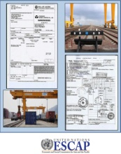
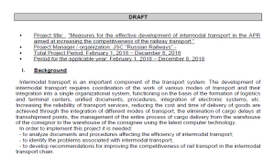
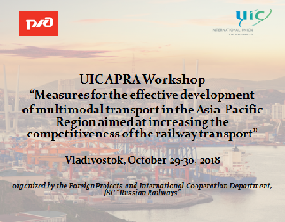

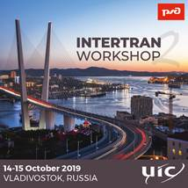
IMPLEMENTATION OF THE INTERTRAN PROJECT
UNESCAP STUDY AIMED AT OPTIMISING INTERMODAL RAIL LINKS IN NORTH-EAST AND CENTRAL ASIA
2016
INTERTRAN WAS IDENTIFIED AS A PRIORITY PROJECT FOR 2018 (WITH SUPPORT FROM UIC APRA AND INTERNATIONAL ORGANISATIONS SUCH AS ESCAP, OSJD, CCTT)
2017
UIC APRA WORKSHOP ON THE INTERTRAN PROJECT (VLADIVOSTOK, 29–30 OCTOBER 2018)
2018
DEVELOPMENT AND IMPLEMENTATION OF INFORMATION TECHNOLOGY FOR THE INTERTRAN PROJECT AND ORGANISATION OF PILOT TRANSPORTATION ALONG THE IOKOHAMA – VLADIVOSTOK – SILIKATNAYA ROUTE
2019
UIC APRA WORKSHOP ON THE INTERTRAN PROJECT (VLADIVOSTOK, 14 OCTOBER 2019)
2019

Slide 6
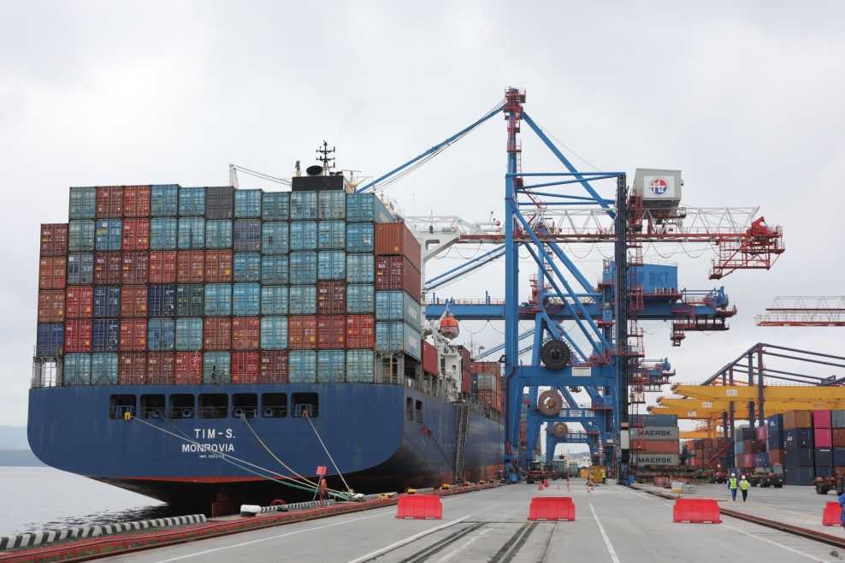
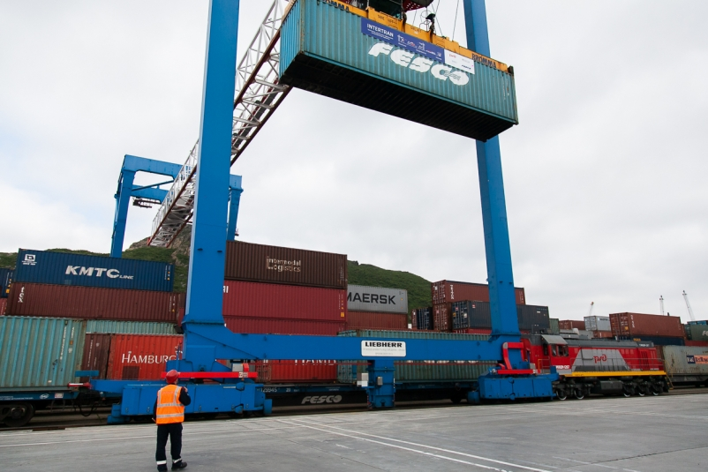
INTERTRAN INFORMATION TECHNOLOGY
DEVELOPED INFORMATION TECHNOLOGY DEFINES THE PROCEDURE FOR ELECTRONIC INTERACTION BETWEEN THE SEA PORT AND THE RAILWAY IN THE PROCESS OF INTERMODAL FREIGHT SHIPMENT VIA SEA PORTS USING ELECTRONIC DOCUMENTS AND DATA
INTERTRAN TECHNOLOGY PRESENTATION
WAS HELD IN VLADIVOSTOK COMMERCIAL SEA PORT ON 4 SEPTEMBER 2019

Slide 7

PILOT TRANSPORTATION ROUTE
Russia
Silikatnaya
Belarus
Kazakhstan
Mongolia
Vladivostok
Yokohama
China
Yokohama Port (Japan) –Vladivostok Port (Russia) – Silikatnaya station

Slide 8

EFFICIENCY OF INTERTRAN PROJECT IMPLEMENTATION
Electronic interaction with customs authorities at the port when declaring goods and using electronic transit declarations
Using electronic waybills (paperless technology) when processing railway transportation documents
Optimising the processing of technological operations at a railway station using mobile workstations
Completion of the customs transit procedure in electronic form a the customs authorities of destination on the territory of the Russian Federation without providing documents in hard copy

Slide 9
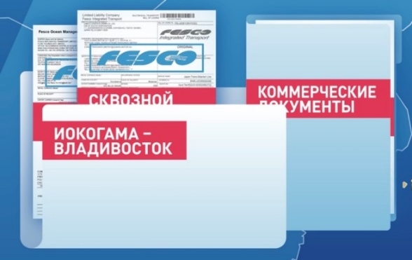
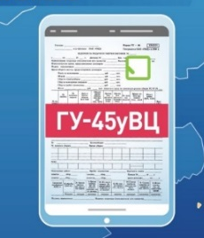
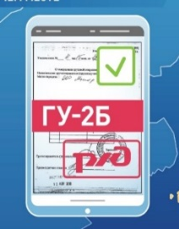
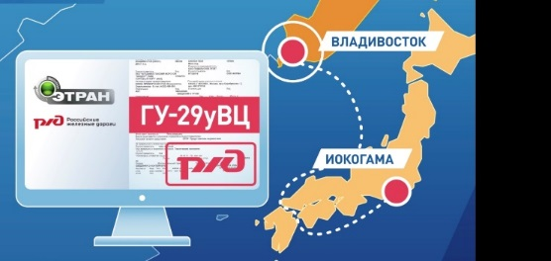

USE OF MOBILE WORKSTATIONS
BEFORE INTERTRAN, THE FOLLOWING DOCUMENTS WERE PROCESSED ELECTRONICALLY:
Commercial documents
Marine Bill of Lading
Through Bill of Lading
Applications for freight transportation
Transit declaration (paper copy attached “on the way”)
THE INTERTRAN PROJECT ENABLED THE ELECTRONIC PROCESSING OF THE FOLLOWING DOCUMENTS AT MOBILE WORKSTATIONS BY ACCEPTANCE/DELIVERY AGENTS AT THE PORT:
Notification about completion of loading operation
Wagon feeding and cleaning memo
IN THE ETRAN SYSTEM:
Consignment note
IN THE Federal Customs Service SYSTEM:
A transit declaration without a paper copy "on the way “
Electronic closing of transit at the destination station

Slide 10











PILOT TRANSPORTATION UNDER INTERTRAN PROJECT
INTERNATIONAL INTERMODAL TRANSPORTATION USING PAPERLESS TECHNOLOGY IN COOPERATION BETWEEN THE CUSTOMER, CARRIERS (SEA AND RAIL) AND REGULATORS
INITIATOR & CARRIER :
PILOT OPERATOR:
BEFORE PROJECT:
5 hours
9 days
4 days
9 days
3 days
Иокогама
Vladivostok Commercial Seaport
Vladivostok railway station – Moscow
Terminal
AFTER PROJECT IMPLEMENTATION:
5 hours
9 days
2 days
9 days
1 day
EFFECT
REDUCTION OF TOTAL CARGO HANDLING TIME BY 4 DAYS AND REDUCTION OF COSTS FOR TRANSPORTATION PARTICIPANTS

Slide 11

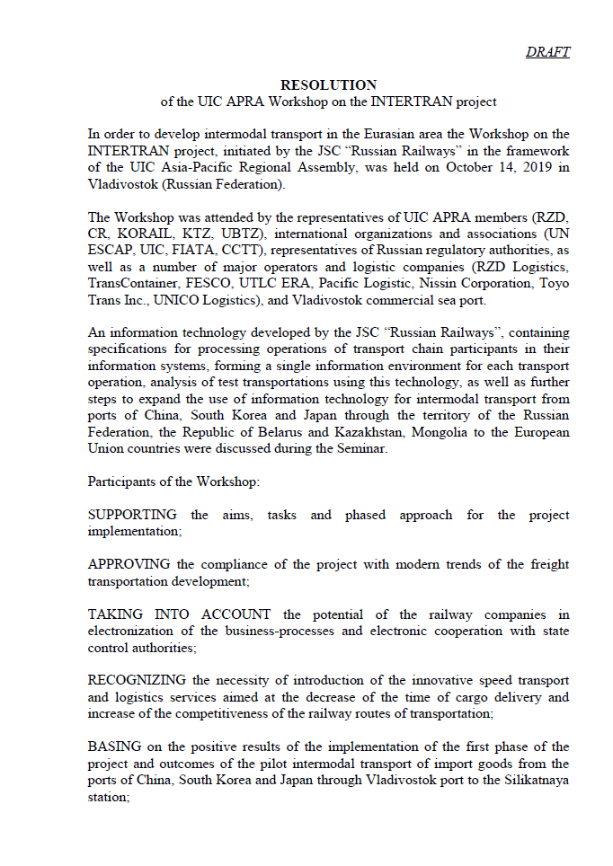
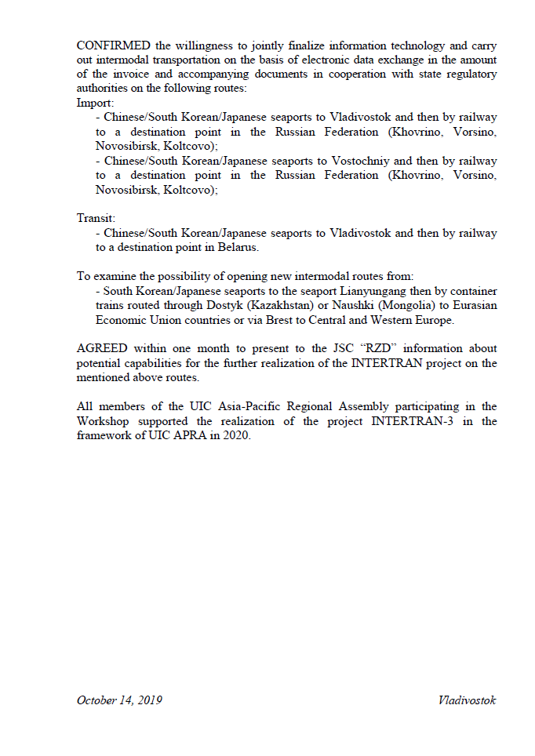





Import - Chinese/South Korean/Japanese seaports to Vladivostok / Vostochniyand then by railway to a destination point in the Russian Federation (Khovrino, Vorsino, Novosibirsk, Koltcovo);
Transit - Chinese/South Korean/Japanese seaports to Vladivostok and then by railway to a destination point in Belarus.
To examine the possibility of opening new intermodal routes from South Korean/Japanese seaports to the seaport Lianyungang then by container trains routed through Dostyk (Kazakhstan) or Naushki (Mongolia) to Eurasian Economic Union countries or via Brest to Central and Western Europe.
FURTHER STEPS: PILOT INTERMODAL TRANSPORTATIONS STATES
Russia
Belarus
Kazakhstan
Mongolia
Dostyk
Zamyn-Üüd
Vladivostok
South Korea
Japan
China
Lianyungang

Slide 12

THANK YOU FOR YOUR ATTENTION!

