Slide 1
AEBS systems on Trucks Road Safety for user and roadworker
Submitted by the expert from the Netherlands (Announced during the session, not displayed)
Informal document GRVA-01-43 1st GRVA, 25-28 September 2018 Agenda item 7
Jan van Hattem, RWS- WVL

Slide 2
Road operator roles
Different roles:
As employer responsible for safety of our own personnel
Responsible for safety of contracted personnel
Road operator: safety of road user

Slide 3
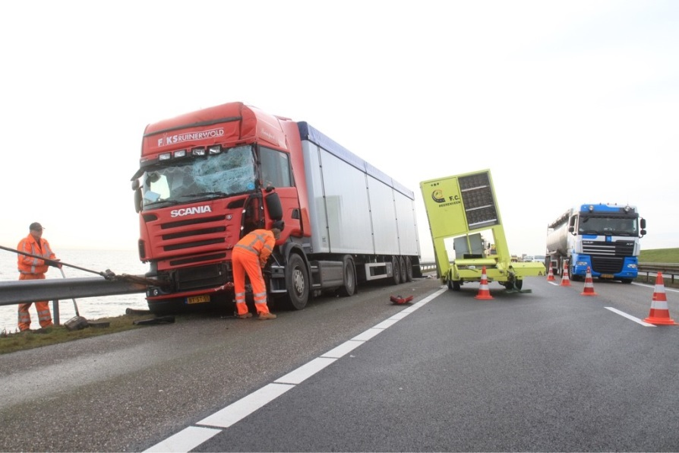
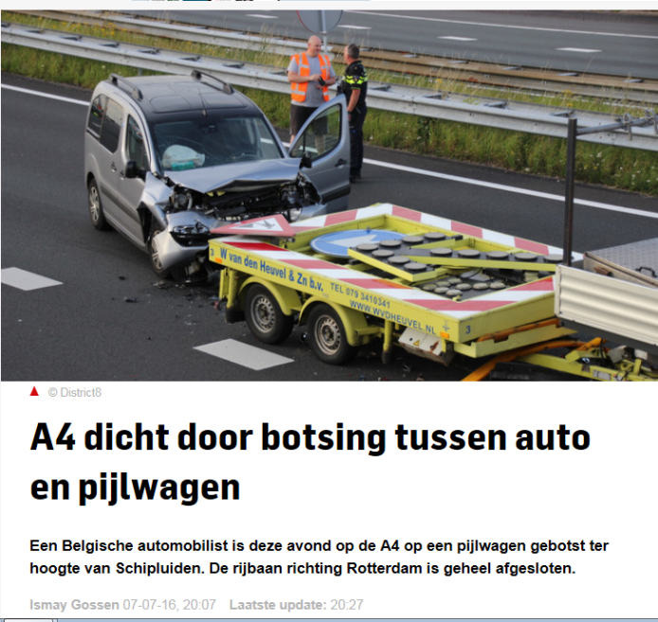
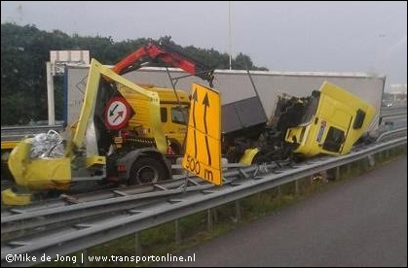
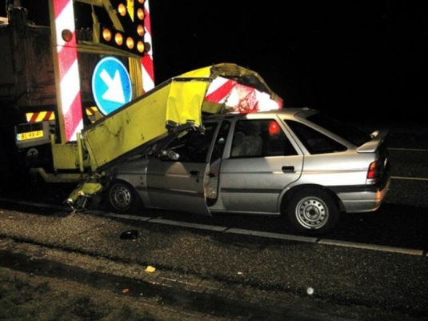
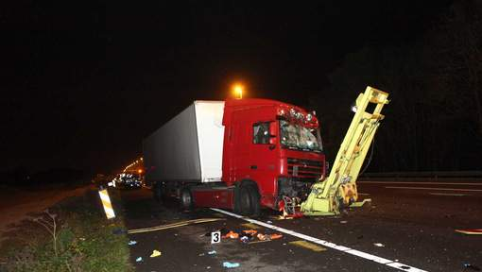
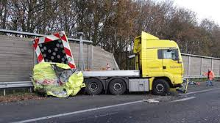
Starting point: Road worker safety

Slide 4
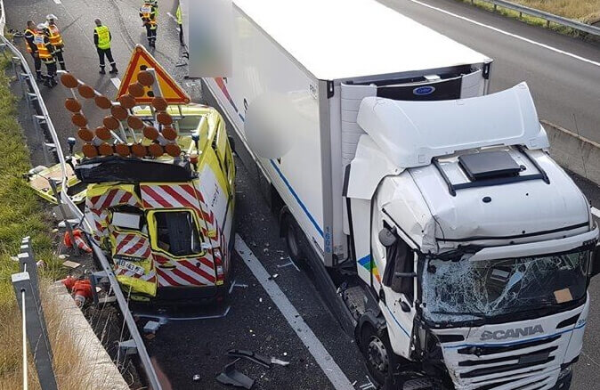
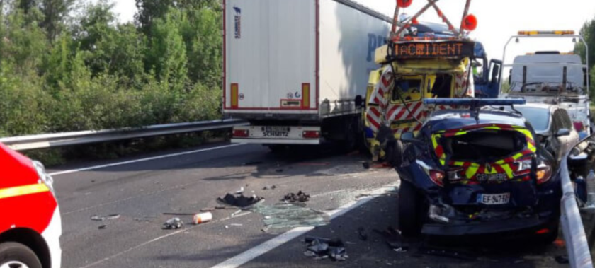
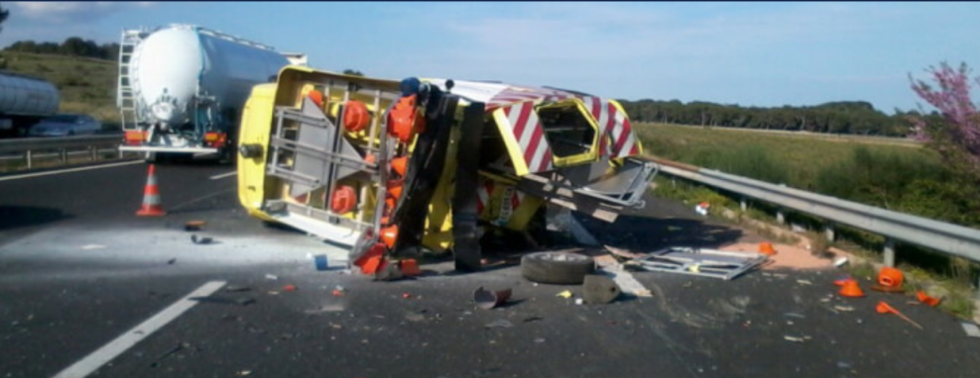
France: Vinci Autoroutes
En 2017, 88 véhicules d’intervention ont été heurtés sur le réseau VINCI Autoroutes, et 185 à l’échelle de l’ensemble du réseau autoroutier français. Depuis le 1er janvier 2018, ce sont déjà 32 fourgons qui ont été percutés par des conducteurs inattentifs ou hypovigilants.

Slide 5
Video 1: AEBS and Road works
From interviews (30) and Questionnaire we learned that the majority of truck drivers expect that their AEBS system can recognise Road works
Tests showed differently

Slide 6
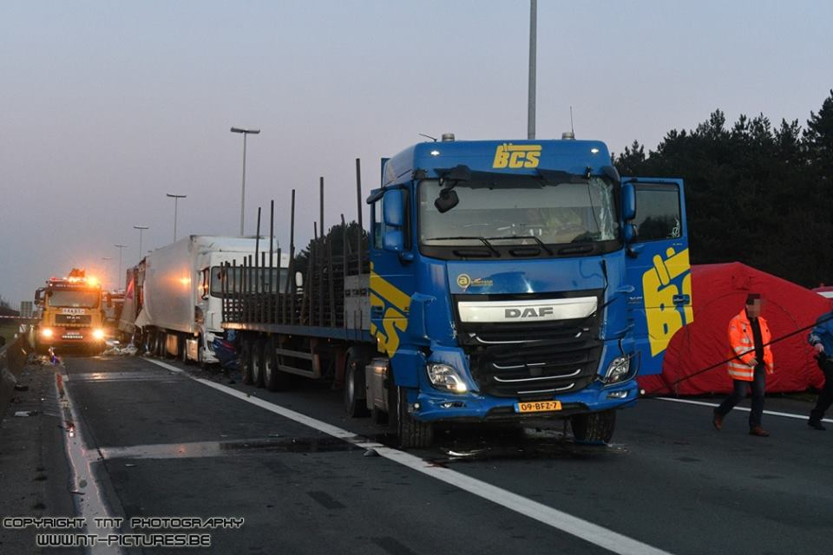
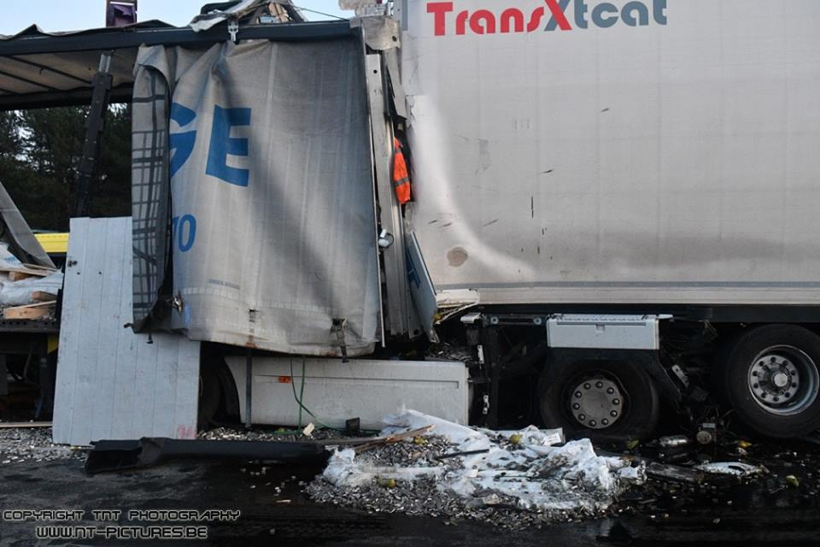
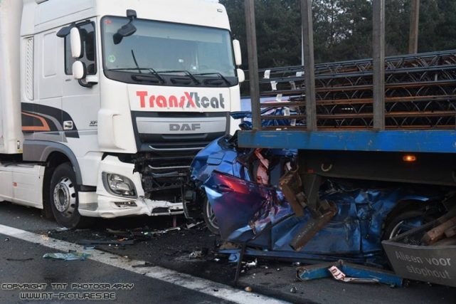
Results AEBS recognition of Road works 2017
Road works are not recognised at 40 meters
How about the recognition of vehicles other than the sedan personal car?

Slide 7
Video 2: AEBS and truck combinations, new TMA

Slide 8
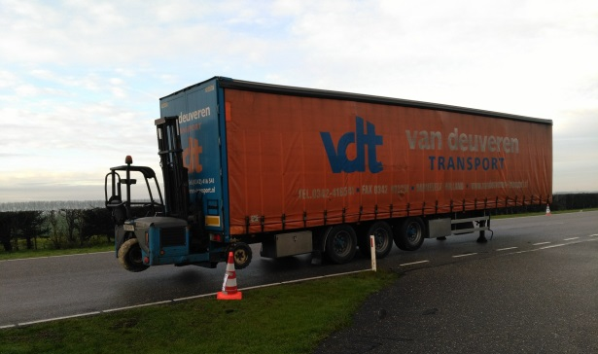
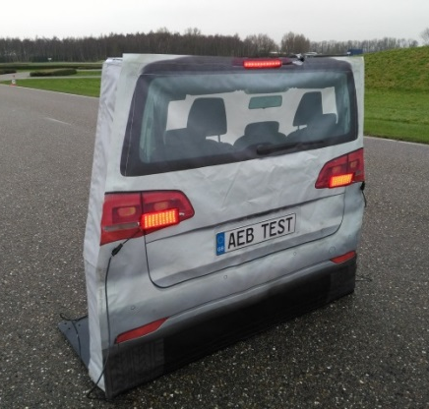
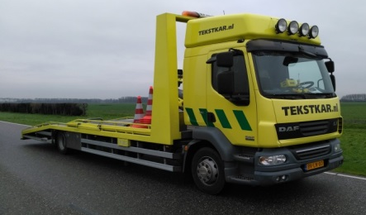
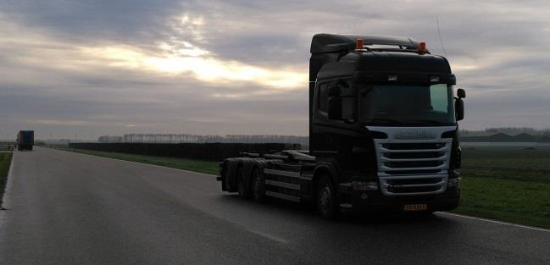
Results
Large variation in recognition
79% to 21%
Average:48%
Test Target: 81%

Slide 9
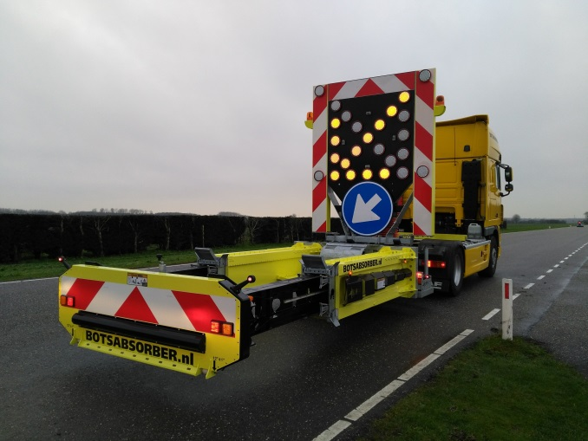
Road works: improvement
Previous model was not recognised, new model with bigger flat plate is better recognised.

Slide 10
Request to the meeting
Develop tests that incorporate all real road situations
Go on with improving the systems
Help Road Authorities to make their systems better recognisable for Trucks and cars.
Improve the recognition of barriers by the systems
If we work together to help automated systems to recognise special cases the road will be a safer place.

Slide 11
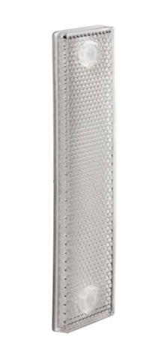
Suggestion
Ad checker board diagram, radar reflector and lidar reflector or prism to road works and barriers.

Slide 12
Thank you for your attention
Ir. J. van Hattem mba
Rijkswaterstaat, WVL, Safety department,
+31 (0)6 4673 2271
Jan.van.hattem@rws.nl
Lange Kleiweg 34, 2288 GK Rijswijk.
Postbus 2232 | 3500 GE Utrecht

