Slide 1
Introduction of Booster Cushions in R129
Informal document GRSP-64-16-Rev.1
(64th GRSP, 11-14 December 2018
agenda item 19)
Clepa Proposal for R129/04 Series of Amendments
GRSP 64th Session
Farid Bendjellal

Slide 2
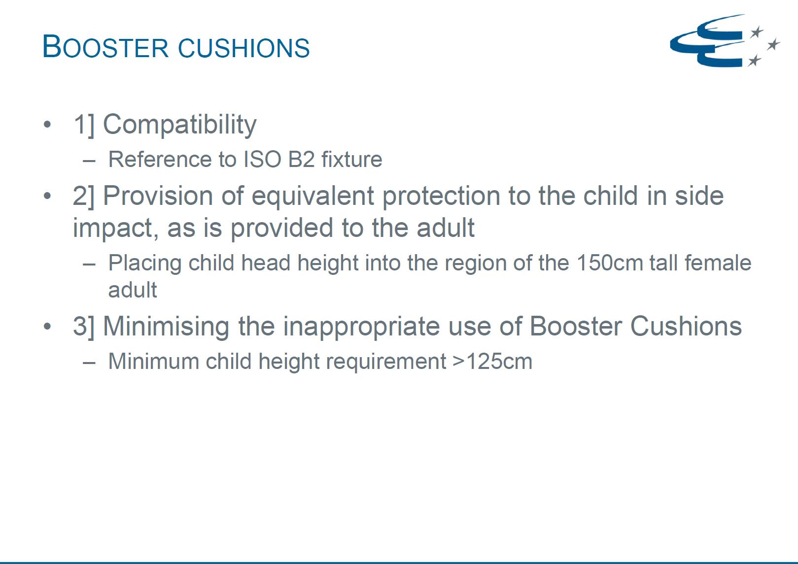
Extract from Informal Group Document CRS 66-10

Slide 3
ECRS categories
The scope of the regulation will be extended by two new categories following the same principle as before to have an i-Size and a specific vehicle category.
Paragraph 1., amend to read:
1. Scope
This Regulation applies (in Phases 1, 2 and 3) to the following child restraint system for child occupants of power driven vehicles:
…
(f) Integral Specific vehicle Belted Enhanced Child Restraint Systems;
(g) Non-integral Universal Enhanced Child Restraint Systems with no backrest (i-Size booster cushion);
(h) Non-integral Specific vehicle Enhanced Child Restraint Systems with no backrest (Specific vehicle booster cushion).

Slide 4
Definitions
The definitions for both new categories are based on the already existing definitions for booster seats but without the requirement to have a backrest.
Insert a new paragraph 2.3.4., to read:
2.3.4. "i-Size booster cushion" (Non-Integral Universal Enhanced Child Restraint System with no backrest) is a category of Enhanced Child Restraint System with no backrest and stowable ISOFIX attachments if any, primarily designed for use in all i-Size seating positions of a vehicle.
Insert a new paragraph 2.7.4., to read:
2.7.4. "Specific vehicle booster cushion" is a category of Non-Integral Enhanced Child Restraint System, with no backrest, for use in specific vehicle types, with vehicle anchorages approved according to UN Regulation No. 14 or UN Regulation No.145. This category includes "Built-in booster cushions".

Slide 5
Definitions
Although a booster cushion fixture is defined by ISO it is proposed to use the lower part of the already existing i-Size booster seat fixture for i-Size booster cushions for two reasons:
  The external dimensions of both fixtures are the same
  No new fixture has to be added to UN Regulation R16
Therefore only slight additions are needed.
Paragraph 2.17.2., amend to read:
2.17.2. "i-Size booster seat fixture" means a fixture, of the dimensions given in figure 2 of Annex 17, Appendix 5 of Regulation No. 16 and used by an Enhanced Child Restraint System manufacturer to determine the appropriate dimensions of an i-Size booster seat or i-Size booster cushion and its compatibility with most vehicle seating positions and, in particular, those which have been assessed without ISOFIX attachments, according to Regulation No.16 as being compatible with such a category of an Enhanced Child Restraint System.

Slide 6
Applications and their combinations
Both new categories are added to the list of possible applications as well as to the allowed combinations of those. For booster cushions the same combinations are allowed as for booster seats.
Paragraph 3.2.2., amend to read:
3.2.2. The applicant shall indicate the kind of application:
(a) Application for an i-Size Enhanced Child Restraint Systems; or
(b) Application for a specific vehicle ISOFIX; or
(c) Application for a i-Size booster seat Enhanced Child Restraint System; or
(d) Application for a specific vehicle booster seat Enhanced Child Restraint System;
(e) Application for a Universal Belted Enhanced Child Restraint Systems; or
(f) Application for Specific vehicle Belted Enhanced Child Restraint Systems; or
(g) Application for an i-Size booster cushion Enhanced Child Restraint Systems; or
Application for a Specific vehicle booster cushion Enhanced Child Restraint Systems;
or
(i) Any combination of (a), (b), (c), (d), (g) and (h) as long as they fulfil paragraph 5.4.2.2., 6.1.2. and 6.1.3. provided there is only one belt route or
(j) Any combination of (c), (d), (e), (f), (g) and (h) as long as they fulfil paragraphs 5.4.2.2., 6.1.2. and 6.1.3. provided there is only one belt route and that the booster seat and/or booster cushion is not equipped with ISOFIX connectors.

Slide 7
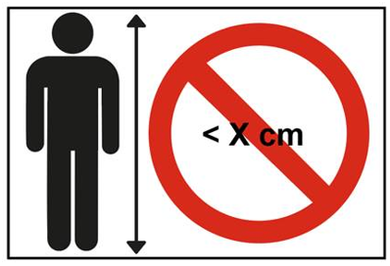
Stature limitation
The standard warnings required for all ECRS were extended to include booster cushions.
The following label from R44 was carried over, but modified to inform the consumer that booster cushions shall only be used above a stature declared by the manufacturer.
Insert new paragraph 4.8.5., to read:
4.8.5. Booster cushion Enhanced Child Restraint Systems shall have the following label (Minimum size: 60 x 40 mm) a permanently attached and visible to the person installing the Enhanced Child Restraint System in the car.
The limit X shown on the label represents the lower stature of the size range the Enhanced Child Restraint System is approved to. If the booster cushion is approved in combination with a booster seat the label shall be visible only when the ECRS is used as a booster cushion.

Slide 8
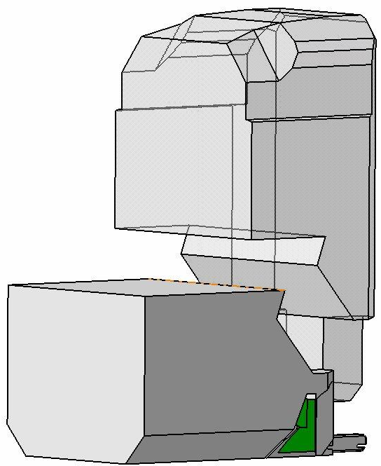
External dimensions
The requirement which envelope has to be fulfilled is extended for booster cushions to fit into the B2. The explanation for adjustment was limited to booster seats only.
B2
Insert a new paragraph 6.3.2.2.3., to read
6.3.2.2.3. Booster cushions
The maximum external dimensions for the width, height and depth of the Enhanced Child Restraint System and the locations of the ISOFIX anchorages system if any, with which its attachments shall engage, shall be defined by the i-Size booster seat fixture as defined in paragraph 2.17.2. of this Regulation.
(a) i-Size booster cushion Enhanced Child Restraint Systems shall fit within the ISO/B2 size envelope;
(b) Specific vehicle booster cushion Enhanced Child Restraint Systems shall fit:
(i) In vehicle(s) specified in a list; or
(ii) At least in one of ISO/B2 or ISO/B3 size envelope as described in Annex 17, Appendix 5 of regulation No. 16.
B2 fixture

Slide 9
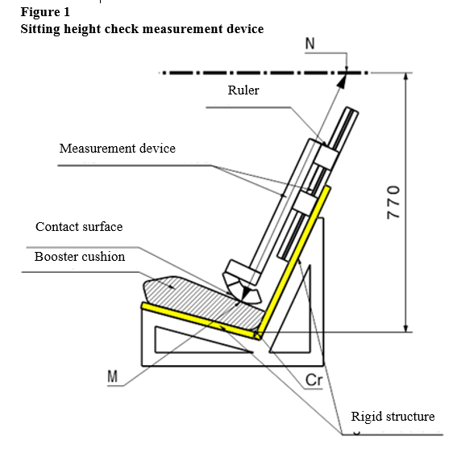
Minimum seating height of booster cushions
To let children seated on booster cushions benefit from side impact protection provided from nowadays vehicles their head needs to be raised to a certain height. A procedure was added to check if the booster cushion achieves the requested height for the claimed stature.
Insert a new paragraph 6.1.3.6., to read:
6.1.3.6. For booster cushions, type approval shall not be granted for a stature below 125 cm. Booster cushions shall not be declared for use below a stature of 125 cm.
Booster cushions shall ensure that the top of the child's head is at or above a horizontal plane at 770 mm vertically from Cr when seated on the test bench described in Annex 6.
The procedure to check if a booster cushion fulfils this requirement is outlined as follows (See figure 1 below):

Slide 10
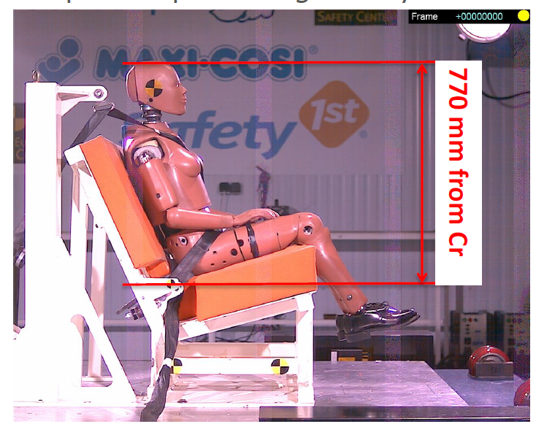
Reason for a height check procedure
From CRS-47-09
In R129 the protection for children in side impacts shall be improved if they are seated on booster cushions
Intention is to let children on booster cushions also benefit from the same side protection as is provided for adults.
To achieve this the head of a child needs to be placed at the same height of a 5% female occupant
Height of HIII 5% female dummy‘s head sitting on a R129 test bench is 770 mm.
A booster cushion needs to lift child‘s head to at least this height
A procedure is needed to check if a booster cushion fulfils this requirement.

Slide 11
Minimum seating height of booster cushions
6.1.3.6. continued:
(a) A rigid mock-up of the test bench, as defined in Annex 25, is used for this check. The mock-up shall have the same geometry as the R129 test bench with enough rigidity. For the rest of the text the mock-up is called simulated test bench.
(b) A rigid structure is attached to the simulated test bench and holds a sliding part. A horizontal plane that is located at a vertical distance of 770 mm from Cr is defined.
The booster cushion shall be placed on the simulated test bench with its centreline aligned with the centreline of the test bench and the rear surface of the booster cushion contacting the backrest of the test bench.
If ISOFIX attachments are present these shall be latched with the test bench lower ISOFIX anchorages. An additional force of 135 +/-15N shall be applied in a plane parallel to the surface of the simulated test bench. The force shall be applied along the centreline of the Enhanced Child Restraint System and at a height of no more than 100 mm above the simulated test bench seat surface.
The measurement device is extended downwards parallel to the simulated test bench backrest, until it is stopped by the booster seat cushion.

Slide 12
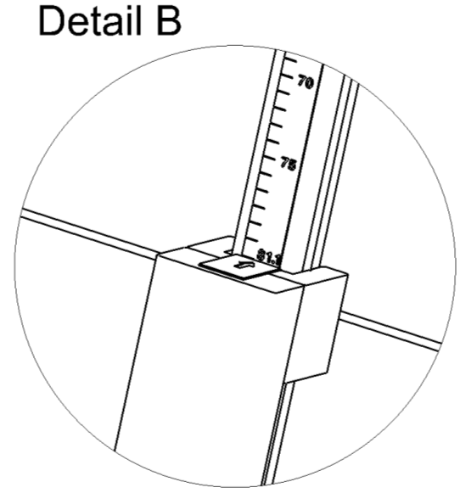
Minimum seating height of booster cushions
6.1.3.6. continued:
The measured distance between the two points M and N represents the sitting height of a child who will use the cushion represented in Figure 1. The corresponding value is displayed by a ruler that is provided with the device as shown in Figure 2.
(g) Using the data in Table 3, the sitting height is utilized to determine the corresponding minimum stature of the child that can be accommodated by the booster cushion. Example: A sitting height of 70,2 cm shall correspond to a child minimum stature of 125 cm; a sitting height of 81,1 cm shall correspond to 150 cm.
In case the value obtained for the sitting height is between two integer values always round up to the next integer value (e.g. Measured sitting height = 72,9 cm ► resulting stature = 132.25 cm ► Smallest stature allowed = 133cm)
(h) The stature determined in this procedure shall be compared to the lower limit of the approval stature range. The requirement is fulfilled if the lower approval stature is greater or equal than the obtained minimum stature.
Ruler showing sitting height of child
Figure 1
Table 3
Sitting heights with corresponding minimum statures (as indicated in Table 1 Annex 18)
Minimum Sitting Height 95% [cm] | Stature [cm]
70,2 | 125
72,3 | 130
74,4 | 135
76,5 | 140
78,6 | 145
81,1 | 150
Note: For statures in between the displayed values the respective sitting height needs to be calculated by means of a linear interpolation."

Slide 13
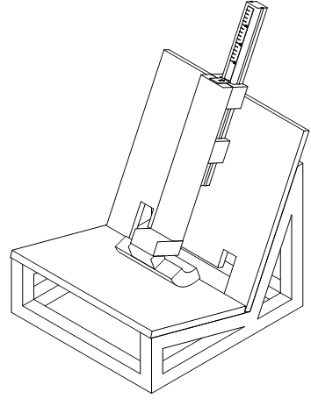
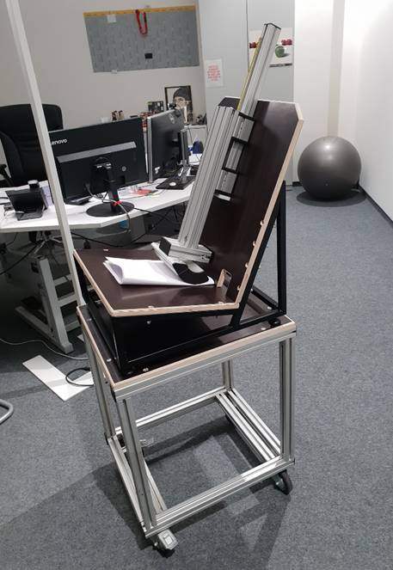
Measurement device for booster cushion height check
The following device is proposed to be used to check if the booster cushion provides the required height for the claimed stature.
Insert a new Annex 25, to read:
Annex 25 Measurement device for booster cushion height check

Slide 14
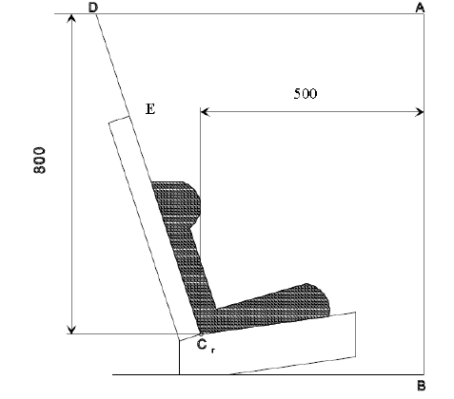
Dynamic Test
New paragraph 6.6.4.1.3.1 to read:
The dynamic test shall be performed on Enhanced Child Restraint
Systems which have not previously been under load. The Enhanced Child
Restraint System of the i-Size booster cushion category shall be tested on the test bench
described in Annex 6, and in conformity with paragraph 7.1.3.1. below
Paragraph 6.6.4.4.1.1., amend to read:
Forward facing Enhanced Child Restraint Systems
Head excursion: No part of the head of the dummy shall pass beyond the planes BA, DA and DE as defined in Figure 1 below. This shall be judged up to 300 ms or the moment that the dummy has come to a definitive standstill whatever occurs first. Except for booster seats and booster cushions when testing using Q10 dummy the following apply:
(a) The value in relation to the DA plane is 840 mm; and
(b) The value in relation to the BA plane is 550 mm; and
(c) The rebound phase is not considered for the assessment of the plane DA and DE.
For booster cushions the following also apply when testing with a Q6:
(d) The rebound phase is not considered for the assessment of the plane DE

Slide 15
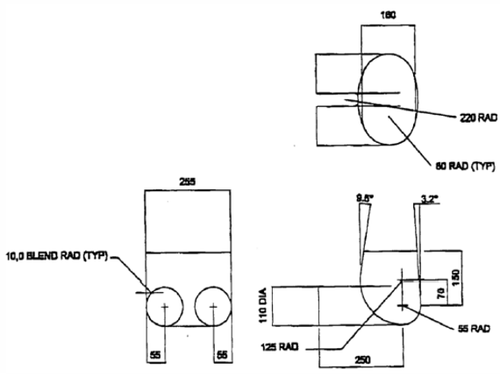
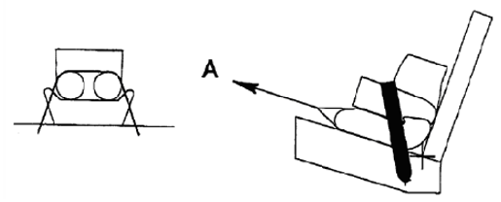
Body block test
As required in R44 the following body block test has to be fulfilled with a booster cushion. Compared to the wording from R44 it is proposed to add the last sentence to define a criteria for this test
Insert a new paragraph 7.1.3.7., to read:
7.1.3.7. Restraint of booster cushions
Place a cotton cloth on the seating surface of the test bench. Position the booster cushion on the test bench, position the lower torso body block as described in Annex 26, Figure 1, on the seating surface, fit and apply the 3-point adult safety-belt and tension as prescribed in paragraph 7.1.3.5.2.2. With a piece of 25 mm width webbing or similar tied round the booster, apply a load of 250 ± 5 N in the direction of arrow A, see Annex 26, Figure 2, in line with the seating surface of the test bench.
It should not be allowed that the booster cushion is completely pulled out under the lower torso body block.
Insert new Annex 26, to read:
Lower torso body block test
Figure 1
Manikin block (based on truncated P10)
Material: EPS (40 to 45 g/l)
Figure 2
Booster pull test using manikin block

Slide 16
Documentation of results
The results of the sitting height check shall be added to the test report.
Insert a new paragraph 8.5., to read:
8.5. For all categories of ECRS the following results shall be included in the test report:
(a) The minimum and maximum approved stature range;
(b) The internal dimensions according to Annex 18;
(c) The minimum stature with corresponding sitting height according to paragraph 6.1.3.6

Slide 17
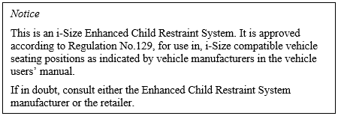
User information
Instead of adding another label with basically the same content as the already existing i-Size/i-Size booster labels it is proposed to have only one label for all i-Size products informing the user.
The existing paragraph specifically for i-Size booster seats is not needed anymore and shall be deleted
Paragraph 14.2.1., amend to read:
14.2.1. For i-Size Enhanced Child Restraint Systems (incl. i-Size booster seats and i-Size booster cushions) the following label shall be clearly visible on the exterior of the packing:
Paragraph 14.2.2., shall be deleted

Slide 18
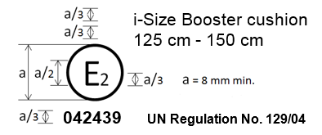
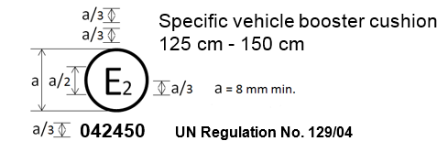
Approval Mark
Approval mark added to Annex 2 for i-Size Booster cushion & Specific vehicle booster cushion
Paragraph added to Annex 2 to include:

Slide 19
Adaptions to include booster cushions
The following paragraphs are proposed to be adapted or inserted to include booster cushions to the range of categories which need to fulfil existing requirements:
  Paragraph 4.8.3. & 4.8.4. inserted – i-Size & specific vehicle labels
  Paragraph 5.4.2.1. amended – Categories on approval labels
  Paragraph 6.1.1. & 6.1.3. amended – Positioning and securing on the vehicle
  Paragraph 6.2.1.5. amended – Belt positioning
  Paragraph 6.3.2.1. amended – Internal geometric characteristics
  Paragraph 6.6.4.1.3., 6.6.4.4.1.1., 7.1.3. & 7.1.3.5.2.2. amended – Dynamic testing
  Annex 20 amended – Minimum list of documents required for approval

Slide 20

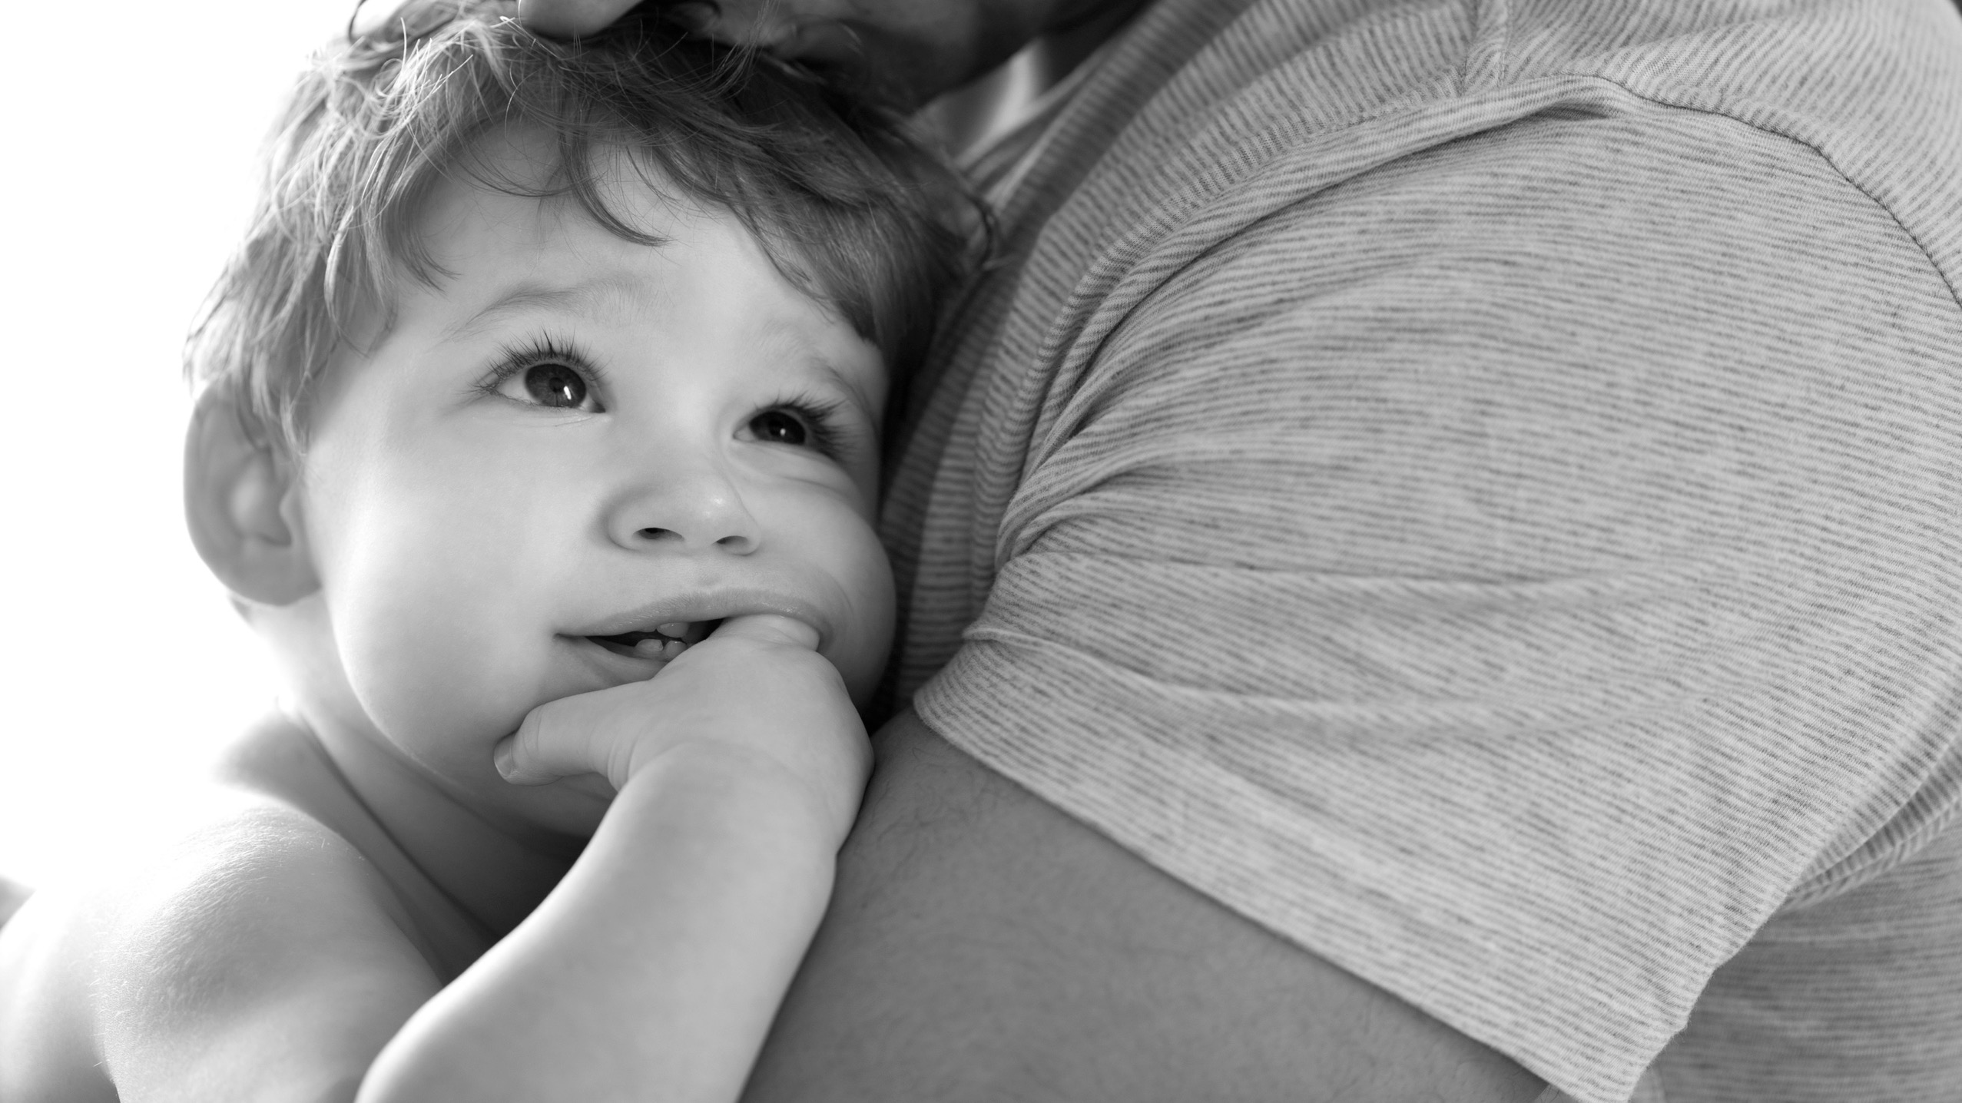
Thank you for your attention!
Thank you for your attention!

