Slide 1
Submitted by the Russian Federation Technical Sponsor of UN GTR No. 16
Document TYREGTR-19-13
19th TYREGTR, 11-12 September 2018
Agenda item 9
Informal document GRB-68-16
68th GRBP 12-14 September 2018
Agenda item 19
Development of Amendment # 2 to UN GTR No. 16 on Tyres
Status after the 19th IWG Meeting* Geneva, 11-12 September 2018
* Meeting participants: Canada, China, France, India, Japan, Russian Federation, United States of America, ETRTO, JATMA, USTMA

Slide 2
Subject of Amendment No. 2 to UN GTR No. 16 as authorized by AC.3
Reference: Authorization ECE/TRANS/WP.29/AC.3/48
Amendment of the GTR text:
Addition of new definitions (Section 2)
Harmonization of the Load Range concept in relationship to Inflation Pressure (Section 2)
Alignment of the provisions with the most recent developments in UN Regulations Nos. 30 and 54 (Sections 3.3 and 3.5, Annexes 3 and 6)
Harmonization of FMVSS 139 requirements relative to UNECE PSI index (Sections 3.14 and 3.15)
Addition of new harmonized provisions for physical dimensions of LT/C tyres (new Section 3.20; old Sections 3.20 & 3.21 to be deleted)
Addition of new harmonized provisions for high speed test for LT/C tyres (new Section 3.19, old Section 3.16 to be modified with endurance test only, old Section 3.19 to be deleted)
Other topics to be discussed:
Consideration of feasibility of harmonization of endurance test for LT/C tyres (Sections 3.16 and 3.17)
Consideration of feasibility of development of provisions for global tyre marking

Slide 3
New Harmonized Provisions a. Physical Dimensions
Reference: GRRF-86-28
Addition of new harmonized provisions for physical dimensions of LT/C tyres
(new Section 3.20; old Sections 3.20 & 3.21 to be deleted)
Subdivision in 3 categories:
Physical dimension for metric sizes (excluding all sizes listed in Annex 6) Most stringent requirements from FMVSS 139/R54 retained
Physical dimension for high flotation sizes (excluding all sizes listed in Annex 6)
Requirements as per ECE/TRANS/WP.29/GRRF/2018/5 amended by GRRF-86-26,
approved at the 86th GRRF session and submitted for adoption by WP.29/AC.1 at the June 2018 session (ECE/TRANS/WP.29/2018/XX)
Physical dimension for sizes listed in Annex 6 (Legacy)

Slide 4
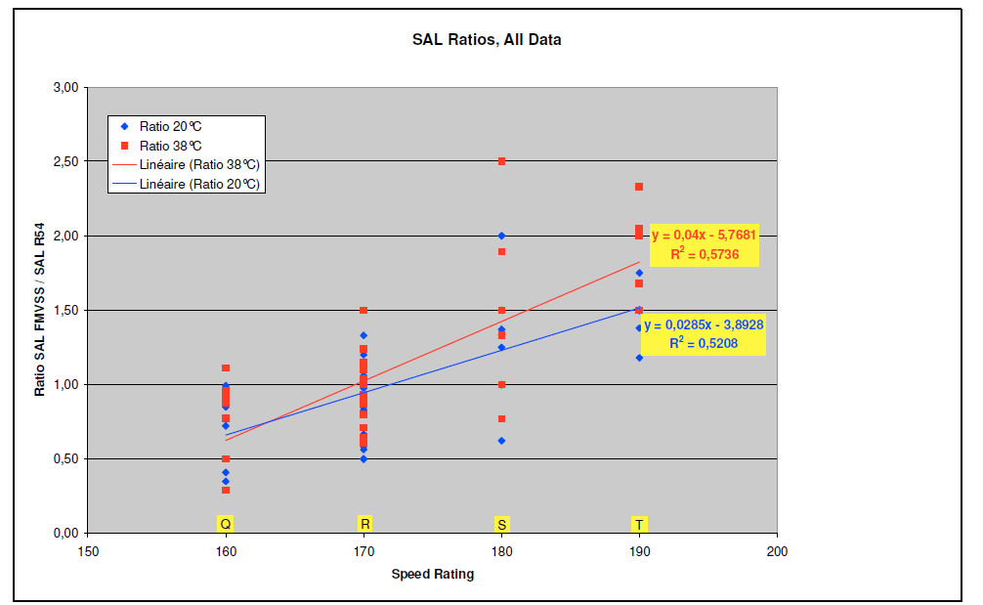
New Harmonized Provisions b. High Speed Test
Reference: GRRF-84-05
Assessment of FMVSS139 High Speed test vs R54 Load/Speed test made by tyre industry:
FMVSS 139 more severe
?
R54 more severe
Since available results did not allow to decide between R54 and FMVSS139 High Speed tests for ‘Q’ and ‘R’ Speed Symbols, one of the reasons of the extension of the IWG mandate by 2 years was requested and confirmed in order to give tyre industry the possibility to confirm the initial results on the High Speed harmonised test method.
17th IWG endorsed the Industry High speed test program.
Updated results and proposal were presented to IWG at its 18th session in June 2018 and will be presented to GRB 68th session in September 2018.

Slide 5
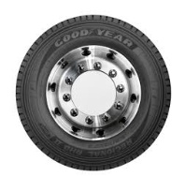
Proposal by the industry: Create a strong link between the test inflation and the tyre load rating
Elimination of inconsistencies in the text
a. Reference Test Inflation Pressure
Reference: GRRF-86-28
Industry Standards
Test Conditions
FMVSS 139
Test Condition
UN R 54
US CFR
Title 49
Transportation
Tire Stamping
Defined by the regulation
Loose relationship/Manufacturer’s decision
Proposal to para 2.56: “Reference Test Inflation Pressure applicable for LT/C tyres is the minimum cold inflation pressure for the maximum load carrying capacity of the tyre. [for single application]”
b. Measuring Rim
Inconsistent usage of the term ‘Measuring rim’ in definitions and different sections of the GTR: in some cases – a unique rim width; in other cases – any rim width
Proposal: Remove the concept of 'measuring rim' in the sense of rims on which a test is to be performed from GTR and replace it by 'test rim' in line with the ISO definition.
This proposal brings clarity and coherence without changing the technical provisions intent

Slide 6
Amendments reflecting Chinese and Indian proposals
References: TYREGTR-17-03, -04, -10, -05
IWG agreed that the relevant text containing alternative level of requirements as proposed by China may be included in GTR No. 16 as per Article 4.2 of the 1998 Agreement.
Actions taken by the IWG:
The proposal by China to use relations between Load Range and Ply Rating is considered as obsolete and to be replaced by Load Index for LT/C tyres
The proposal by China in regards to paragraph 3.4, tread wear indicators, will be reflected in Part A (technical rationale) of the GTR amendment 2.
In paragraph 3.14, strength test, the GTR requirements are to be general requirements, and China and India requirements became the part of the revised table of requirements. Still subject to confirmation by US due to internal rulemaking activities.
China proposal 3.16.1. - Requirements for High-Speed test are put on hold, and will be considered when the harmonised High Speed test will be discussed.

Slide 7
Other discussion topics (1) Feasibility of harmonization of endurance test for LT/C tyres
References: TYREGTR-16-06, TYREGTR-16-04, TYREGTR-17-12
The assessment made by industry (TYREGTR 16-06) shown the high complexity in harmonizing the endurance test.
Due to the high complexity in harmonising the endurance test, the proposal is to keep the tests non harmonised for the time being.
(2) Feasibility for the introduction of the global tyre marking
The concept for global tyre marking was proposed by the Russian Federation (TYREGTR-16-04). The Russian Federation presented to GRRF a memorandum explaining introduction of global marks in Tyre GTR to the Contracting Parties (GRRF-86-22).
Industry has assessed the situation and estimated the potential benefit of introduction of a global mark. Industry will assess what would be the cost reduction and other benefits for Tyre industry by the introduction of a Global Marking.

Slide 8
Other discussion topics (3) Presentation of the North-American all-season tyre
Reference: TYREGTR-18-23
IWG agreed that for the time being no provisions related to North American all season tyres will be proposed to the Tyre GTR amendment 2, and that ffollowing additional evaluation of the adhesion performance on wet surfaces (section 3.12), a future additional category of use might be necessary for certain tyre types typical in the North American market. These provisions will be developed in a separate amendment to Tyre GTR

Slide 9
IWG TYREGTR 19th Meeting Geneva, 11-12 September 2018
Reference: TYREGTR-19-XX
The 19th meeting the IWG TYREGTR acknowledged the completion of research on the subject of Amendment No. 2 to UN GTR No. 16 and addressed the preparation of the final text of the draft Amendment No. 2, the Statement on Technical Rationale and Justification and the Technical Report

Slide 10
Next steps
Reference: Report of the IWG 19th meeting
Next IWG 20th meeting (tentative)
Venue: ETRTO in Brussels : October 29th to 31st 2018
Schedule: 3-day meeting
Objectives:
To confirm and finalize the text of the amendment 2 to the GTR 16 (text of the amendment, statement on technical rationale and justification and technical report) to be presented to GRB 69th session.
To work out the action items defined by the IWG at its 18th and 19th sessions.
The meeting documents may be found at: IWG 18th meeting: https://wiki.unece.org/display/trans/TYRE+GTR+SESSION+18 IWG 19th meeting: https://wiki.unece.org/display/trans/TYRE+GTR+SESSION+19
IWG 20th meeting: https://wiki.unece.org/display/trans/TYRE+GTR+SESSION+20

Slide 11
IWG TYREGTR Chairman: Mr. Andrei Bocharov (NAMI, Russian Federation), e-mail: ab@satrfond.ru, a.bocharov@nami.ru.

