Slide 1
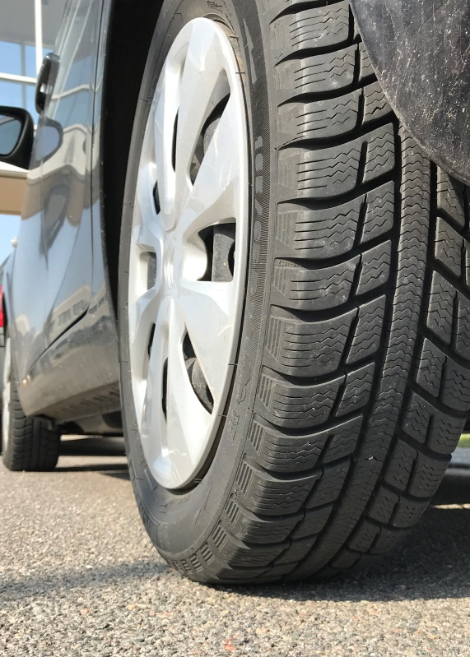

NordTyre - the potential for noise reduction using less noisy tyres and road surfaces
Hans Bendtsen, Danish Road Directorate
Senior Researcher, Project leader
Jakob Fryd, Danish Road Directorate
Jannicke Sjøvold, Norwegian Public Roads Administration
Julia Bermlid, Swedish Transport Administration
Rasmus Stahlfest Holck Skov,
DELTA - a part of FORCE Technology
Informal Document GRB-68-09
68th GRB, 12-14 September 2018
Agenda item 11
Transmitted by the expert from Norway

Slide 2
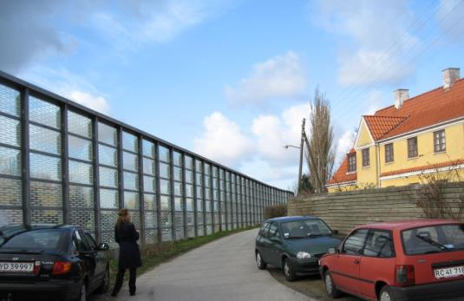
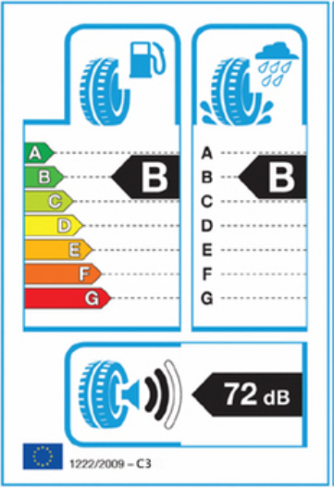
Background and challenge
Traffic noise is a big and expensive challenge for Nordic road administrations
In 2009, new European tyre noise limits were introduced
Labelling of new tyres by November 2012 became mandatory in EU and EEC countries. 3 parameters:
  Wet grip
  Rolling resistance
  Noise
A need to know how “low noise” tyres and road surfaces could contribute to traffic noise mitigation
Investigated in the NordTyre projects 2011 to 2017

Slide 3
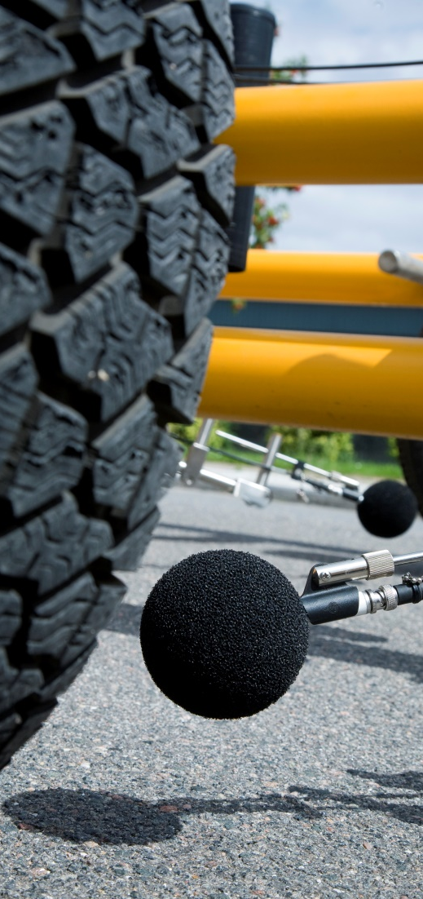
NordTyre financed through NordFoU
A co-operation between the national road and transport administrations in Denmark, the Faroe Islands, Finland, Iceland, Norway and Sweden
Purpose to create research and development synergies within the areas which present shared challenges and needs between the Nordic countries
NordFoU’ organizes joint research projects between the NordFoU partners
Financed by partners interested – common pot

Slide 4



Active people and organisations
Steering group
Advisory group
Espen Andersson (Chair), Norwegian Public Roads Administration
Jannicke Sjøvold, Norwegian Public Roads Administration
Jakob Fryd, Danish Road Directorate
Julia Bermlid , Swedish Transport Administration
Luc Goubert, Belgian Road Research Centre
Ulf Sandberg, Swedish National Road and Transport Research Institute, VTI
Ingunn Milford, Multiconsult, Norway
Jan Boe Kielland, independent noise expert, Norway
Panu Sainio, Aalto University, Finland
Roger Williams (until 2015), independent tyre expert, United Kingdom

Slide 5
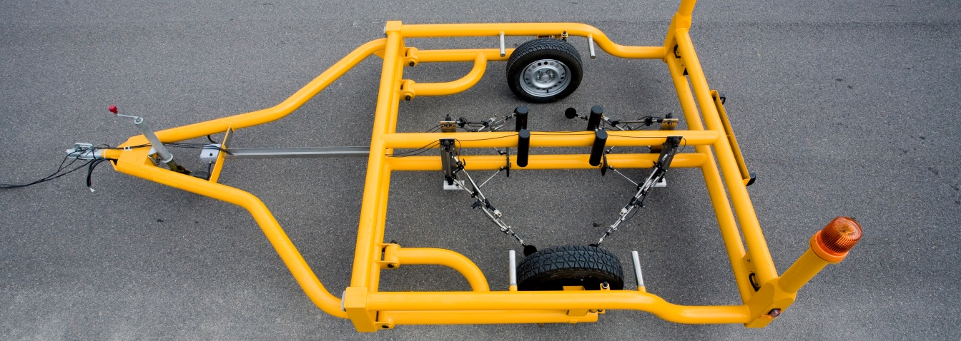
The people who did the work
Project group
Subcontractors
Jørgen Kragh, Danish Road Directorate (until May 2016 when he retired)
Rasmus Stahlfest Holck Skov, Danish Road Directorate, now DELTA a part of FORCE Technology
Jens Oddershede, Danish Road Directorate, now DELTA a part of FORCE Technology
Hans Bendtsen, Danish Road Directorate
SINTEF, Norway
Testworld Ltd, Finland
Technical University of Gdansk, Poland
M+P Consulting Engineers, The Netherlands
DELTA a part of FORCE Technology

Slide 6
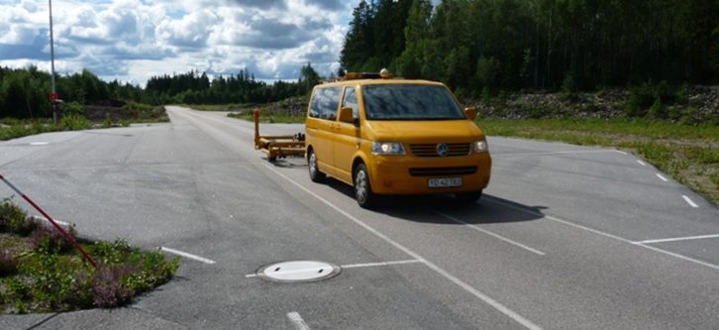
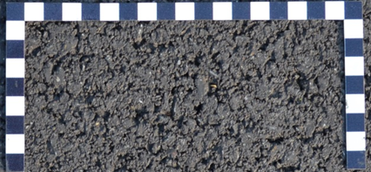
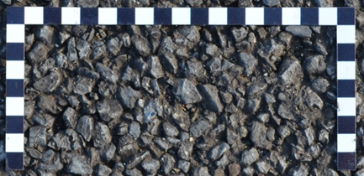
Noise labelling
Measurement procedure
Type approval noise measurements performed on ISO test track
Vehicle coast-by at 80 km/h (passenger car), 70 km/t (truck)
Smooth densegraded surface
Nordic surfaces typically SMA 11 (DK) or SMA 16 (S and N)
Results are truncated (rounded down to the nearest integer)
1 dB subtracted to account for uncertainty
The noise level measured may exceed the noise label value by up to 1.9 dB
ISO
SMA 11

Slide 7
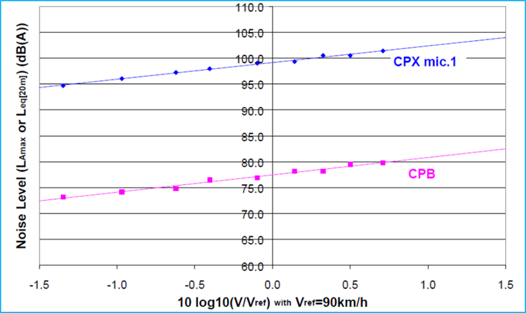
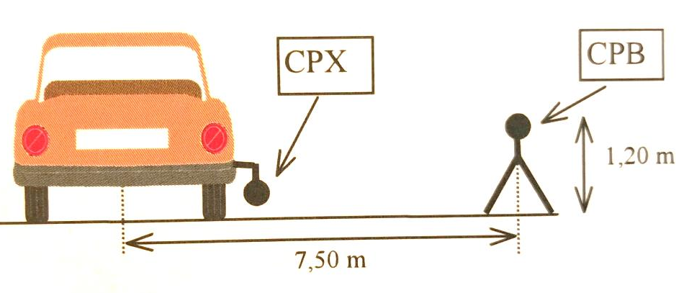
CPX versus Controlled Pass-By measurements
LCPC/IFSTTAR experiment
For non-porous pavements and for some porous asphalt pavements, the typical difference between CPX and CPB noise levels in the French data is 22 dB

Slide 8
Objectives of the NordTyre projects
Clarify the “real” influence of the new tyre noise labelling of passenger car and truck tyres
Establish scientific evidence on the tyre/road contribution to traffic noise emission from roads in the Nordic countries
Generate a basis for qualified decision making concerning actions to mitigate traffic noise
Demonstrate the usefulness or necessity of a second Nordic “roughly textured” ISO reference test surface - creating scientific arguments for a short term revision of EU tyre noise regulation

Slide 9
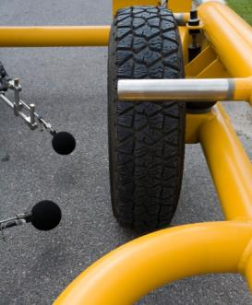
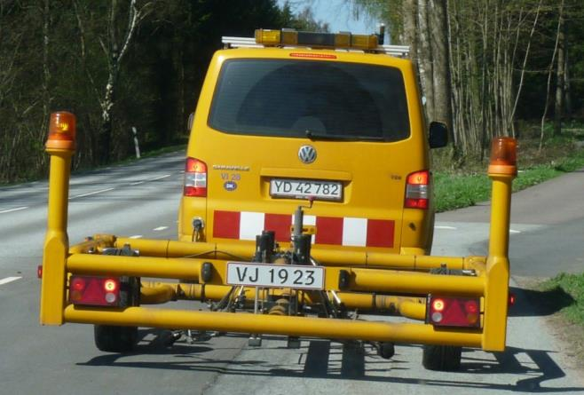
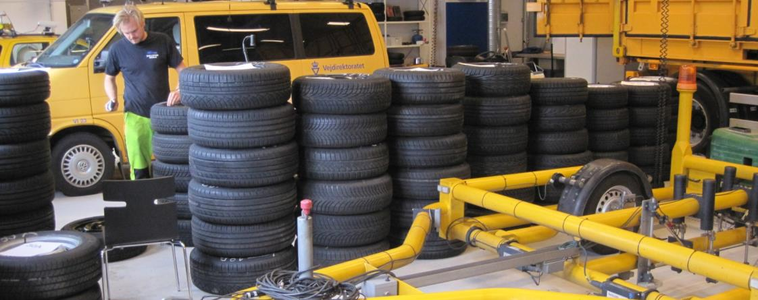
Tyres for passenger cars
31 set of tyres selected and procured in May 2012
Labelled values looked up on producers homepage in January 2013
Tested on 30 Nordic road surfaces and two ISO test tracks in 2012
Test method used – The CPX noise trailer deciBellA from DRD. Speed 80 km/h
DRD has very fine correlation between CPX results and road side measurements

Slide 10
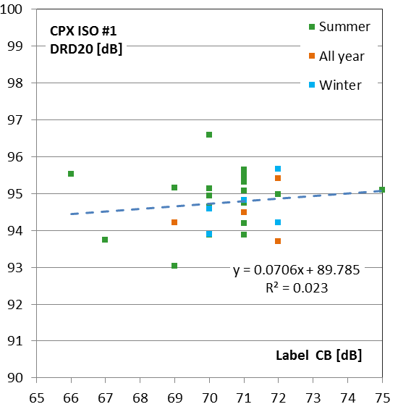

Results for ISO test surface
Microphone position of ISO road side test method
No correlation between measured noise and the labelled values!

Slide 11
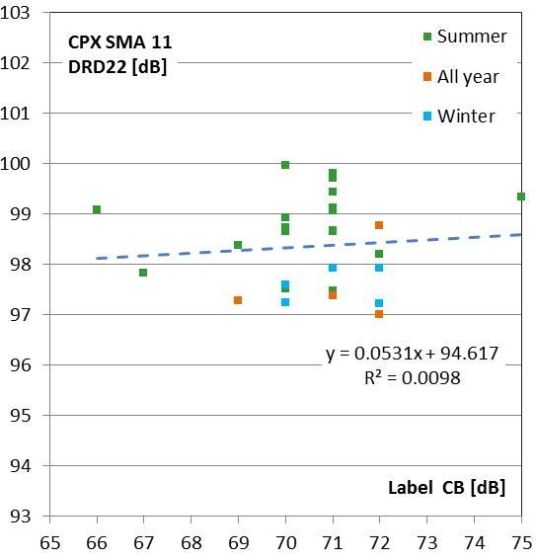
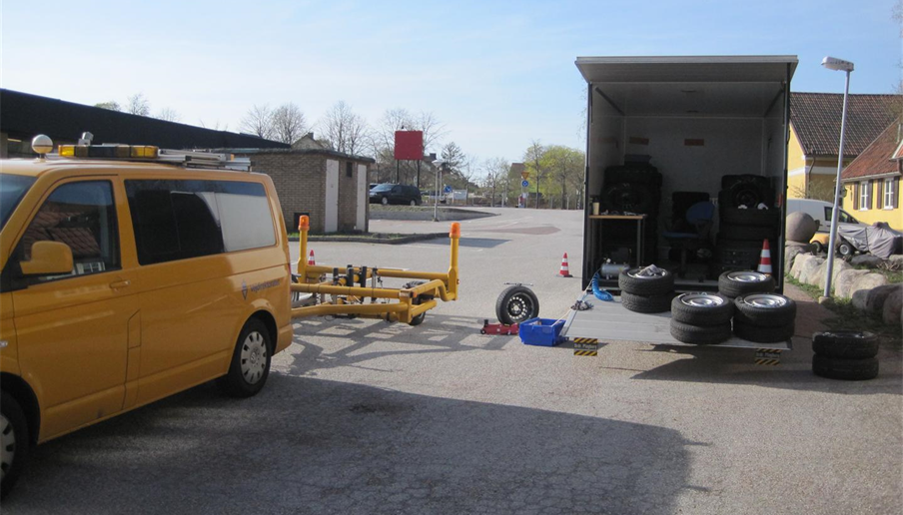
Results for Nordic SMA 11 surface
No correlation between measured noise and the labelled values!

Slide 12
CPX trailer results compared with EU Regulation on noise limits
CPX trailer results translated into coast-by noise levels, truncated and rounded down

Slide 13
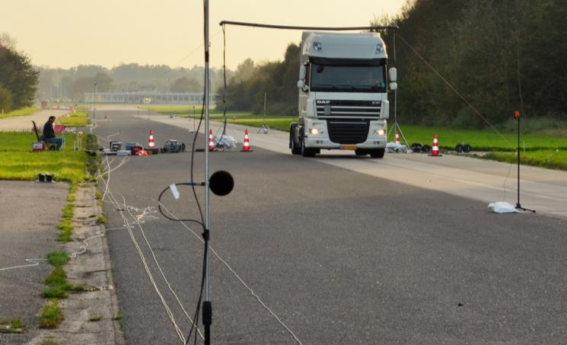
Tyres for trucks
30 sets of truck tyres representative for the Scandinavian tyre population procured in 2014
8 steering axle, 12 drive axle (9 original, 3 retreated), Trailer axle tyres (6 original, 4 retreated)
Tested on four road surfaces including SMA surface and ISO test surface
Using the coast-by test procedure
On Twente Proving Ground in the Netherlands

Slide 14
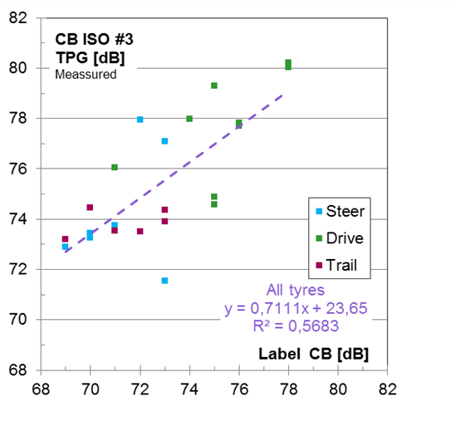
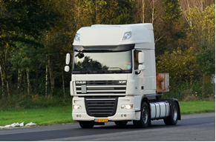
Results for ISO test surface
Retreaded tyres not regulated and therefore not included
Some correlation between measured noise and the labelled values!

Slide 15
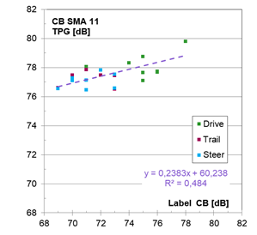
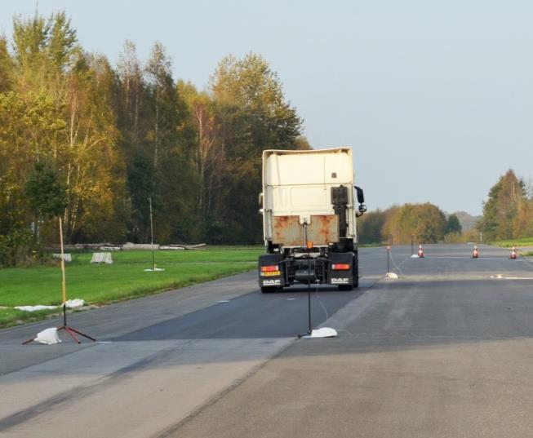
Results for Nordic SMA 11 surface
No good correlation between measured noise and the labelled values!

Slide 16
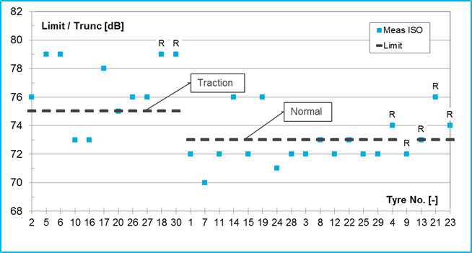
Measured results compared with EU regulation noise limits
Measured results truncated and rounded down
Retreaded more noisy than original tyres

Slide 17
Potential effects to society of regulating tyre/road noise
Conditions considered:
Selecting and using only the 25 % tyres with lowest noise
Denmark changing all pavements from SMA 11 to SMA 8
Norway changing all pavements from SMA 16 to SMA 8
Predictions made on the national noise mappings
Results:
Indicator | Norway Total reduction in % | Denmark Total reduction in %
Percent Highly Annoyed / % HA | 19 % | 13 %
Noise annoyance index / SPI | 11 % | 6 %

Slide 18
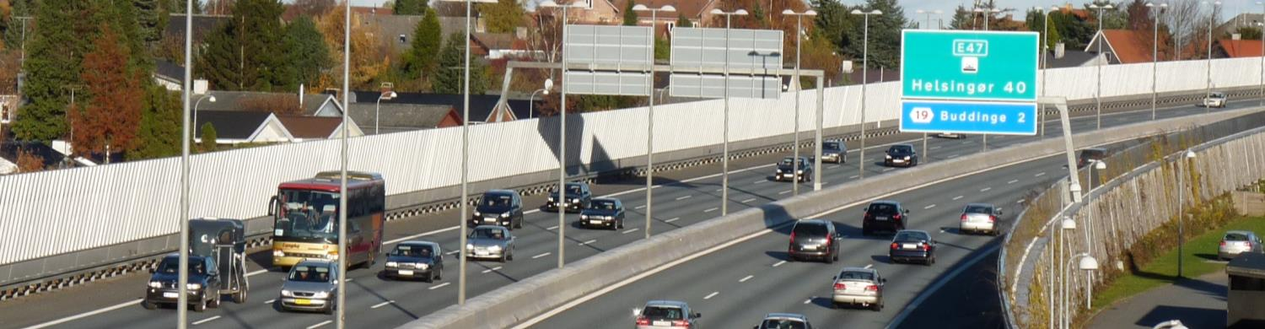
Conclusions and actions
The labelled values do not represent actual noise of tyres operating on typical Nordic pavements
If the labelling system worked ok, there would be a good potential for noise reduction
Campaigns and tax incentives encouraging car owners to buy the least noisy tyres possible
Encouraging public organizations and private companies to require the use of the least noisy tyres
Further decreasing the noise levels limits in the tyre type approval system

Slide 19
Research needs identified in the NordTyre projects
Reasons for poor correlation between labelled and measured values must be determined
Suggestions to improve labelling system to obtain acceptable correlation between labelled and measured values on actual road surfaces
Develop a more rough-textured reference surface, suitable in countries using such
Establish stricter specifications of test track properties (ISO 10844)
Development of a procedure for inter-calibration of test tracks (see e g ppr at Inter-Noise 2017)
Investigate the variation of noise levels within tyre families
Investigate how tyre/road noise develops over time as tyres get older and worn
Investigate tonality of truck tyre noise emission and tonality perceived by road neighbours

Slide 20
The five reports
Analysis of data form passenger car tyres
Noise from Truck Tyres
Potential Society Effects of Regulation tyre/road noise
Summary report of the NordTyre Projects
Two background reports with data:
  NordTyre CPX Measurement journal
  NordTyre Part 3
  Results of tyre/road noise measurements
Download: http://www.nordfou.org

Slide 21
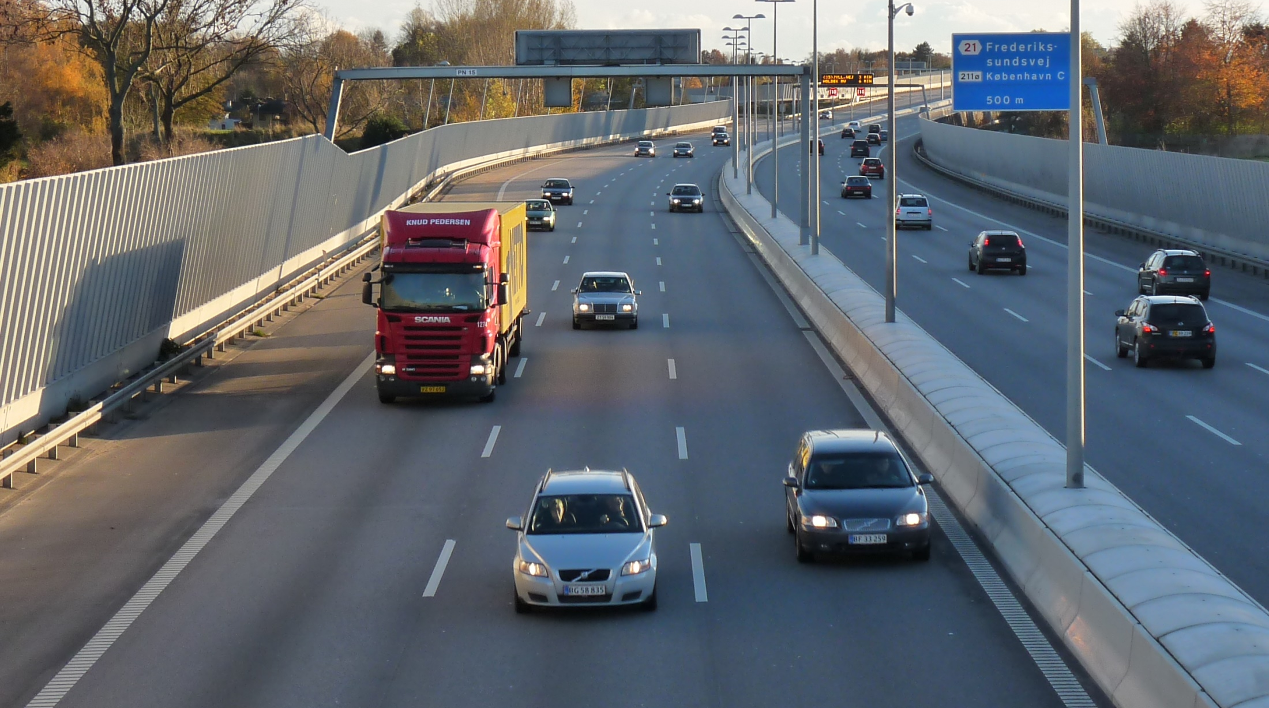
Thank you!
Any questions?

