Slide 1
NL response to GRB-67-08 (ETRTO)
Transmitted by the expert from the Netherlands
Informal document GRB-67-18
(67th GRB, 24-26 January 2018,
agenda item 6)

Slide 2
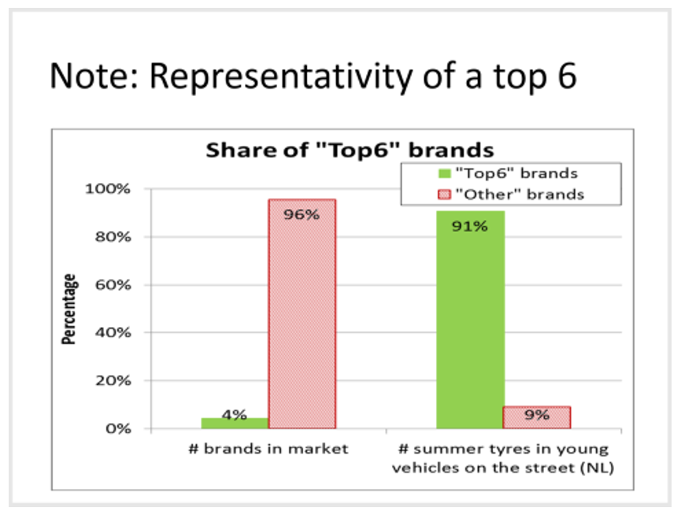
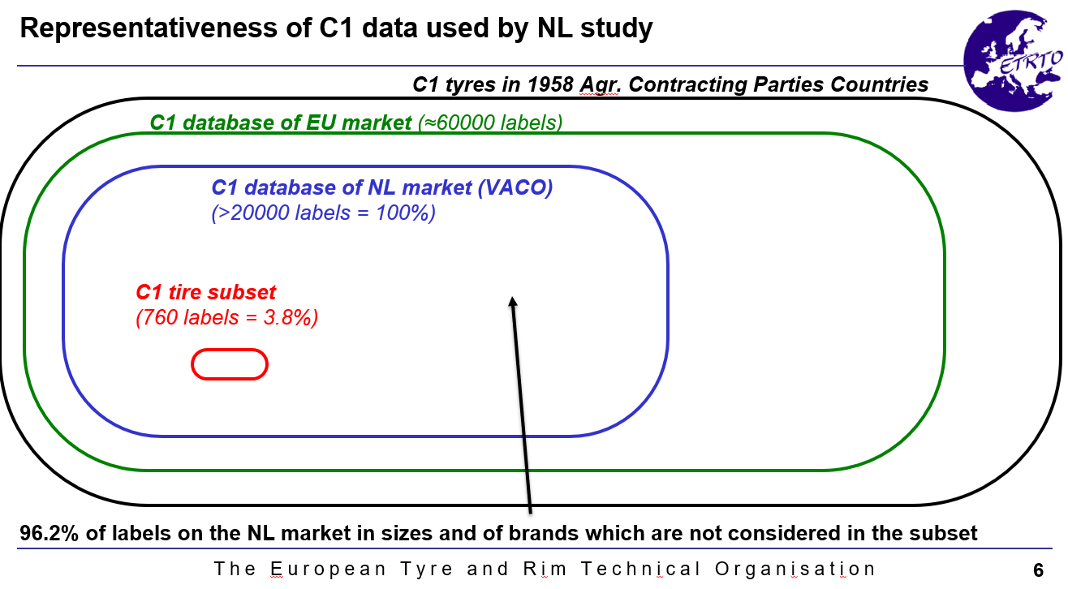
NL agrees with ETRTO on 4% subset
But don’t forget this 4% complies with >90% marketshare

Slide 3
What is the goal of UN/ECE?
Legalize everything that is produced?
or
Setting minimum requirements
in order to protect unknowing consumers from unsafe products

Slide 4
Source Autobild 14-2-2006 http://www.autobild.de/artikel/produkttest-billig-winterreifen-54465.html
Impact speed 50,5 km/h

