Slide 1
Lateral Protection Device
Informal document GRSG-113-11
(113th GRSG, 10-13 October 2017, agenda item 7.)
France – Evolution study on Regulation UNECE n° 73

Slide 2
Structure
Accidentology analysis
Regulation context
International overview
Protection structures for motorcyclists
Protection device comparative analysis
Vehicles design
Test phase
Technical proposal

Slide 3
Structure
Accidentology analysis
Regulation context
International overview
Protection structures for motorcyclists
Protection device comparative analysis
Vehicles design
Test phase
Technical proposal

Slide 4
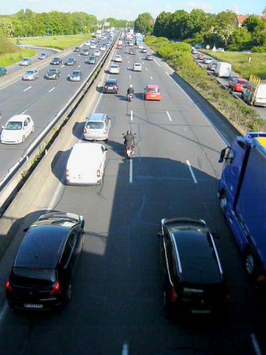
Accidentology analysis
Accident conditions
Last accident case was observed in France, 2014, a motorcyclist drive on highway between the left and the central lanes when he hurts a private car, falls on the ground and slips on the roadway under the wheels of a semi-trailer located on the right lane.
This accident was a direct consequence of a lane switch by a car driver, from the left to the center lane, when the motorcyclist arrived on the same level.
Main factors
High speed differential between the motorcycle that was traveling around 70 kph and the car that was quite stationary.
The motorcyclist's low detectability in a dark light conditions, in spite of the adapted turn signal switch on.
Aggravation by the motorcyclist slide under a semi-trailer that was made possible by a large space, although compliant with regulations, that was clear between the ground and the protection device equipping this semi-trailer.

Slide 5
Structure
Accidentology analysis
Regulation context
International overview
Protection structures for motorcyclists
Protection device comparative analysis
Vehicles design
Test phase
Technical proposal

Slide 6
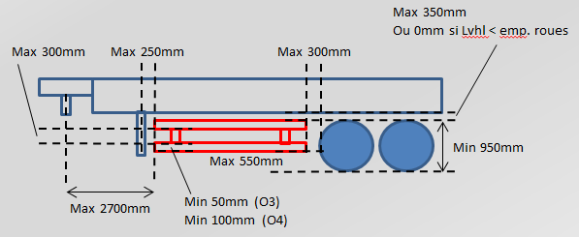
Regulation context
Current requirements in Europe : UNECE n°73 series 01 of amendment
Geometrical requirements on Y axis
Geometrical requirements on Z axis (depending on vehicle category)
Loading requirement under 1kN force application : displacement under 30mm or 150mm depending on the force application location

Slide 7
Structure
Accidentology analysis
Regulation context
International overview
Protection structures for motorcyclists
Protection device comparative analysis
Vehicles design
Test phase
Technical proposal

Slide 8
International overview
French statistics
Status including collision loadcases between 2 wheels motorized vehicles and heavy duty vehicles in 2011 (all kinematics) :
0.6% of the total number of accidents, ie approximately 390 accidents (total 65 024)
1.6% of fatalities were recorded, ie approximately 58 users killed (total 3 647)
0.4% of the injured, or approximately 325 injured (total 81,251)
0.9% of the hospitalized injured, ie approximately 267 patients (total 29,679)
Even if this loadcase seems to be a minor one, fatalities versus number of accident is high, around 15%.

Slide 9
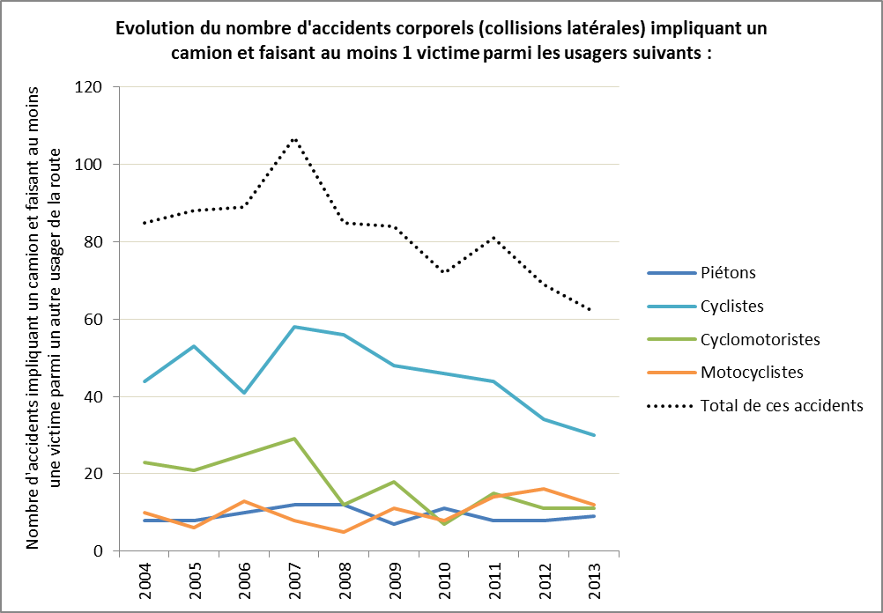
International overview
Feedbacks from other countries
United Kingdom : loadcase considered as a minor one, without explicit statistic on it.
Netherlands : low feedbacks on accidentology but in addition to the dimensional specifications, the loading level seems to not be in adequation with a collision including a morotcyclist.
Belgium : low feedbacks on accidentology except an overview on side-impact collision with a heavy duty vehicle including at least one victim :

Slide 10
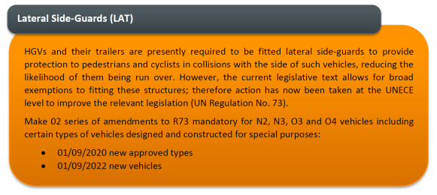
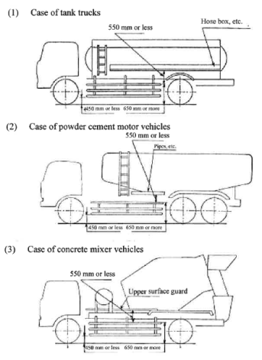
International overview
Feedbacks from other countries
European Union : study considering an efficiency increase (covering surface and ground clearance updates) based on accidentology feedbacks with cyclists users.
Japan : Similar UNECE n° 73 national requirements referenced in the "Safety Regulations for Road Vehicle" and associated delegated acts. The main dimensional requirements are as follows: the height of its lower edge is 450 mm or less above the ground and the height of its upper edge is 650 mm or more above the ground.

Slide 11
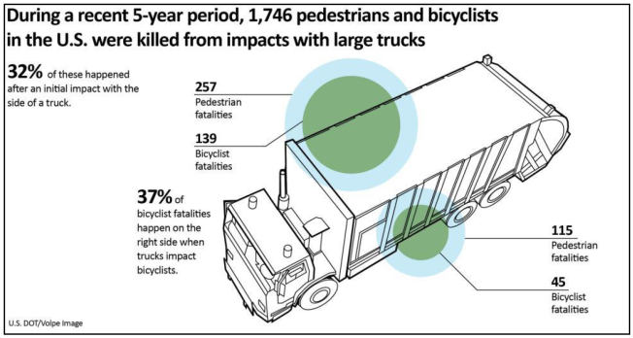
International overview
Feedbacks from other countries
Cana / US : There is no federal requirement to equip heavy-duty vehicles with lateral protection because of a high variety of vehicle design, their use, cost, maintenance and climatic conditions. Studies are underway but are more oriented towards requirements in terms of detection of other users around the vehicle (blind spot).

Slide 12
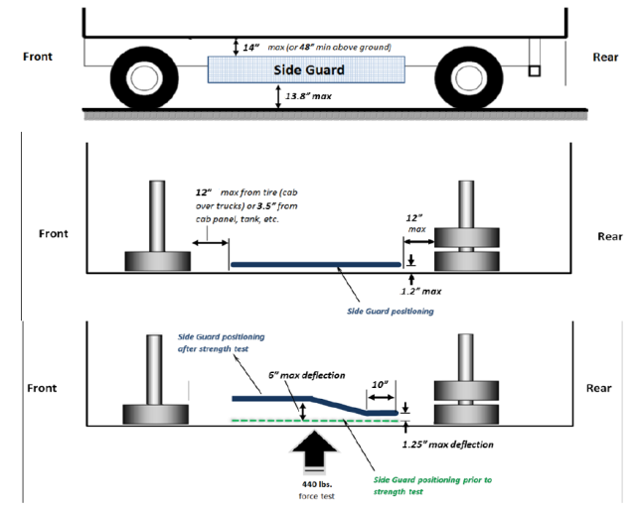
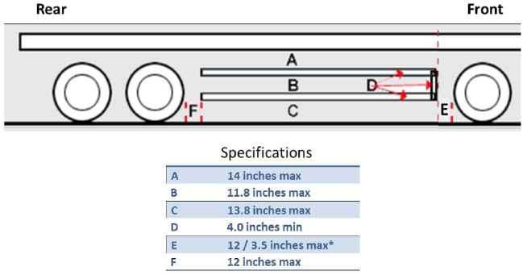
International overview
Feedbacks from other countries
US : Study for Cambridge safer truck initiative in 2016 to improve vulnerable road users safety in the extended city. As a conclusion, a significant safety increase can be brought by fulfilling the following specifications :
Maximum ground clearance at 350mm
Loading resistance to 2kN force (30mm or 150mm maximum deformation)
350mm
350mm

Slide 13
Structure
Accidentology analysis
Regulation context
International overview
Protection structures for motorcyclists
Protection device comparative analysis
Vehicles design
Test phase
Technical proposal

Slide 14
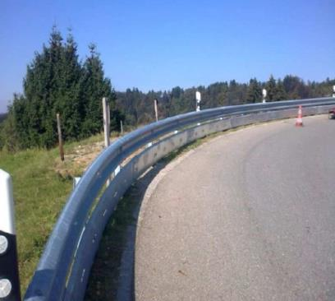
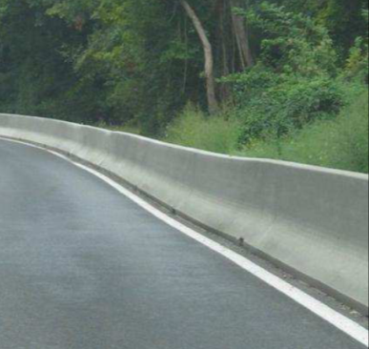
Protection structure for motorcyclists
XP CEN/TS 1317-8 : Road restraint systems for motorcycles to reduce the severity of impact in the event of a collision with safety barriers
In order to reduce the consequences of an impact between a two-wheeled motor vehicle and a barrier, it may be necessary to install an additional specific structure above the regular barrier.
Some studies indicating that the "slip" configuration is predominant have led to the development and use, in some European countries, of test procedures evaluating the systems with respect to this loadcase.

Slide 15
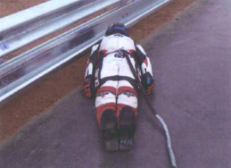
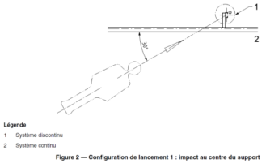
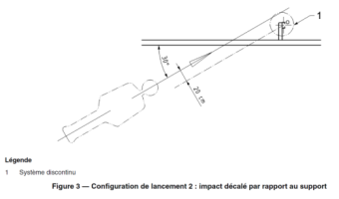
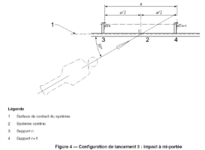
Protection structure for motorcyclists
Test principle
The full-scale impact test consists of launching an equipped ATD (Anthropomorphic Testing Device) at a given speed against a barrier equipped with a Motorcycle Protection System (SPM) in a suitable test area.
At the moment of impact, the DAE (50mm HIII dummy) slips while its back and legs are in contact with the ground.
3 test configuration: impact at the center of the support, offset from the support and at mid-range with an angle of 30 ° with respect to the device and 2 speeds, 60 kph and 70 kph.

Slide 16
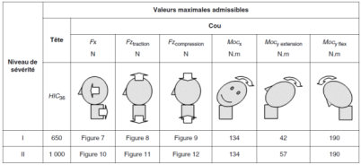
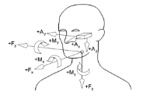
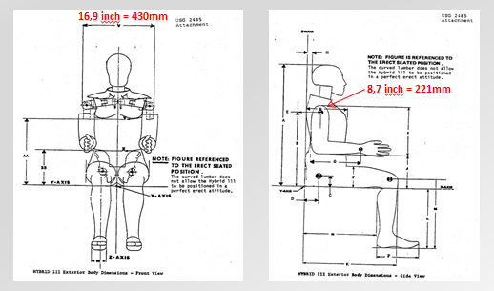
Protection structure for motorcyclists
Test conformity
Compliance with requirements is assessed through the following biomechanical criteria: Head Injury Criteria, Neck shear force, Axial neck tension, axial compression of neck, neck moment around X and neck moments around Y (extension and flexion )
The height of the SPM is directly related to the geometry of the ATD used during the tests (HIII 50th pc - Mass 80kg)

Slide 17
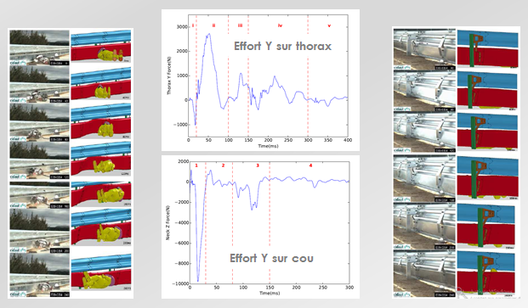
Protection structure for motorcyclists
Loading levels (Public thesis university Lyon 2016 “Evaluation and modelling of restraints for motorcyclists) – Injury criticity
Improved attention to the case of impact accidents with road restraints indicates that torso injuries are the most serious injuries compare to other parts of the body.
Evaluations of impact forces Fy cou ~ 10kN and Fy thorax ~ 3kN for impact at 60kph and 30 °

Slide 18
Structure
Accidentology analysis
Regulation context
International overview
Protection structures for motorcyclists
Protection device comparative analysis
Vehicles design
Test phase
Technical proposal

Slide 19
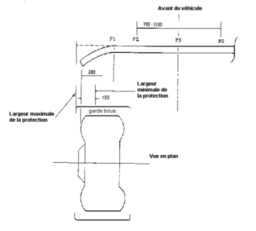
Protection device comparative analysis
Regulation UNECE n° 58 on rear underrun protective device
Text intended to ensure a minimum level of protection for the occupants of a light vehicle in the event of an impact on the rear of a heavy goods vehicle (high loading performance level between 5t and 10t)
The severity of injuries is related to 2 main factors: kinetic energy of the light vehicle during the impact and the structural interaction between the front of the light vehicle and the rear of the heavy vehicle (max ground clearance at 550mm).
Regulation UNECE n° 93 on front underrun protective device
Text intended to ensure a minimum level of protection for the occupants of a light vehicle in the event of a frontal impact with an N2 or N3 vehicle (high loading performance level between 80kN and 160kN)

Slide 20
Structure
Accidentology analysis
Regulation context
International overview
Protection structures for motorcyclists
Protection device comparative analysis
Vehicles design
Test phase
Technical proposal

Slide 21
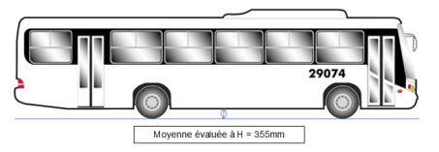
Vehicles design
Dimensional constraints
Dimensional constraints integrated during the vehicle development phase is mainly based on the constraints of ISO 612: 1978 dealing with the "Dimensions of cars and towed vehicles".
By analogy with the studies carried out for the last series of amendments to UNECE Regulation No. 58 (leakage angle), the minimum value to be considered for the ramp angle to ensure an easy traffic is 8 °.
A non-exhaustive analysis of the other categories of vehicles shows that vehicles using the same traffic lanes as those used by vehicles falling within the scope of UNECE Regulation No.73 have much lower ground clearances.

Slide 22
Structure
Accidentology analysis
Regulation context
International overview
Protection structures for motorcyclists
Protection device comparative analysis
Vehicles design
Test phase
Technical proposal

Slide 23
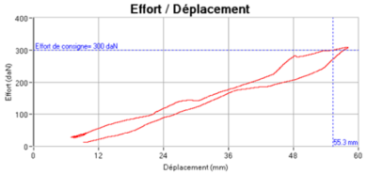
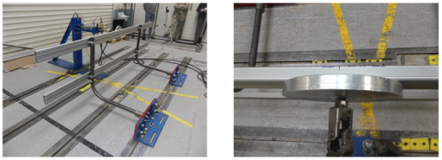
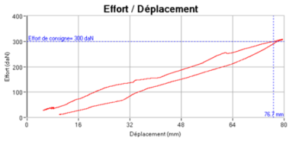
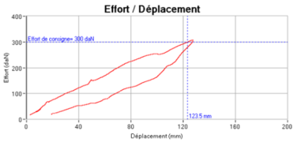
Test phase
Phase 1 : Tests performed - Evaluation of a separate unit resistance to a loading up to 3kN and quantification of the displacement observed.
Loading applied on pillar with 3m gap between pillars.
Loading applied in the middle between pillars with 1,5m gap between pillars.
Loading applied outside 350mm from the last pillar with 1,5m gap between pillars.
Max. disp. : 55,3mm
Max. disp. : 76,7mm
Max. disp. : 123,5mm

Slide 24
Test phase
Phase 1 : Analysis
The current structures, without any reinforcement, can be used to fulfill loading requirements increased at 3kN, using implementation adjustments (gap between pillars).
Without device design update, a decrease (in the order of -50%) of the distances between pillars could allow to achieve the targeted performance level for the device resistance.
The front and rear extremities also require a decrease of current distance from the last pillar in order to improve the device resistance, in association with a reduced distance between the connecting elements.

Slide 25
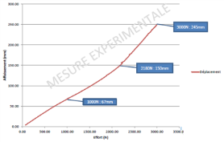
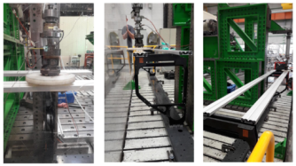
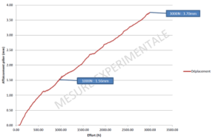
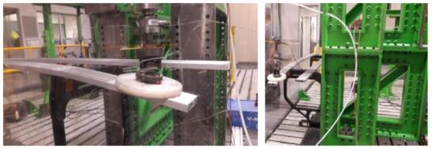
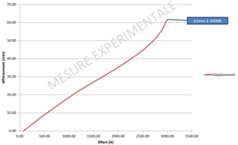
Test phase
Phase 2 : Tests performed - Evaluation of vehicle integrated unit resistance to a loading up to 3kN and quantification of the displacement observed.
Loading applied in the middle between pillars with 2,65m gap between pillars.
Loading applied on pillar with 2,65m gap between pillars.
Loading applied outside 400mm from the last pillar with 2,65m gap between pillars.
Max. disp. : 245mm
Max. disp. : 3,7mm
Max. disp. : 61mm

Slide 26
Test phase
Phase 2 : Analysis
The evaluated structures without any reinforcement can be used to achieve targeted loads at 3kN without any particular update vehicle implementation.
Only the front and rear extremities from the last pillar would require a slight decrease (of the order of -10%) without update on the distance between the connecting elements.
On the basis of these results, an update of the current requirements could be investigated with the application of a coefficient 3 on both loading performance level and the required maximum displacement levels.

Slide 27
Structure
Accidentology analysis
Regulation context
International overview
Protection structures for motorcyclists
Protection device comparative analysis
Vehicles design
Test phase
Technical proposal

Slide 28
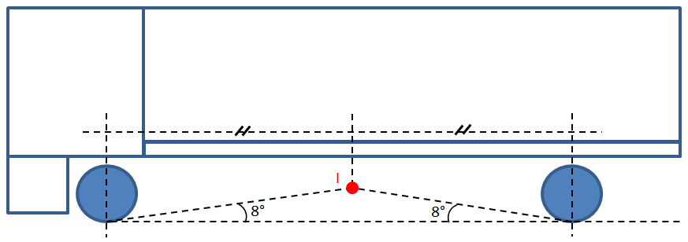
Technical proposal
Geometrical constrains
This proposal deals with the requirements for the installation of protective devices on vehicles, integrating the following parameters:
Dimensional thorax manikin HIII 50th pc width
Dimension of existing devices on the market
International studies and other regulations
Compatibility with current road devices
The dimensional principle proposed is based on the ramp angle, considering the intersection point “ I “ within the wheelbase, with the following requirements along the Z axis of the vehicle reference:
If I ≤ 350mm then the ground clearance can be 350mm max.
If 350mm < I ≤ 450mm then the ground clearance is I
If 450mm < I then the ground clearance is 450mm max.

Slide 29
Technical proposal
Geometrical constrains
Associated distances adjustment
Height conservation (50 / 100mmm).
Max. gap between devices at 400mm.
Vehicle chassis distance to top edge of the device at 450mm max.
Upper edge of the device shall not be less than 850 mm above the ground.
Loading and displacement constrains
While the current 1kN solicitation of UNECE Regulation No. 73 comply with an adapted protection for pedestrians or cyclists impacts, it appears to be too limited when a motorcycle driver impacts the device.

Slide 30
Technical proposal
Loading and displacement constrains
Target is to encourage a device behavior still in the material elastic area, including linear strains.
In this way, a device close to the required limit under the new loading will stay close to the limit under current loading level : keep the same protection level for low and for high loadings.
A parallel with the design of motorcycle road restraints and especially of the major criteria of injuries (thorax), the following loading requirements could be updated :
Application of a force of 3kN perpendicular to the device (as currently defined).
Max. strain under loading at 90mm over the 250mm most backwards part.
Max. strain under loading at 450mm on the other parts.

Slide 31
Thanks for your attention.

