Slide 1
Submitted by the VIAQ Chairs and Secretary
Informal document GRPE-75-19
75th GRPE, 6-9 June 2017
Agenda item 12
Progress Report of the
VIAQ (Vehicle Interior Air Quality)
Informal Working Group
8th June 2017
Chair: Jongsoon Lim, Korea
Co-chair : Yunshan Ge, China
Technical secretary: Andreas Wehrmeier, OICA

Slide 2
VIAQ Background
VIAQ Background, ToR and Mandate
WP.29 Mandate(ECE/TRANS/WP.29/1112, para 133)
AC.3 endorsed the proposed action plan to, in a first stage, collect information, review existing standards and develop recommendations.
End of mandate : November 2017
GRPE Adoption(ECE/TRANS/WP.29/GRPE/70)
GRPE adopted the proposals for terms of reference to the IWG on VIAQ as reproduced in Annex VI of this report.
Review of VIAQ Terms of Reference
The scope of the work is to develop a recommendation (R.E.3, S.R.1, or a new Mutual Resolution) to harmonize test procedures of interior air emissions emitted/generated from interior materials.
Notes:
2

Slide 3
VIAQ IWG Meetings
VIAQ IWG Meetings since the last GRPE sessions
8th VIAQ IWG Meeting
Moscow, Russia, April 25th – 26th
9th VIAQ IWG Meeting
Tele-conference Meeting, June 1st
Notes:
3

Slide 4
VIAQ Progress Report
Working document
ECE/TRANS/WP.29/GRPE/10
Proposal for a new Mutual Resolution (M.R.3) of the 1958 and the 1998 Agreements concerning Vehicle Interior Air Quality (VIAQ)
< Contents>
I. Statement of technical rationale and justification
1. Introduction
2. Procedural background
3. Existing regulations and standards
4. Technical rationale and justification,
5. Technical feasibility, anticipated costs and benefits
II. Text of the Mutual Resolution on Vehicle Interior Air Quality
1. Purpose
2. Scope and application
3. Definitions
4. Abbreviations
5. General Provisions
6. Normative references
7. Requirements for the test vehicle
8. Requirements for the test apparatus/instrument/equipment
9. Test procedure, test mode, and test conditions
10. Calculation, presentation of results, and precision and uncertainty
11. Performance characteristics
12. Quality assurance/quality control
Annex 1 Whole vehicle chamber
Annex 2 Sampling position
Annex 3 Test Schedule
Annex 4 Test report
Notes:
4

Slide 5
VIAQ Progress Report
Informal documents
GPRE-75-02-rev.1, GRPE-75-03-rev.1 (consolidated version)
Proposal for amendments to ECE/TRANS/WP.29/GRPE/2017/10 on a new Mutual Resolution on VIAQ
Justification
Most paragraphs are editorial corrections to improve the wording clarification
Adds “carbonyl compounds” and “VOCs” to further define and classify test substances
Considers the current level of background concentration
Gives flexibilities with no affects to the tests for opening the door time to “30-60 minutes”
Gives specific set temperature for HVAC setting in driving mode and changes to “23 °C
Test reports (Annex IV) includes additional information with regard to series of date, and temperature and humidity of ambient, parking and driving test modes.
Notes:
5

Slide 6
Roadmap, Timeline
Roadmap
2015 2016 2017
1 2 3 4 5 6 7 8 9 10 11 12 1 2 3 4 5 6 7 8 9 10 11 12 1 2 3 4 5 6 7 8 9 10 11 12
WP.29
GRPE
VIAQ
171
172
173
70
71
72
73
74
75
VIAQ Madate
Informal
document
formal
document
Kick-off
1
2
3
4
5
6
7
8
9
Half of working items almost closed
Make a drafting grup
VIAQ recommendation (a new mutual Resolution)
Develop provisions and harmonized test procedures.
January 2017 : Submit the VIAQ document as an informal document
June 2017 : Submit the amendment of VIAQ document, if necessary
Notes:
6

Slide 7
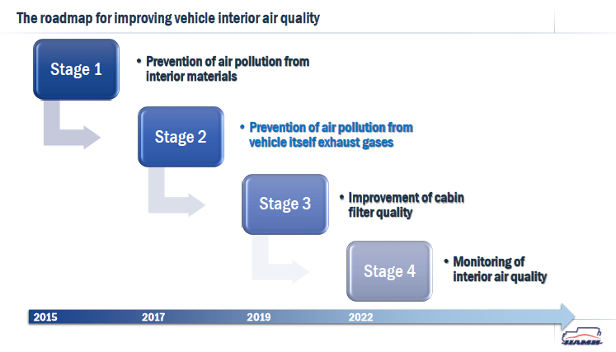
The Second Stage Mandate
Second stage of VIAQ IWG Mandate
Discussion on the second stage(VIAQ-07-11)
Notes:
7

Slide 8

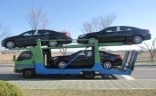
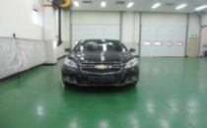
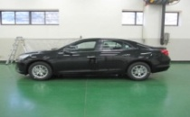
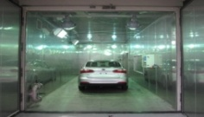
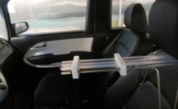
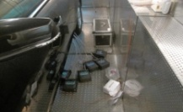
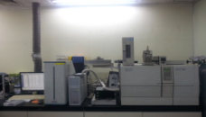
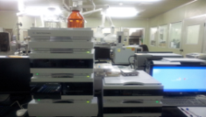
The Second Stage Mandate
Roadmap of VIAQ IWG Activities
Stage 1 - Measurement for interior material emissions
Car Preparation
Transportation
Storage
28days
± 5 days
16±1 hours
Test Mode
Ambient mode
Parking mode
Driving mode
Temp. Stabilizing
Sampling (Driver’s nose position)
Sample
Analysis
  8
GC/MS
HPLC
Content Analysis
GC/MS: Gas Chromatography Mass Spectrometry
HPLC : High Performance Liquid Chromatography
Notes:
8

Slide 9
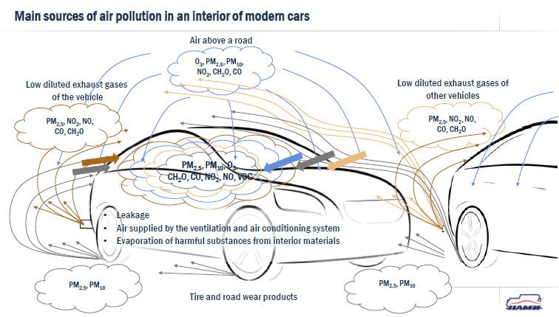

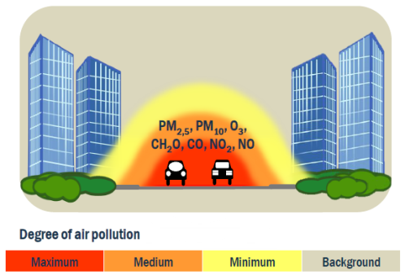
The Second Stage Mandate
Roadmap of VIAQ IWG Activities
Stage 2 - Develop the test procedure for vehicle exhaust gases entering the vehicle cabin (VIAQ-07-11)
Outside air pollution
Odors
Interior material emissions
Passenger breathing
Exhaust Gas
Exhaust Gas
Particles
Notes:
9

Slide 10
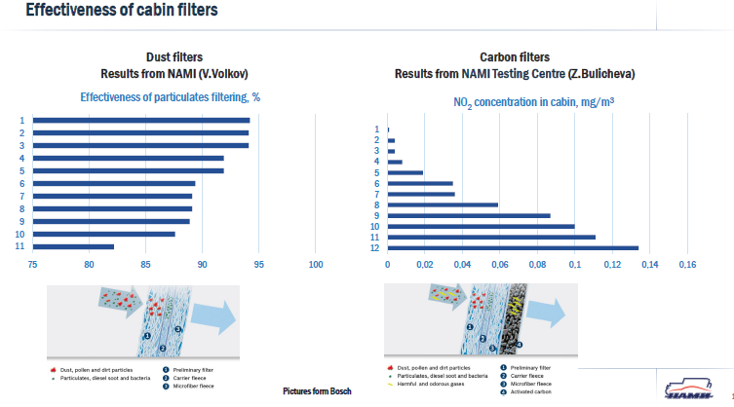
The Second Stage Mandate
Roadmap of VIAQ IWG Activities
Stage 3 - Assessment of cabin filter quality (VIAQ-07-11)
Particle filter, Active carbon filter, Combined filter, HEPA filter
Notes:
10

Slide 11
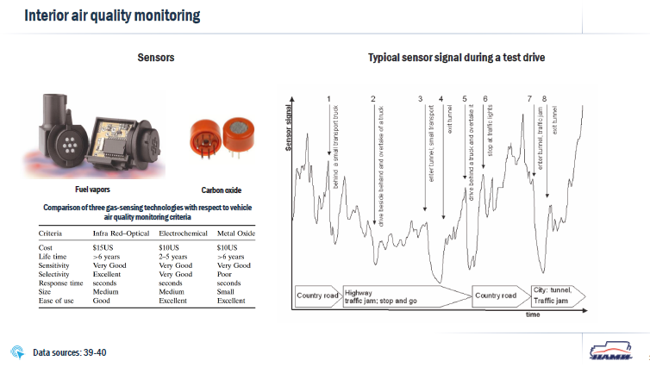
The Second Stage Mandate
Roadmap of VIAQ IWG Activities
Stage 4 - Monitoring of interior air quality (VIAQ-07-11)
AQS (Air Quality Sensors), PM sensor, Ionizer, CO2 management in cabin,
Notes:
11

Slide 12
The Second Stage Mandate
Informal documents (GPRE-75-14)
Terms of Reference for the second stage (Draft)
Objective
This proposal expands on the issues of the vehicle interior air quality, addressing exhaust gases entering into vehicle cabin air, to develop a test procedure in a recommendation.
End of mandate : November 2020
New leadership team : Chair(Russia), Co-chair(Korea),Secretary(OICA)
Submit Final Terms of Reference : 76th GRPE January Session
Notes:
12

Slide 13
The Second Stage Mandate
Informal documents (GPRE-75-0x)
Work scope and work items (Draft)
6.1 Interior air emissions emitted from interior materials
(a) Continue to work, review, and assess the harmonized test procedures
(b) Update the interior emissions sections for the Mutual Resolution
6.2 Exhaust gas entering into vehicle cabin air
(a) Collect the information and research data on relevant and similar issues, and understand the current regulatory requirements with respect to vehicle interior air quality in different markets
(b) Review, assess and develop new test procedures suitable for the measurement methods of exhaust gases entering into the vehicle cabin (including test modes, sample collection methods and analysis methods, etc.)
(c) Discuss the maximum permissible concentrations of harmful substances in the vehicle interior air
(d) Develop a draft for test procedures in a recommendation
6.3 Vehicle cabin air affected by outside air pollution sources
(a) Collect the information and research on relevant and similar issues
Notes:
13

Slide 14
Next VIAQ IWG Meeting
Next VIAQ IWG Meeting
9th VIAQ IWG Meeting (TBD)
October or November 2017
10th VIAQ IWG Meeting (TBD)
Geneva, Switzerland, January, during 76th GRPE session
Half a day requested
Notes:
14

