Slide 1
UNECE Regulation 53 DRL auto switch
Transmitted by the expert from Italy | Informal document GRE-77-17 (77th GRE, 4-7 April 2017 Agenda item 7 c))
The Japanese Administration presented, at the 75th GRE session a study on the disturbance due to the use of DRL during night time (see informal document GRE-75-09).
A proposal on the automatic switching between DRL and headlamps was then presented at the 76th GRE session with the official document ECE/TRANS/WP.29/GRE/2016/35, supported by the informal document GRE-76-03.
The Japanese proposal was considered positively by Germany, Finland and the Commission of European Union while France, United Kingdom and Italy presented some negative comments on it.
With the present informal document, Italy would like to better specify and clarify the reasons for his objections to the Japanese proposal.

Slide 2
Japan:
GRE-75-09e
ECE/TRANS/WP.29/GRE/2016/35
GRE-76-03e
We have seen no statistical evidence of the problem described in the three documents above indicated outside Japan, nor we are aware of any glaring/disturbance issues with riders NOT switching to dipped beam in dawn/dusk/cloud or night time conditions, also at night on urban streets with full street lighting.

Slide 3
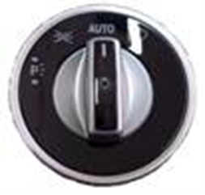
Motorcycles ≠ M & N Vehicles
On M and N categories vehicles, main light control switch shall retain a position for manual headlamp activation and deactivation. Only in the “AUTO” position the lamps operate via an ambient light sensor. Position lamps (front, rear, side) and plate lamps are not mandated to be operate together with the DRL and usually they are illuminated only when the headlamps are switched ON.
On a motorcycle, with the Automatic Headlamp On requirement, the manual switch for lighting control should be completely deleted. On a motorcycle, the rear position lamp and registration plate lamp are mandated to be illuminated with the DRL.

Slide 4
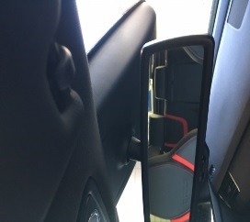
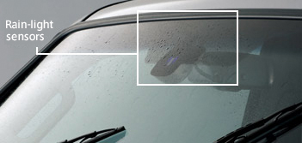
Motorcycle ≠ M & N Vehicles - Technology for auto-switching 1
In a car, the sensor is mounted inside the cabin, most typically near the rear view mirror. It is forward facing, but angled to give an unobstructed line-of-sight view to the sky in order to measure ambient light conditions. It is also typically located in a position that is within the arc of the windscreen wipers where it can be kept clean.

Slide 5
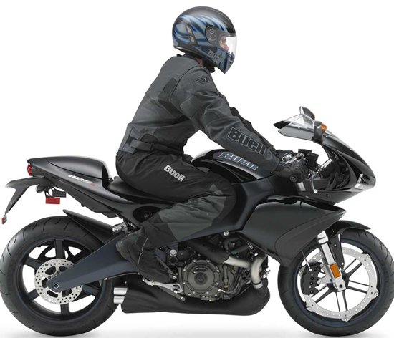
Motorcycle ≠ M & N Vehicles - Technology for auto-switching 2
The two positions where the sensor can be fitted to a motorcycle are in or near the headlight or in the instrument pack.
For safety reasons, the headlight area cannot be used. It is prone to becoming dirty, which will reduce sensor accuracy, and the sensor may not be able to differentiate between bright daytime conditions and an oncoming vehicle’s headlight at night. At night, this becomes critical because the DRL could be automatically switched on in conditions where the headlamp must be on for safety reasons (i.e. to illuminate the road ahead).
In the instrument pack, it is more protected from contamination but is likely to be in shadow, either from the rider and/or from surrounding bodywork and windscreens, especially those windscreens which are tinted. This will lead to the headlamp being on in conditions where the DRL could/should be on. The net result would be that , although a DRL may be fitted, there will be very few occasions when it will actually function.
Motorcycle with Cockpit and Windscreen – Instruments Directly Face the Rider (sensor therefore in shadow)

Slide 6
Motorcycle ≠ M & N Vehicles - Technology for auto-switching 3
There are motorcycles available today which have automatic switching. However, our experience of them is that the issues described above are present at some extent in all of them and may also have led to customer complaints of unreliability.
Retaining the manual switch has not reported safety issue that we are aware of. We have received no reports of riders using the DRL at night, as switching to the headlamp is done for evident practical reasons. The photometric configuration of a DRL makes it a very poor road illumination device and the rider switches to see where he is going. We have also not received any reports of DRLs causing glare in any daytime condition or any daytime/dawn/dusk ambient light condition.

Slide 7
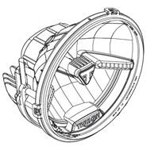
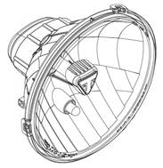
Cost
Adding automatic switching requires a sensor and a control unit on each bike costing between 25 and 35 Euros depending on the headlamp technology used. A system for an LED headlamp would be the lower figure, but the unit cost of the lamp itself would of course be higher.
Lamps with (left) and without (right) DRL
For the same motorcycle model, a headlamp with a reciprocally incorporated LED DRL has a unit cost to the manufacturer 6 times higher than for the same unit with a headlamp and position lamp using bulb light sources and with no DRL.
If the automatic switching apparatus is added, this rises to 10 times higher than for the basic non-DRL lamp fitted to the same motorcycle.
If the automatic switching system currently proposed ensures that lamp is rarely in operation, it is easy to foresee that manufacturers will consider deletion of the DRL version altogether. This may solve the alleged problem of glare but it also removes all benefits there may be in having DRLs at all.
Also, motorcycle manufacturers have invested in DRL technologies on their products including, in addition to the lamps themselves, manually operated switches costing (approx.) 3.5 million Euros in tooling.

Slide 8
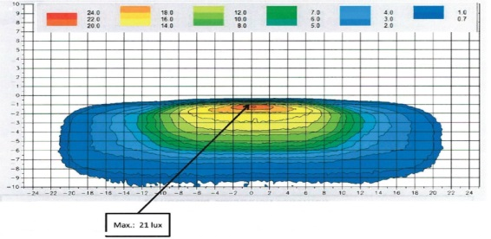
DRL & headlamp
Understanding the Distinct Differences in Each Lamp Type
The DRL regulated by R87 are foreseen for use on both L and M categories and it is important to understand the photometric differences between a headlamp (night-time road illumination device) and a DRL (daytime conspicuity device).
PHOTMETRIC SIMULATION DRL (R87)
PHOTMETRIC SIMULATION LOW BEAM HEADLAMP (R113)
As can be seen, the daytime conspicuity device (DRL) is required to provide light in H/V grid areas where the amount of light is deliberately controlled in a night time illumination device (low beam headlight). In other words both lamps are good for one purpose and not necessarily for the other.
However the emission of light in the glare critical zone for an oncoming vehicle is quite always lower for a DRL than for an headlamp; consequently the switching from DRL to headlamps do not ensure to solve the disturbance problems claimed by the Japanese study.

Slide 9
Conclusion and proposal
The Japanese proposal assumes that the light sensor technology can be easily shifted from cars. This is not the case for the reasons and differences previously explained.
In fact, the difficulty in finding a reliable sensor and sensor location on all types of motorcycle are such that doubt exists as far as the viability of auto-switching is concerned.
Therefore, we suggest that the proposal be withdrawn until evidence is provided that riders do not switch from DRL to headlamp in low-light conditions, causing disturbance/glare to other road users. The difficulties to find a proven and reliable solution for all motorcycle types are evident and time and investments are necessary to solve the problem, where proven necessary, taking into account a reasonable cost/benefit ratio.

