Slide 1




Slide 2



UTLC – JOINT PROJECT OF RAILWAYS OF KAZAKHSTAN, RUSSIA AND BELARUS
2
BELARUS
RUSSIA
KAZAKHSTAN
Main operational target – high quality rail service in the Eurasian transit

Slide 3

MARKET SIZE
3
Dynamic of volumes between EU and SEA & China
2011 | 2012 | 2013 | 2014 | 2015 | 2016 | 2017 forecast
20 202 | 19 901 | 20 429 | 21 926 | 21 700 | 22 400 | 23 070
99 % SHIPPED BY SEA
thousand, TEUs

Slide 4
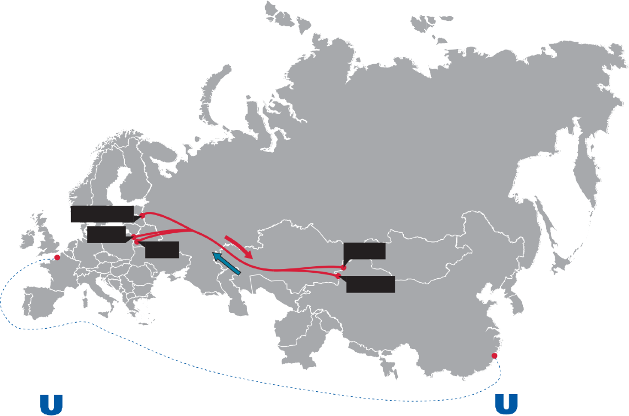


BASIC ROUTES AND SERVICES OF UTLC
4
4
RUSSIA
Kaliningrad
5-6 DAYS
Bruzhi
BELARUS
Brest
KAZAKHSTAN
Dostyk
Altynkol
DEEP SEA
35-40 DAYS
CHINA
UTLC
DEEP SEA
EUROPE
CHINA
EUROPE
CHINA

Slide 5






WHY RAIL?
KEY STRATEGIC ADVANTAGES
5
1 500
.
KM/DAY
1150
SPEED
.
REGULARITY
990
SECURITY
.
750
COMPETITIVE TARIFFS
550
.
Regularity – up to 10 trains/day Security – 24/7 convoy service
.
2014
2015
2016
2017
2018 (target)
Transit time
10 days
7,5 days
5,5 days
4,8 days
3,5 days

Slide 6
TARGET VOLUMES
6
1 000 000
.
TEU
815 687
652 549
.
522 039
417 632
334 105
.
253 110
191 750
.
165 000
100 983
47 000
.
2015
2016
2017
2018
2019
2 020
2 0 21
2 022
2 023
2 024
2 025
1 mln TEUs – a common and very ambitious target for the Eurasian transport industry

Slide 7
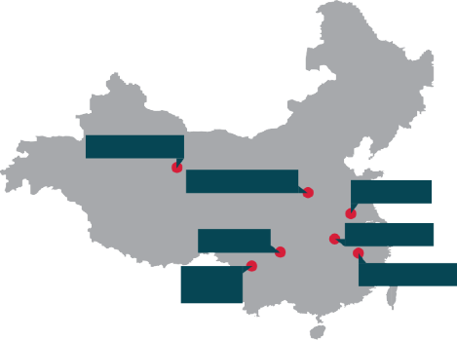
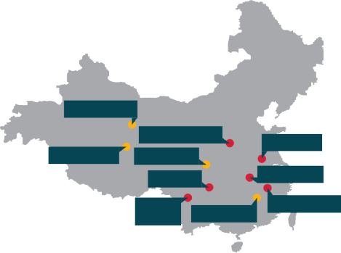
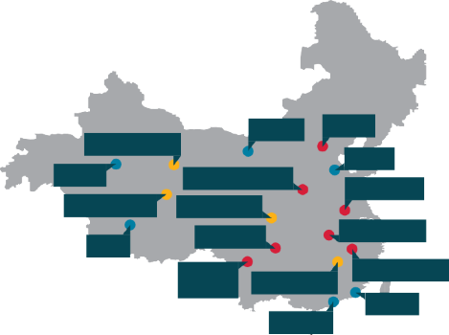
MORE CHINESE PROVINCES AND CITIES AT UTLC SERVICES IN 2017
7
in 2015
Added in 2016
Added in 2017
Lanzhou, Gansu
Lanzhou, Gansu
Lanzhou, Gansu
Taiyuan
Beijing
Zhengzhou, Henan
Zhengzhou, Henan
Urumqi
Zhengzhou, Henan
W eihai
Hefei, Anhui
Xining, Qinghai
Xi'an, Shaanxi
Hefei, Anhui
Xining, Qinghai
Xi'an, Shaanxi
Hefei, Anhui
Chongqing
Wuhan, Hubei
Chongqing
Chengdu, Sichuan
Wuhan, Hubei
Korla
Chongqing
Chengdu, Sichuan
Wuhan, Hubei
Chengdu, Sichuan
Yiwu, Zhenjiang
Wuxi, Jiangsu
Yiwu, Zhenjiang
Wuxi, Jiangsu
Yiwu, Zhenjiang
Xiamen
Shenzhen
The number of regular routes in UTLC services in 2017 has reached 48
(at the beginning of 2016 there were 19)

Slide 8

EUROPEAN DESTINATIONS AND SHIPPING POINTS IN THE U WEST AND U EAST
8
Tilburg
Hamburg
Gorzow
Kutno
Antwerpen
Duisburg
Poznan
Małaszewicze
London
Reinhausen
Warszawa
Lodz
Nürnberg
Prague
Pardubice
Lyon
Munich
Budapest
Milan
Madrid
20 container terminals in EU
12 rail carriers in EU
48 routes between EU and China

Slide 9
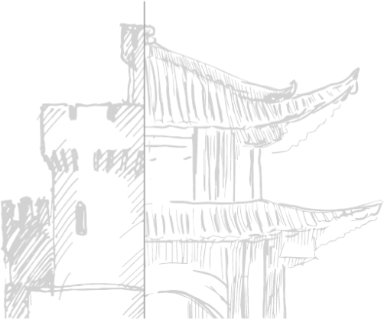
BARRIERS AND RISKS
9
1
LIMIT OF CAPACITY AT EU BORDER
2
WEAK COORDINATION BETWEEN MAIN PLAYERS IN EU AND EAEU
3
INSUFFICIENT INVESTMENTS IN EU RAIL INFRASTRUCTURE
4
HIGH PRICING FOR EU RAIL TRANSPORTATION*
*TWICE AS EXPENSIVE AS EAEU AND CHINA
5
ESTIMATED SHORTAGE OF WAGONS AND TRACTION IN EU AND EAEU

Slide 10
PROPOSALS
10
State and dynamics of trade between China and EU need new alliance in Eurasian rail business
Factor of success – joint efforts of EU and EAEU carriers, forwarders and other rail industry
players focusing on the main Eurasian Rail KPI - speed, security, pricing
Simultaneous development of rail and terminal infrastructure
Harmonized technologic standards at 1520/1435 connections
Adjustment of common operational targets and planning process
LET’S RAIL TOGETHER!

Slide 11
ARE
?
ARE
?
THANK YOU FOR ATTENTION!

