Slide 1
Railway contribution to the Intermodal Transport Workshop UNECE, Geneva; 23November 2017
SLOVENIA –
INTERMODAL
LOGISTIC
PLATFORM
Jure Leben, State Secretary

Slide 2
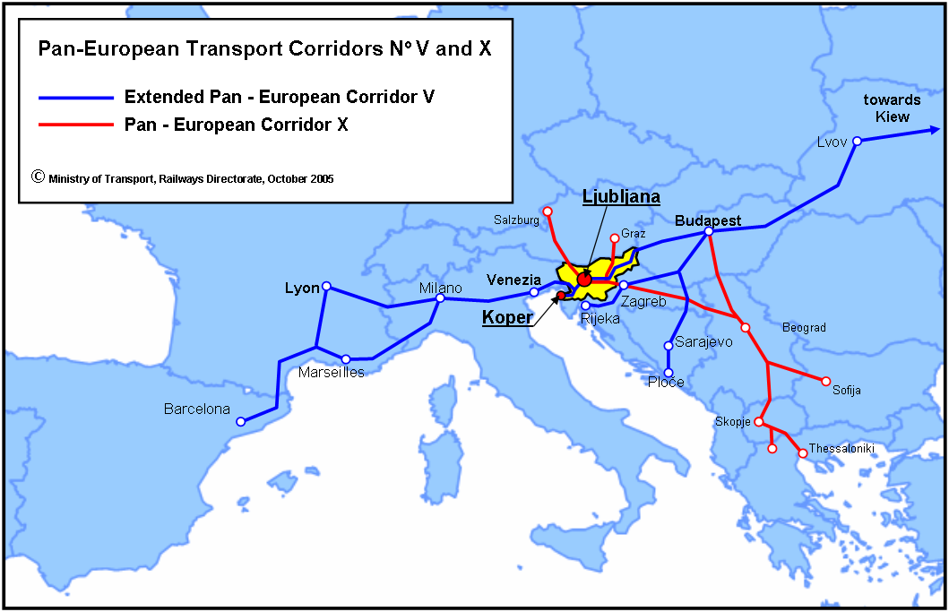
Geographical position of the Republic of Slovenia
CEMT - Helsinki – 1997

Slide 3
Baltic -Adriatic and Mediterranean Corridor

Slide 4
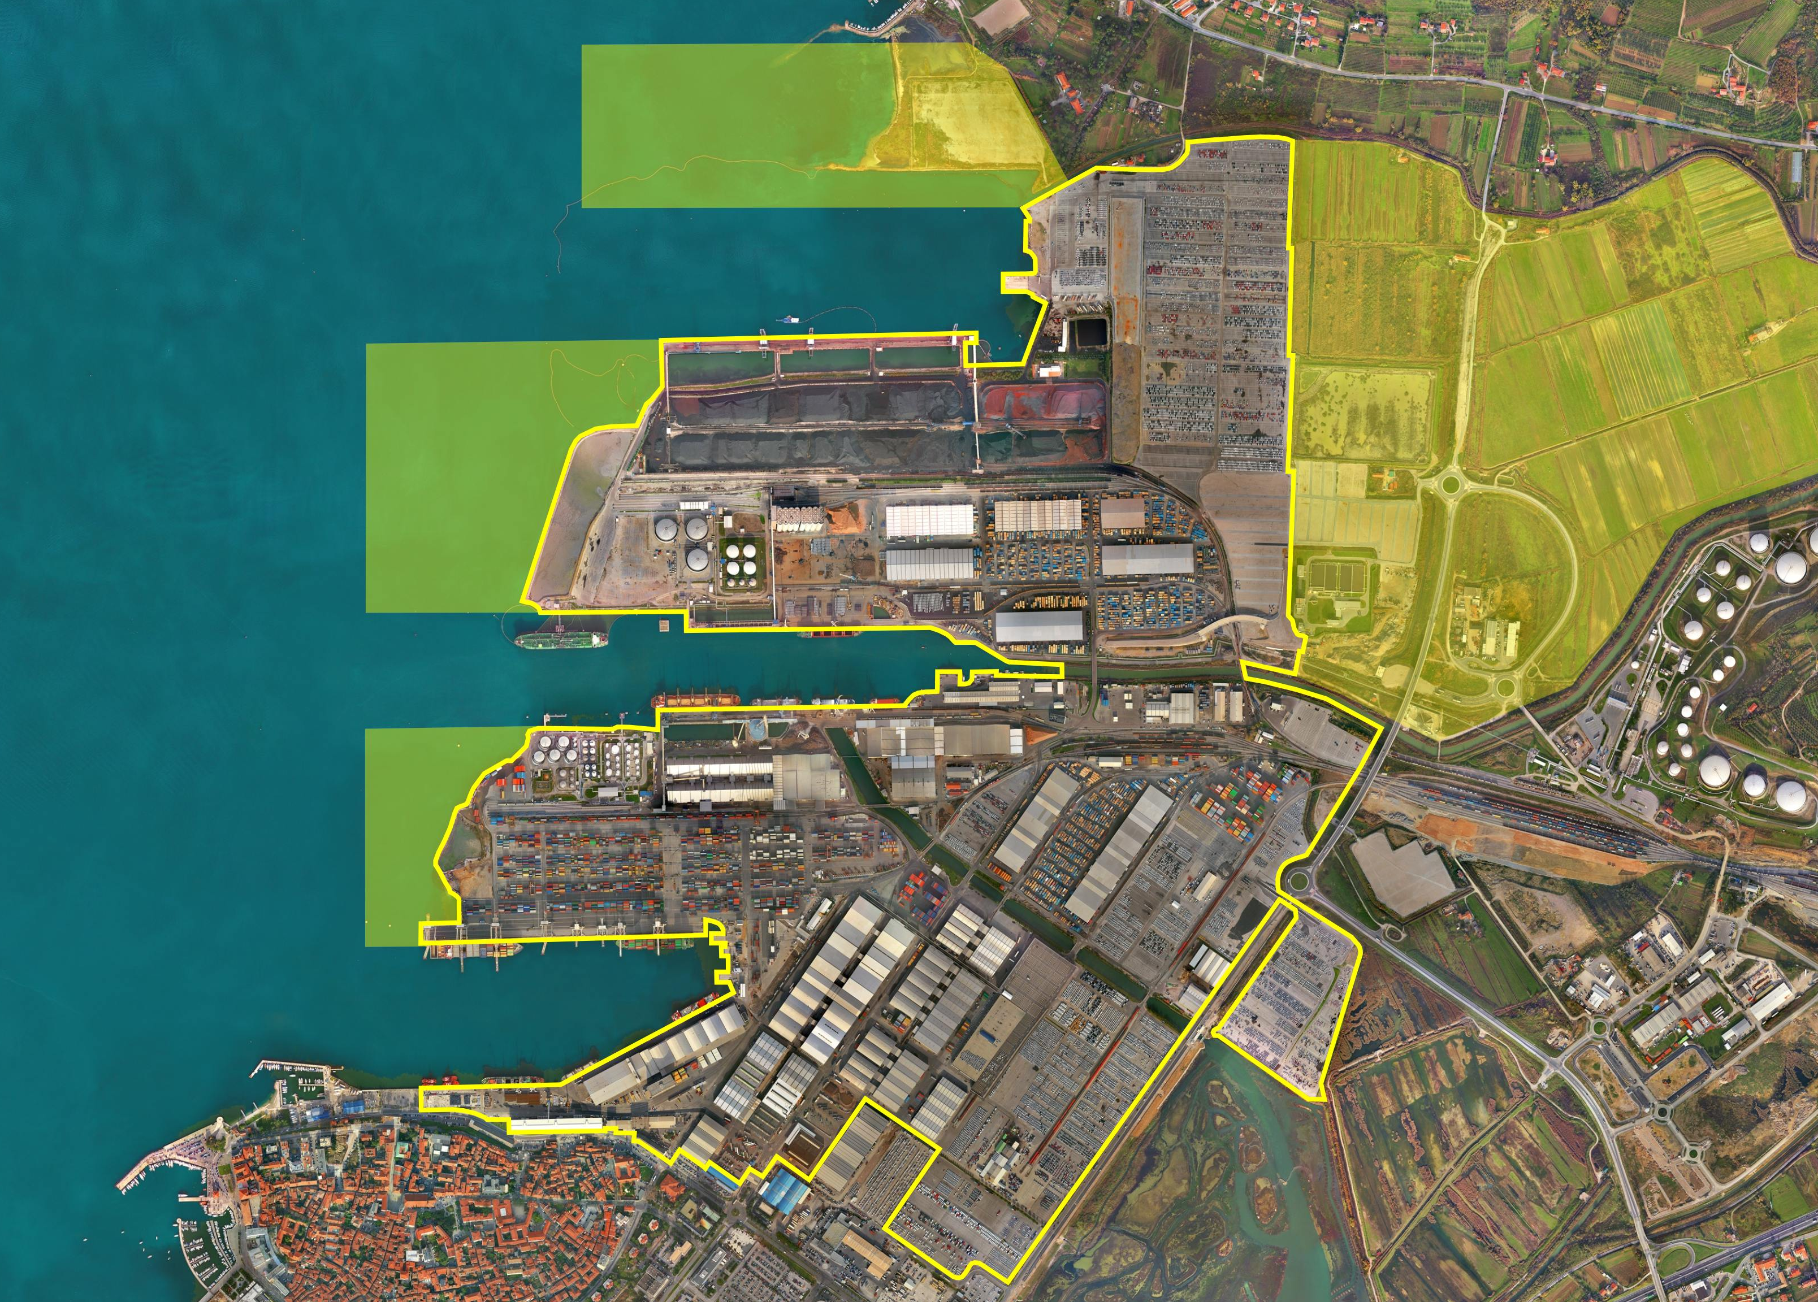
Port of KOPER - key development projects
NEW PIER III
NEW Ro-Ro berth
CONTAINER FREIGHT STATION
and
DISTRIBUTION CENTRE
EXTENSION OF PIER II
Dredging of port baisins
DREDGING OF ACCESS CHANNELS
NEW berth no. 12
NEW main Entrance and Truck Terminal
EXTENSON OF PIER I
Extension of Container Terminal
Enlarged shunting station
MULTI STOREY
WAREHOUSES FOR CARS
RAILWAY
INFRASTRUCTURE DEVELOPMENT
PASSENGER
TERMINAL

Slide 5
Railway projects in Slovenia

Slide 6
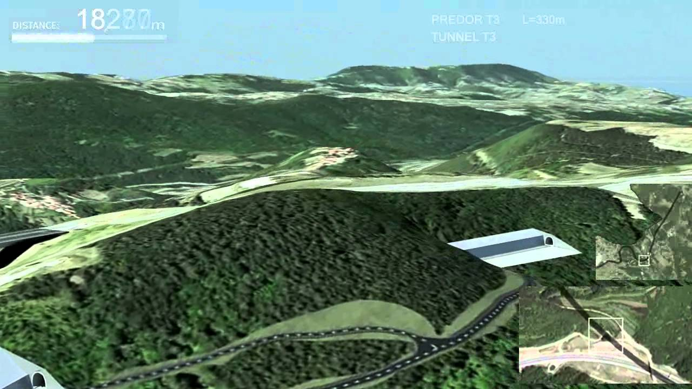
Railway infrastructure
Second track of the Koper – Divača railway line
Notes:
As I mentioned before for the development of railway transport in Slovenia a new second track from port of Koper to Divača is necessary. Few years ago we modernized existing railway track from port of Koper and a capacity in now 85 trains per day. With new second railway track we will be able to incise this capacity to 222 trains per day. Project is huge due to geographical situation and we must build 8 tunnels with the lent around 18 km, 2 bridges, 2 galleries and 1 gallery – all this will cost Slovenia a little bit more than 1 billion euro. It is a lot for us. For implementation of this project we establishment a company for the construction of the second track so called 2TDK,Company for the development of the project Koper - Divača. The company, initially owned by the Republic of Slovenia, will implement, as an internal contractor of the state, all activities necessary for realising the project of the second track on the Koper-Divača railway line and will later take over the management of the investment of the relevant project. The initial capital of the company was 1 million EUR with the prospect of recapitalization up to 200 million EUR. Later on this year an act on the construction of the new rail link was adopted. The act determines all the bases necessary for the construction and management of the new railway connection and the construction and management of additional transfer storage capacities and other logistics-related activities. The award of the concession is envisaged to this company for the construction and management of the new rail link between Divača and Koper and the construction and management of additional transfer storage capacities and other logistics-related activities. After establishment the company immediately started implementing the activities necessary to acquire EU funds and the preparation of bases for the establishment of a public-private partnership. The company conducted these activities as an agent of the state. In implementing the second track project, Slovenia is counting on obtaining some 250 million EUR in EU funds. As this line is so important for hinterland countries we expect contributions by private investors and interested hinterland countries in a total amount exceeding the contribution of the Republic of Slovenia. This activity anticipates the establishment of a public-private partnership model.

Slide 7
Future challenges
Thank you
for your attention

