Slide 1
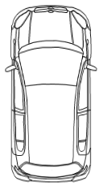
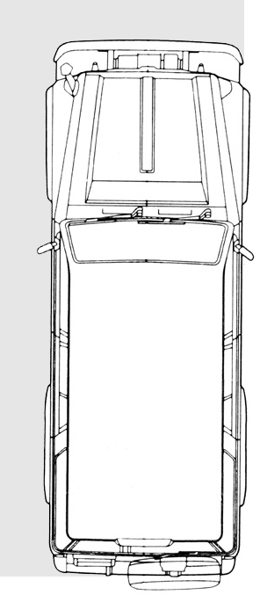
Informal document GRSG-110-11 - (110th GRSG, 26-29 April 2016, agenda item 5.)
Requirement for the view of the vehicle’s surroundings and rear
Purpose: To prevent accidents by enabling the driver to notice any pedestrians around or behind the vehicle.
Requirement: The close-proximity and rear-view device shall be such that the driver can detect objects (with a height of 1,000 mm and a diameter of 300 mm) located within the areas defined in Figures 1 and 2, using a mirror, camera, sonar, etc.
Object
1,000mm
(φ300mm)
Object
1,000mm (φ300mm)
0.3m
1.5m
Overall width/2
Overall width/2
3.5m
1.5m
1.5m
Field of vision around the vehicle (Figure 1)
Field of vision behind the vehicle (Figure 2)

