Slide 1
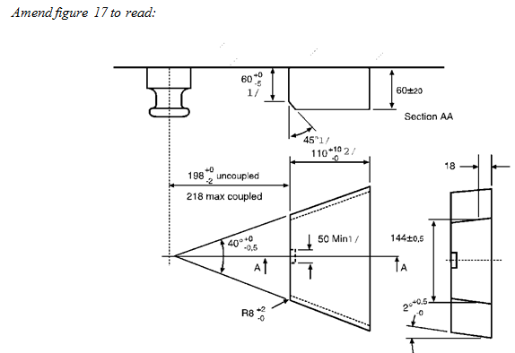
Proposals from IWG-R55 to GRRF-82
Submitted by the Secretary of the
IWG on Regulation No. 55
Informal document GRRF-82-02
82nd GRRF, 20-23 September 2016
Agenda item 5
Minor corrections and clarifications
Typos in Annex 5 figures 12 and 17

Slide 2
Proposals from IWG-R55 to GRRF-82
Minor corrections and clarifications
Articulation angles as installed.
5th-wheels pivoting around a transvers axis
6° to the front and 7° to the rear
Drawbars with drawbar couplings
±90° around a vertical axis
±20° around a transvers axis by rear mounted couplings
±6° around a transvers axis by underslung mounted couplings
In this case the drawbar is considered to be an endless line starting in the coupling point

Slide 3
Proposals from IWG-R55 to GRRF-82
Minor corrections and clarifications
Identification of worst case for testing
Clarification that worst case is supposed to be used
Linguistic change in relation to calculation based approval of “simple designs”
The word “check” is exchanged to “assessment”

Slide 4
Proposals from IWG-R55 to GRRF-82
Attachment points for secondary coupling devices
Broadened definition of secondary coupling device
Addresses coupling devices in general rather than just Class B
Attachment point required for towing bracket/drawbeam aimed at towing of O1 and O2 trailers.
Location of a single or a double attachment point stated.
Alternatively attachment point may be integrated to the coupling mounted on the towing bracket/drawbeam
Attachment point required for coupling head/drawbar eye aimed at towing of O1 and O2 trailers.
Performance and test requirements detailed

Slide 5
Proposals from IWG-R55 to GRRF-82
Separation of approval process from application assessment
Components can be approved without knowing anything about the vehicles where they will be installed.
In essence definitions and the annexes 5 and 6 set the requirements
The way application requirements are calculated sets the safety margin
All application assessment formulae are moved in the new annex 8

Slide 6
Proposals from IWG-R55 to GRRF-82
Adding multi vehicle combination assessment formulae
The traditional two vehicle combination formulae are moved to annex 8
Note, only the formula for full trailer can be used to decide towable mass, however then it is just one out of several decisive factors.
Then the formulae for more than two vehicle combinations according to ISO18868 are added to annex 8
These formulae are by necessity more complex
Support structures e.g. web applications will supply easy to use vehicle combination assessment tools
Vehicle combinations commonly seen in the roads today can then be assessed at the same safety level in different markets

Slide 7
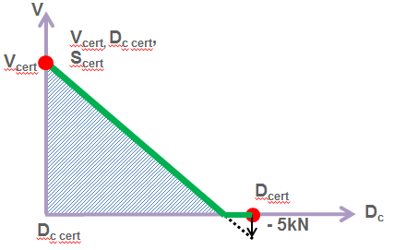
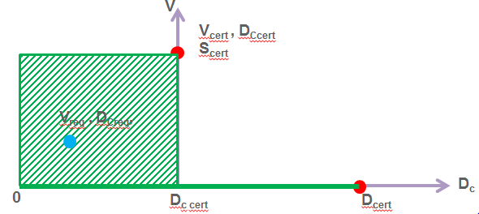
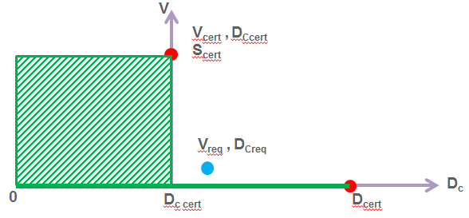
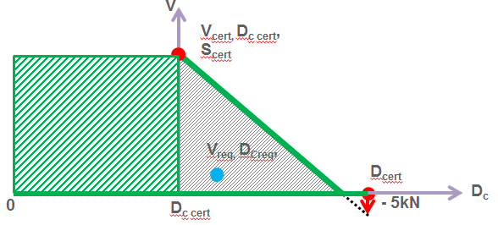
Proposals from IWG-R55 to GRRF-82
Adding D_{c}/V-trade-off possibility to annex 8
Some multi vehicle combinations require high D_{c}-performance in combination with a low V-performance
OK, Practice of today
NOK, Practice of today
OK, Practice of tomorrow

