Slide 1
GTB Task Force Conformity of Production TF CoP
Transmitted by the expert from GTB | Informal document GRE-75-15 (75th GRE, 5 - 8 April 2016, agenda item 11(b))
Report for GRE-75

Slide 2
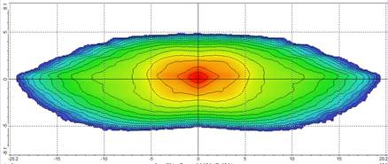
Motivation for TF CoP on AFS
to set R123 in line with other headlamp CoP procedures to have common CoP procedures for work of IWG-SLR
to show R123 CoP compliance up to 80 photometric measurements are necessary compared to only 8 measurements for HID (R98) or Halogen (R112) headlamps with bendlight
Initial Position
Bend max.Left
R112/R98
R123
Bend max.Right
High Beam
→AFS COP TESTING HAS TO BE SIMPLIFIED

Slide 3
GTB TF CoP
in average 15 experts from Industry and Testhouses participated since 2012
Outcome:
Work on ECE Reg. 123 to simplify AFS tests for serial production
GRE Reporting
Regular Progress Report to GRE
69th session(GRE-72-29)
72nd session(GRE-69-40)

Slide 4
Work items of TF:
include in Reg.123 the new CoP procedure similiar to Reg.112 change adopted at 69th GRE session (ECE/TRANS/WP.29/GRE/2013/37)
clarify which tests are necessary for CoP testing compared to type approval testing, clarify that tests apply only for the entire system (Annex 5, Appendix 1 , paragraph 1.)
create simplified photometric CoP tables for each class (C,V,W,E,R,RADB) with applicable tolerances (Annex 5, Appendix 1 ,Tables 1 to 16)

Slide 5
Work items:
reduce&simplifiy the measurements
if there is more than one mode in a Class then only the basic mode for CoP to be measured(paragraph 2 of Annex 5, Appendix 1)
if bending modes use same functional unit, then only worst case bending mode to be measured (paragraph 2 of Annex 5, Appendix 1)
if ADB has same functional unit, then only the worst case situation for CoP to be measured (in most cases this will be Line 1 and Line 4 (“50m case”) in Table 16 Part A of Annex 5, Appendix 1)
substitute zone scans by line scans and line-scans by point measurements (Table 1 to 16 of Annex 5, Appendix 1)

Slide 6
Work items:
reduce&simplifiy the measurements
instead of Imax scan usage of characteristic points (Annex 5, Appendix 1, Table 1, 75R,50V,50R instead of Imax)
allowance of an automatic 0.25° re-aim for CoP tests instead of a re-alignment of the unit without re-testing all other modes for CoP (Annex 5&7 Paragraph 1.22 and Annex 5, Appendix 1 Paragraph 1)

Slide 7
Work in Detail:
update paragraph 9 and Annex 7 with new CoP procedure as adopted by GRE (GRE 69: ECE/TRANS/WP.29/GRE/2013/37)
define which tests are applicable for CoP
Photometry according to new CoP Tables in Annex 5
Colour
Stability of Cut-Off (Annex 4)
include simplified CoP Tables for Photometry in Annex 5 for each Class/Mode
Class C / Class E / Class V / Class W / Class R /RADB
Overview of AFS see GRE-48-28 or GRE-48-30

Slide 8
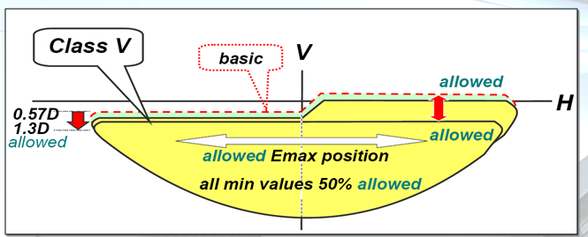
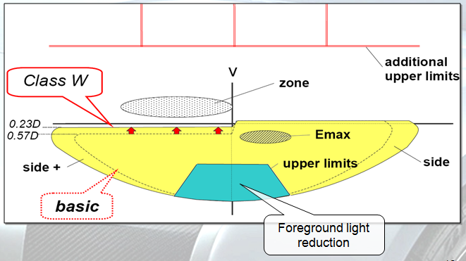
Simplify Classes to most important key test points
Simplify classes/modes (C,V,W,E,R, RADB)to most important key test points
e.g.
Class V: “Village”
→ check reduced kink/ light at crossing
Class W: “Wet Road”
→check reduced foreground illumination, extended range...

Slide 9
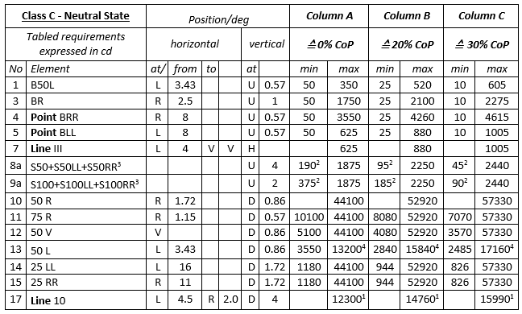
Simplifed photometric tables for CoP
Proposal for a simplified Class C Table for CoP:
instead of Line-scan- only a Point-measurement (e.g. Line BRR/BLL -> Point BRR/BLL)
instead of Zone-scan- only Line-measurement (e.g. ZoneIII -> LineIII)
instead of Imax scan use characteristic points (75R)
DRAFT

Slide 10
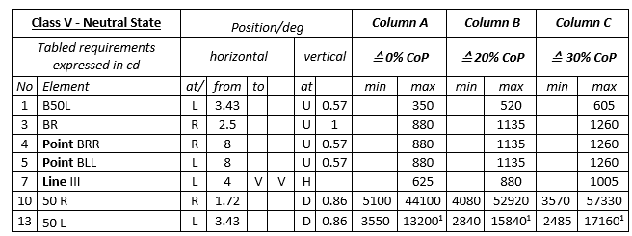
Reduced CoP Tables and Tests
e.g. Simplified Class V Table for CoP:
e.g. reduction to key test points
DRAFT
DRAFT

Slide 11
new definition of „functional unit“
“1.22. “Functional unit” means a part of a lighting unit providing a specific light distribution which may be used for different modes or classes. If used for the bending mode its light distribution may vary as a function of the T-signal(turn-radius); however, the light distribution shall be identical for a given T-signal(turn-radius) in all modes or classes.
some examples for such a „functional unit“ for the bending:
for Cat.1 Bendlight:(bending mode with horizontal movement of the kink of the cut-off)
-the swivelling of a complete projection module or only the optical lens
- the activation of static optical elements which produce moveable kink patterns by sequential activation (pixel/matrix light)
etc....
for Cat 2 Bendlight: (bending mode without horizontal movement of the kink of the cut-off)
-the activation of static optical elements (e.g. cornering lamp reflector, pixel/matrix light) below cut off line
-the swivelling of optical elements below cut off line
etc....

Slide 12
Reduce the measurements according to the following decision table:
reduction of ADB measurements to worst case condition if same functional unit is used
reduction to measurements of only the basic mode if more than one mode in a Class exists
reduction of bend light test if same „functional unit“ is used.
(details see next slide)

Slide 13
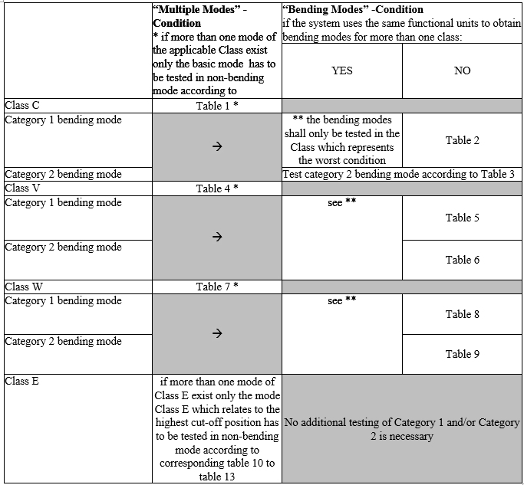

Slide 14
Target:
formal document to be sent to 76th GRE session for adoption
THANK YOU!

