Slide 1
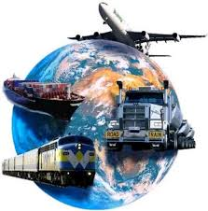
WHAT IS INTERMODAL TRANSPORT?
Kayıhan Ö. TURAN
UTIKAD
TURKEY
October 31 – November 1, 2016

Slide 2
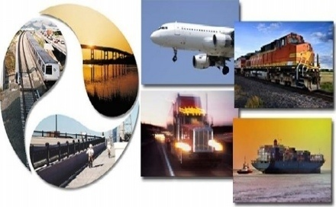
UTIKAD
UTIKAD
Association of International Forwarding and Logistics Service Providers
National and International Transportation:
Road, Air, Sea, Rail and Combined Transportation
Logistics Services
Above 400 Members & 50,000 Direct Employment & 5 USD Billion Turnover
95 % of Air Transport
70 % of Road Transport
60 % of Sea Transport
20 % of Rail Transport
carried out by our members in Turkey

Slide 3
UTIKAD
‘’The Umbrella Organization for the Transportation and Logistics Industry’’
Presence & Organizations
Projects & Cooperations
Training & Publications
Social Responsibilities

Slide 4
NATIONAL & INTERNATIONAL PLATFORMS
VOICE OF INDUSTRY IN TURKEY
VOICE OF INDUSTRY IN THE WORLD

Slide 5
PRESENCE & ORGANIZATIONS
Voice of Industry Abroad with 6 Institutions
FIATA, CLECAT, UNECE, ECOLPAF, TRACECA, SEESARI
Founding Member of ECOLPAF & SEESARI
Working Groups of 7 Sectoral Divisions
Hosted 4 International Organizations
International Organizations By UTIKAD
1999
2002
2011
2014
Balkan Congress
FIATA World
Congress
10. Southeast European
Freight Forwarders
& Logistics Operators
Congress
FIATA World
Congress

Slide 6
FIATA WORLD CONGRESS 2014 ISTANBUL
From 95 Countries, 1039 Participants came together
15 Meetings
35 Speakers
1055 Networking Meetings
43 Exhibitors
Italy
Gana
India
U.S.A
Nigeria
U.A.E.
Taiwan
Ukraine
Malaysia
Belgium
MAIN SPONSOR
PLATIN SPONSOR
PLATIN SPONSOR
MAIN MEDIA SPONSOR
BRONZE SPONSOR
SILVER SPONSOR
YIFFYA SPONSOR
MEDIA SPONSORS

Slide 7
TRAINING & PUBLICATIONS
FIATA Diploma in Freight Forwarding / with 25 graduate end of 1st year June - 2016
Self Improvement and Vocational Trainings
Ahmet Kartal Annual Achievement Award
9 Educational Books & 2 Special Report
UTIKAD Library of 368 Books
Publications By UTIKAD

Slide 8
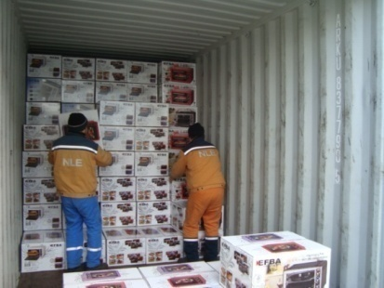
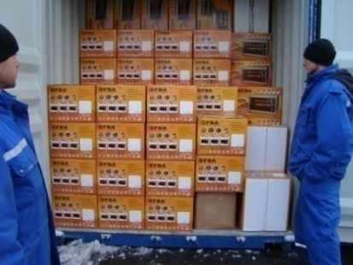
WHAT IS INTERMODAL TRANSPORT ?
AS FREIGHT FORWARDERS
WE ORGANIZE «DOOR TO DOOR» OPERATIONS
BY COMBINING DIFFERENT TYPE OF
TRANSPORTATION MODES & SERVICES
BY PHYSICAL HANDLING THE GOODS AT TERMINAL WHERE WE CHANGE TRANSPORT MODE

Slide 9
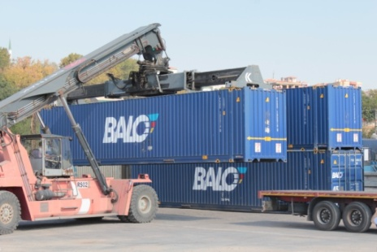
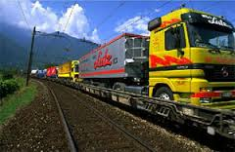
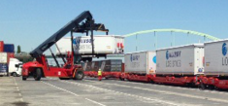
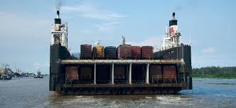
WHAT IS INTERMODAL TRANSPORT ?
OR
AS FREIGHT FORWARDERS
WE ORGANIZE «DOOR TO DOOR» OPERATIONS
BY COMBINING DIFFERENT TYPE OF
TRANSPORTATION MODES & SERVICES
WITHOUT PHYSICAL HANDLING THE GOODS AT TERMINAL WHERE WE CHANGE TRANSPORT MODE

Slide 10
WHAT IS INTERMODAL TRANSPORT ?
SO THERE SHOULD BE ONLY
TWO OPERATIONAL DESCRIPTION OF WHAT WE DO
DESCRIPTION A : BY PHYSICAL HANDLING OF THE GOODS AT
TERMINAL WHERE WE CHANGE
TRANSPORT MODE
DESCRIPTION B : WITHOUT PHYSICAL HANDLING OF THE
GOODS AT TERMINAL WHERE WE CHANGE
TRANSPORT MODE
WE DO NOT HAVE A 3RD OPTION

Slide 11
COMPLICATED TERMINOLOGY
I. Multimodal Transportation (broadest term and covers all of the others)
II. Intermodal Transportation (a specific type of multimodal transportation)
III. Combined Transportation ( recently used one )
IV. Co-Modal Transportation (focusing on the overall sustainability and
resource utilization – not common&known much)
V. Synchromodal Transportation (synchronized combination of different
transport modes and focusing on real-time
flexibility – not common&known much)
THESE ARE NOT OPERATIONAL DESCRIPTIONS

Slide 12
MARKET RESEARCH
LAST YEAR A SHORT QUESTIONNAIRE WAS DONE DURING
ONE OF OUR SESSIONS WITH BELOW RESULTS ☺
TOTAL ATTANDANCE : 18
TOTAL ATTANDANCE : 18
HOW DO YOU NAME BELOW DESCRIPTION
Carriage of goods in one and the same loading unit or road vehicle, which uses two or more modes of transport respectively without handling the goods themselves while changing modes
MULTI MODAL 2 | COMBINED 5 | INTERMODAL 11
HOW DO YOU NAME BELOW DESCRIPTION
The carriage of goods by using two or more modes of transport respectively by physical handling of the goods themselves while changing transport modes.
MULTI MODAL 12 | COMBINED 1 | INTERMODAL 5

Slide 13
SMALL QUESTIONNAIRE IN THE MARKET
WE DID SAME QUESTIONNAIRE WITH OUR MEMBERS AND
HERE ARE THE RESULTS ☺
TOTAL ATTANDANCE : 16
TOTAL ATTANDANCE : 16
HOW DO YOU NAME BELOW DESCRIPTION
Carriage of goods in one and the same loading unit or road vehicle, which uses two or more modes of transport respectively without handling the goods themselves while changing modes
MULTI MODAL 2 | COMBINED 3 | INTERMODAL 11 ( 1=if rail connected)
HOW DO YOU NAME BELOW DESCRIPTION
The carriage of goods by using two or more modes of transport respectively by physical handling of the goods themselves while changing transport modes.
MULTI MODAL 14 | COMBINED 1 | INTERMODAL 1

Slide 14
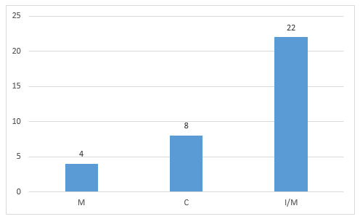
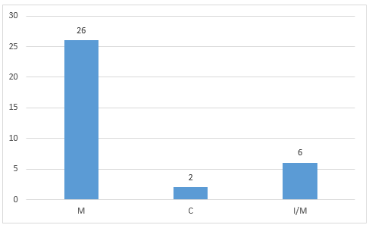
SUMMARY OF QUESTIONNAIRES
Carriage of goods in one and the same loading unit or road vehicle, which uses two or more modes of transport respectively without handling the goods themselves while changing modes
The carriage of goods by using two or more modes of transport respectively by physical handling of the goods themselves while changing transport modes.
SECTOR IDEA %65 & %76 SAME AS IN THE BEGINNING DESCRIPTION

Slide 15
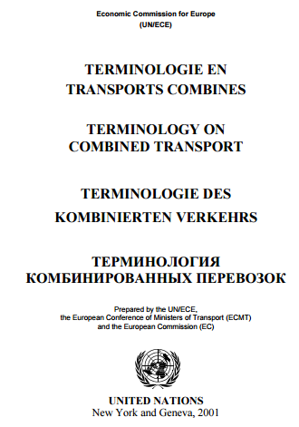
UNECE TERMINOLOGY ON COMBINED TRANSPORT
COVER PAGE
COMBINED TRANSPORT

Slide 16
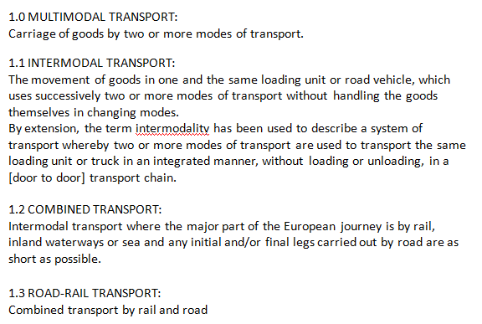
UNECE TERMINOLOGY ON COMBINED TRANSPORT
TITLE IS NOW A SUBTITLE!!!

Slide 17
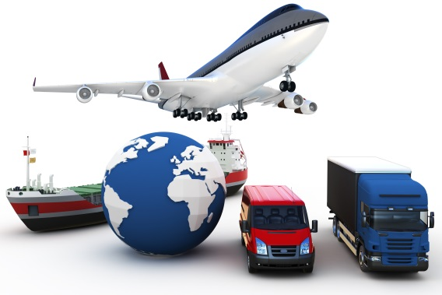
1.0 MULTIMODAL TRANSPORT
Current Definition:
1.0 MULTIMODAL TRANSPORT:
Carriage of goods by two or more modes of transport.
Our Proposal:
1.0 COMBINED TRANSPORT
Carriage of goods by two or more modes of transport respectively. There are two types of combined transport modals.

Slide 18
1.1 INTERMODAL TRANSPORT
Current Definition:
1.1 INTERMODAL TRANSPORT
The movement of goods in one and the same loading unit or road vehicle, which uses successively two or more modes of transport without handling the goods themselves in changing modes.
By extension, the term intermodality has been used to describe a system of transport whereby two or more modes of transport are used to transport the same loading unit or truck in an integrated manner, without loading or unloading, in a [door to door] transport chain.
Our Proposal:
1.1 INTERMODAL TRANSPORT
Carriage of goods in one and the same loading unit or road vehicle, which uses two or more modes of transport respectively without handling the goods themselves while changing modes.
In an intermodal transport, the main transport is executed by rail, inland waterways or sea. Pre carriage and/or final delivery is carried out by road as short as possible.

Slide 19
1.2 COMBINED TRANSPORT
Current Definition:
1.2 COMBINED TRANSPORT
Intermodal transport where the major part of the European journey is by rail, inland waterways or sea and any initial and/or final legs carried out by road are as short as possible.
Our Proposal:
1.2 MULTIMODAL TRANSPORT :
The carriage of goods by using two or more modes of transport respectively by physical handling of the goods themselves while changing transport modes.
UNECE LIMITS DESCRIPTION TO EUROPE

Slide 20
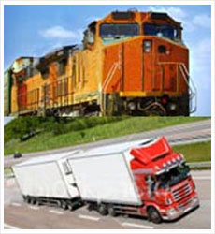
1.3 ROAD-RAIL TRANSPORT
Current Definition:
1.3 ROAD-RAIL TRANSPORT:
Combined transport by rail and road
Our Proposal:
Removal of the term
1.3 ROAD-RAIL TRANSPORT:
Combined transport by rail and road
THEN WHY NOT ANOTHER TOPIC AS «SEA + RAIL»

Slide 21
UNECE TERMINOLOGY ON COMBINED TRANSPORT

Slide 22
UNECE TERMINOLOGY ON COMBINED TRANSPORT
BECAUSE MAIN DISTINGUISHING ITEM
PHYSICAL HANDLING OF THE GOODS OR WITHOUT HANDLING THE GOODS
BY CHANGING MODES
OR

Slide 23
UNECE TERMINOLOGY ON COMBINED TRANSPORT
A FULLY AGREED DEFINITION IN TERMINOLOGY IS A MUST
TO BETTER MEASURE THE TYPE OF BUSINESS PERFORMED IN THE MARKET,
TO EVALUATE AND PREPARE STATISTICAL REPORT
WHICH IN RETURN WILL HELP US
TO SHAPE THE FUTURE TRANSPORT POLICIES

Slide 24
Thank You
Kayıhan Ö. Turan
UTIKAD

