Slide 1
Informal document GRRF-80-31
80th GRRF, 15-18 September 2015,
Agenda item 6
Submitted by the expert from Italy
Proposal
to introduce requirements for the approval
of replacement brake discs for L-category vehicles
in UN Regulation No. 90
Submitted by ITALY
(Revision 2)
80° GRRF
15-18 September 2015

Slide 2
Preamble
At the 78° session of GRRF (16 Sept 2014), ITALY had tabled a proposal
(doc ECE/TRANS/WP.29/GRRF/2014/23), to include in UN-R 90 a set of new requirements for the approval of replacement brake discs for L-category vehicles, taking into consideration the latest technologies available in the market.
At the 79° GRRF session (16 Feb 2015), ITALY forwarded a Revision 1 of the proposal (ECE/TRANS/WP.29/GRRF/2014/23/Rev.1), containing some amendments based on comments raised by CPs, as well as some additional improvements through informal documents (GRRF-79-11e , GRRF-79-13e ).
During the 79° session, GRRF agreed with the above mentioned improvements, but raised also further comments and request of amendments.
Today (80° GRRF session), ITALY is thus willing to propose a Revision 2 of the proposal: ECE/TRANS/WP.29/GRRF/2014/23/Rev.2
It includes:
the improvements previously presented with the 2 informal documents
modifications addressing the comments raised at 79° GRRF
some minor additional editorial improvements

Slide 3
ECE/TRANS/WP.29/GRRF/2014/23/Rev 2
Comment raised at 79° GRRF:
Paragraph 5.3.3.2.1, where the reference to the «lamellar cast iron» would imply the need to include a definition
Revision:
The proposed new paragraph to be inserted, has been modify as follows:
From:
5.3.3.2.1 Lamellar cast iron for brake disc and brake drum of categories M, N and O.
In order to be considered "Equivalent" the replacement brake disc or drum shall be from
the same material subgroup as the original brake disc or drum.
Four original part material subgroups are defined."
To:
5.3.3.2.1. For vehicles of category M,N,O, in order to be considered "Equivalent" the replacement brake disc
or drum shall be from the same material sub-group as the original brake disc or drum.
Four original part material sub-groups are defined

Slide 4
ECE/TRANS/WP.29/GRRF/2014/23/Rev 2
Comment raised at 79° GRRF:
Packaging and marking requirements.
NL objected the possibility to allow the use of the official brake disc manufacturer’s website where to include
info concerning the replacement brake disc for vehicles of L cat, as an alternative to writing them on the package
The proposal was due to the impossibility to include the vast number of codes in a single and space-limited label:
- in case of motorcycles, a same brake disc may be fitted on a very high number of applications
- this huge list is very often subject to updating
ITALY was also ready to investigate other solutions:
use a QR code linked to a closed pdf file including the official updated list of applications,
to whom the dealer may have access
include in the label on the package, only the codes of the most significant models, referring to the website
for the complete updated list.
"6.2.1.4. In the case of motor vehicles of categories L₁, L₂, L₃, L₄ and L₅:
……..
6.2.1.4.2. Website address of the brake disc manufacturer, where following information can be found:
- Applications;
- Date of time period for single application;
- Original part number of the brake disc, if any."
Revision:
The proposal to use the website is withdrawn.
Current prescriptions for packaging as from M,N will apply for vehicles of L cat.

Slide 5
ECE/TRANS/WP.29/GRRF/2014/23/Rev 2
Comment raised at 79° GRRF:
In annex XV (Criteria for groups of discs for vehicle), a reference to the possibility to retreive from «trade magazines»
data otherwise not available from the product sheet.
The proposal had been objected by UK.
“Data for the new calculation of kinetic energy must be traced from the product data sheet issued
by the vehicle manufacturer; if such data is missing in the product data sheet, it can be traced in trade magazines”.
Revision:
The reference to «trade magazines» has been deleted.

Slide 6
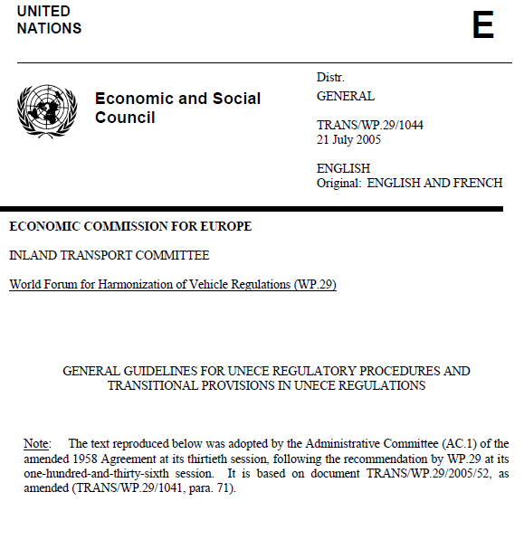
ECE/TRANS/WP.29/GRRF/2014/23/Rev 2
Comment raised at 79° GRRF:
GRRF Chairmanship suggested to review the Transitional Provisions.
Revision:
Paragraph 12 related to Transitional provisions has been amended,
taking inspiration from the General Guidelines
for UNECE Regulatory Procedures
and Transitional Provisions in UNECE Regulations
(TRANS/WP.29/1044/Rev.1)

Slide 7
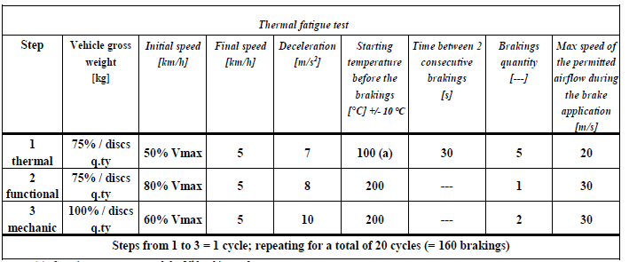
ECE/TRANS/WP.29/GRRF/2014/23/Rev 2
Comment raised at 79° GRRF:
Need to include tolerance for Temperature in the Tables concerning the Thermal Fatigue Test.
Revision:
A tolerance of [+/- 10%] is included for «Starting temperature before the brakings» in following tables:
Table A14 / 5.1.3.1.2 (front disc)
Table A14 / 5.1.4.1.3 (rear disc)

Slide 8
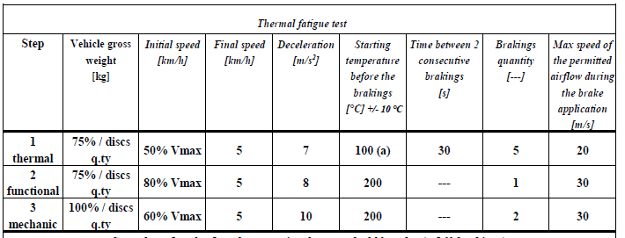
ECE/TRANS/WP.29/GRRF/2014/23/Rev 2
Comment raised at 79° GRRF:
§ 5.1.4.1.2 concerning Fade test.
The use of “rotation speed of the cooling fan” has been questioned.
Suggestion to adopt other parameters such as airflow or temperature has been proposed by NL.
Revision:
The "rotation speed of the cooling fan" has been replaced with the "airflow max speed" parameter.
This is based on testing data elaborated during recent weeks, new values have been included in :
Table A14 /5.1.3.1.1
Table A14 / 5.1.3.1.2
Table A14 / 5.1.4.1.1
Table A14 / 5.1.4.1.2
Table A14 / 5.1.4.1.3
From:
« Rotation speed of the cooling fan, [min⁻¹]»
To:
« Max speed of the permitted airflow
during the brake application, [m/s]»

Slide 9
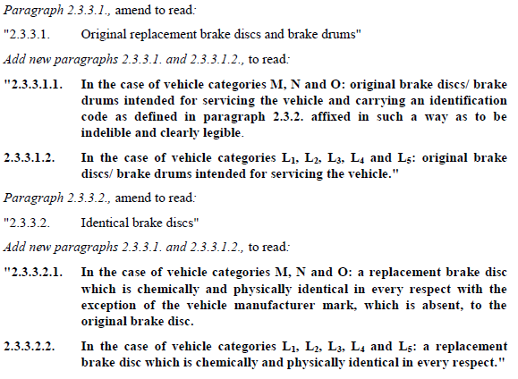
ECE/TRANS/WP.29/GRRF/2014/23/Rev 2
Comment raised at 79° GRRF:
During the 79° GRRF, an amendment to the definition of «identification code» was made in order
to make reference to R 78 as far as braking system for L vehicles are concerned.
This would imply the necessity to also modify UN R 78.
Revision:
The amendment is withdrawn.
As a consequence, amendments to the
Definitions are now proposed:

Slide 10
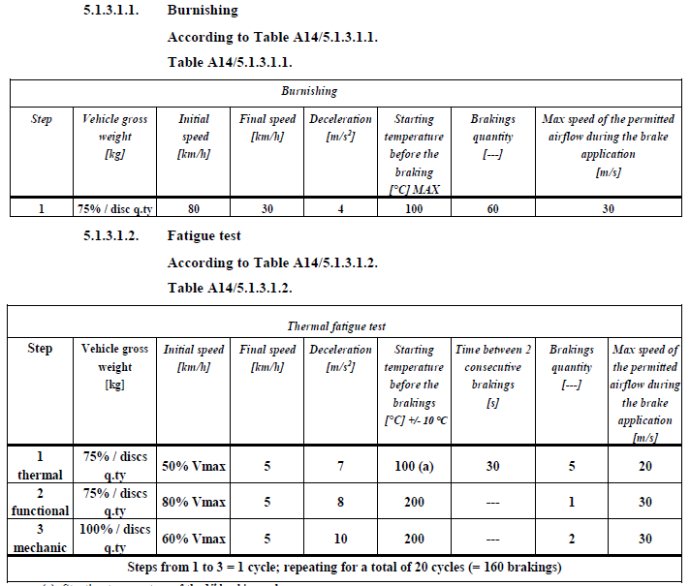
ECE/TRANS/WP.29/GRRF/2014/23/Rev 2
Additional (editorial) improvements:
In Tables of both
FRONT and REAR discs
«MAX»
has been included
«consecutive»
instead of
«following»

Slide 11
79° GRRF

Slide 12
Preamble
At the 78° session of GRRF held on 16 Sept 2014, ITALY had tabled a proposal
(doc ECE/TRANS/WP.29/GRRF/2014/23)
It was aimed at including in UN-R 90 a set of new requirements for the approval of replacement brake discs for L-category vehicles, taking into consideration the latest technologies available in the market.
GRRF agreed to ask ITALY to revise the proposal and submit at 79° GRRF session, taking into account all the comments received.
To this extent, ITALY has forwarded the following documents for today’s discussion:
Working document ECE/TRANS/WP.29/GRRF/2014/23/Rev.1
Informal document GRRF-79-11e
Informal document GRRF-79-13e

Slide 13
ECE/TRANS/WP.29/GRRF/2014/23/Rev.1
Comment raised during 78° GRRF:
Need to exclude L6 and L7 categories.
Revision:
We have included reference to L₁, L₂, L₃, L₄, L₅ throughout the document, excluding L₆ and L₇

Slide 14
ECE/TRANS/WP.29/GRRF/2014/23/Rev.1
Comment raised during 78° GRRF:
Need to modify the definition of both ″Original replacement brake discs for category L ″ (2.3.3.1.2) and
″Identical brake discs for category L ″ (2.3.3.2.2), for competitive reasons.
Revision:
The original definitions are restored, same as for M, N and O categories.

Slide 15
ECE/TRANS/WP.29/GRRF/2014/23/Rev.1
Comment raised during 78° GRRF:
Italy proposal (1): the DTV is modified from 0,015 to 0,020 mm in order to consider the standard of production adopted at international level
Not applicable to L, since no application with vent discs exist
Why
no values
for L ??
Both D10 and H11 tolerances are widely
adopted in OEM, depending from production process
Not applicable to L, since the disk is always mounted externally on the wheel rim, and not interposed between the wheel hub and the rim

Slide 16
ECE/TRANS/WP.29/GRRF/2014/23/Rev.1
Comment raised during 78° GRRF:
May the definition of a list of stainless steel materials pose problem of design restriction?
We confirm that the list can be regarded as exhaustive of the materials used in production
(Example: JIS SUS 420 is included in X20Cr13)
Italy proposal (2): HRC is changed from (32-38) to (30-40) in order to be adapted with the OEM standard and production process

Slide 17
ECE/TRANS/WP.29/GRRF/2014/23/Rev.1
Comment raised during 78° GRRF:
Need to define a better classification,
not based on commercial definition
A new classification is proposed, based on disc DIAMETER and THICKNESS
Notes:
No groups defined for peripherical discs (> 350)
Fixed, floating and composed discs have all a diameter < 3 50 mm
In current production , max of 330 mm is reached

Slide 18
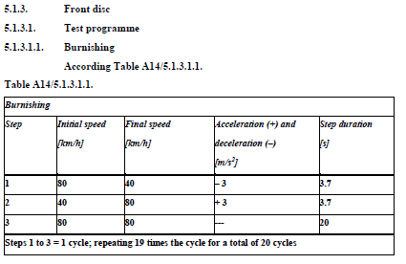
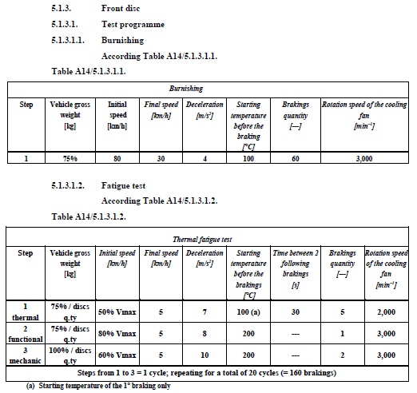
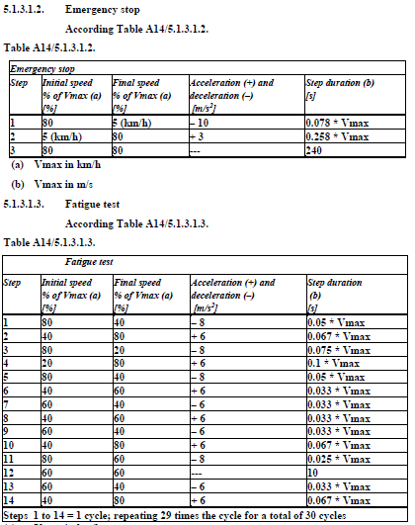
ECE/TRANS/WP.29/GRRF/2014/23/Rev.1
Italy proposal (3):
In Annex 14 (new), the thermal FATIGUE test has been modified for both front and rear discs.
FRONT DISC
TUV Directive
OEM procedure: longer test for a
better /pad/disc alignment
TUV Directive
Emergency stop has been included into fatigue test and improved.
TUV fatigue test is too severe (at first cycle, T was > 800 °C !!)

Slide 19
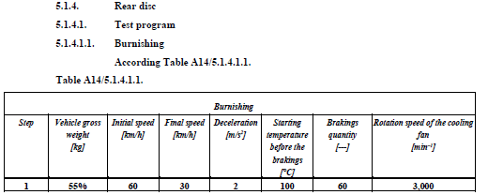
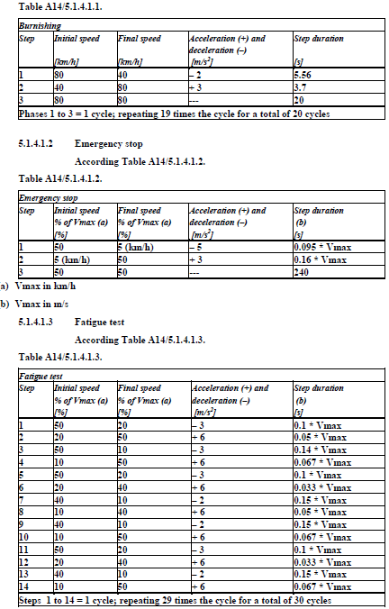
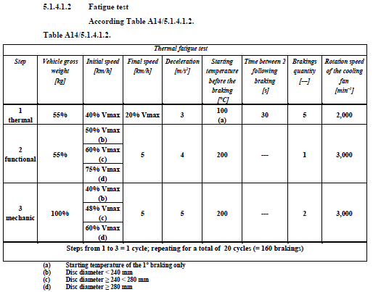
ECE/TRANS/WP.29/GRRF/2014/23/Rev.1
Italy proposal (3):
In Annex 14 (new), the thermal FATIGUE test has been modified for both front and rear discs.
REAR DISC

Slide 20
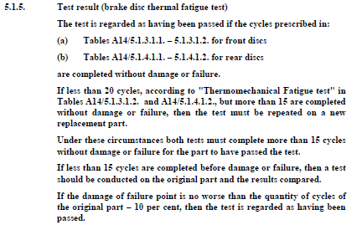
ECE/TRANS/WP.29/GRRF/2014/23/Rev.1
Italy proposal (3):
In Annex 14 (new), the thermal FATIGUE test has been modified for both front and rear discs.
Instead of 30
Instead of 20
The number of cycles have been slightly reduced, BUT the severity of brakings have been also increased.

Slide 21
GRRF-79-11e (informal doc)
In Annex 14, "Requirements for replacement brake discs for vehicles of categories L1, L2, L3, L4 and L5“
Paragraph 2.2.4. , correct to read:
"2.2.4. Apply the force F, specified in Table 2.1.2.5. A14/2.2.5., as shown in Fig.1“
Justification: editorial

Slide 22
GRRF-79-13e (informal doc)
Justification: The note has been introduced in order to allow the operator to carry out and conclude the test
in case of premature wear of the friction material of the pads.

Slide 23
GRRF-79-13e (informal doc)
Justification: the % of the “vehicle gross weight” has been reduced from 55% to 50% in conformity with
what is foreseen in par 5.1.4.1.3.

Slide 24
GRRF-79-13e (informal doc)
Justification: the proposed “Fade” test has the aim of stabilising the friction coefficient of pads.
The Fade test has the target of spilling the gas out from friction material, otherwise these gases
leak during the “Fatigue” test causing a reduction of the friction coefficient.
This could bring to the need of an increase of braking pressure up to excessive values, so that
a sudden consumption of the friction material may happen.
This phenomenon is typical for organic friction material, while pads with sintered friction material
are less subject to it.

Slide 25
GRRF-79-13e (informal doc)
Justification 1: the % of “vehicle gross weight” has been reduced
from 55% to 50% (for step 1 and 2) and from 100 to 90% (for step 3),
in order to optimize the mechanical stress on the brake disc,
so as to reach a Tmax of around 500 °C , instead of 660 °C
Justification 2: the threshold for the diameter
of the rear discs has been modified from 240mm
to 245mm in order to take into account a typology
of rear discs typically used on sport motorcycles
Justification 3: This note is added to allow the operator
to finalize the test in case of premature wear of the
friction material of the pads

Slide 26
GRRF-79-13e (informal doc)
Justification: a reference to UN-R78 is needed for braking system of vehicles of category L

Slide 27
GRRF-79-13e (informal doc)
[AMENDMENT 6 editorial]: for consistency with R.E.3, modify L1, L2, L3, L4, L5
with: L₁, L₂, L₃, L₄, L₅, throughout the document.
[AMENDMENT 7 editorial]: in Table A14/2.2.5, change the heading “spessore disco” with: “disk thickness”.
[AMENDMENT 8 editorial]: in paragraph 3.4.2.1, change “part C” with capital “Part C”.
Justification: all editorial

