Slide 1
Electric Vehicles and the Environment (EVE IWG)
Submitted by the EVE informal working group
Informal document GRPE-70-23
70th GRPE, 15-16 January 2015
Agenda item 10
Report to GRPE 70th Session

Slide 2
Recent Activities
Completion of the 1st EVE mandate:
Approval of the EV Reference Guide
Formal document approved during 69th GRPE, June 2014 and transmitted to WP.29
Formal document approved during the 164th WP.29, Nov 2014: ECE/TRANS/WP.29/2014/81
Filing of the EV Reference Guide on the WP.29 website under discussion
As proposed by the WP.29 Secretariat, the EV Guide number will be left as is and placed under ‘Reference material’ and on the WP.29 homepage
Recommendations in Chapter 5 of the Guide where future work could be completed:
5.1 – Vehicle range and energy consumption
5.2 – Method of stating energy consumption
5.3 – Battery performance and durability
5.4 – Battery recycling/recyclability
Notes:
Activities to date - since the 69th GRPE session

Slide 3
Recent Activities
Approval of the new EVE mandate: ECE/TRANS/WP.29/2014/88, amended by WP.29-164-15
Submitted by Canada, China, Japan, USA and the European Union
The mandate has two parts: Part A will involve additional research and information-sharing, and Part B will potentially involve GTR development:
5.1 – Vehicle range and energy consumption
Removed from consideration in Part A or B of the new EVE mandate because it is understood that this issue will be addressed by the WLTP informal working group in future work
5.2 – Method of stating energy consumption and 5.4 – Battery recyclability
Will be addressed under Part A of the new EVE mandate, and thus be considered for further research and information-sharing only, and not considered for GTR development under Part B
5.3 – Battery performance and durability and “Determining the powertrain performance of EVs”
Will be addressed in both Part A and Part B of the new EVE mandate.
Notes:
Activities to date - since the 69th GRPE session

Slide 4
Recent Activities
Approval of the new EVE mandate: ECE/TRANS/WP.29/2014/88, amended by WP.29-164-15
69th GRPE meeting (June 5-6 2014, Geneva)
Agreement in principle on the new EVE mandate
163rd WP.29 meeting (June 24 -27 2014, Geneva)
Informal consideration of the new EVE mandate
EVE-11 meeting (September 29 2014, teleconference)
Continued discussion on which Guide recommendations should be explored in the new EVE mandate
Identification of leads for the proposed topic areas
EVE-12 meeting (October 28-29 2014, Brussels)
Presentations by leads on the proposed topic areas
Finalization of topic areas and scope of the new EVE mandate
164th WP.29 meeting (November 11-14, 2014, Geneva)
Approval of the new EVE mandate: ECE/TRANS/WP.29/2014/88, amended by WP.29-164-15
Notes:
Activities to date - since the 69th GRPE session

Slide 5
EVE-13 meeting (Jan 12, 2015, Geneva)
Purpose: To discuss detailed proposals for Part A work in each topic area of the new EVE mandate, as presented by leads
Request for participation
Proposed work
Method of stating energy consumption- China (EVE-13-03e)
Step1: Literatures review: Study on the electric vehicle energy consumption evaluation method executed by main countries.
Step2: Data collection: Build database and conduct comparative analysis on the energy structure for main countries in the world.
Step3: Method Development: Discusses the necessity and possibility to standardize the energy consumption method.
Battery performance and durability- USA and Canada (EVE-13-04e)
Literature review to inform the decision of GTR development in Part B:
Establish definition of xEV battery durability, factors affecting xEV battery durability
Review existing test programs or methodology for evaluating battery durability
Determining power of EVs- Germany and Korea (EVE-13-05e)
Focus on light duty vehicles
Clear demand from WLTP EV sub-group, potential collaboration
Part A will focus on answering open questions: Which concept to follow for LD HEVs (KATRI, JARI, SAE, new method?), resources, new GTR or UN R85 amendment?, organizational issues
Updates from other IWGs: WLTP, EPPR, EVS, VPSD, HDH

Slide 6
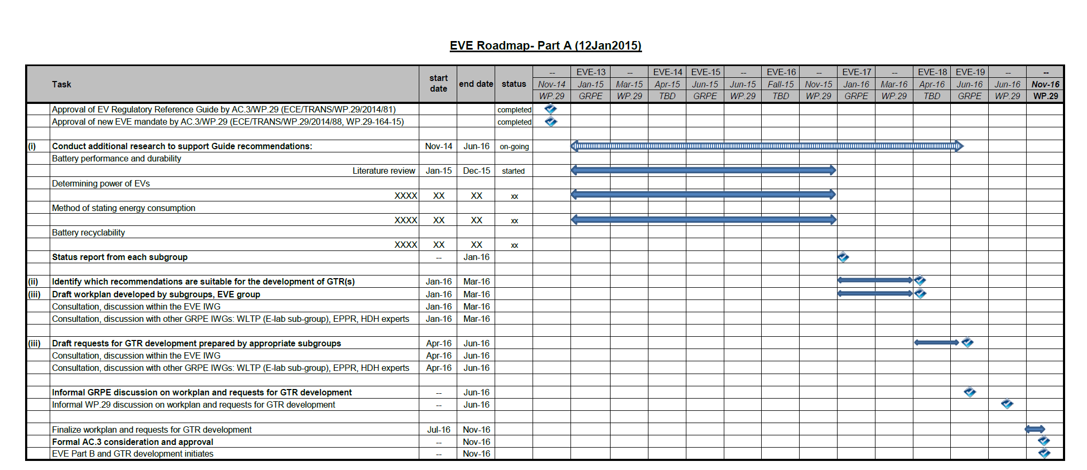
EVE-13 meeting (Jan 12, 2015, Geneva)
Roadmap, Part A, Jan 2105-Jan 2016: EVE-13-06e
Notes:
Activities to date - since the 69th GRPE session

Slide 7
EVE-13 meeting (Jan 12, 2015, Geneva)
Roadmap, Part A, Jan 2016-Nov 2016: EVE-13-06e
Notes:
Activities to date - since the 69th GRPE session

Slide 8
Next Steps
April, 2015: EVE-14 meeting (TBD)
Teleconference or face-to-face meeting (Ottawa, Canada)
Status report of Part A research
June, 2015: EVE-15 meeting and GRPE session
Status report of Part A research
Fall, 2015: EVE-16 meeting (TBD)
Teleconference or face-to-face meeting (China)
Status report of Part A research, preparation for Jan GRPE discussion

