Slide 1
International Whole Vehicle Type Approval
Note by the secretariat
Informal document GRB-62-24
(62nd GRB, 1-3 September 2015,
agenda item 14)
Definition of vehicle type
(outcome of IWG on IWVTA; June 2015)

Slide 2
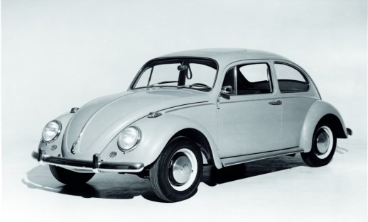
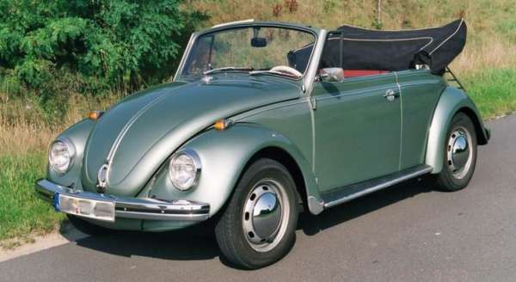
2-10. Definition of a vehicle type for IWVTA
A vehicle type can contain all variants regardless of their level of conformity → it corresponds to what we are used to
Within a vehicle type every single IWVTA type defines one level of conformity
1 IWVTA approval always covers 1 IWVTA type
Manufacturer identifies the IWVTA types within a vehicle type by a unique type designation
Vehicles within one vehicle type get approval numbers that are related (see next slide)
Approvals for all IWVTA types within 1 vehicle type shall be handled by the same approval authority
Vehicle type Beetle
IWVTA type 1:
“Beetle with ESC”
IWVTA type 2:
“Beetle without ESC”

Slide 3
2-11. Modified Approval Number for IWVTA
E4*0R00/U*0004/01*02
Explanation of changes:
The letters U or L are included in section 2 after the number of the series of amendments
A 6-digit number for Section 3 is proposed which is construed as follows:
First 4 digits identify the vehicle type : a new sequential number is assigned by the approval authority once the manufacturer applies for the first approval of a new vehicle type
/ followed by 2 last digits which sequentially number the different type approvals within a vehicle type starting with 01. They correspond to different IWVTA types
Section 4: Number of the extension
Section 3: sequential number of the approval
Section 2: Regulation #, # of series of amendments /letter U for universal, L for limited
Section 1: # of CP

Slide 4
2-12. Example how to deal with extension of an IWVTA
Before
vehicle type covered by U-IWVTA
What happens
New requirements enter into force
Manufacturer performs technical changes in order to meet new requirements (involves no change in vehicle type characteristics) but only for part of the vehicles
What to do
Extend existing U-IWVTA, here Sections 1-3 of the approval number and marking remain unchanged
Create a new L-IWVTA under a new type designation
U-IWVTA
E4*0R01/U*0021/01*01
New requirement: pole impact
U-IWVTA
E4*0R01/U*0021/01*02
Covers vehicles complying to pole impact
L-IWVTA
E4*0R01/L*0021/02*00
Covers vehicles not complying
to pole impact

