Slide 1
Western Balkan Intermodal study
Working Party on Intermodal Transport and Logistics
30th November-1st December, 2015
Nedim Begovic, Regional Railway Expert

Slide 2
SEETO Regional Cooperation
South East Europe Transport Observatory
SEETO
2004 - Memorandum of Understanding
on the development of the South East
Europe Regional Transport Network
MONTENEGRO
FYR MACEDONIA
BOSNIA AND HERZEGOVINA
SERBIA
KOSOVO*
ALBANIA
EUROPEAN COMMISSION
*This designation is without prejudice to positions on status, and is in line with UNSCR 1244 and ICJ Advisory opinion on the Kosovo declaration of independence.

Slide 3
SEETO ‘s role
Develop the indicative TEN-T Comprehensive and Core Network to the Western Balkans;
Improve and harmonise regional transport policies and technical standards;
Integrate the indicative TEN-T Comprehensive and Core Network to the Western Balkans in the framework of the wider Trans European Network.

Slide 4
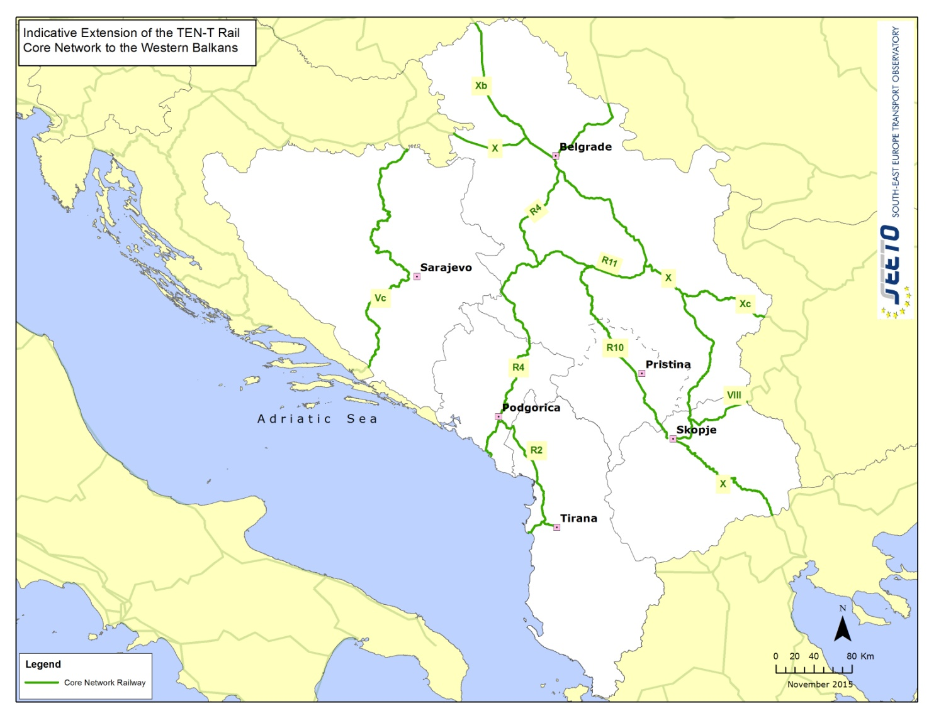
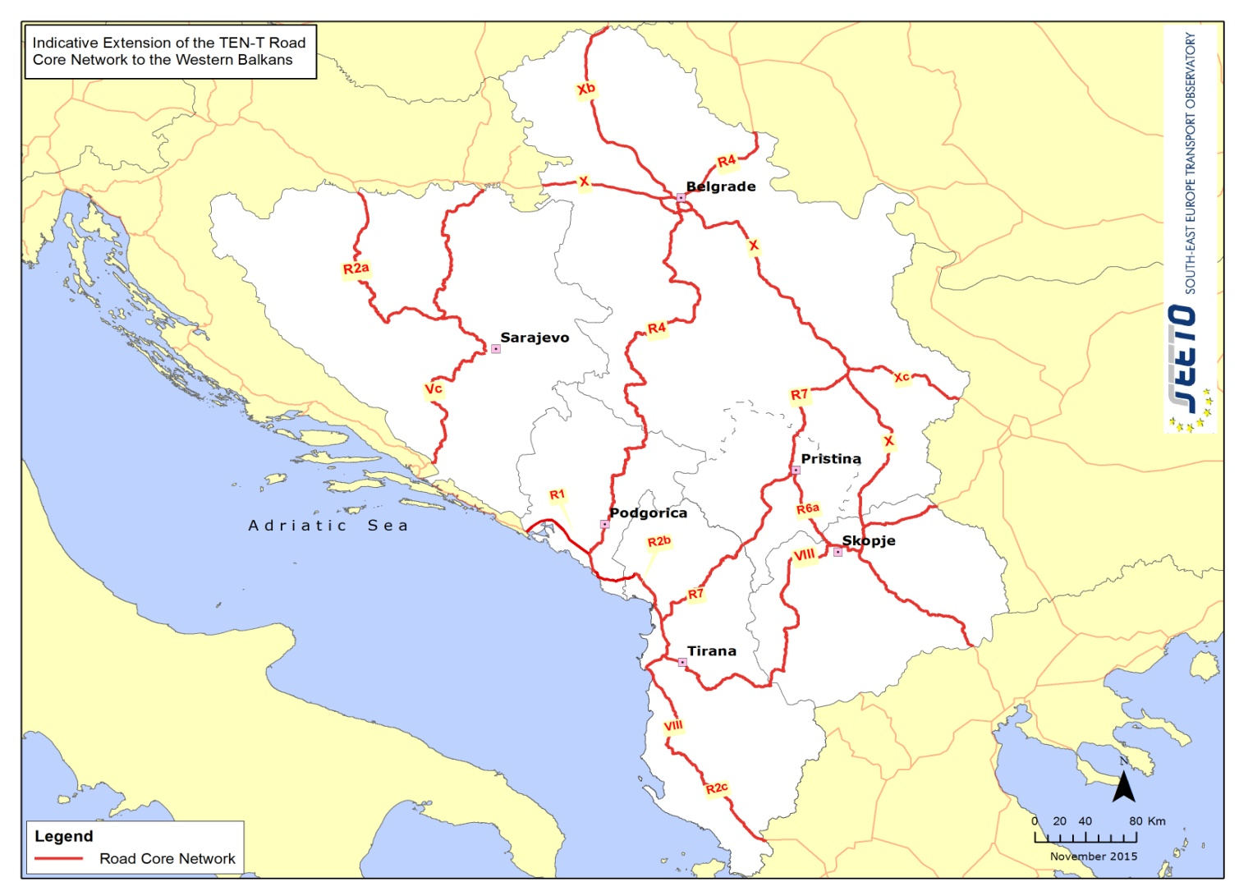
Main transport novelties in 2015
Regional Core Transport Network established in WB (Brussels, April)
Core network corridors (the Mediterranean, Orient/East-Med and Rhine/Danube corridors) extended to WB
Priority list of Core Network infrastructure projects to be implemented by 2020 agreed (Vienna, August)
List of Soft measures to complement the infrastructure development (Vienna, August)
Opening of the transport market
Establishment of competitive, reliable and safe transport system
Increasing the effectiveness of Border Crossing Procedures
Modification process of the Comprehensive Network opened

Slide 5
Core Corridors
Western Balkans countries included in three TEN-T Core Corridors: Orient/East-Med ,Mediterranean and Rhine-Danube corridor
for the first time TEN-T network united: no more grey area on the maps
Source: European Commission

Slide 6
WB Intermodal study
Objective
Development of a transport demand and supply assessment model
Assessment of the main logistic corridors/routes on the SEETO Comprehensive Network
Gap assessment analysis of the main logistic corridors of the SEETO Comprehensive Network
Identification of potential efficiency-enhancing measures as well as certain infrastructure measures (e.g terminals)
The ultimate aim is to achieve more integration and complementarity among the modes of transportation and thus more efficient supply chains.

Slide 7
Obstacles and opportunities
The main problems that the development of the intermodal transport in SEE region:
Institutional issues
Planning process
Operational issues
Lack of infrastructure facilities
Economic constrains
Tariff policy issues
Awareness issues
Policy questionnaires and check-lists
Opportunities
The favourable transit position of the region offer great potential for the development of intermodal transport
Intermodal operations can encourage economic development and job creation
Current EU policy favouring co modal solutions

Slide 8
Current state - infrastructure
SEETO region
total of 42 locations with 46 multimodal facilities identified
Fifteen facilities have attributes of intermodal terminals.
Using the discrete model, eleven intermodal terminals have been identified as the main holders of intermodal transport services:
Three terminals - type “SEA-RAIL-ROAD TERMINALS” (Port of Durres, Port of Bar, Port of Ploče
Two-terminals - type “RIVER-ROAD-RAIL TERMINALS” (Port of Belgrade, Port of Novi Sad);
Six terminals - type “RAIL-ROAD TERMINALS” (“Intereuropa RTC” - Alipašin, Logistic Centre Tuzla, Logistic Centre Banja Luka, Container terminal Tovarna-Skopje, Container terminal Donje Dobrevo (Miradi),Logistics Centre Belgrade ŽIT).

Slide 9
Current status
 | Port | 2009 | 2010 | 2011 | 2012 | 2013 | %2013/2009 | Country | Region
1 | Rotterdam | 9,743 | 11,146 | 11,876 | 11,865 | 11,621 | 119% | Netherlands | N.Europe
2 | Hamburg | 7,008 | 7,900 | 9,014 | 8,891 | 9,302 | 133% | Germany | N.Europe
3 | Antwerp | 7,310 | 8,468 | 8,664 | 8,635 | 8,578 | 117% | Belgium | N.Europe
4 | Bremerhaven | 4,536 | 4,871 | 5,915 | 6,115 | 5,831 | 129% | Germany | N.Europe
5 | Algeciras | 3,043 | 2,810 | 3,602 | 4,114 | 4,501 | 148% | Spain | Med.Europe
6 | Valencia | 3,654 | 4,207 | 4,327 | 4,469 | 4,328 | 118% | Spain | Med.Europe
7 | Felixstowe | 3,100 | 3,400 | 3,400 | 3,700 | 3,740 | 121% | UK | N.Europe
8 | Piraeus | 665 | 513 | 1,680 | 2,734 | 3,164 | 476% | Greece | Med.Europe
9 | Gioia Tauro | 2,857 | 2,851 | 2,305 | 2,721 | 3,087 | 108% | Italy | Med.Europe
10 | Duisburg | 935 | 1,181 | 2,500 | 2,600 | 3,000 | 321% | Germany | N.Europe
11 | Marsaxlokk | 2,260 | 2,371 | 2,360 | 2,540 | 2,750 | 122% | Malta | Med.Europe
12 | St Petersburg | 1,342 | 1,931 | 2,365 | 2,524 | 2,515 | 187% | Russia | N.Europe
13 | Le Havre | 2,241 | 2,358 | 2,215 | 2,306 | 2,486 | 111% | France | N.Europe
14 | Zeebrugge | 2,258 | 2,390 | 2,206 | 1,953 | 2,026 | 90% | Belgium | N.Europe
15 | Genoa | 1,534 | 1,759 | 1,847 | 2,064 | 1,988 | 130% | Italy | Med.Europe
16 | Barcelona | 1,800 | 1,946 | 2,034 | 1,756 | 1,720 | 96% | Spain | Med.Europe
17 | Southampton | 1,400 | 1,540 | 1,563 | 1,475 | 1,491 | 107% | UK | N.Europe
18 | La Spezia | 1,046 | 1,285 | 1,307 | 1,247 | 1,298 | 124% | Italy | Med.Europe
Source: For 2008~2011, "Containerisation International Yearbook" (2004~2012) data was used. For 2012&2013,"Top 100 ports 2014 of Containerisation International"data were used.

Slide 10
Key findings
From 2008 to 2013, container traffic generally was constantly declining or stagnating
The largest container traffic in the period 2004-2013 was achieved in the Port of Durres (2013 - 109,055 TEU).
80-90% of the container traffic, Port of Ploče realizes with the Bosnia and Herzegovina, while about 40% of container traffic Port of Bar realizes with Serbia
Port of Bar and Port of Ploče achieved the largest container traffic in 2008 (43,708 TEU, 35,124 TEU, respectively).
Currently, all three terminals have equipment and capacities that allow transhipment of containers with the values of utilization factors of about 50-60%.
Port of Belgrade and Port of Novi Sad have the equipment and capacities that are poorly developed, but they are sufficient for the current intermodal container traffic.
An analogous situation is present in the three “rail-road” terminals but with higher values of utilization factors (similar to sea ports).

Slide 11
Current status
Low purchasing power of the population in catchment area and unfavourable operating conditions of the rail corridor Vc, rail corridor VIII and rail route R4 threaten the competitiveness of ports in the segment of container traffic and represent a significant limiting factor.
Apart from the influence of insufficiently economically developed areas, the Port of Ploče and the port of Bar are mainly focused on working with a limited number of clients in the industrial and market catchment area that is subjected to unpredictable fluctuations and crises
From the standpoint of the performance of intermodal transport service (inland aspect), missing infrastructure facilities and appropriate terminals hinder successful development of intermodal transport
Presence of other intermodal transport technologies, Huck-pack and Ro-Ro, in total intermodal flows is negligible. In Albania, Bosnia and Herzegovina, the former Yugoslav Republic of Macedonia, Kosovo, Montenegro, and Serbia, there are no Ro-La terminals
In the whole course of the Danube River through Serbia and Save River through Bosnia and Herzegovina there are no ramps (terminals) for Ro-Ro transport

Slide 12
European container port system
Source: Notteboom, T.E. 2010. Concentration and the formation of multi-port gateway regions in the European container port system: an update

Slide 13
Potential measures
Legislative, regulatory and administrative measures
Strategy and national programes for development of intermodal transport
Specific regulations and incentives for development of intermodal transport
The measures and activities for improvement of infrastructure for intermodal transport
Terminals, logistics centers and industrial sidings
Transport infrastructure investment projects
Organizational measures and activities for improving of intermodal transport
Improvement of planning and performance of intermodal transport
IT systems (NCTS, SEED etc, ITS)
Border crossings

Slide 14
Potential measures
The measures and activities of technical and technological improvement of intermodal transport
Intermodal transport techonologies
Reloading equipment
Monitoring system, IT equipment and support

Slide 15
Thank you for your attention !
nbegovic@seetoint.org
www.seetoint.org

