Slide 1
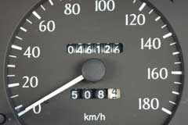
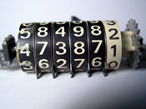
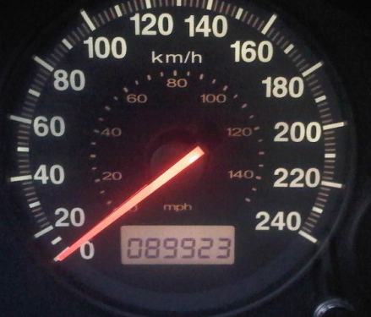
Proposal for draft amendments to Regulation No. 39 (Speedometer)
Informal document GRSG-106-36
(106th GRSG, 5-9 May 2014,
agenda item 13)
Submitted by the expert from Belgium
Informal document GRSG -106-06
(106th session, 5-9 May 2014)

Slide 2
Background
Belgium made a proposal in 104/GRSG (GRSG-104-14) for establishing regulatory provisions on odometers.
Already now in different regulations : R121, R10, R49 and R83 a reference to the odometer is made.

Slide 3
R121 : Identification of controls, tell-tales and indicators
Table 1
Symbols, their illumination and colours.

Slide 4
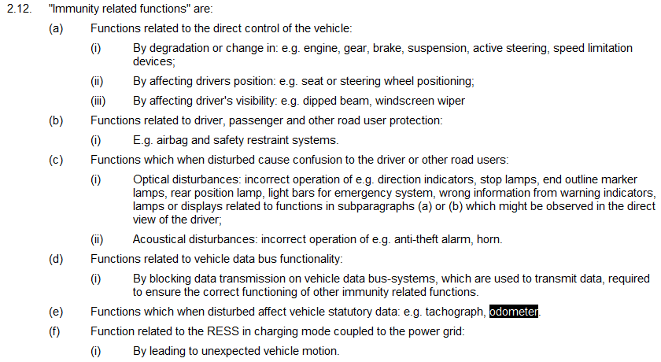
R10 : Electromagnetic compatibility

Slide 5
R49 : Emissions of C.I. and P.I. (LPG an CNG) engines

Slide 6
R49 : Emissions of C.I. and P.I. (LPG an CNG) engines

Slide 7
R83 : Uniform provisions concerning the approval of vehicles with regard to the emission of pollutants according to engine fuel requirements

Slide 8
R83 : Uniform provisions concerning the approval of vehicles with regard to the emission of pollutants according to engine fuel requirements

Slide 9
Conclusions
Several Regulations have references to odometer presence or readings
Although there is no direct requirement in ECE regulations, there are enough references to odometer requirements to conclude that indirectly it is required to have an odometer in every vehicle.
Proposition for amendments to R39 (Uniform provisions concerning the approval of vehicles with regard to the speedometer equipment including its installation) - Informal document GRSG -106-06
+ : Reduces instances of mileage fraud

