Slide 1
Status report
Informal Working Group on the Electronic Vehicle Stability Control
Informal document No. GRRF-57-30
(57th GRRF, 31 January-4 February 2005,
agenda item 6.1.)
Dr. Laszlo Palkovics
Geneve, February 2, 2005

Slide 2
Mandate and targets of the Working Group
Mandate of the EVSC Working Group
“ Regarding the consideration of electronically controlled stability enhancement systems, the Chairman requested the consent of WP.29 to establish an informal group in order to investigate that issue in greater detail. WP.29 gave its consent.”
How to understand this mandate?
  Make a consolidated concept for the future regulation clarifying the following issues:
    What to regulate (system, vehicle) – definition of the EVSC system
    Where to include (Reg. 13, Reg. 111, separate, etc.)?
    How to regulate – only technical aspects, no economical or political aspect are considered.
  Based on the concept, prepare a text proposal for the regulation.

Slide 3
Project plan
Target deadline | Activities | Output | Remarks
November, 2004 | 1st EVCS meeting | Concept proposal for the regulation
End of January, 2004 | 2nd Meeting in Paris | Finalize the concept, make agreement | Preparation to the February GRRF meeting
February, 2004 | GRRF Meeting | Accept the concept proposal, comments
April 15, 2004 | Working meeting 1 | First consolidation of the text | Meeting in Brussels
July, 2004 | Working meeting 2 | Second consolidation of the text
September, 2004 | GRRF Meeting | Accept text proposal



Slide 4
Summary of the activities and results
1st meeting of the ad hoc group (Budapest, November 25-26, 2004). Major activities and achievements:
  Definition of the tasks for the working group
  Text proposal for the future regulation – embedded in Reg. 13. Basis: draft paper from the European industry work group.
  Identification of potential problem areas – nomination of persons dealing with those topics
  Over 40 persons participated at the meeting, industry is well represented
2nd meeting
  Discussion of the identified problem areas
  No conceptual change in the text generated during the first meeting, refinements at some points. Valuable contribution from the Russian delegation
  Principal agreement about the structure of the proposal
  More than 30 participants at the meeting, good mixture of participants (industry, government, technical services)

Slide 5
The most important issues
Why should we regulate the EVSC systems?
How complex should the regulation be?
Where the regulation should be embedded?
Definition of the EVSC system – no unified definition for power driven vehicle and trailer.
Design requirement (+demonstration of the functionality) vs. performance requirement.
How to demonstrate functionality? Vehicle test and/or simulation.
Warning signal to driver – light vs. audible signal.
Compatibility between tractor – semi trailer, or truck – trailer
Align activities with the ISO 11992 Working Group

Slide 6
Why EVSC should be regulated?
Increased society demand for enhanced traffic safety, signaled by facts that
  EVSC is becoming typical in the higher passenger vehicle classes
  Attempts to mandate it for some special service vehicles
  Local attempts for mandating EVSC systems for buses (either government initiative, or manufacturers initiative)
Different kind of systems are available on the market (developed, industrialized), which would fulfill the society demand
Legislation has to bridge the society demand with the existing and future systems in order to provide terms of references

Slide 7
Why EVSC should be regulated?
Denmark will mandate stability control system for coaches of class M3 as of 01.05.2005.
This attempt is highly welcome, since the stability control system significantly contributes to the traffic as well as passenger safety.
However, there are several problems with the current formulation:
  Definition of the required stability control system (called ESP in the document) is not sufficient
  There are no clear requirements defined
  EVSC in class M3 is only available for the heavy coaches (> 10 tons) with electro-pneumatic brake system. The system is not available for lower category coaches.
  Even in M3 > 10 tons class most of the delivered bus chassis will not have the stability control system, that must be applied for this vehicles

Slide 8
Cornerstones of the future regulations
The regulation shall not be very complex, and put a very high burden on the manufacturers and the Technical Services to fulfill its requirements, but
It must be comprehensive enough and provide terms of references in order to exclude the systems not performing on the expected level
It should appear as soon as possible in order to follow the demand of the society.
The mandated types must be selected according to their impact on the traffic safety (most common, high volume vehicles).
A fair trade-off should be found

Slide 9
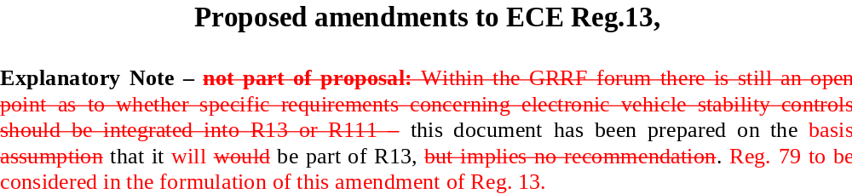
Where to include?
Regulation 13 has been selected, since almost all of the state-of-the-art EVSC systems are using the brake as intervention actuator
However, where other intervention is possible, this regulation should comply with the relevant other regulations, such as Reg. 79 in case of superimposed steering (a footnote has been created)

Slide 10
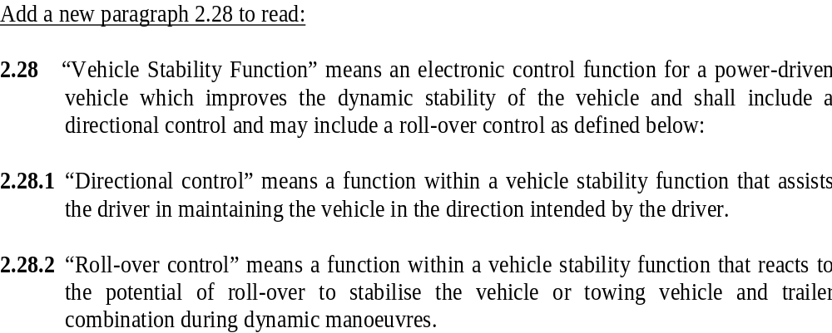
Definition for power driven vehicle
Definition of the EVSC system for individual vehicle units but not for combinations

Slide 11
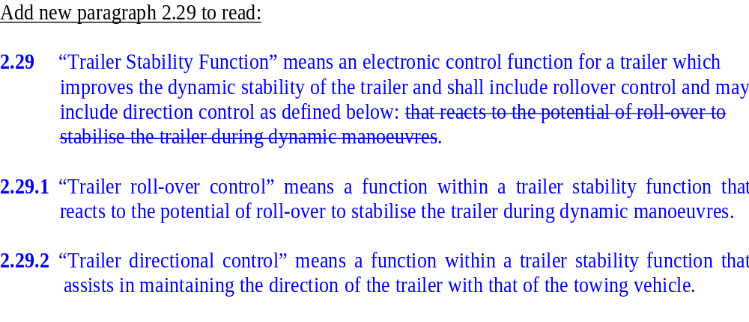
Definition for trailer
Separate definition for trailer because of the most complex dynamics

Slide 12
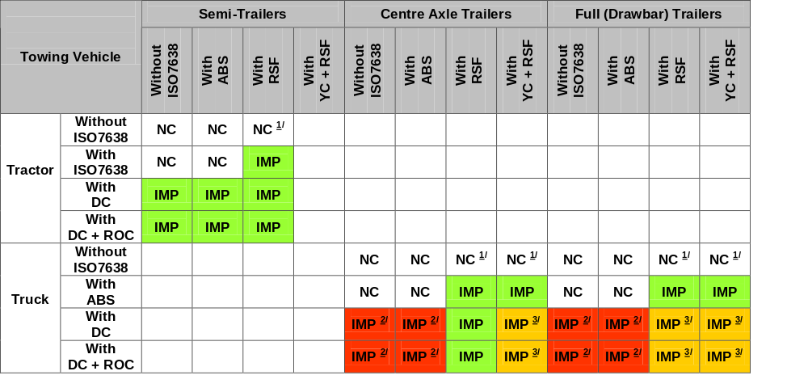
Compatibility matrix for multi-unit vehicles
1/: Stability function(s) not functional as the tractor has no ISO7638 power supply is available
2/: Identification problem between centre axle and full trailers as the trailer has no electric control line to identify the trailer type
3/: It is not clear how the respective truck and trailer systems will interact and how this will impact on combination stability therefore it may be necessary to define priorities to inhibit either the truck or trailer stability system.

Slide 13
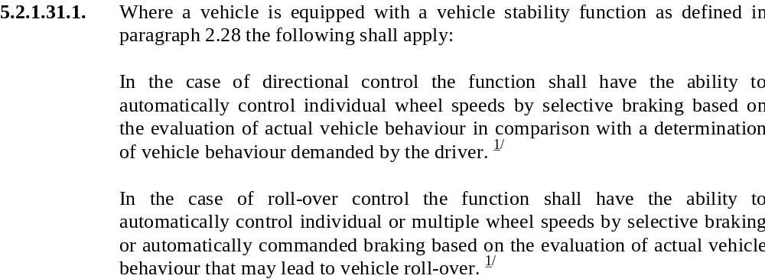
Design requirement for the intervention
Brake system based intervention – a clear design requirement

Slide 14
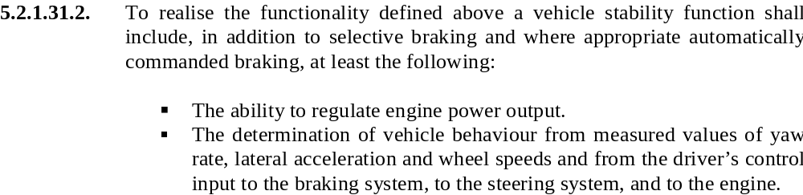
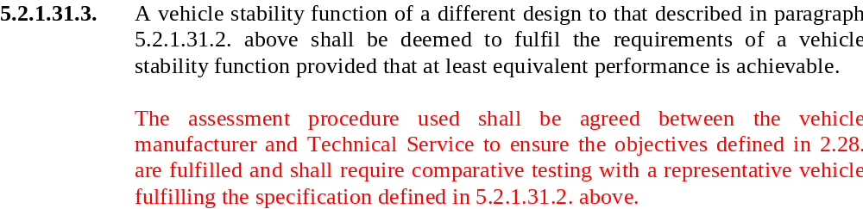
Design requirement for the dynamic estimation
Design requirement – derived from state-of-the-art systems as necessary and sufficient requirement

Slide 15
Performance requirements?
The most severe discussion has been induced by the question: should we define performance requirements?
Difficulties with performance requirements:
  There is no uniquely defined performance level for the EVSC systems
  Definition of the possible tests is not obvious (all ISO standards have been analyzed)
  Repeatability of the tests on the stability limit is not possible
  Complex test requirements (similar to those conducted by the OEs and system manufacturers during the release process) is hardly possible at the Technical Services, puts additional very high burden an the system
Conclusion: if there is no obviously defined, realistically measurable performance requirement – better not to define anything

Slide 16
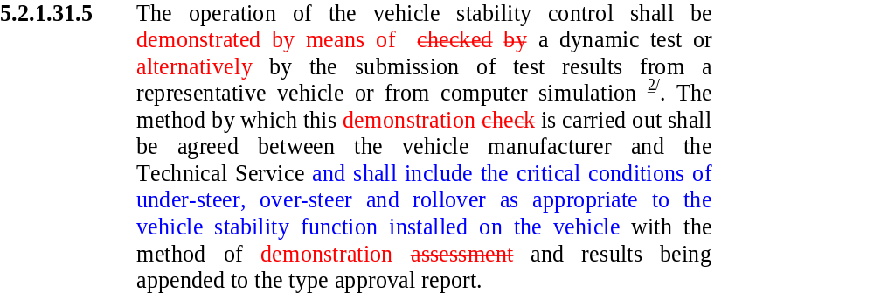
Compromise: “performance demonstration”
An acceptable compromise has been found – vehicle demonstration as well as simulation is possible

Slide 17
Alignment with the informal ISO 11992 WG
An informal ISO WG is active in re-considering the ISO 11992-2003. Activities in the EVSC WG will be aligned
Proposals for several new information transmitted via the electronic control line. Some of the most relevant ones:
  EVSC active on the truck/trailer
  Request for relative brake demand side and axle-wise on the trailer
  Geometric data content of the trailer
  Trailer identification data
  Motor vehicle/trailer is/is not equipped with EVSC system
  Disable of complete/partial EVSC function on motor vehicle/trailer
Input from EVSC WG fits to the schedule of the ISO WG

Slide 18
Summary of the current status
Generally: the progress in the working group is much higher as we expected.
A draft version of the text proposal for the EVSC regulation embedded in Reg.13 is available
The major characteristics are:
  Clear design requirements for the intervening actuators and sensors, as minimum set
  Demonstration of the functionality during critical maneuvers is required
  The proposal does not put very high burden an the end user, manufacturer, but comprehensive enough to give clear terms of references
  To introduce the regulation in the proposed form as soon as possible, and re-visit performance demonstration issue in 2 years based on the experience collected by the Technical Services

Slide 19
Thanks to the participants of the ad hoc group for their commitment and work what they provided during last period.

