Slide 1


BUILDING REGIONAL TRUST
Overview of Accreditation & Pan African Quality Infrastructure (PAQI)
December 2015
By
Dr Elsabe Steyn
AFRAC Chairperson
SANAS Executive for Strategy and Development

Slide 2


Content
Overview of Accreditation Bodies
African Accreditation Cooperation
Pan African Quality Infrastructure (PAQI)
African Quality Infrastructure Global Link
Conclusion

Slide 3
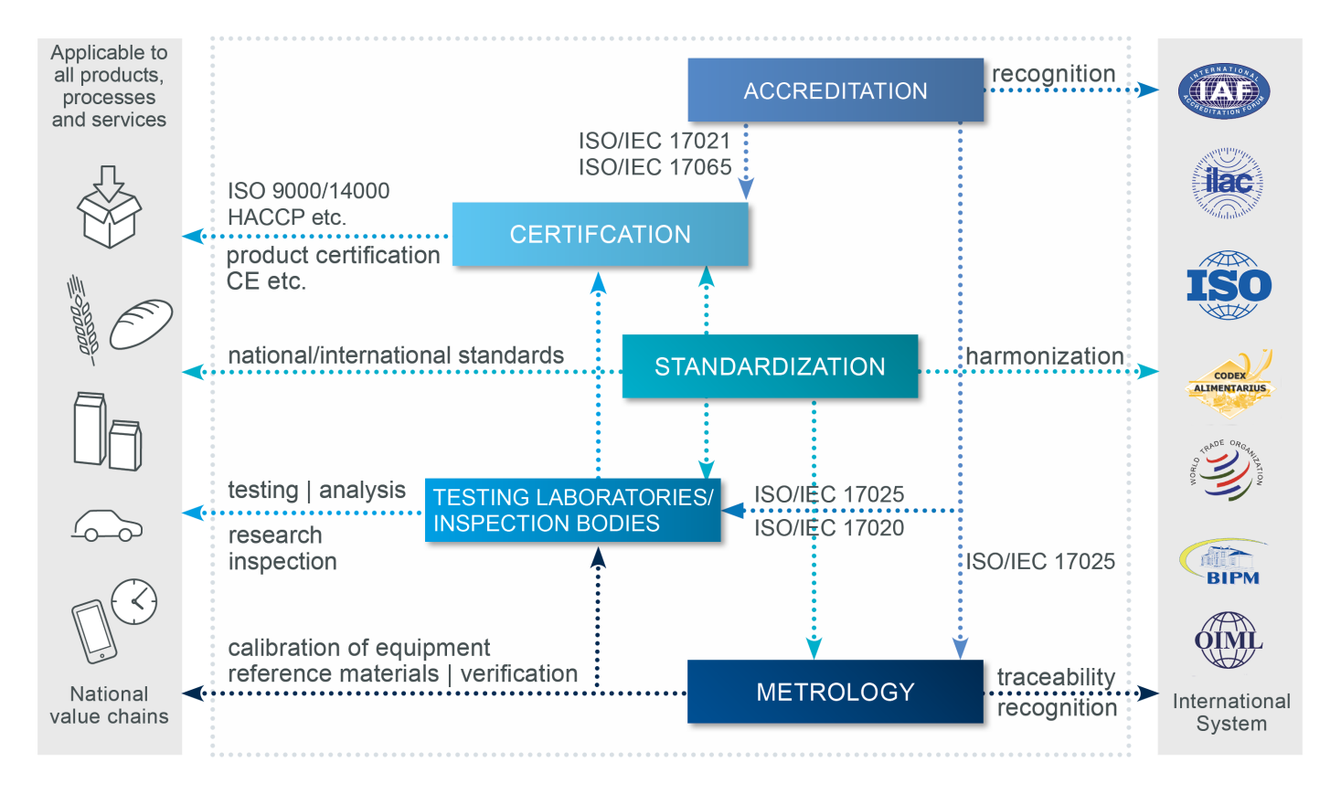
UNBROKEN CHAIN OF TRUST

Slide 4


ILAC/IAF
MRA/MLA
EAC
COMESA
SADC
MULTI-ECONOMY
ACCREDITATION
BODY
NATIONAL
ACCREDITATION
BODIES
KENAS
EGAC
Signatory to ILAC/IAF MRA
ENAO
TUNAC
Signatory to ILAC/IAF MRA
MAURITAS
SANAS
Signatory to ILAC/IAF MRA
SADCAS
CONFORMITY ASSESSMENT BODIES
RG
COMMERCE
INDUSTRY
PUBLIC/
CONSUMERS
GOVERNMENT
REGULATORS
(HEALTH&SAFETY
ENVIRONMENT)
RESEARCH INSTITUTIONS
TRADE

Slide 5

Map of Accreditation Bodies in Africa at March 2014
TUNAC
MCA
ALGERAC
LNCSM
EGAC
In progress
ENAO
In progress
KENAS
SADCAS
SADCAS
 | ILAC/IAF MLA Signatories
 | ILAC Affiliate Members
 | ILAC Associate Members
 | Developing AB
 | None/ Unknown
SADCAS
SADCAS
SADCAS
SADCAS
SADCAS
SADCAS
SADCAS
SADCAS
MAURITAS
SADCAS
SANAS
SADCAS

Slide 6
The International Response
ILAC/IAF
EA
APLAC & PAC
ARAC
AFRAC
SADCA
IAAC
EA European co-operation for Accreditation
APLAC Asia Pacific Laboratory Accreditation Cooperation
IAAC Inter-American Accreditation Cooperation
SADCA SADC Accreditation Cooperation
ARAC ARAB Accreditation Cooperation
AFRAC African Accreditation Cooperation

Slide 7
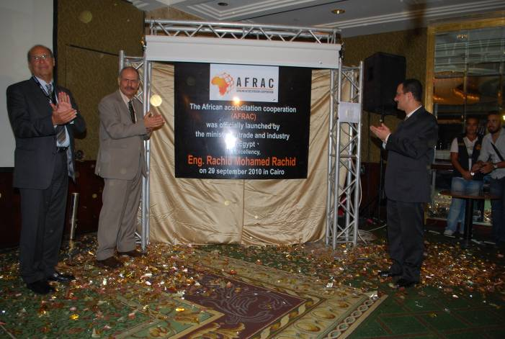
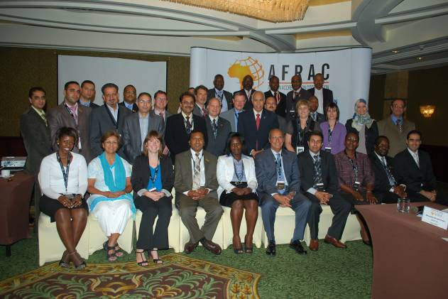
Unveiling of the AFRAC plaque: From left to right—Mr
Hassan Shaarawi (EGAC); Professor Mohammed Elarbi
Aouani (NEPAD) and His Excellency Dr Ahmed Darwish
Delegates at the First AFRAC General Assembly meeting held from 29 to 30 September 2010 in Cairo, Egypt

Slide 8
PAN-AFRICAN
QUALITY INFRASTRUCTURE (PAQI)
Function – Impact
Notes:
PAN AFRICAN QUALITY INFRASTRUCTURE
Although most of the regional blocks have established some framework for quality infrastructure e.g. in SADC, SADC establish the Standards, Quality Assurance Accreditation and Metrology (SQAM), The East African Community (EAC) established STQM. SADC in this regard has implemented its framework with the establishment of SADCSTAN, SADCMEL, SADCA and SADCMET. Realising the importance of accreditation and conformity assessment as well as the interdependence of standards, Metrology and Accreditation in the Quality Infrastructure of Africa, the AU NEPAD and the African Standards (ARSO), Metrology (AFRIMETS) , Electro technical Standardization Commission (AFRSEC) and Accreditation (AFRAC) started discussion to establish the Pan African Quality Infrastructure (PAQI).In 2012, the four institution signed a Memorandum of Understanding to cooperate in advancing the Africa growth initiatives. PAQI was formally accepted by the Council of Minister of the AU as the African Quality Infrastructure Institutions. PAQI was formally launch in 2013 by the Director for Trade and Industry , African Union Commission

Slide 9
Quality Infrastructure
  African Quality Infrastructure has three key elements namely: metrology, standardization and accreditation of conformity assessment services such as certification, testing, calibration and inspection
  These elements are independently managed however, they form a close network based on a technical hierarchy.
3

Slide 10




  African Quality Infrastructure has three key elements namely: metrology, standardization and accreditation of conformity assessment services such as certification, testing, calibration and inspection
  These elements are independently managed however, they form a close network based on a technical hierarchy.
Accreditation
Standards
Recognition of technical competence
Definition of properties, dimensions, tolerances, etc.
Accreditation
Standards
Conformity
assessment
Metrology
Conformity assessment
Metrology
Conformity with requirements defined
by standards
.
Guarantee of exact and reliable measurements
Notes:
10

Slide 11

The African Accreditation Cooperation (AFRAC)
was established in 2010.
AFRAC is a cooperation of accreditation bodies,
sub-regional accreditation co-operations and stakeholders whose objective is to facilitate trade and contribute to the protection of health, safety and the environment, in Africa and improvement of Africa’s competitiveness.
AFRAC will build confidence in African produced goods and services thus facilitate their acceptance on the global market through Mutual Recognition Arrangements (MRA).
14

Slide 12

The Intra-Africa Metrology System (AFRIMETS)
was formed in the year 2006
The Principal members of AFRIMETS are
the 6 sub-regional metrology organizations
AFRIMETS promotes harmonisation industrial and legal metrology issues across Africa and to operate as a fully-fledged Regional Metrology Organization in accordance to the Mutual Recognition Arrangement of the International Committee for Weights and Measures, the CIPM MRA
AFRIMETS facilitates inter and intra Africa trade through use of accurate measurements and ensuring safety, health of consumers and environmental protection.
15

Slide 13

AFSEC
The African Electrotechnical Standardisation Commission (AFSEC) was established in February 2008 .
AFSEC identifies existing standards and prioritizes
standards needs, and harmonizes existing standards through either the adoption of international standards; or where
necessary their adaptation to African conditions.
Common standards and conformity regimes in the electrotechnical area have a multiplier effect especially in electricity generation and transmission (power pools and common manufacturing facilities) and trading in electrical systems and in support of universal access to electricity.
16

Slide 14

ARSO
The African Organisation for Standardisation
(ARSO) in her current state is Africa’s intergovernmental
standards body formed in 1977.
ARSO develops tools for standards development, standards harmonization and implementation of these systems to enhance Africa’s internal trading capacity, increase Africa’s product and service competitiveness globally and uplift the welfare of African consumers.
Creating viable, sustainable and effective continental standardization infrastructure, forms the basis for ARSO strategic direction.
17

Slide 15
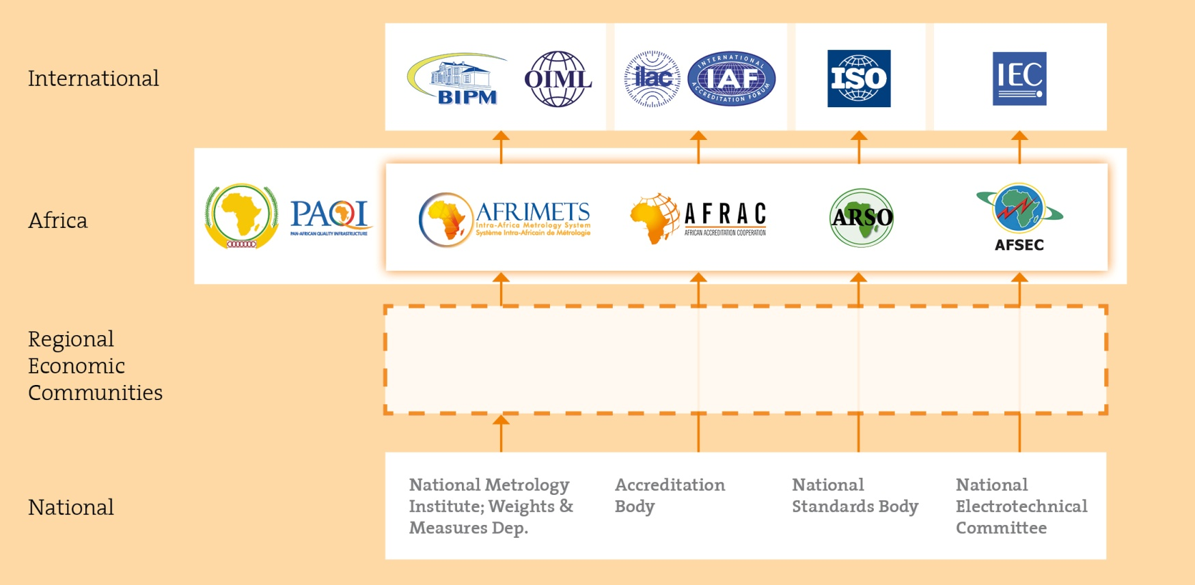
Link to International Quality Infrastructure
9

Slide 16
Integrated PAQI Structure
10

Slide 17

PAQI’s Contribution to the AU Sectors
Accurate
measurement
Harmonization of Standards
Adoption of Standards
Confidence in
Testing
Calibration
Certification
Inspection
Through Accreditation
Training
Research and innovation Education
Ede
Calibration ,
Certification, Inspection
Agriculture
Agro food and agriculture
programmes of CAADP &
3ADI
Infrastructure, Transport & Energy
Power sector (generation)
Power trade
Renewable energy
Environmental & Natural Resources
Mining Industry
Air & water quality
Land use
Climate Change
Health
Pharmaceutical Industry
Traditional Medicine
Medical devices
Support to SMEs
Reduction of Trade barriers
Africa Trade Support Web
Portal
Awareness & Education
Trade & Industry

Slide 18
Contribution to the Trade facilitation
Reduction of Technical Barriers to Trade
Improve the quality of life
Inter- connectivity – Power Trade

Slide 19
Thank you
AFRAC & SADCA Secretariat
Ms Nonhlanhla Halimana
+27 12 394 3760
nonhlanhlah@sanas.co.za
Notes:
PAQI www.paqi.org
AFRAC www.intra-afrac.com
AFRIMETS www.afrimets.org
ARSO www.arso-oran.org
AFSEC www.afsec-africa.org

