Slide 1





UNECE, Committee on Trade
Geneva, June 18, 2012
How to increase the participation of transition economies in international trade
The World Bank's
Logistics Performance Index (LPI)
- One way to identify areas for action
With some thoughts on challenges in
Trade & Transport Facilitation (TTF) work
Turku School of Economics University of Turku, Finland
International Federation for Freight Forwarders Associations
Keynote by Professor Lauri Ojala
Turku School of Economics, Finland
Lauri.ojala@utu.fi
Global Facilitation Partnership for Transportation and Trade

Slide 2

A short introduction
Since 1997, Full Professor of Int’l Logistics at the Turku School of Economics, Finland
Since the 1990s, worked as an TTF expert for:
  The World Bank (WB), ADB & Nordic Investment Bank
  OECD (ITF), EC, APEC and UNIDO
  the Finnish, Dutch, Danish, Swedish, Latvian, Lithuanian and Estonian Governments
Conducted TTF analyses for the WB on the Baltic States, Albania, Southern Africa and CIS states
Initiator of WB’s Logistics Performance Index
Published widely in scientific journals on logistics

Slide 3
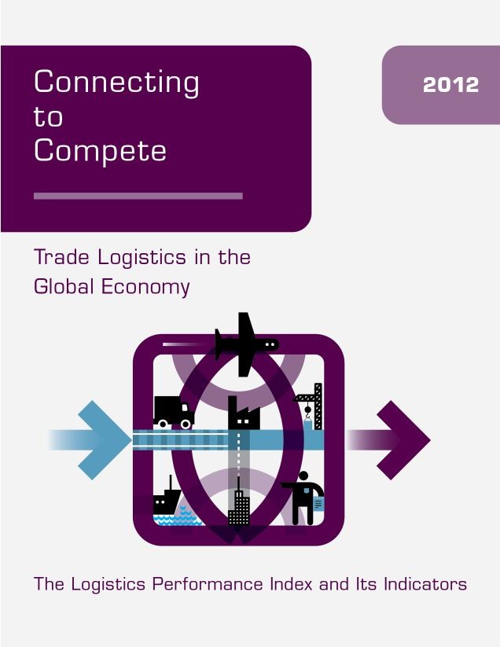
Background on the LPI
First report & data launched on Nov. 5, 2007
www.worldbank.org/lpi
LPI 2010 launched by WB President Robert B Zoellick in Berlin on Jan. 15, 2010
Worldwide media coverage
LPI 2012 out May 16, 2012

Slide 4
What is the LPI?
A set of indicators that measure the performance of the trade logistics environment of economies
Data for the LPI
Logistics professionals in international freight forwarding operations

Slide 5
LPI 2010 & 2012 data collection
Web-based Survey in:
  English, French, Spanish, Chinese and Russian
1,000+ individual respondents
Responses from 130-160 economies
Over 5,000 international evaluations of 155 economies ”from the outside”
Data from 100-140 economies for evaluation ”from the inside”
All survey data is indicative due to e.g. sampling errors, subjective evaluations & confidence intervals

Slide 6
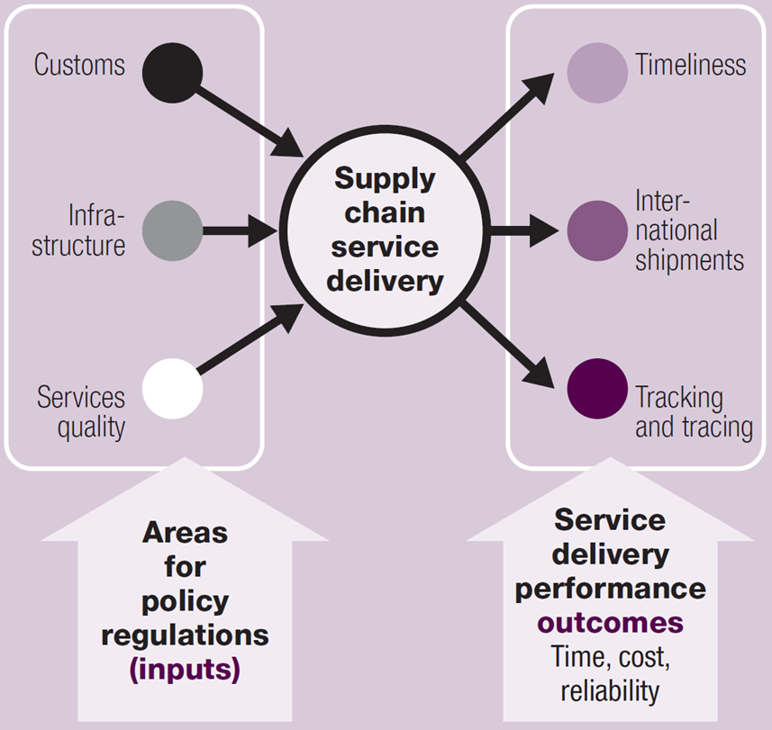
155 economies compared internationally based on 5,000+ individual evaluations on:
The Overall
LPI Score is
composed of
these six
dimensions
Country ranks
in the
International LPI
LPI measures measures how “easy” or “difficult” Trade Logistics is
More applicable to trade of manufactures than to bulk commodities

Slide 7
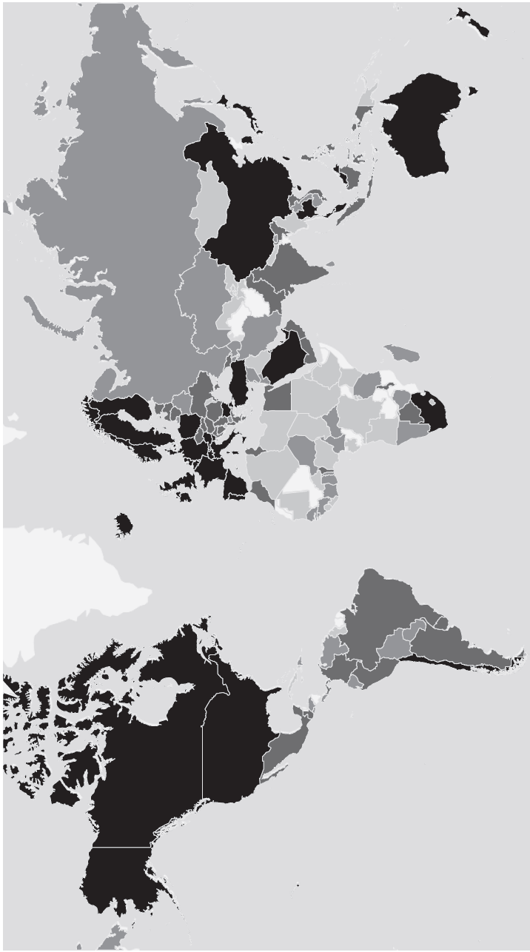
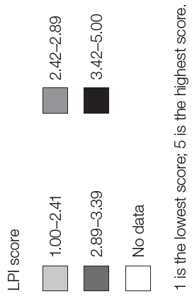
Overall LPI 2012 scores
www.worldbank.org/lpi

Slide 8
Upper Middle Income countries a “watershed”; you find them in all performance quintiles
LPI 2012 data

Slide 9
It is more how things are done than what the formal regime is
Sorted by LPI 2012 quintile
Number of..
9

Slide 10
Income level alone does not explain economies’ trade logistics performance
Countries by LPI 2012 overall score and GDP/capita
The boundaries for the four categories indicative only
”Logistics Friendly”
”Consistent Performers”
”Partial Performers”
”Logistics Unfriendly”

Slide 11
Four main categories of countries identified
in the LPI Trade logistics reform matrix
With selected countries as examples
Kyrgyz Rep.
Moldova
Tajikistan
Mongolia
Kazakhstan
Belarus
Russia
Armenia
Azerbaijan
Uzbekistan
Tunisia
Brazil
Vietnam
Lithuania
Ukraine
Georgia
Malaysia
Thailand

Slide 12
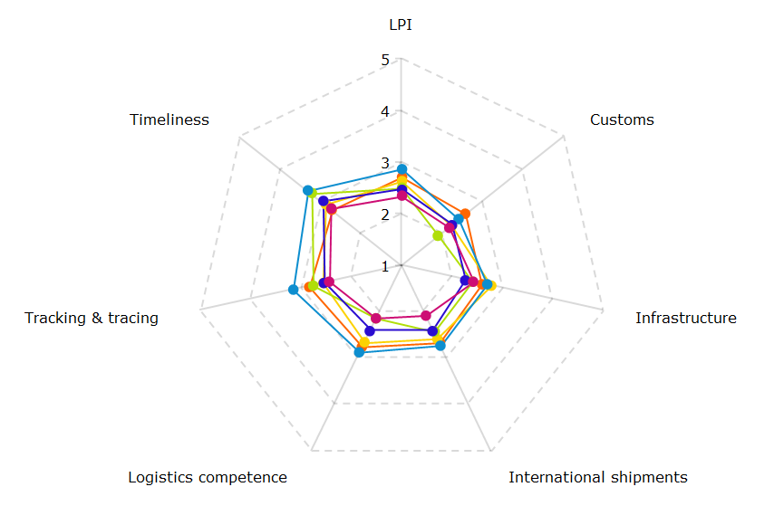
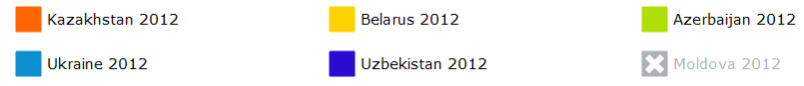
LPI 2012 scores overall (top) and by each of the six dimensions of selected CIS countries
Scores:
5 = highest
1 = lowest

Slide 13
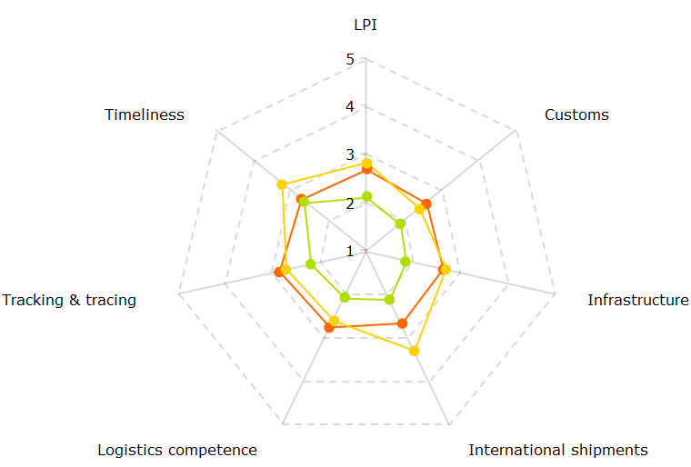
Kazakhstan’s LPI scores overall (top) and by each of the six dimensions 2007-2012
= 2007
= 2010
= 2012

Slide 14
LPI 2007 indicated a strong correlation of national logistics performance and costs
Source: Arvis et al. (2007) Connecting to Compete; Logistics Performance Index, World Bank

Slide 15
Conclusion on the LPI survey
A useful indicator on how ”easy” or ”difficult” a country’s Trade Logistics is
Provides also domestic assessments; no. of respondents in a single economy often low
Scores = Confident Intervals, not fixed points
The resolution is rather low, but the LPI correlates very well with other datasets
Robust & pragmatic data; useful in research, teaching, business and policy-making
15

Slide 16
Some thoughts on challenges in
Trade & Transport Facilitation work
- Using Central Asia as an example

Slide 17
The ”Spaghetti Bowl” of Regional Trade agreements involving Central Asian Republics
Source: ADB (2006) Increasing Gains from Trade Through Regional Cooperation in Trade Policy, Transport, and Customs Transit
As of 31 January 2006
Customs Union

Slide 18
The ”Noodle Soup” of Donors and Multilaterals* involving Central Asian Republics
The World Bank
ADB
EBRD
IsDB
UNECE
UNDP
ESCAP
EU
All
Others
USAID
JAICA
GTZ
DFID
*) without bilateral activities e.g. from China and Russia

Slide 19
Typical problems with TTF project work in such a challenging environment
Projects often not completed before new ones start
High turnaround of civil servants and consultants
Ambitious plans to consolidate permits & licenses into a single database, but no implementation
Customs and other Border Agencies may have several poorly coordinated electronic systems; there is no lack of money, but that of management
Too often Trade Facililtation means procurement of fancy new equipment, without the skills or the will to use them in order to facililate the processes

Slide 20
Thank you!
The 2012 LPI is available at: www.worldbank.org/lpi

Slide 21
A comprehensive overview
By Rantasila & Ojala
Discussion Paper 2012 - 04
Published at the
ITF Summit 2012, May 4, in
Leipzig, Germany
Available also at:
www.internationaltransportforum.org
21

Slide 22

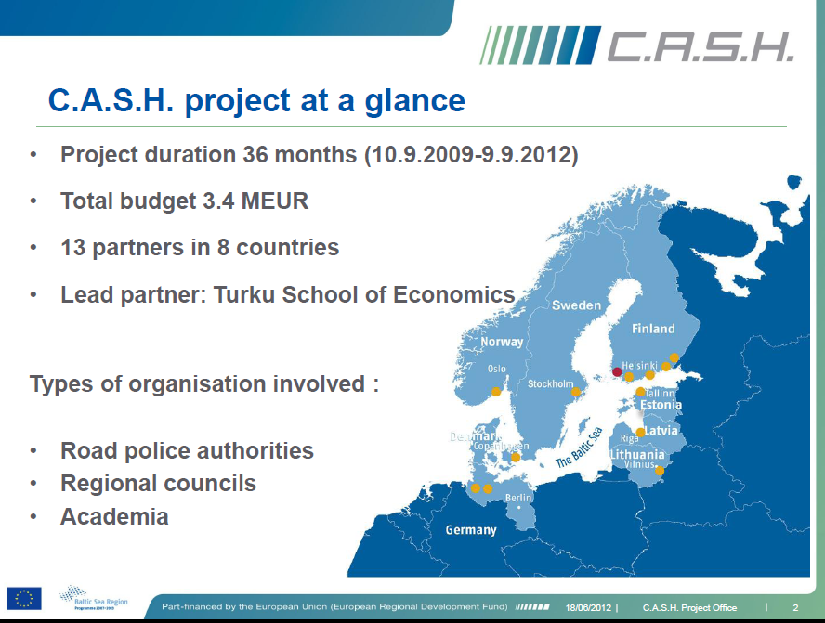
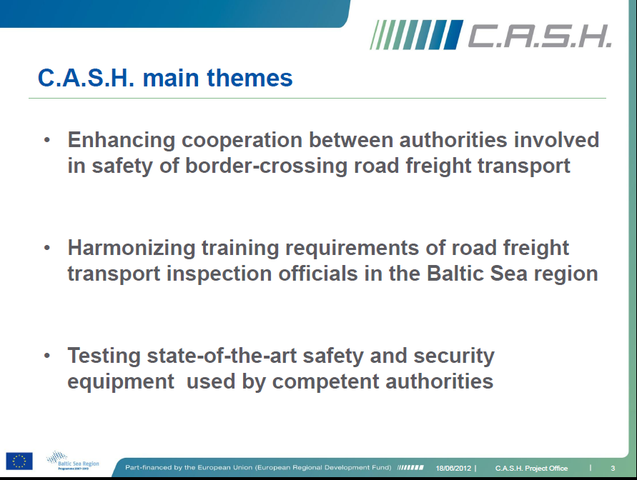
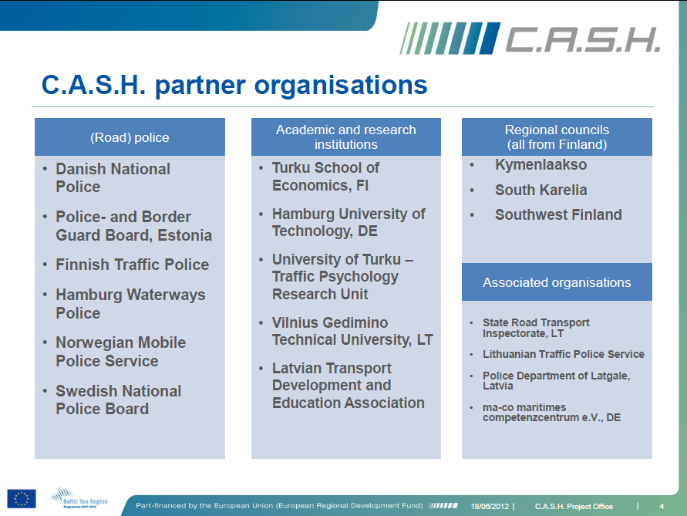
www.cash-project.eu

